Slide 1


Board of Finance Proposed Budget
Fiscal Year 2024
March 28, 2023
This presentation is available under Finance/Budget on the Town website:
https://www.berlinct.gov/topic/index.php?topicid=324&structureid=16
Residential property tax impact of proposed mil rate is available on the town website: https://www.berlinct.gov/topic/index.php?topicid=324&structureid=16
The Annual Report is in the Town Manager’s Dept. on the Town website:
https://www.town.berlin.ct.us/department/index.php?structureid=27

Slide 2
Agenda
Overall Budget
General Government Budget
Revenue Budget
Board of Education Budget
Board of Finance Chairman

Slide 3
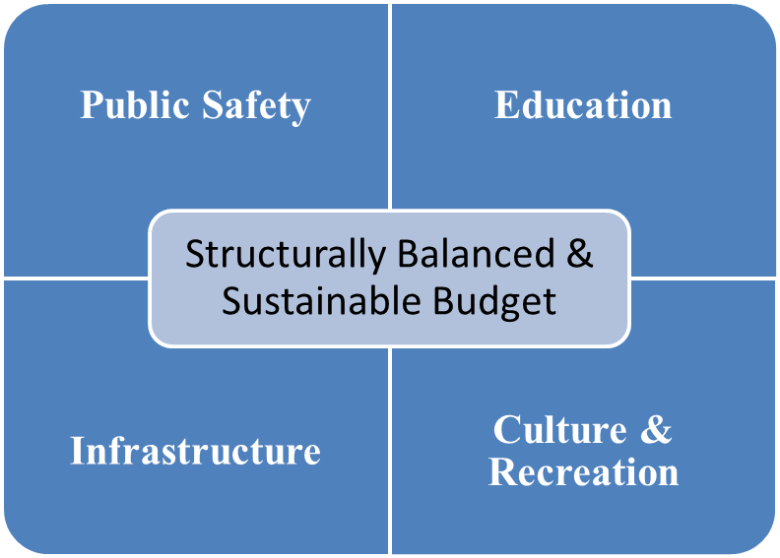
Overall Strategy
  Continue to provide services residents expect, grow the local economy and closely manage the Town’s liabilities.

Slide 4
The Grand List and Re-Stated Mill Rate
$2.869 billion (+17.7% vs FY23)
+$2.2 million in tax revenue excluding revaluation.
Components:
Real Estate: +19.8%
Personal Property: +7.1%
Motor Vehicle: +12.5%
Mill Rate:
  FY 23 budget restated with revaluation impact: 29.16
  FY24 BOF proposed budget: 30.02 (+0.86 mills vs. restated FY23)

Slide 5
Fiscal Year 2024 Budget Priorities
AREAS OF INVESTMENT IN FY 2024
Infrastructure
School HVAC
Police Station
BHS Courtyard
Fields
Roads
Ballast Blocks
Public Safety
Police DB Pension
New Police Officers
School Vans
Highway Trucks
School Cameras
Timberlin Bridges
Economic Dev.
Steele Blvd.
Farmington Ave.
Berlin Turnpike
ON-GOING OPERATIONS
Public Safety, Education, Legal, Contractual and Regulatory Compliance & Recreation
REQUIRED LONG-TERM OBLIGATIONS
Bonds, Leases, Defined Benefit Plans

Slide 6
Board of Finance Budget Actions

Slide 7
General Government

Slide 8
Drivers of Gen Gov’t $2.539 million increase
(FY24 vs. FY23)

Slide 9
General Government Expenditure Budget

Slide 10
$100,637,696 Total Budget
30.02 mil rate (-4.29 vs. FY23)
Target = 3%
Ceiling = 5%
Board of Education
$50,555,071
+$1,472,475
+3.0%
General Government
$50,082,625
+$2,539,443
+5.3%
Total General Fund Budget
$100,637,696
+$4,011,918
+4.2%

Slide 11
General Fund Revenue Drivers
Local taxes fund almost 87% of the budget
Maintained 99.3% tax collection rate
+$1,500k of interest income
+$310k of non-education State grants (MV Cap PILOT)
+$178k of unassigned fund balance (savings)
Flat Education Cost Sharing grant funding vs. FY23
-$470k fees with Private Duty Police receipts & expenditures moved out of General Fund

Slide 12
Berlin Water Control

Slide 13
Berlin Water Control – Enterprise Fund
Combined operating budget change: -$301k (-5.01%)
  Removed capital projects that will be debt funded
  Included consulting and software requirements to address audit fundings
  No staffing changes budgeted
  Budgeting projected Mattabasset cost increase
Capital needs:
  Deming Road pump station
    Fund with Sewer Fund reserves
    MOU for MDC to pay majority of cost over 5-years
  Meriden water line connection
    DWSRF Loan (pursue grant to offset some borrowing)
    Need connection for Lamentation Tank project (see below)
  Lamentation tank corrosion rehabilitation
    Critical project to maintain integrity of tank
    Fund from Water Fund reserves
  Kensington Road water line extension – DWSRF loan (pursue grants)
  Berlin Turnpike pump station – CWF loan

Slide 14
Next Steps
Action to be taken… | Timing & Location…
Board of Finance votes to recommend Board of Education & General Government budgets to the Town Council. | Immediately following Annual Budget Hearing
Town Council acts on the recommended budget; either: - Approve the BOF recommended budget “as is” - Approve the BOF recommended budget “with reductions” - Reject the BOF recommended budget | April 4th Town Council Chambers Budget sent to referendum Budget sent to referendum Special joint meeting between Council & BOF immediately after the Council vote
Budget Referendum | April 25th

Slide 15

Board of Finance Recommended Budget
Fiscal Year 2023-2024
March 28, 2023

Slide 16

Board of Education Goals for 2023-2024
Goal 5
TO COMMIT TO A SAFE LEARNING ENVIRONMENT FOR ALL STUDENTS AND STAFF
Goal 1
TO PROVIDE QUALITY EDUCATION
Goal 2
TO PREPARE STUDENTS FOR MULTIPLE OPTIONS AND OPPORTUNITIES
Goal 4
TO CONSISTENTLY SUPPORT TECHNOLOGY
Goal 3
TO MAINTAIN FAVORABLE CLASS SIZES & COURSE OFFERINGS
Notes:
Goals from last year- Confirm with Brian if they have changed

Slide 17
Berlin’s Beliefs About Learning
All students learn when they feel safe, included, respected, and valued by their community.
We must believe in, challenge, and support all students to reach their personal goals and our high expectations.
Learning is enhanced by a cycle that includes goal setting, practice, feedback, and reflection.
Students are empowered and engaged by choice and authentic learning experiences.

Slide 18
Quick Glance at the Budget Process….
Superintendent Proposed Budget: 4.87%
BOE Adopted Budget: 5.84%
  4.23% Contractual Obligations
Board of Finance Adopted: 3.00%
Town Council: Decreases, Rejects or Accepts 3.00%
  Rejected - Joint meeting Town Council and BOF vote
1st Public Referendum: BOE Budget & Town Budget
  Separate vote for each budget Yes or No to accept
    If voted down select too high or too low
Board of Finance: Adjusts budget and sends back to Town Council and Process is Repeated
2nd Public Referendum: BOE Budget & Town Budget
  Separate vote for each budget Yes or No to accept
    If voted down select too high or too low
Town Council Sets Final Budget

Slide 19
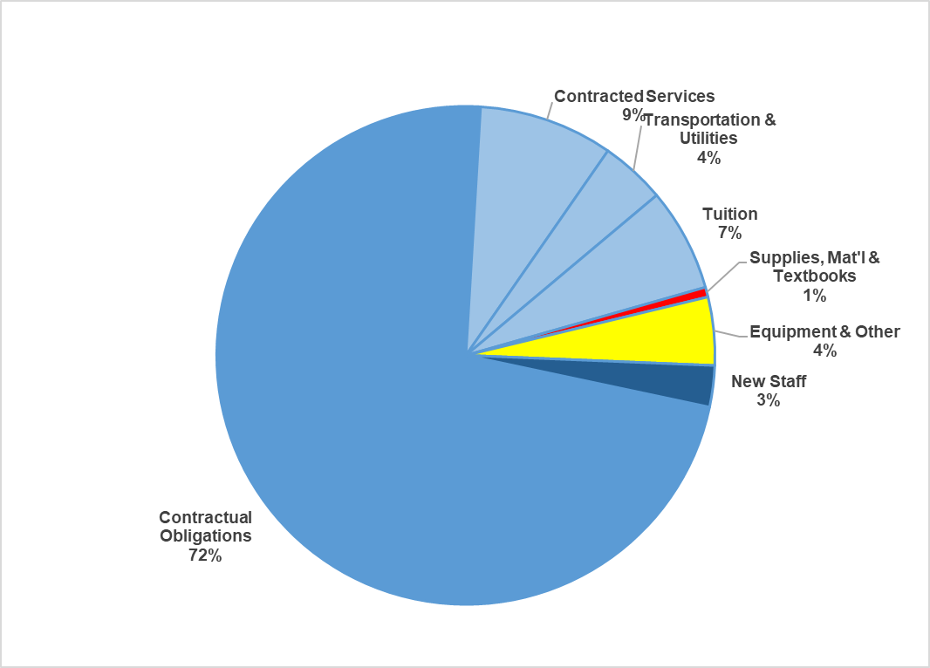
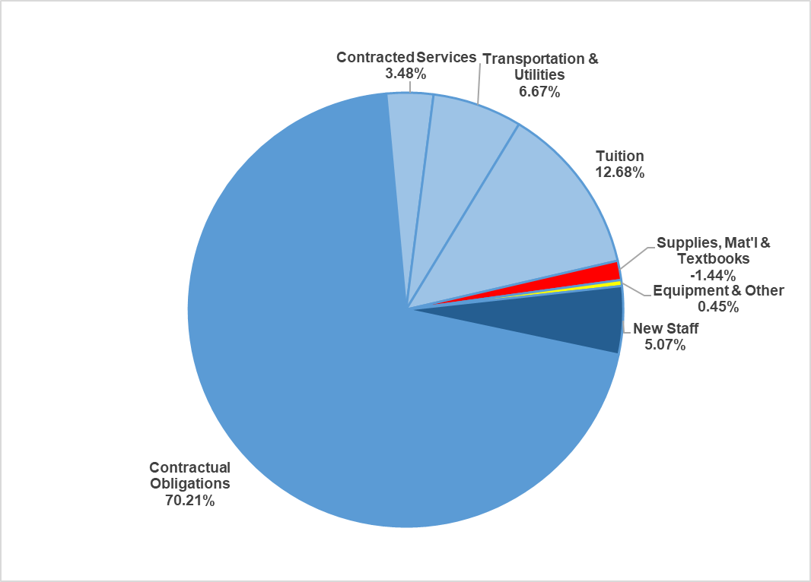
Board of Education’s Budget at a Glance
$51,949,019.60
5.84%
Board of Finance’s Recommended Budget at a Glance
$50,555,074
3.00%
Notes:
Need to Update

Slide 20
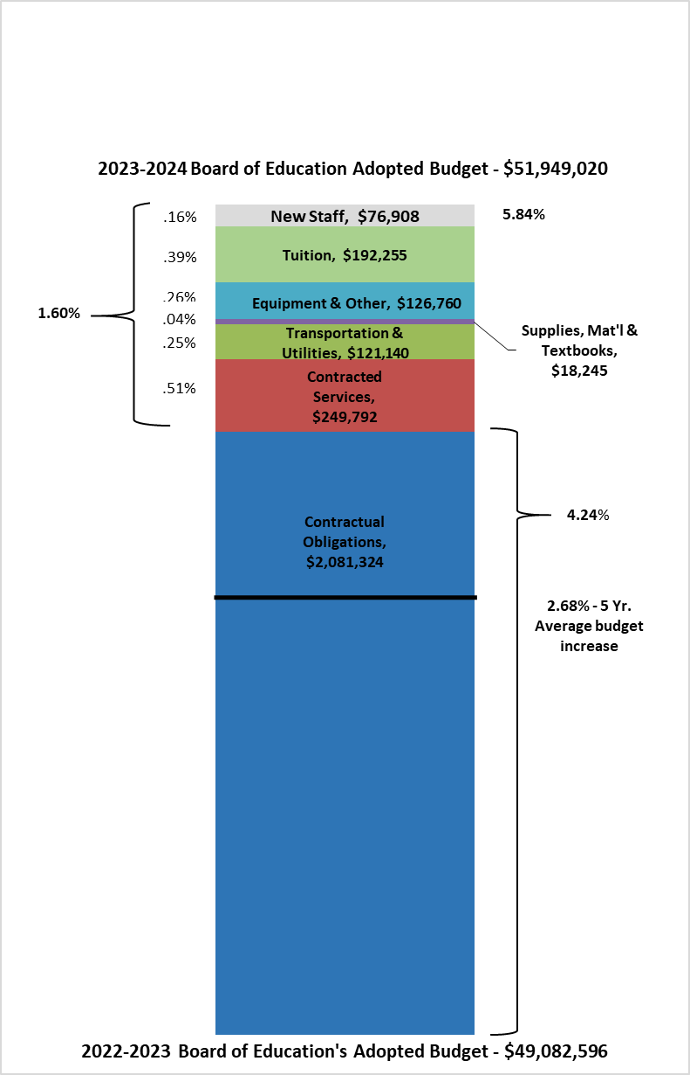

2023-2024 Board of Education Adopted Budget Overview
Administrative Salaries
Certified Salaries
Non-Certified Salaries
Employee Benefits
Total rounded to the nearest dollar
Notes:
Updated

Slide 21
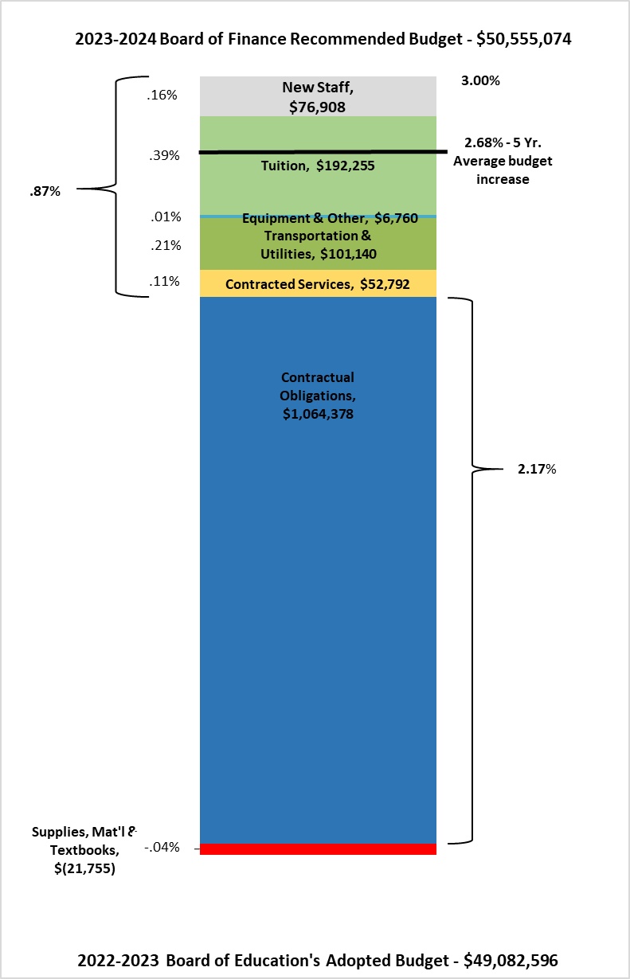
2023-2024 Board of Finance Recommended Budget
Administrative Salaries
Certified Salaries
Non-Certified Salaries
Employee Benefits
Category | Amount | Description
11 | $429,187 | Certified Salaries
12 | $550,159 | Non Certified Salaries
20 | $37,600 | Employee Benefits
30 | $197,000 | Contracted Services
40 | $20,000 | Utilities
60 | $40,000 | Supplies, Textbooks, & Materials
70 | $20,000 | Equipment
80 | $100,000 | All Other Expenditures
Total Cuts | $1,393,946
Total rounded to the nearest dollar
Notes:
Updated

Slide 22
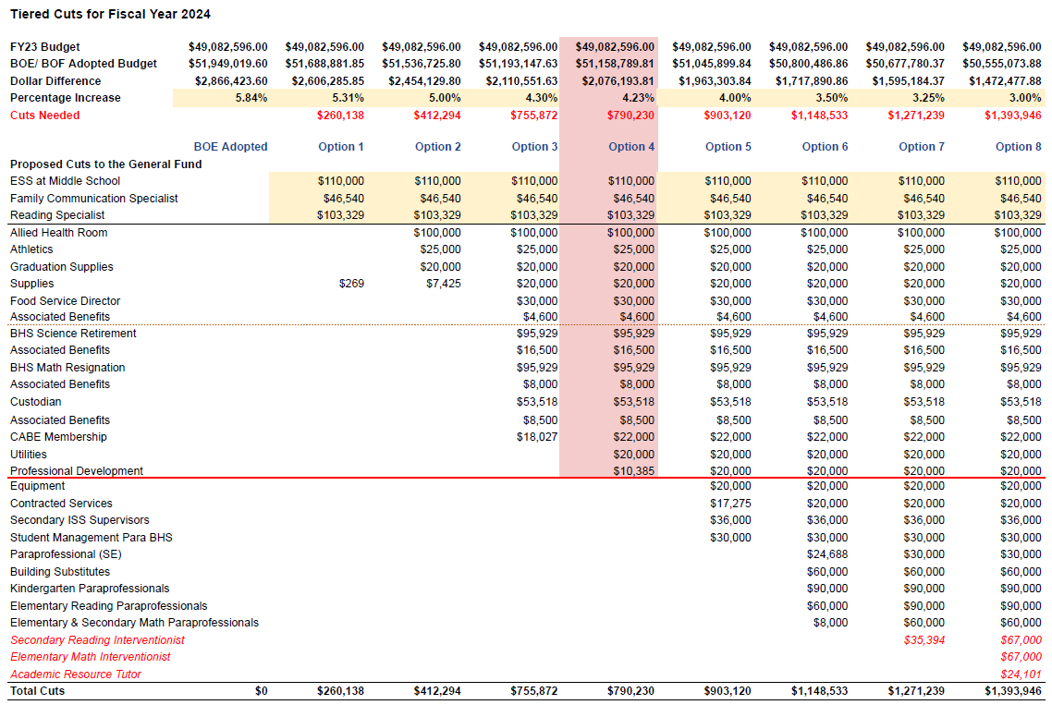
Tiered Cuts for Fiscal Year 2024
Notes:
ESSER Funds

Slide 23
Alternatives Cuts
Alternatives Cuts
Family Communication Specialist | $46,540.00
Middle School ESS | $110,000.00
Department Secretary II | $30,000.00
Secondary World Language | $52,000.00
Elementary Social Worker | $76,000.00
Middle School Lead Teacher | $100,000.00
Pay for Play | $40,000.00
Parking Permit for BHS | $20,000.00
Secondary Music Teacher | $52,000.00
Middle School Sports | $117,000.00
High School Freshman Sports | $20,000.00
Districtwide Administrator | $100,000.00

Slide 24
Reallocation of ESSER Funding
The District will reallocated remaining ESSER Funds to maintain:
Effective School Solution (ESS) at the Middle School
The Family Communication Specialist
One Reading Intervention Teacher
The ESSER Funds will NOT be used for:
Summer Academy for 2023
Summer Academy for 2024
Ruler Training for the 2023-24 School Year

Slide 25
New Staffing $76,908
Board of Education's Staffing Changes |  |  |  | $76,908.00
Location | Position | FTE | Estimated Salary | Estimated Benefits
NEW Position
Griswold or Willard | Elementary Teacher | 1.00 | $67,413.00 | $9,495.00
Positions New to General Fund |  | 1.00 | $67,413.00 | $9,495.00

Slide 26
New for Fiscal Year 2024
$76,908
$34,500
New Position
Mandated Training
One elementary teaching position at Griswold or Willard Elementary School
Paraprofessionals will be required to participate in an additional 18 hours of professional development in FY24
To maintain favorable class sizes for young learners
Compliance with the House Bill #5321

Slide 27
Board of Finance Recommended Budget
Increase: $1,472,478, Percentage: 3.00%
BOF Recommended Budget Executive Summary |  |  |  |  |  |  | $50,555,074.00
Description |  | FY 21-22 Budget | FY 21-22 Actuals | FY 22-23 Budget as of 12/1/22 | FY 23-24 BOE Adopted | FY 23-24 BOF Recommended | Dollar Difference | Percent Difference
10 | Administrative Salaries | $2,865,886.57 | $2,850,832.43 | $2,789,213.04 | $2,865,490.71 | $2,865,491.00 | $76,277.96 | 2.73%
11 | Certified Salaries | $21,545,983.58 | $21,686,899.79 | $22,023,886.34 | $23,054,679.82 | $22,625,493.00 | $601,606.66 | 2.73%
12 | Non Certified Salaries | $7,646,170.41 | $7,655,639.05 | $7,837,750.23 | $8,269,590.06 | $7,719,431.00 | -$118,319.23 | -1.51%
20 | Employee Benefits | $6,755,970.54 | $6,609,022.80 | $7,105,186.27 | $7,724,507.00 | $7,686,907.00 | $581,720.73 | 8.19%
30 | Contracted Services | $1,865,459.00 | $2,001,459.27 | $1,940,744.22 | $2,190,536.11 | $1,993,536.00 | $52,791.78 | 2.72%
40 | Utilities | $406,303.00 | $398,052.40 | $418,370.00 | $505,915.00 | $485,915.00 | $67,545.00 | 16.14%
51 | Transportation | $3,251,276.79 | $3,061,357.39 | $3,312,355.00 | $3,345,950.00 | $3,345,950.00 | $33,595.00 | 1.01%
56 | Tuition | $2,270,714.53 | $2,090,272.23 | $2,380,288.00 | $2,572,543.00 | $2,572,543.00 | $192,255.00 | 8.08%
60 | Supplies, Textbooks, & Materials | $967,449.58 | $974,188.98 | $969,150.90 | $987,395.90 | $947,396.00 | -$21,754.90 | -2.24%
70 | Equipment | $179,979.00 | $373,059.07 | $216,205.00 | $241,725.00 | $221,725.00 | $5,520.00 | 2.55%
80 | All Other Expenditures | $130,439.00 | $182,446.90 | $89,447.00 | $190,687.00 | $90,687.00 | $1,240.00 | 1.39%
Totals: |  | $47,885,632.00 | $47,883,230.31 | $49,082,596.00 | $51,949,019.60 | $50,555,074.00 | $1,472,478.00 | 3.00%
BOF recommended column is rounded to the nearest whole dollar.

Slide 28
5 Year FTE Comparisons
Employee Type | 2019-2020 FTE | 2020-2021 FTE | 2021-2022 FTE | 2022-2023 FTE | Anticipated 2023-2024 FTE | Change/Prior Year
Administrators | 18.6 | 19.6 | 19.6 | 18.8 | 18.8 | 0.0
Teachers/Certified Staff | 259.4 | 266.7 | 270.3 | 266.3 | 262.3 | -4.0
Paraprofessionals | 109.1 | 109.1 | 115.0 | 115.8 | 103.8 | -12.0
Clerical | 20.1 | 22.1 | 20.5 | 17.4 | 17.4 | 0.0
Custodians | 26.0 | 29.5 | 27.0 | 27.0 | 26.0 | -1.0
Cook Managers | 5.0 | 5.0 | 5.0 | 5.0 | 5.0 | 0.0
Food Service | 10.0 | 9.3 | 9.8 | 10.74 | 10.74 | 0.0
Unaffiliated | 20.9 | 10.8 | 25.1 | 29.8 | 29.3 | -0.5
Armed Security | 4.0 | 5.0 | 5.0 | 6.0 | 6.0 | 0.0
Includes all positions regardless of funding source.
Notes:
Updated 3/24/23

Slide 29
Hartford Open Choice Enrollment
 | 2017-2018 | 2018-2019 | 2019-2020 | 2020-2021 | 2021-2022 | 2022-2023 | Projected 2023-2024
Choice Students | 92 | 131 | 116 | 121 | 109 | 96 | 110
Total Enrollment | 2781 | 2787 | 2735 | 2688 | 2678 | 2658 | 2612
% Choice Students | 3.31% | 4.70% | 4.24% | 4.50% | 4.07% | 3.61% | 4.21%
For the 2022-2023 school year, we offered 39 new seats for Choice students and 19 were filled.
11 kindergarten students
3 second grade, 2 fourth grade, 1 fifth grade and 2 seventh grade – all siblings/relatives of students
Open Choice Funding is based on the percentage of enrollment. As the percentage of Open Choice students decreases, funding in the Open Choice Grant follows.
Notes:
Need to Update

Slide 30
Open Choice Anticipated Budget - $1,031,875.00
Opening Balance (Prior Year Carryover) |  |  |  | $300,000.00
Anticipated Revenue |  |  |  | $731,875.00
Anticipated CHOICE Funds for FY 24 |  |  |  | $1,031,875.00
Expense Type | FY 2023 Budget | FY 2024 Budget | Dollar Difference | Percentage Difference
Certified Salaries
BHS | $167,201.00 | $171,039.00 | $3,838.00 | 2.30%
Griswold | 69,869.00 | 74,435.00 | 4,566.00 | 6.54%
Hubbard | 0.00 | 0.00 | 0.00 | 0.00%
McGee | 94,251.00 | 95,929.00 | 1,678.00 | 1.78%
Willard | 168,659.00 | 175,900.00 | 7,241.00 | 4.29%
subtotal: | 499,980.00 | 517,303.00 | $17,323.00 | 3.46%
Non Certified Salaries
BHS | $35,139.00 | $36,193.00 | $1,054.00 | 3.00%
Griswold | 71,400.00 | 86,895.00 | 15,495.00 | 21.70%
Hubbard | 39,456.00 | 40,354.00 | 898.00 | 2.28%
McGee | 47,974.00 | 52,531.00 | 4,557.00 | 9.50%
Willard | 108,966.00 | 111,448.00 | 2,482.00 | 2.28%
subtotal: | 302,935.00 | 327,421.00 | 24,486.00 | 8.08%
Special Education Outplacements | 100,000.00 | $187,151.00
Total Choice Budget: | $902,915.00 | $1,031,875.00 | $128,960.00 | 14.28%
Notes:
Ask about Carry over Balance and Remaining Funds
If we do not carry over 300,000 from 2023 to 2024 we will need to cut additional staff

Slide 31
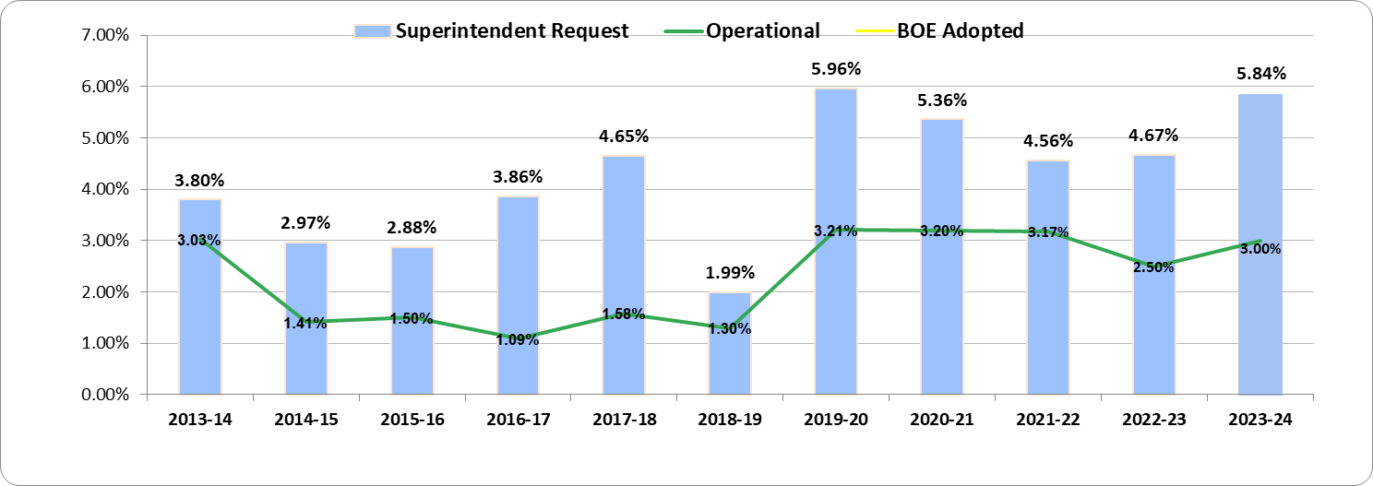


Budget Funding History
4.87%
The 5.84% represents the Board of Education’s adopted budget for fiscal year 2023-24.

Slide 32
New Apartment Complexes
Address | Number of Units | # of 1 Bedroom | # of 2 Bedroom | Other Notes | Expected Completion
833 Deming Road | 88 units | 44 | 44 | 11 buildings/(4) 1-BR and (4) 2-BR per building | Fall 2023
404 Berlin Tpk. | 200 units | 120 | 40 | 40 studio apartments 200 units in 5 buildings | Site work has begun; some foundation/retaining walls installed
250 Berlin Tpk. | 72 units |  | 72 | 3 buildings | Foundation permits have been issued and work has commenced
309 Main St. East Berlin | 19 |  | 19 | Existing 2-family and 5 new 3 & 4 unit townhouse style buildings | Permit applications are being reviewed
West Lane | 76 |  | 76 | 76 total 2-BR units split between 3-4 unit buildings and 28 single-family buildings | Minimal to no site work or permitting requests at this time

Slide 33
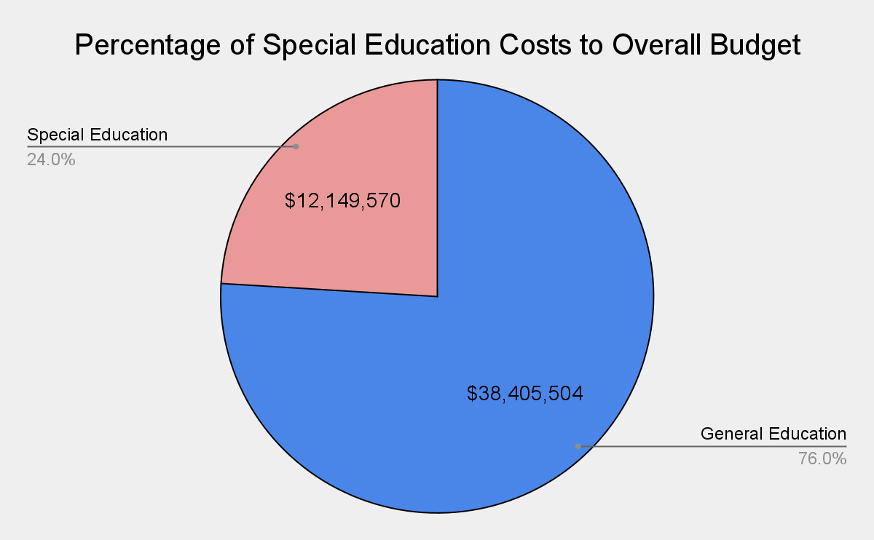

Slide 34
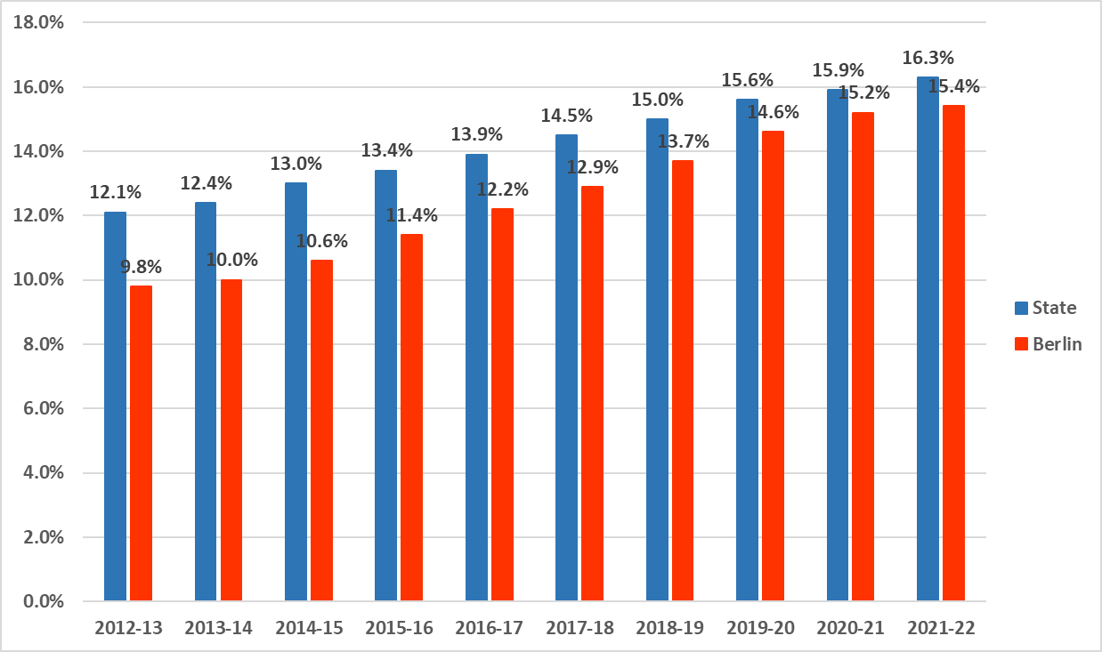
PreK-12 Special Education Prevalence Rate

Slide 35
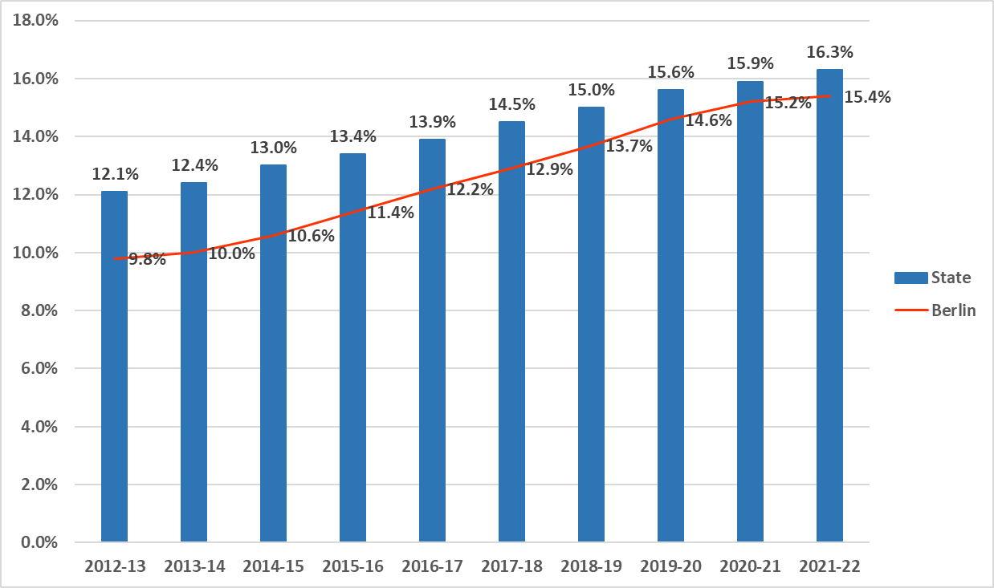
PreK-12 Special Education Prevalence Rate

Slide 36
Berlin’s adopted budgets in the past two years have compared favorably.
District | Adopted 2018-19 | Adopted 2019-20 | Adopted 2020-21 | Adopted 2021-22 | Adopted 2022-23 | 5 Yr. Average Increase
Rocky Hill | 4.54% | 2.50% | 3.84% | 3.75% | 3.26% | 3.58%
Cromwell | 1.53% | 3.29% | 3.60% | 2.97% | 3.81% | 3.04%
Farmington | 2.54% | 2.90% | 3.35% | 3.30% | 2.99% | 3.02%
Wethersfield | 2.97% | 3.50% | 2.05% | 0.53% | 4.98% | 2.81%
Berlin | 1.30% | 3.21% | 3.20% | 3.17% | 2.50% | 2.68%
Glastonbury | 1.91% | 3.16% | 2.81% | 1.60% | 2.98% | 2.49%
Newington | 3.40% | 2.70% | 2.67% | 0.00% | 2.46% | 2.25%
Notes:
Updated

Slide 37
DRG D Budget Percentage Increase Requested for 2023-24
District | Percent Requested | DRG
North Haven | 2.87% | D
Clinton | 2.93% | D
Ledyard | 3.94% | D
Milford | 4.39% | D
East Granby | 4.79% | D
Rocky Hill | 4.79% | D
Windsor | 4.84% | D
Old Saybrook | 4.94% | D
East Hampton | 5.80% | D
Berlin | 5.84% | D
Bethel | 5.95% | D
Waterford | 5.99% | D
Shelton | 6.00% | D
Wallingford | 6.21% | D
Cromwell | 6.94% | D
Newington | 6.95% | D
East Lyme | 6.97% | D
Southington | 7.31% | D
Average Percentage Requested | 5.41%
Notes:
UPDATED

Slide 38
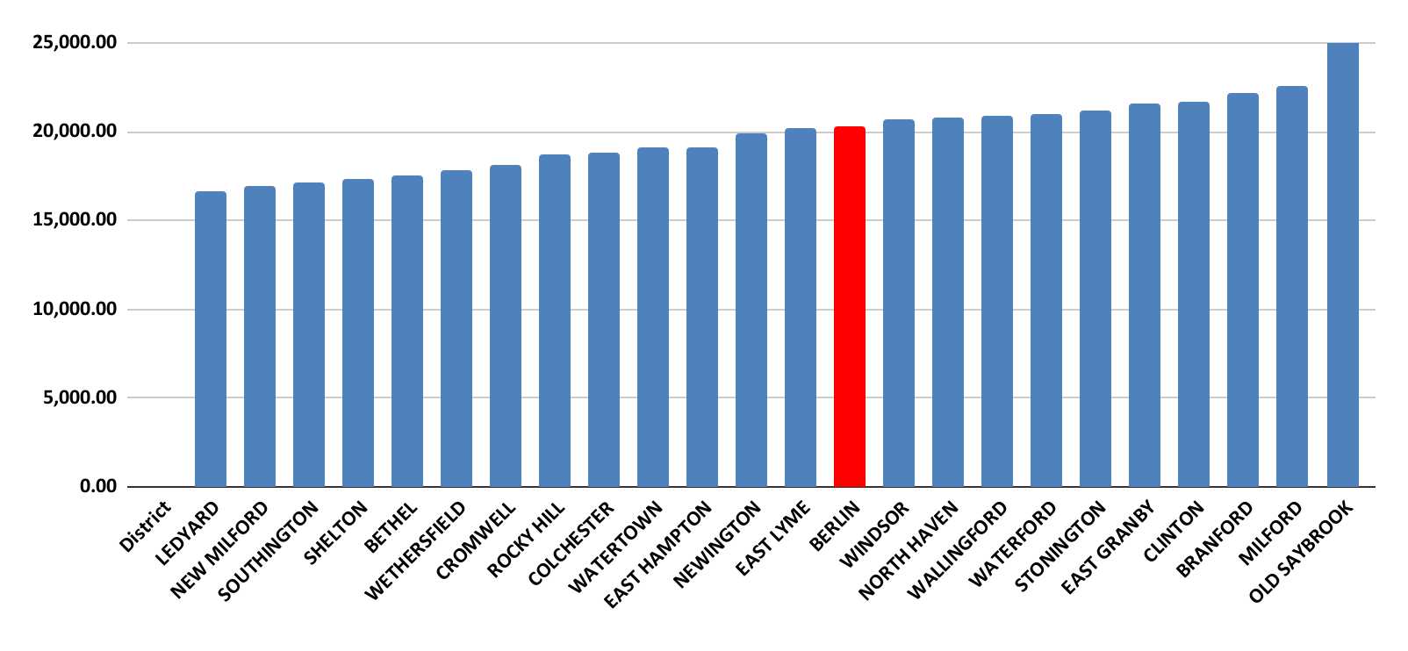
NCEP - Net Current Expenditure per Pupil
*Information was revised following updated information posted on the CSDE website in January 2023.
Notes:
Updated

Slide 39
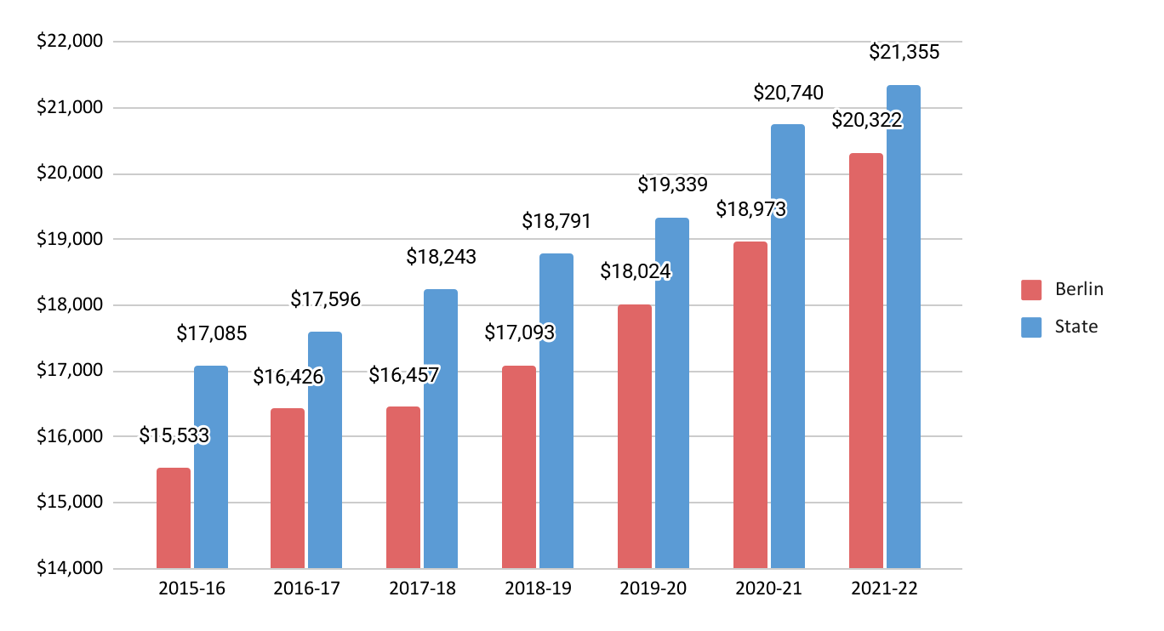
Berlin and State Per Pupil Expenditure
The Wealth Ranking in fiscal year 2022 was 60 out of 169.
Notes:
UPDATED

Slide 40
HISTORICAL BERLIN NET CURRENT EXPENDITURE PER PUPIL (NCEP)/WEALTH RANKINGS
The chart illustrates the per-pupil spending (NCEP) Ranking for Berlin along with its wealth ranking. In both columns, ranking #1 would be the "best" town and ranking #169 would be the "lowest".
YEAR | WEALTH RANK | NCEP RANK | BERLIN NCEP | STATE NCEP | +/- | # DAYS
2012-13 | 64 | 102 | $14,067 | $14,491 | ($424) | 181
2013-14 | 60 | 103 | $14,760 | $15,183 | ($423) | 182
2014-15 | 65 | 116 | $14,964 | $15,708 | ($744) | 183
2015-16 | 69 | 108 | $15,533 | $17,085 | ($1,552) | 183
2016-17 | 72 | 101 | $16,426 | $17,596 | ($1,170) | 180
2017-18 | 65 | 106 | $16,457 | $18,243 | ($1,786) | 180
2018-19 | 72 | 108 | $17,093 | $18,791 | ($1,698) | 180
2019-20 | 60 | 96 | $18,024 | $19,339 | ($1,315) | 181
2020-21 | 60 | 106 | $18,973 | $20,740 | ($1,767) | 177
2021-22 | 60 | 86 | $20,322 | $21,355 | ($1,033) | 180
NCEP - Includes all educational expenses, less expenditures for (a) pupil transportation; (b) debt services; (c) adult education; (d) health and welfare services for non-public school children (e) tuition receipts; (f) food services; and (g) student activities supported by gate receipts. Sec 10-261
Per Connecticut State Department of Education Website
Wealth Rank is the AENGLC (Adjusted Equalized New Grand List per Capita)
*Information was revised following updated information posted on the CSDE website in January 2023.

Slide 41
Historical Deposits into the Non-lapsing Account
Project Description | FY 2018-2019 | FY 2019-2020 | FY 2020-2021
Blast Classroom at McGee | $200,000.00
Refinish Gym Floors | $117,775.00
Paint McGee Gym | $37,225.00
Security Equipment | $25,000.00
 | $380,000.00
Hubbard Fire Alarms |  | $150,000.00
McGee Rooftop HVAC Unit |  | $225,000.00
 |  | $375,000.00
McGee LMC Lighting Upgrade |  |  | $150,000.00
Paving of Willard Playground |  |  | $150,000.00
Hubbard Classroom Storage |  |  | $50,000.00
McGee Removal of Retaining Wall and Paving |  |  | $25,000.00
Additional Funding for McGee Rooftop HVAC Unit |  |  | $25,000.00
 |  |  | $400,000.00
Total 3-Year History for Non-Lapsing Deposit for Unfunded Capital Projects |  |  | $1,155,000.00
In fiscal years 2020 and 2021 the District was significantly impacted by the COVID-19 pandemic and substantial savings were realized.
In fiscal year 2020 the Board of Education returned $400,000 to the Town
In fiscal year 2021 the Board of Education returned $400,000 to the Town

Slide 42
A school district's budget reflects the commitment of the community to invest in the future of our children.
The erosion of funding for education challenges the sustainability of Berlin as a competitive school district with rich educational and co-curricular opportunities for our students.

Slide 43






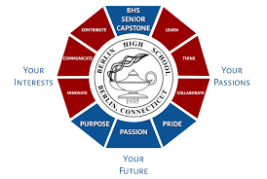


2022-2023 Recognitions
Notes:
NEED TO UPDATE

Slide 44
Elementary Projected Enrollment
Griswold Elementary School
Grade | Projected 2023-24 Enrollment | # Teachers | Projected 2023-24 Average
K | 80 | 5 | 16.0
1 | 93 | 4 | 23.3
2 | 86 | 4 | 21.5
3 | 82 | 4 | 20.5
4 | 87 | 4 | 21.8
5 | 87 | 4 | 21.8
Total | 515 | 25 | Net Change -11
Hubbard Elementary School
Grade | Projected 2023-24 Enrollment | # Teachers | Projected 2023-24 Average
K | 35 | 2 | 17.5
1 | 29 | 2 | 14.5
2 | 43 | 2 | 21.5
3 | 30 | 2 | 15.0
4 | 43 | 2 | 21.5
5 | 37 | 2 | 18.5
Total | 217 | 12 | Net Change -10
Willard Elementary School
Grade | Projected 2023-24 Enrollment | # Teachers | Projected 2023-24 Average
K | 60 | 4 | 15.0
1 | 58 | 3 | 19.3
2 | 71 | 4 | 17.8
3 | 69 | 3 | 23.0
4 | 51 | 3 | 17.0
5 | 71 | 4 | 17.8
Total | 380 | 21 | Net Change -4
Griswold
Hubbard
Willard
Notes:
Updated

Slide 45
Secondary Projected Enrollments
McGee Middle School
Grade | 2022-23 Enrollment as of 10/1/2022 | Projected 2023-24 Enrollment | Net Change
6 | 182 | 200
7 | 197 | 185
8 | 203 | 202
Total | 582 | 587 | 5
Berlin High School
Grade | 2022-23 Enrollment as of 10/1/2022 | Projected 2023-24 Enrollment | Net Change
9 | 199 | 203
10 | 234 | 198
11 | 195 | 233
12 | 256 | 222
Total | 884 | 856 | -28
McGee
Berlin
High School
Notes:
Updated

Slide 46
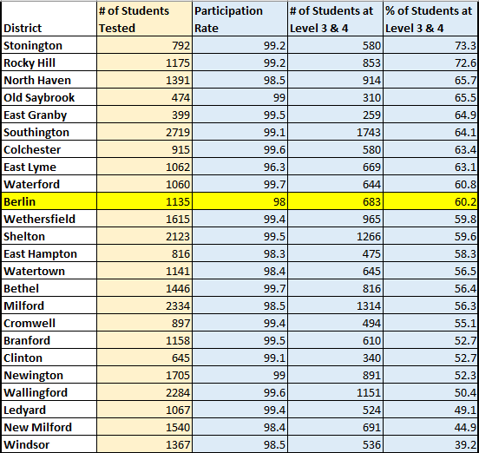
SBA -DRG ELA Comparison 2022 (Gr 3-8)

Slide 47
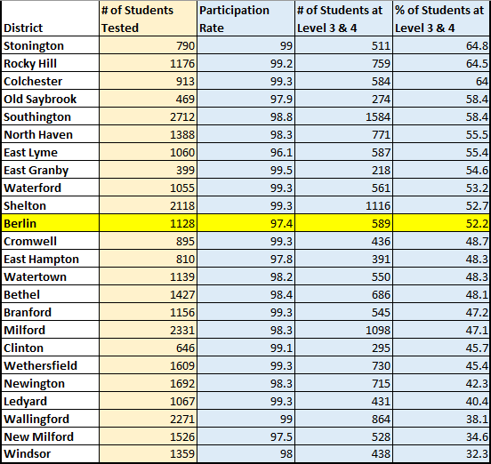
SBA - DRG Math Comparison 2022 (Gr 3-8)

Slide 48
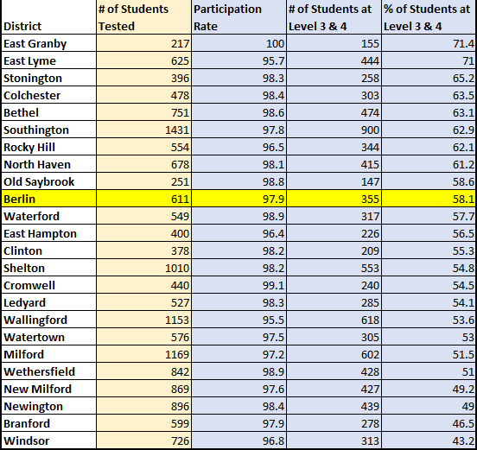
NGSS - DRG NGSS Comparison 2022 (Gr 5, 8, 11)

Slide 49
SAT State Comparison: EBRW
 | District Met or Exceeded | District | State Met or Exceeded | State
 | % | Avg Score | % | Avg Score
2016 | 73.9 | 532 | 65.0 | 520
2017 | 73.1 | 534 | 65.4 | 524
2018 | 77.5 | 547 | 62.4 | 516
2019 | 70.8 | 537 | 61.6 | 514
2020* | 72 | 541 | 66 | 527
2021 | 67.5 | 514 | 59 | 509
2022 | 66.2 | 522 | 55.6 | 501
*Taken in Fall of 2020
Point of reference:
SAT College and Career Readiness Benchmark = 480
Notes:
Evidence Based Reading & Writing portion of the SAT
District average score showed an increase, state showed a decrease

Slide 50
Overview of SAT - EBRW
66.2% of Berlin High School students met or exceeded the EBRW goal of 480
EBRW overall score increase from 513 to 522 (State fell from 509 to 502)
Berlin High School students increased in six areas while the State average declined in five
  Overall ERW score
  Reading mean score
  Writing / Language mean score
  Analysis in Science
  Words in Context
  Expression of Ideas
ERW scores did not decline in any area
  Analysis in Social Studies, Command of Evidence, and Standard English Conventions held steady; the State declined in all three areas

Slide 51
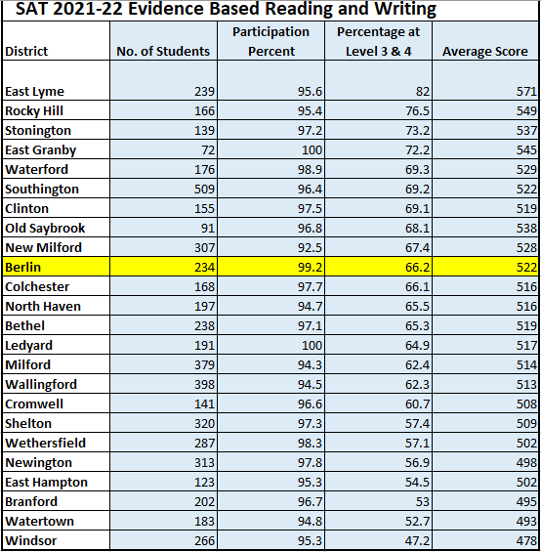

Slide 52
SAT State Comparison: Mathematics
 | District Met or Exceeded | District | State Met or Exceeded | State
 | % | Avg Score | % | Avg Score
2016 | 49.1 | 525 | 39.3 | 502
2017 | 45.4 | 523 | 41.3 | 507
2018 | 55 | 537 | 40.3 | 503
2019 | 41.6 | 516 | 40.6 | 500
2020* | 42 | 512 | 42 | 505
2021 | 36.4 | 501 | 37 | 494
2022 | 47.4 | 516 | 34.8 | 486
*Taken in Fall of 2020
Point of reference:
SAT College and Career Readiness Benchmark = 530
Notes:
District average score increased while state decreased
% of students meeting or exceeding in Berlin was the highest it has been since 2018

Slide 53
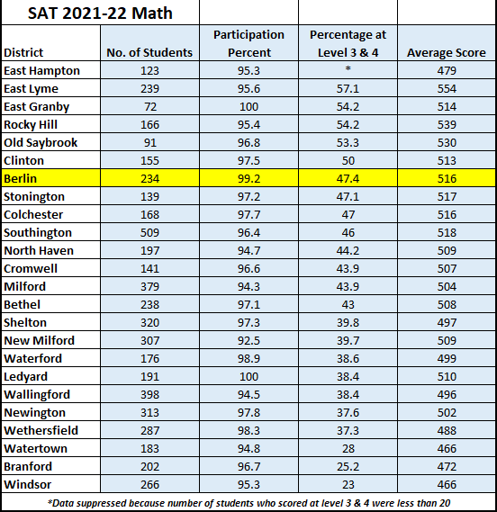

Slide 54
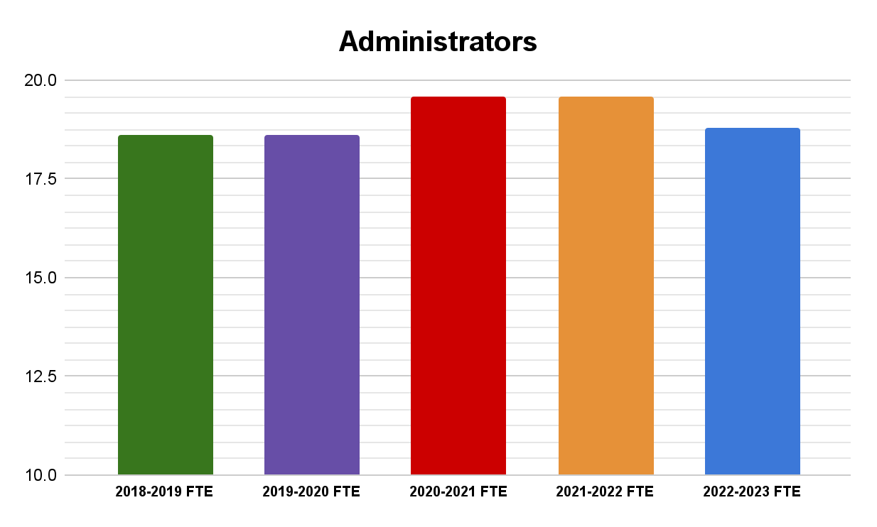
Administrators - $76,277.96
(Increase of 2.73%)
Affiliated contract increase 2.25% or 4.60% with step
5 administrators are eligible for step increases
Non-affiliated administrators are budgeted at 3% increase
Notes:
What years are you including in all these slides?

Slide 55
Certified Staff - $601,606.66
(Increase of 2.73%)
Includes the elimination of two high school positions and two inventionists
153 teachers are on max step for the 2023-2024 school year
109 teachers advance a step for the 2023-2024 school year
6 teachers are eligible for a salary lane change
District cost of teachers at the CCTA are split with Cromwell Public Schools

Slide 56
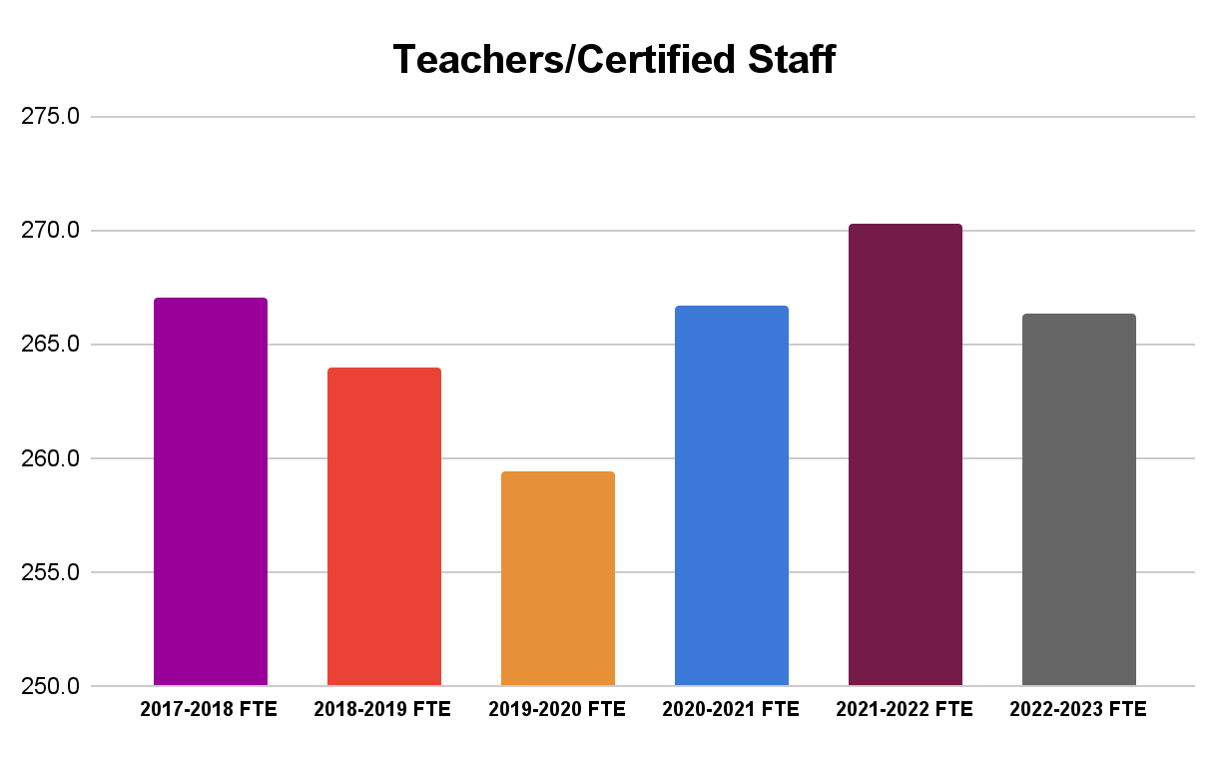
6 Year FTE Comparisons
Teachers/Certified Staff
Employee Type | 2017-2018 FTE | 2018-2019 FTE | 2019-2020 FTE | 2020-2021 FTE | 2021-2022 FTE | 2022-2023 FTE
Teachers/Certified Staff | 267.0 | 264.0 | 259.4 | 266.7 | 270.3 | 266.3

Slide 57
Non-Certified Salaries - $-118,319.23
(Increase of -1.51%)
Includes the elimination of twelve instructional paraprofessionals and one custodian
Mandated Training for Paraprofessionals (2 days)
Non-affiliated contracts budgeted at 3% increase
Increase to Per Diem Substitute account (new rate)
Custodial Overtime

Slide 58
Employee Benefits - $581,720.73
(Increase of 8.19%)
Rate increase for medical insurance is 10% (set by Town)
The employer percentage for staff groups has been adjusted to meet the contractual obligation for each group
Pension account adjustment
Notes:
Pension based on plan participation not just those eligible

Slide 59
Contracted Services - $52,791.78
(Increase of 2.72%)
Includes all operational and educational software systems which increase 3% to 7% annually.
Includes legal fees, copier leases, athletic training, and other operational expenses.

Slide 60
Utilities - $67,545.00
(Increase of 16.14%)
The cost of utilities in the previous and current fiscal year have increased significantly. The district is continuing to monitor industry trends but we continue to adjust the usage for appropriately budgeting for 2023-2024 year.
Berlin and Cromwell split the utility cost for the CCTA program at 50%.
Notes:
Need to Update

Slide 61
Transportation - $33,595.00
Increase of 1.01%
Contractual increase for 2023-2024 school year is 3% with New Britain Transportation.
The cost of fuel is negotiated annually and the price per gallon for both diesel and gasoline is expected to increase.
The number of Technical Schools the District transports to is less than the current fiscal year.
District intends to use a portion of Excess Cost funds to offset Special Education transportation.

Slide 62
Tuition - $192,255.00
Increase of 8.08%
Special Education tuition is budgeted net of Excess Cost
Includes unanticipated Special Education placements for 2023-2024 School Year
Includes tuition cost for Career Pathways & Independent Study
Includes anticipated 3% increase for all Special Education Outplacements
Accounts for students aging out of the Magnet School Tuition Program

Slide 63
Supplies, Textbooks & Materials - $-21,754.90
Increase of -2.24%
Principals and department leaders have redistributed funds from supplies, equipment, and all other expenditures to best fit the needs of their students and programs for the 2023-2024 school year.
With the rising cost of inflation a zero percent increase is a cut to all building and department budgets.

Slide 64
Equipment - $5,520
(Increase of 2.55%)
With the exception of supplies needed for the Career Pathways program, all buildings and departments are taking a zero percent increase to their budgets.
With the rising cost of inflation a zero percent increase is a cut to all building and department budgets.

Slide 65
All Other Expenditures - $1,240.00
(Increase of 1.39 %)
Includes marginal increases for dues and fees

Slide 66
Board of Finance Chairman
Section
March 28, 2023

Slide 69
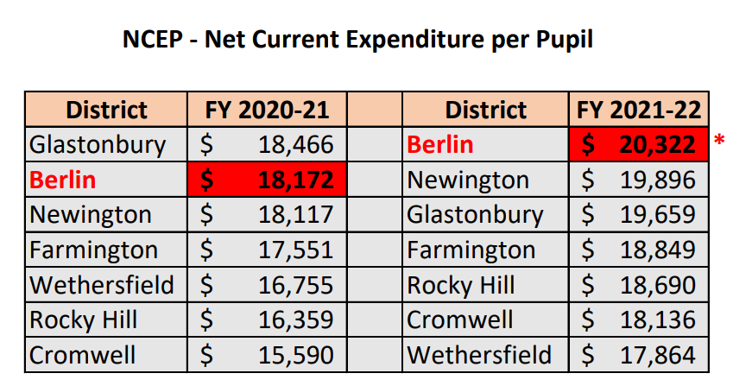
*Berlin has the Highest Net Current Expenditure
Per Pupil Compared To Six Similar Nearby Towns

Slide 70
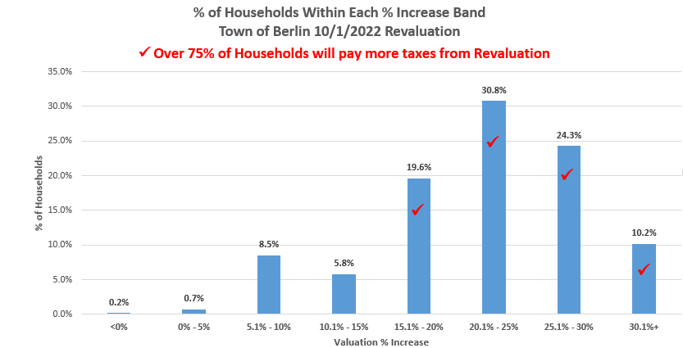

Slide 71
