Slide 1


Board of Finance Proposed Budget
Fiscal Year 2023
March 29, 2022
This presentation is available under Finance/Budget on the Town website:
https://www.berlinct.gov/topic/index.php?topicid=324&structureid=16
The Annual Report is in the Town Manager’s Dept. on the Town website:
https://www.town.berlin.ct.us/department/index.php?structureid=27

Slide 2
Agenda
Overall Budget
Revenue Budget
General Government Budget
Board of Education Budget

Slide 3
$96,625,778 Total Budget
34.31 mill rate (+0.38 vs. FY22)
34.39 (RE/PP)/29.00(MV) – IF State passes MV cap
Target = 3%
Ceiling = 5%
Board of Education
$49,082,596
+$1,196,964
+2.5%
General Government
$47,543,182
+$1,469,767
+3.2%
Total General Fund Budget
$96,625,778
+$2,666,731
+2.8%

Slide 4
Board of Finance Budget Actions
Expenditure Changes
Capital removed -$1,132,859
Gen. Gov’t Operating -$ 642,200
BOE Operating -$1,040,000
TOTAL DECREASED EXPENDITURES -$2,815,059
Receipt Changes
Assigned Fund Balance +$ 380,000
State & Federal Grants (ARPA) +$ 300,000
Increase Town Clerk +$ 100,000
Increase Back Tax Collections +$ 100,000
Increase Supp. Motor Vehicle +$ 100,000
Increase Building Inspection +$ 75,000
TOTAL INCREASED RECEIPTS +$ 1,050,000

Slide 5
The Grand List
A Measure of the Local Economy
The Grand List for the proposed budget is
2.438 billion (+2.9% vs FY22)
This growth generates $2.3 million in additional tax revenue.

Slide 6
General Fund Revenue Drivers
Local taxes fund almost 89% of the budget
99.3% tax collection rate
Flat Education Cost Sharing grant funding vs. FY22
Other BOF changes:
  +$380k of Unassigned fund balance (savings)
  +$300k of ARPA funds
  +$100k Town Clerk
  +$75k Building
  +$100k Back Taxes
  +$100k Supp MV Taxes

Slide 7
General Government

Slide 8
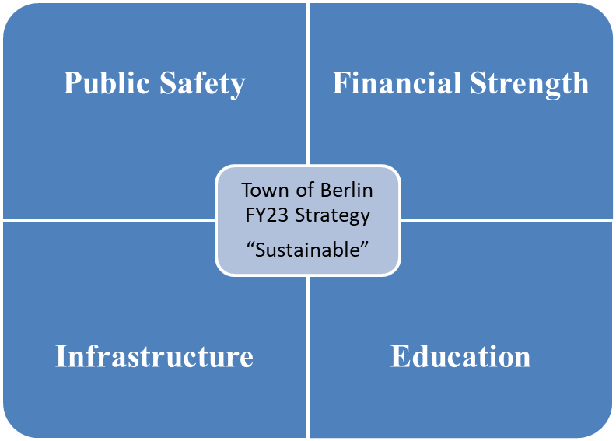
General Government Strategy
  Continue to provide services residents expect, grow the local economy and closely manage the Town’s liabilities.

Slide 9
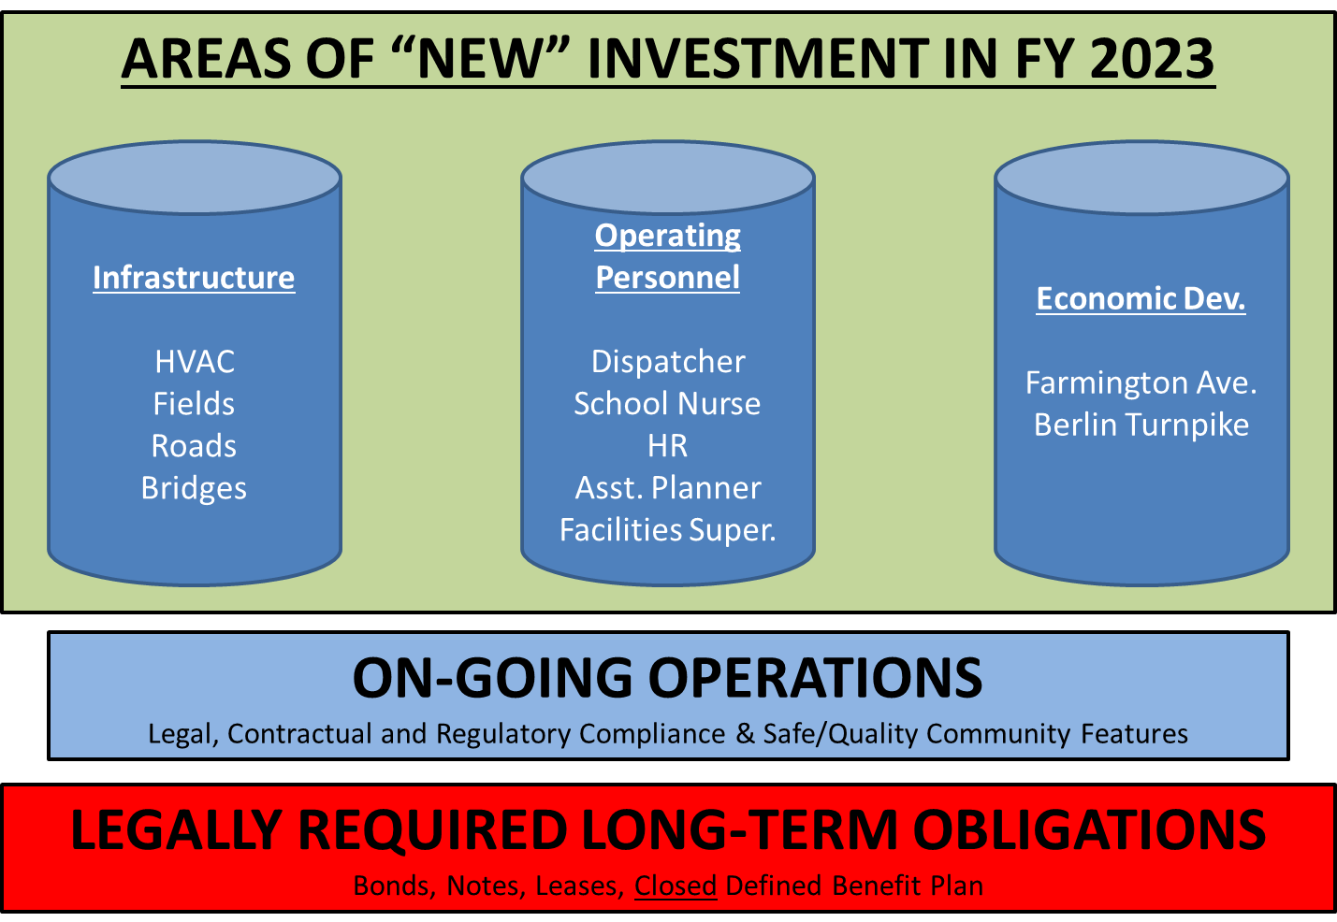
General Gov’t Budget Priorities
Notes:
Roads: LOTCIP road project (Porters Pass, Christian Lane & Deming Rd); remaining local roads depend on final town contribution to LOTCIP project
Bridges: Kensington Rd, Glen Street, 4-Bridge (complete Heritage Drive and start last bridge), S-T work on Spruce (using reimbursement from 4-bridge to fund Spruce replacement)

Slide 10
Drivers of Gen Gov’t $1.47 million increase
(FY23 vs. FY22)
Employee-related costs: +$1.6 million
  New positions: +$805k
    Wages: +$563k
    Fringes: +$242k
      5 full-time & 7 part-time
      5 part-time positions fully funded by golf fees (no budgeted tax impact)
      FT HR Director (replacing position shared with BOE)
      Adding Asst Planner for economic development
      Adding Dispatcher for public safety
      Adding Facilities Superintendent
      Adding School Nurse (ensure coverage all schools, each day)
  Existing positions: +$747k
    Wages: +$411k
    Fringes: +$336k

Slide 11
Drivers of Gen Gov’t $1.47 million increase
(FY23 vs. FY22)
Operations costs: +$488k
  Insurance (cyber, liability, property): +$200k
  Vehicle fuel: +$158k
  Computer support: +140k
  All other costs: -$10k
Capital: -$370k
Debt Service: -$217k
Transfer: +$10k (POCD – required by State statute)

Slide 12
Projected 6/30/2022 Liability Balance
General Obligation Bonds (P&I) $62.5 million
Capital Leases (P&I) $10.3 million
Net Pension Liability (NPL) $ 1.8 million
TOTAL $74.6 million
(77% of Proposed Budget)
No 2022 bonding in budget – lowers debt $8.8 million
Notes:
Down from 95% of total budget last year
Starting showing this slide in FY18 presentation – down $25.4 million in less than 5 years
6/30/2017 balance : $115 million ($106.1 debt + $8.9 million NPL)

Slide 13
In Summary
Education
+
Community Services
+
Public Safety
+
Infrastructure
+
Servicing Liabilities
=
34.31 Mill Rate
(34.39/29.00 if State passes MV cap)

Slide 14
Berlin Water Control – Enterprise Fund
Combined operating budget change: +$121k (+2.1%)
  Water: +$118k
  Sewer: +$3k
Capital needs:
  Deming Road Pump Station
    Complete replacement
    Est. $3.2 million (approx. 70% of cost borne by MDC)
  Berlin Turnpike (future development connection)
    Replace/enlarge pipe
    Est. $2.0 million
    Pursuing debt financing
  East Berlin water line updates

Slide 15
Next Steps
Action to be taken… | Timing & Location…
Board of Finance votes to recommend Board of Education & General Government budgets to the Town Council. | Immediately following Annual Budget Hearing
Town Council acts on the recommended budget; either: - Approve the BOF recommended budget “as is” - Approve the BOF recommended budget “with reductions” - Reject the BOF recommended budget | April 5th Town Council Chambers Budget sent to referendum Budget sent to referendum Special joint meeting between Council & BOF immediately after the Council vote
Budget Referendum | April 26th

Slide 16

Board of Education Budget
2022-2023
March 29, 2022

Slide 17
BOE & Superintendent’s Goals for 2022-2023
Continue to provide quality education to all students at the standard that Berlin parents expect.
Provide all students with an education that prepares them for multiple options and opportunities upon graduation.
Maintain favorable class sizes and adequate course offerings.
Consistent support for technology use with adequate funding of hardware, software, infrastructure, and IT support.
An ongoing commitment to implementing safety measures, equipment and systems that provide all students and staff a safe learning environment.

Slide 18
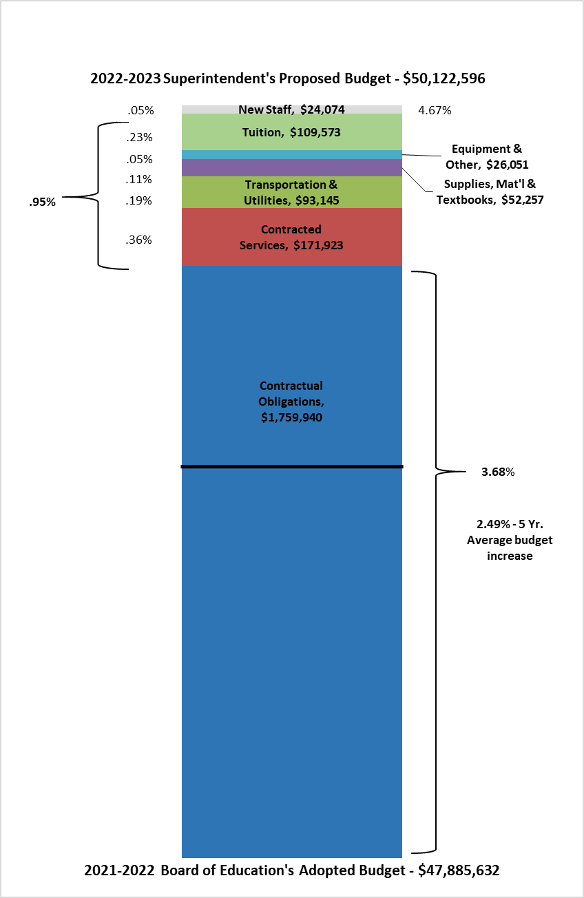
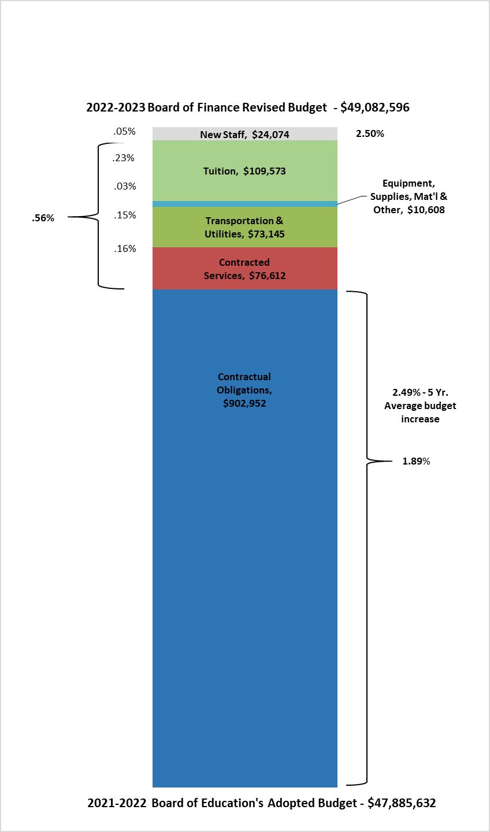
2022-2023 Board of Education Budget
4.67% Increase
2022-2023 Board of Finance Budget
2.5% Increase
Reduction 2.17%
Administrative Salaries
Certified Salaries
Non-Certified Salaries
Employee Benefits
Administrative Salaries
Certified Salaries
Non-Certified Salaries
Employee Benefits

Slide 19
2022-2023 Board of Finance Proposed Budget
Reductions to BOE Approved Budget 4.67% to 2.50%
Category | Amount | Description
10 | $185,614.00 | Administrative Salaries
11 | $497,741.00 | Certified Salaries
12 | $122,291.00 | Non-Certified Salaries
20 | $51,343.00 | Benefits
30 | $95,311.00 | Contracted Services
51 | $20,000.00 | Transportation
60 | $53,700.00 | Supplies
70 | $10,000.00 | Equipment
80 | $4,000.00 | Dues & Fees
Total: | $1,040,000.00
Administrative Salaries
Certified Salaries
Non-Certified Salaries
Employee Benefits

Slide 20
Revised Budget Executive Summary |  |  |  |  |  | $49,082,596.00
Object Summary |  | FY 20-21 Budget | FY 20-21 Actual | FY 21-22 Budget as of 12/1/2021 | FY 22-23 Revised BOE Budget as of 3/25/2022 | Dollar Difference | Percentage Difference
10 | Administrative Salaries | $2,737,080.00 | $2,772,037.00 | $2,855,886.00 | $2,789,212.00 | -$66,674.00 | -2.33%
11 | Certified Salaries | $20,900,470.00 | $20,997,178.00 | $21,545,984.00 | $22,023,886.00 | $477,902.00 | 2.22%
12 | Non Certified Salaries | $7,472,905.00 | $7,085,852.00 | $7,646,170.00 | $7,837,752.00 | $191,582.00 | 2.51%
20 | Employee Benefits | $6,462,707.00 | $6,430,651.00 | $6,780,970.00 | $7,105,186.00 | $324,216.00 | 4.78%
30 | Contracted Services | $1,778,688.00 | $1,848,494.00 | $1,862,459.00 | $1,939,071.00 | $76,612.00 | 4.11%
40 | Utilities | $406,303.00 | $330,009.00 | $406,303.00 | $418,370.00 | $12,067.00 | 2.97%
51 | Transportation | $3,212,078.00 | $2,460,948.00 | $3,251,277.00 | $3,312,355.00 | $61,078.00 | 1.88%
56 | Tuition | $2,155,787.00 | $1,948,765.00 | $2,270,715.00 | $2,380,288.00 | $109,573.00 | 4.83%
60 | Supplies, Textbooks, & Materials | $1,074,100.00 | $1,112,560.00 | $973,450.00 | $972,007.00 | -$1,443.00 | -0.15%
70 | Equipment | $154,200.00 | $535,863.00 | $176,979.00 | $216,205.00 | $39,226.00 | 22.16%
80 | All Other Expenditures | $62,186.00 | $485,535.00 | $115,439.00 | $88,264.00 | -$27,175.00 | -23.54%
Totals |  | $46,416,504.00 | $46,007,892.00 | $47,885,632.00 | $49,082,596.00 | $1,196,964.00 | 2.50%

Slide 21
Projected Student Population for Fiscal Year 23
School | Anticipated 2022-23 Enrollment | Projected 2022-2023 | Net Change
Griswold | 514 | 521 | 7
Hubbard | 218 | 223 | 5
Willard | 391 | 395 | 4
McGee | 601 | 570 | -31
BHS | 886 | 872 | -14
Net Change | 2610 | 2581 | -29

Slide 22
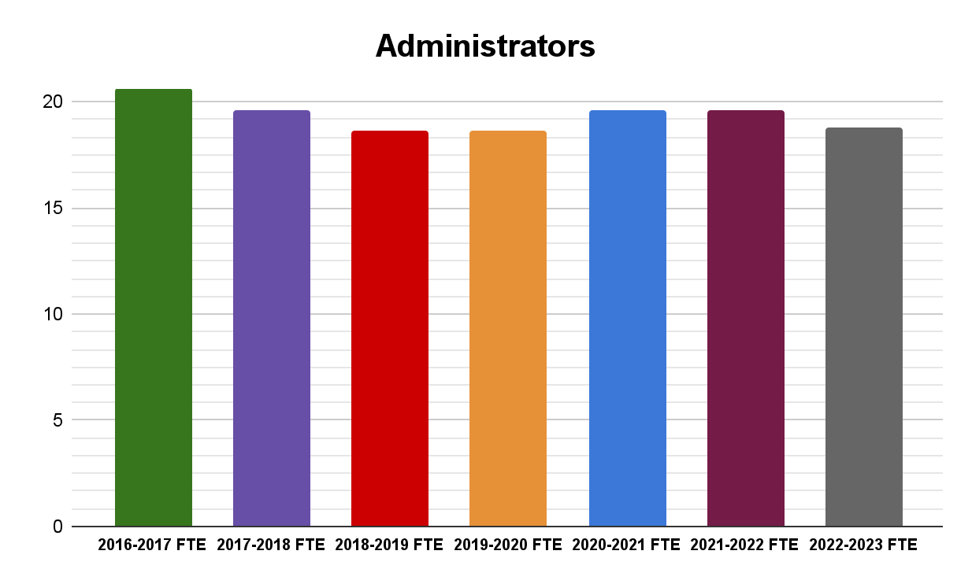
Administrators - ($66,674)
(with Anticipated Staff Changes for Fiscal Year 23)
Annual contract increase with step is 2.50%
Four administrators have step increase
Decrease of 1.0 Administrator
Increase of .2 for Human Resources Director for .6 to .8

Slide 23
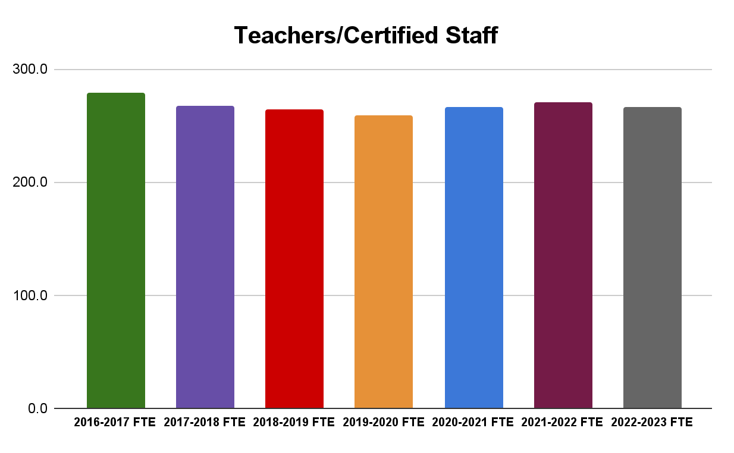
7 Year FTE Comparisons
Teachers/Certified Staff
(with Anticipated Staff Changes for Fiscal Year 23)
Employee Type | 2016-2017 FTE | 2017-2018 FTE | 2018-2019 FTE | 2019-2020 FTE | 2020-2021 FTE | 2021-2022 FTE | 2022-2023 FTE
Teachers/Certified Staff | 279.3 | 267.0 | 264.0 | 259.4 | 266.7 | 270.3 | 266.9

Slide 24
Initial Staffing Request for Operational Budget - $912,065
Total Initial Staffing Requests - $1,153,755
General Fund Requests | Position | FTE | Estimated Salary | Estimated Benefits
Central Office | Office Assistant | 0.50 | $37,425.00 | $12,322.00
Central Office | Increase of Hours HR Director | 0.20 | $24,075.00 | $0.00
Districtwide | I.T. Technician | 1.00 | $65,000.00 | $23,890.00
Districtwide (PPS Department) | Paraprofessional | 6.00 | $157,764.00 | $65,991.00
Griswold Elementary School | Writing Interventionist | 1.00 | $64,189.00 | $19,365.00
Griswold Elementary School | Assistant Principal | 0.00 | $18,000.00 | $0.00
Hubbard Elementary School | Writing Interventionist | 1.00 | $64,189.00 | $19,365.00
Hubbard Elementary School | Social Worker | 0.50 | $31,000.00 | $9,666.00
Hubbard Elementary School | Art Teacher | 0.60 | $38,513.00 | $11,600.00
McGee Middle School | Assistant Principal | 0.00 | $18,000.00 | $0.00
Special Education | Elementary Teacher | 1.00 | $64,189.00 | $19,365.00
Special Education | Registered Behavior Technician | 1.00 | $35,604.00 | $10,999.00
Willard Elementary School | Writing Interventionist | 1.00 | $64,189.00 | $19,365.00
Willard Elementary School | Assistant Principal | 0.00 | $18,000.00 | $0.00
General Fund Subtotal |  | 13.80 | $700,137.00 | $211,928.00
Grant & Other Fund Requests
Districtwide | Armed Security Guard | 1.00 | $44,606.00 | $23,354.00
District Elementary | Resident Teacher | 1.00 | $67,500.00 | $19,365.00
BHS | Work Based Learning Coordinator | 1.00 | $67,500.00 | $19,365.00
Grant & Other Funds Subtotal |  | 3.00 | $179,606.00 | $62,084.00
Total |  |  | $879,743.00 | $274,012.00

Slide 25
2022-2023 New Staff Request Summary
16.80 Total Requests for New Staff
14.60 Requests Not Funded
2.20 Requested for Funding (Operational, Grant & Town)
  Operational General Fund
    .20 Increase to Director of Human Resources
  Town of Berlin
    1.0 Armed Security Guard (BHS Night Shift)
  Open Choice Grant
    1.0 Work Based Learning Coordinator

Slide 26
Contracted Services - $76,612
Includes all operational and educational systems which increase 3% to 7% annually
Additional cybersecurity software required by insurance company
Increase in legal fees & anticipated copier contract

Slide 27
Transportation - $61,078
Contractual increase for 2022-2023 school year is 3.45% with New Britain Transportation
District intends to use a portion of Excess Cost funds to offset Special Education transportation

Slide 28
Tuition - $109,573
No funds have been budgeted for anticipated outplacements for 2022-2023.
The anticipated increase for CREC Magnet School is 12%
The budget assumes the current Pre-K (non-tuition students) will continue through the magnet school system as a tuition student in the next fiscal year
Tuition |  |  |  |  | $2,380,288.00
Description | FY 20-21 Budget | FY 20-21 Actual | FY 21-22 Budget as of 12/1/2021 | FY 22-23 Superintendent's Proposed | Dollar Difference | Percent Difference | Comments
Southington Vocational Agriculture Center | $34,115.00 | $27,292.00 | $40,801.00 | $36,250.00 | -$4,551.00 | -11.15%
Tuition Summer School | $0.00 | $118,737.26 | $0.00 | $0.00 | $0.00 | 0.00%
Out-Of-District Tuition- Public In State | $548,483.00 | $257,990.25 | $483,615.51 | $410,243.00 | -$73,372.51 | -15.17%
Out-Of-District Tuition- Private In State | $1,261,813.00 | $1,240,618.39 | $1,434,485.02 | $1,560,820.00 | $126,334.98 | 8.81%
Expulsion Program | $0.00 | $0.00 | $0.00 | $15,450.00 | $15,450.00 | 100.00%
Magnet School Tuition for Berlin Residents | $311,376.00 | $304,127.00 | $311,813.00 | $357,525.00 | $45,712.00 | 14.66%
Totals | $2,155,787.00 | $1,948,765.00 | $2,270,715.00 | $2,380,288.00 | $109,573.00 | 4.83%

Slide 29
All Other Expenditures - ($27,175)
The District is taking a 0% increase from the original July 1, 2021 budget for All Other Expenditures. The budget, as of 12/1/2021, includes the Board approved $20,000 transfers for the Griswold Band Room. The proposed budget cuts the funds entirely from the original category.
Initial Requests to Superintendent included an additional $474,700 for equipment and facilities improvements which was cut by the Superintendent before the January 10th BOE Meeting.

Slide 30
Revised Budget Executive Summary |  |  |  |  |  | $49,082,596.00
Object Summary |  | FY 20-21 Budget | FY 20-21 Actual | FY 21-22 Budget as of 12/1/2021 | FY 22-23 Revised BOE Budget as of 3/25/2022 | Dollar Difference | Percentage Difference
10 | Administrative Salaries | $2,737,080.00 | $2,772,037.00 | $2,855,886.00 | $2,789,212.00 | -$66,674.00 | -2.33%
11 | Certified Salaries | $20,900,470.00 | $20,997,178.00 | $21,545,984.00 | $22,023,886.00 | $477,902.00 | 2.22%
12 | Non Certified Salaries | $7,472,905.00 | $7,085,852.00 | $7,646,170.00 | $7,837,752.00 | $191,582.00 | 2.51%
20 | Employee Benefits | $6,462,707.00 | $6,430,651.00 | $6,780,970.00 | $7,105,186.00 | $324,216.00 | 4.78%
30 | Contracted Services | $1,778,688.00 | $1,848,494.00 | $1,862,459.00 | $1,939,071.00 | $76,612.00 | 4.11%
40 | Utilities | $406,303.00 | $330,009.00 | $406,303.00 | $418,370.00 | $12,067.00 | 2.97%
51 | Transportation | $3,212,078.00 | $2,460,948.00 | $3,251,277.00 | $3,312,355.00 | $61,078.00 | 1.88%
56 | Tuition | $2,155,787.00 | $1,948,765.00 | $2,270,715.00 | $2,380,288.00 | $109,573.00 | 4.83%
60 | Supplies, Textbooks, & Materials | $1,074,100.00 | $1,112,560.00 | $973,450.00 | $972,007.00 | -$1,443.00 | -0.15%
70 | Equipment | $154,200.00 | $535,863.00 | $176,979.00 | $216,205.00 | $39,226.00 | 22.16%
80 | All Other Expenditures | $62,186.00 | $485,535.00 | $115,439.00 | $88,264.00 | -$27,175.00 | -23.54%
Totals |  | $46,416,504.00 | $46,007,892.00 | $47,885,632.00 | $49,082,596.00 | $1,196,964.00 | 2.50%

Slide 31
Changes to ESSER II Grant
Changes to Esser II from Board of Education Adopted Budget
Department | Description | Original Estimate | FY 22 Budget | FY 23 Budget | Changes
Curriculum | Extended Learning Opportunities | $142,922.00 | $70,000.00 | $40,960.00 | -$31,962.00
Certified Staff | Reading Support at the Middle School | $0.00 | $0.00 | $101,962.00 | $101,962.00
Special Education | ESS in Middle School | $241,000.00 | $118,000.00 | $123,000.00 | $0.00
Districtwide | "Common Ground" Partnership w/ Social Services | $60,000.00 | $30,000.00 | $20,000.00 | -$10,000.00
Districtwide | Partially Fund Zoom License | $105,946.00 | $45,946.00 | $0.00 | -$60,000.00
Districtwide | Family Communication Specialist | $92,000.00 | $45,000.00 | $47,000.00 | $0.00
Totals |  | $641,868.00 | $308,946.00 | $332,922.00 | $0.00

Slide 32
Changes to ESSER ARP Grant
Changes to Esser ARP from Board of Education Adopted Budget
Department | Description | Original Estimate | FY 22 Budget | FY 23 Budget | FY 24 Budget | Changes
Curriculum | Extended Learning Opportunities- expand summer programs, including offering some summer courses at BHS | $339,942.00 | $90,000.00 | $115,000.00 | - | -$134,942.00
Curriculum | RULER training and curriculum work | $65,000.00 | $35,000.00 | $15,000.00 | $15,000.00
Certified Staff | Reading Support at the Elementary Schools | $0.00 | $0.00 | $134,942.00 |  | $134,942.00
Facilities | Mental Health Suite- McGee | $124,000.00 | $124,000.00
Districtwide | WAN: Upgrade current fiber network between all buildings from 10gb to 40gb | $102,000.00 | $102,000.00
Districtwide | Install fiber from Town Hall data closet to Board of Education data center. | $10,000.00 | $10,000.00
Districtwide | BOE of Ed Data Center Switches s | $40,000.00 | $40,000.00
Districtwide | Berlin High School MER (Main Equipment Room) Core Switches | $120,000.00 | $120,000.00
Totals |  | $800,942.00 | $521,000.00 | $264,942.00 | $15,000.00 | $0.00

Slide 33
Hartford Open Choice Enrollment
 | 2016-2017 | 2017-2018 | 2018-2019 | 2019-2020 | 2020-2021 | 2021-2022 | Projected 2022-2023
Choice Students | 96 | 92 | 131 | 116 | 121 | 109 | 110
Total Enrollment | 2792 | 2781 | 2787 | 2735 | 2688 | 2678 | 2639
% Choice Students | 3.44% | 3.31% | 4.70% | 4.24% | 4.50% | 4.07% | 4.17%
For the 2021-2022 school year, we offered 14 new seats for Choice students and 11 were filled.
8 kindergarten students
1 second grade, 1 third grade and 1 sixth grade – all siblings/relatives of students
Every effort is being made to accept students at the kindergarten level with a conscious awareness of maintaining at least 4% Choice Enrollment as these funds are tied to additional staff and programs.

Slide 34
Hartford Open Choice Anticipated Budget - $1,034,275
Expense Type | FY 2022 Budget | FY 2023 Budget | Dollar Difference | Percentage Difference
Certified Salaries
BHS | $176,734.00 | $247,304.00 | $70,570.00 | 39.93%
Griswold | 66,495.00 | 69,869.00 | 3,374.00 | 5.07%
Hubbard | 0.00 | 0.00 | 0.00 | 0.00%
McGee | 92,630.00 | 94,251.00 | 1,621.00 | 1.75%
Willard | 162,499.00 | 168,659.00 | 6,160.00 | 3.79%
 | 498,358.00 | 580,083.00 | $81,725.00 | 16.40%
Non Certified Salaries
BHS | $36,911.00 | $38,026.00 | $1,115.00 | 3.02%
Griswold | 55,958.00 | 57,201.00 | 1,243.00 | 2.22%
Hubbard | 38,592.00 | 39,457.00 | 865.00 | 2.24%
McGee | 47,760.00 | 51,883.00 | 4,123.00 | 8.63%
Willard | 105,082.00 | 108,390.00 | 3,308.00 | 3.15%
 | 284,303.00 | 294,957.00 | 10,654.00 | 3.75%
Salaries Totals: | 782,661.00 | $875,040.00 | $92,379.00 | 11.80%
Remaining Fund for Allocation |  |  |  | $159,235.00
Special Education Reserve | $150,000.00 | $134,235.00 | -$15,765.00 | -10.51%
Rent for CCTA | 25,000.00 | 25,000.00 | 0.00 | 0.00%
Other Expenses: | $175,000.00 | $159,235.00 | -$15,765.00 | -9.01%

Slide 35
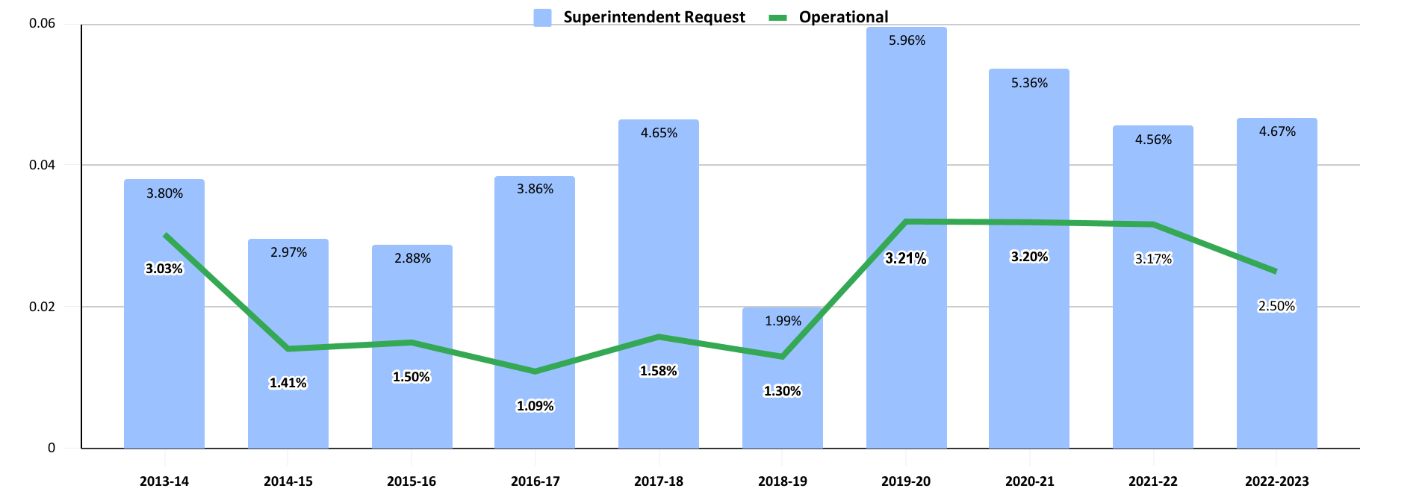
Budget Funding History
(with Anticipated Board of Finance Changes for Fiscal Year 23)

Slide 36
Berlin’s adopted budgets in the past three years have compared favorably
District | Adopted 2017-18 | Adopted 2018-19 | Adopted 2019-20 | Adopted 2020-21 | Adopted 2021-22 | 5 Yr. Average Increase
Rocky Hill | 2.93% | 4.54% | 2.50% | 3.84% | 3.75% | 3.51%
Farmington | 2.37% | 2.54% | 2.90% | 3.35% | 3.30% | 2.89%
Cromwell | 2.00% | 1.53% | 3.29% | 3.60% | 2.97% | 2.68%
Berlin | 1.58% | 1.30% | 3.21% | 3.20% | 3.17% | 2.49%
Wethersfield | 0.75% | 2.97% | 3.50% | 2.05% | 0.53% | 1.96%
Glastonbury | 0.00% | 2.20% | 3.16% | 2.81% | 1.60% | 1.95%
Newington | 0.29% | 3.40% | 2.70% | 2.67% | 0.00% | 1.81%

Slide 37
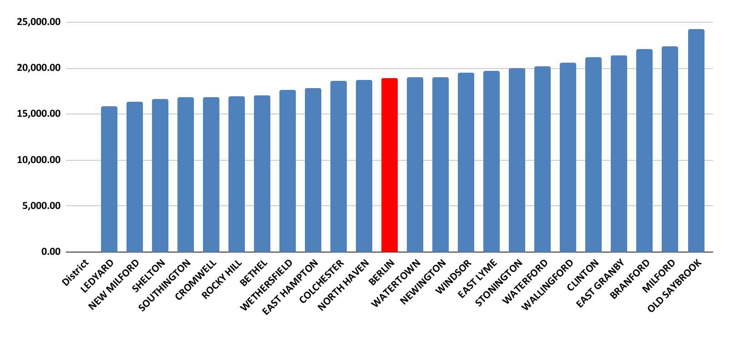
NCEP - Net Current Expenditure per Pupil
* Revised on 2/15/2022 to included the most recent information available from the CSDE.

Slide 38
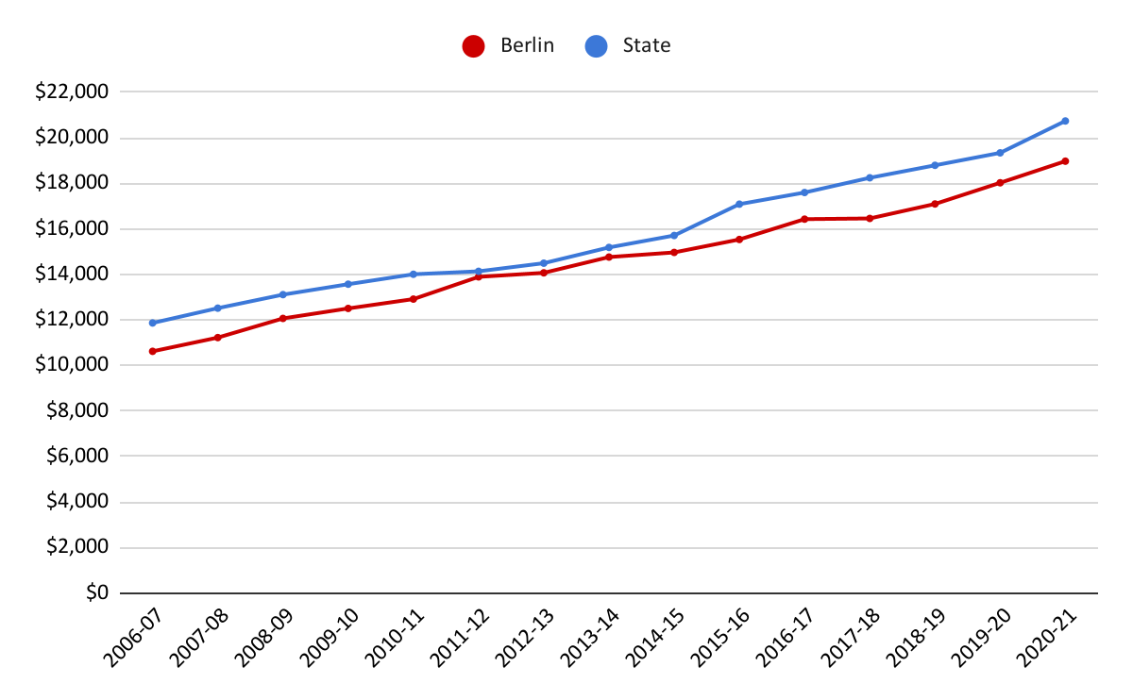
Berlin and State Per Pupil Expenditure
In the 20-21 school year, state per pupil spending was $20,740, Berlin per pupil spending was $18,973 or $1,767 less than the state.
* Revised on 2/15/2022 to included the most recent information available from the CSDE.

Slide 39
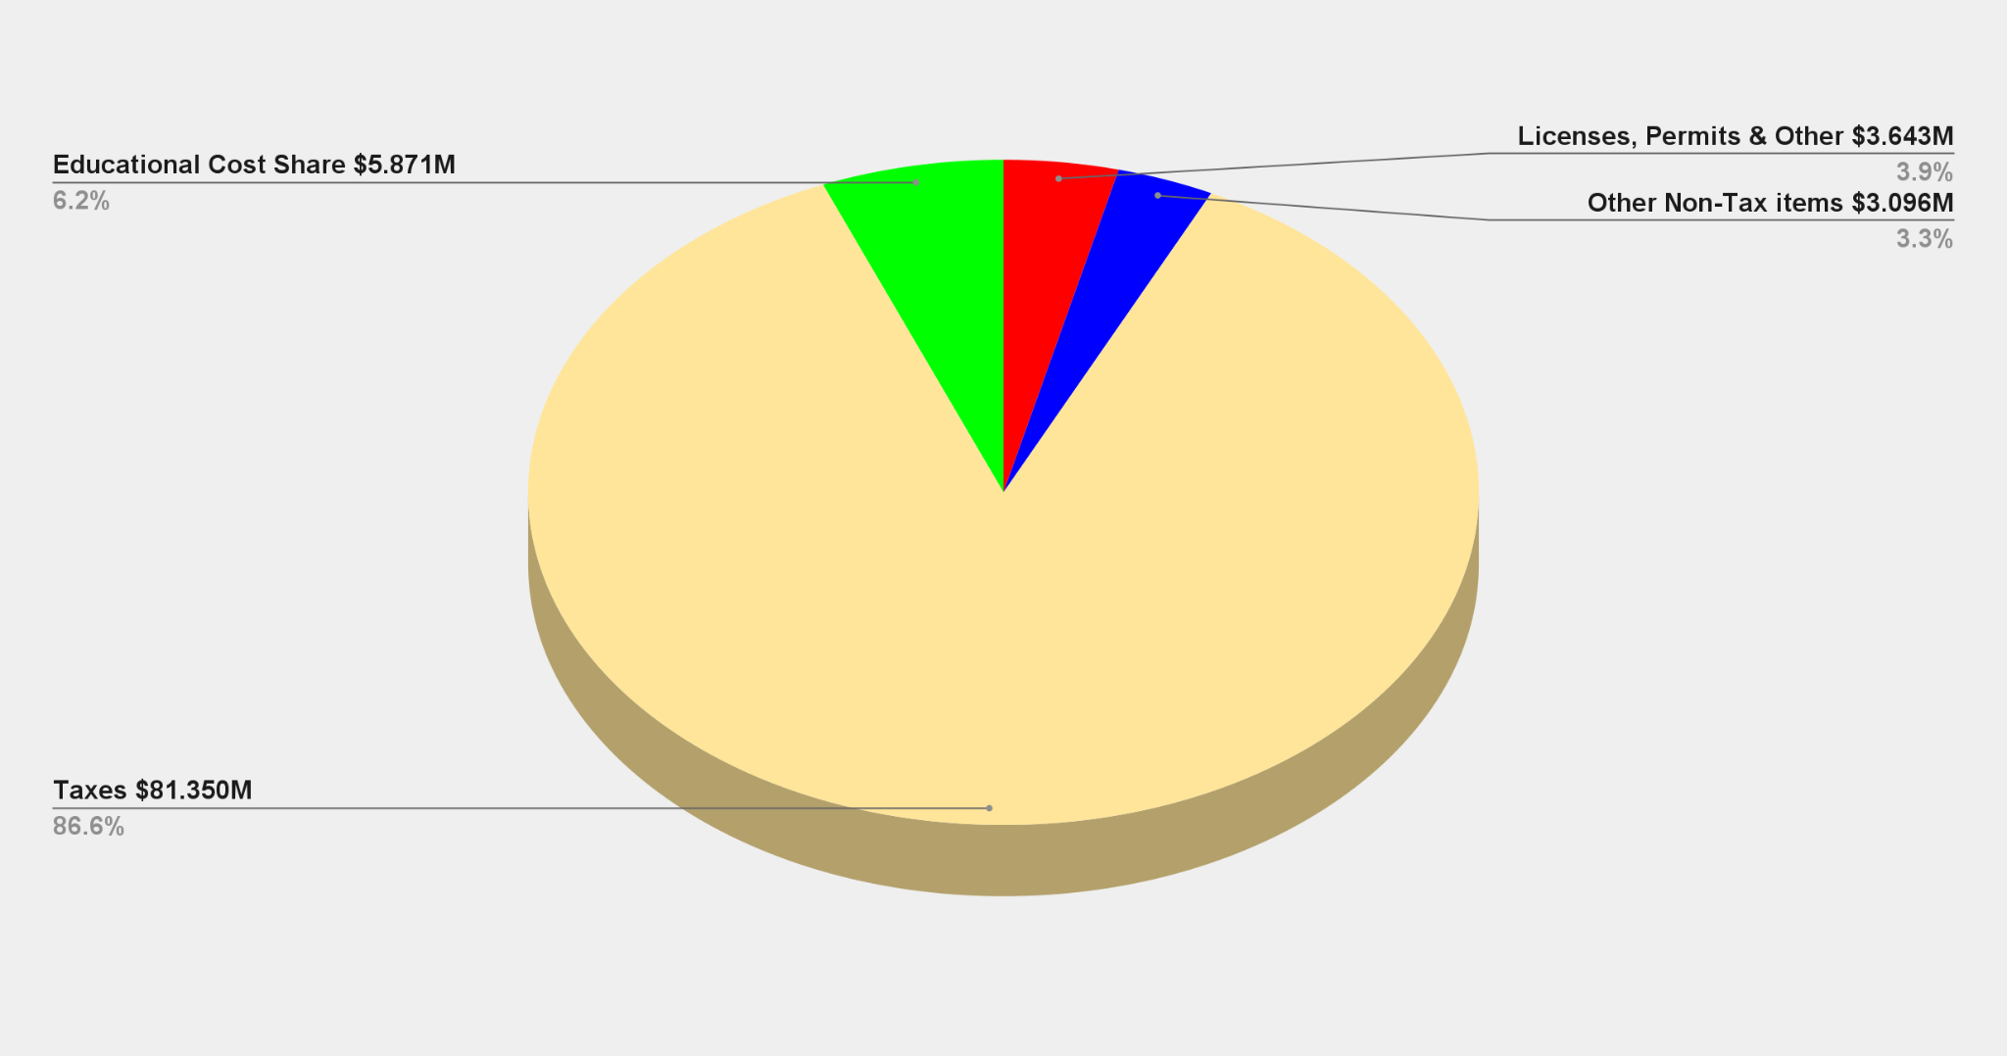
All Town Revenue Sources
Data from the FY 2021-22 Town General Fund Budget, Adopted at Referendum 4/27/2021

Slide 40
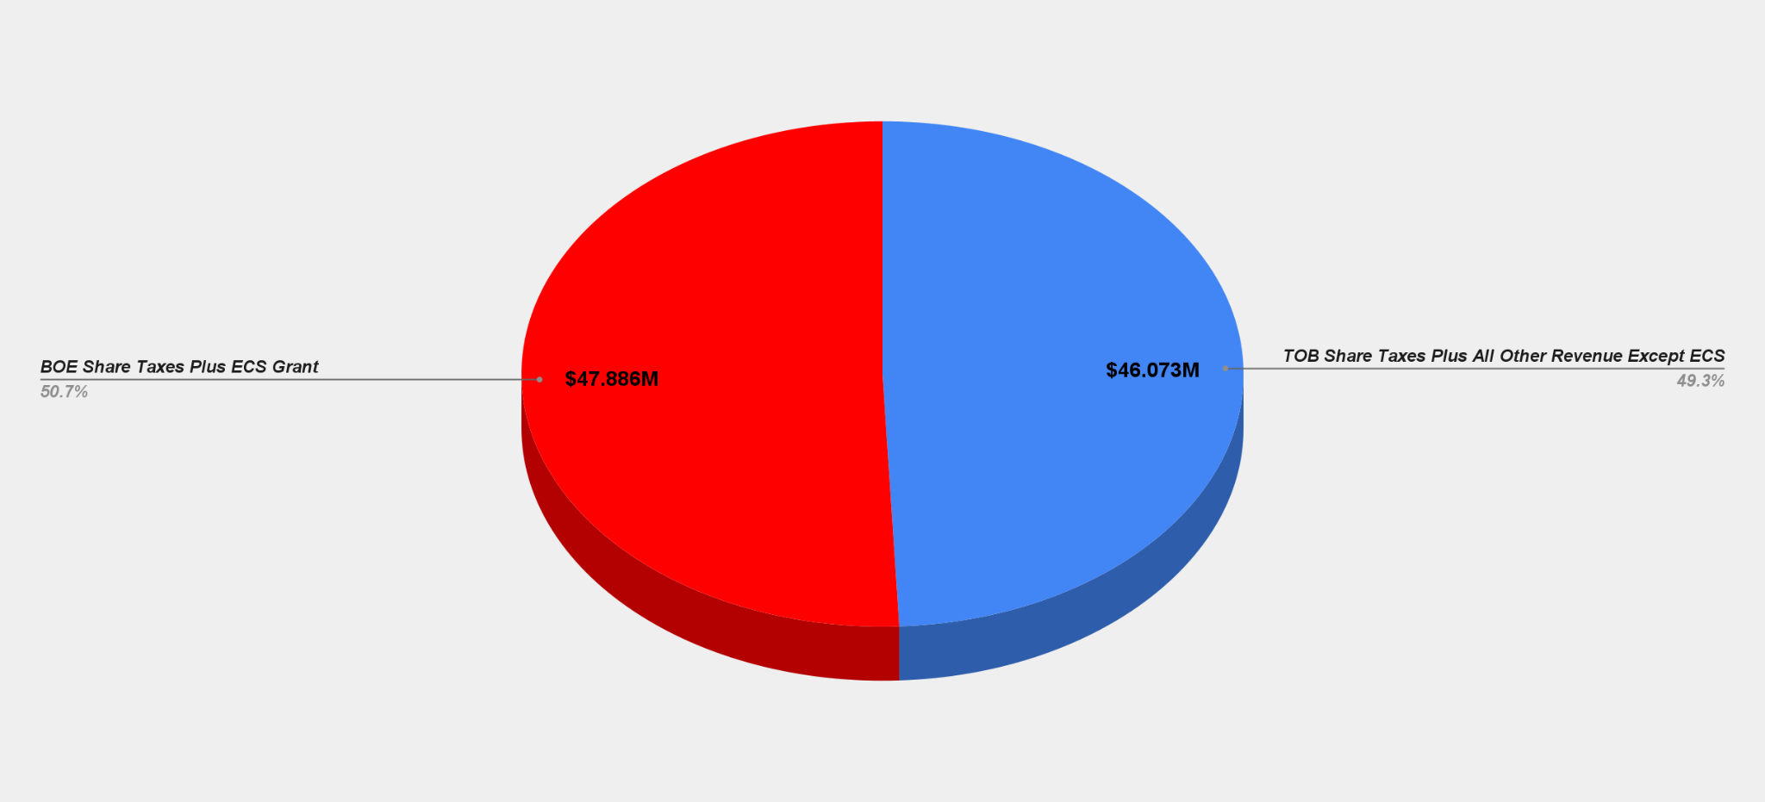
Share of Revenue Sources
Data from the FY 2021-22 Town General Fund Budget, Adopted at Referendum 4/27/2021

Slide 41
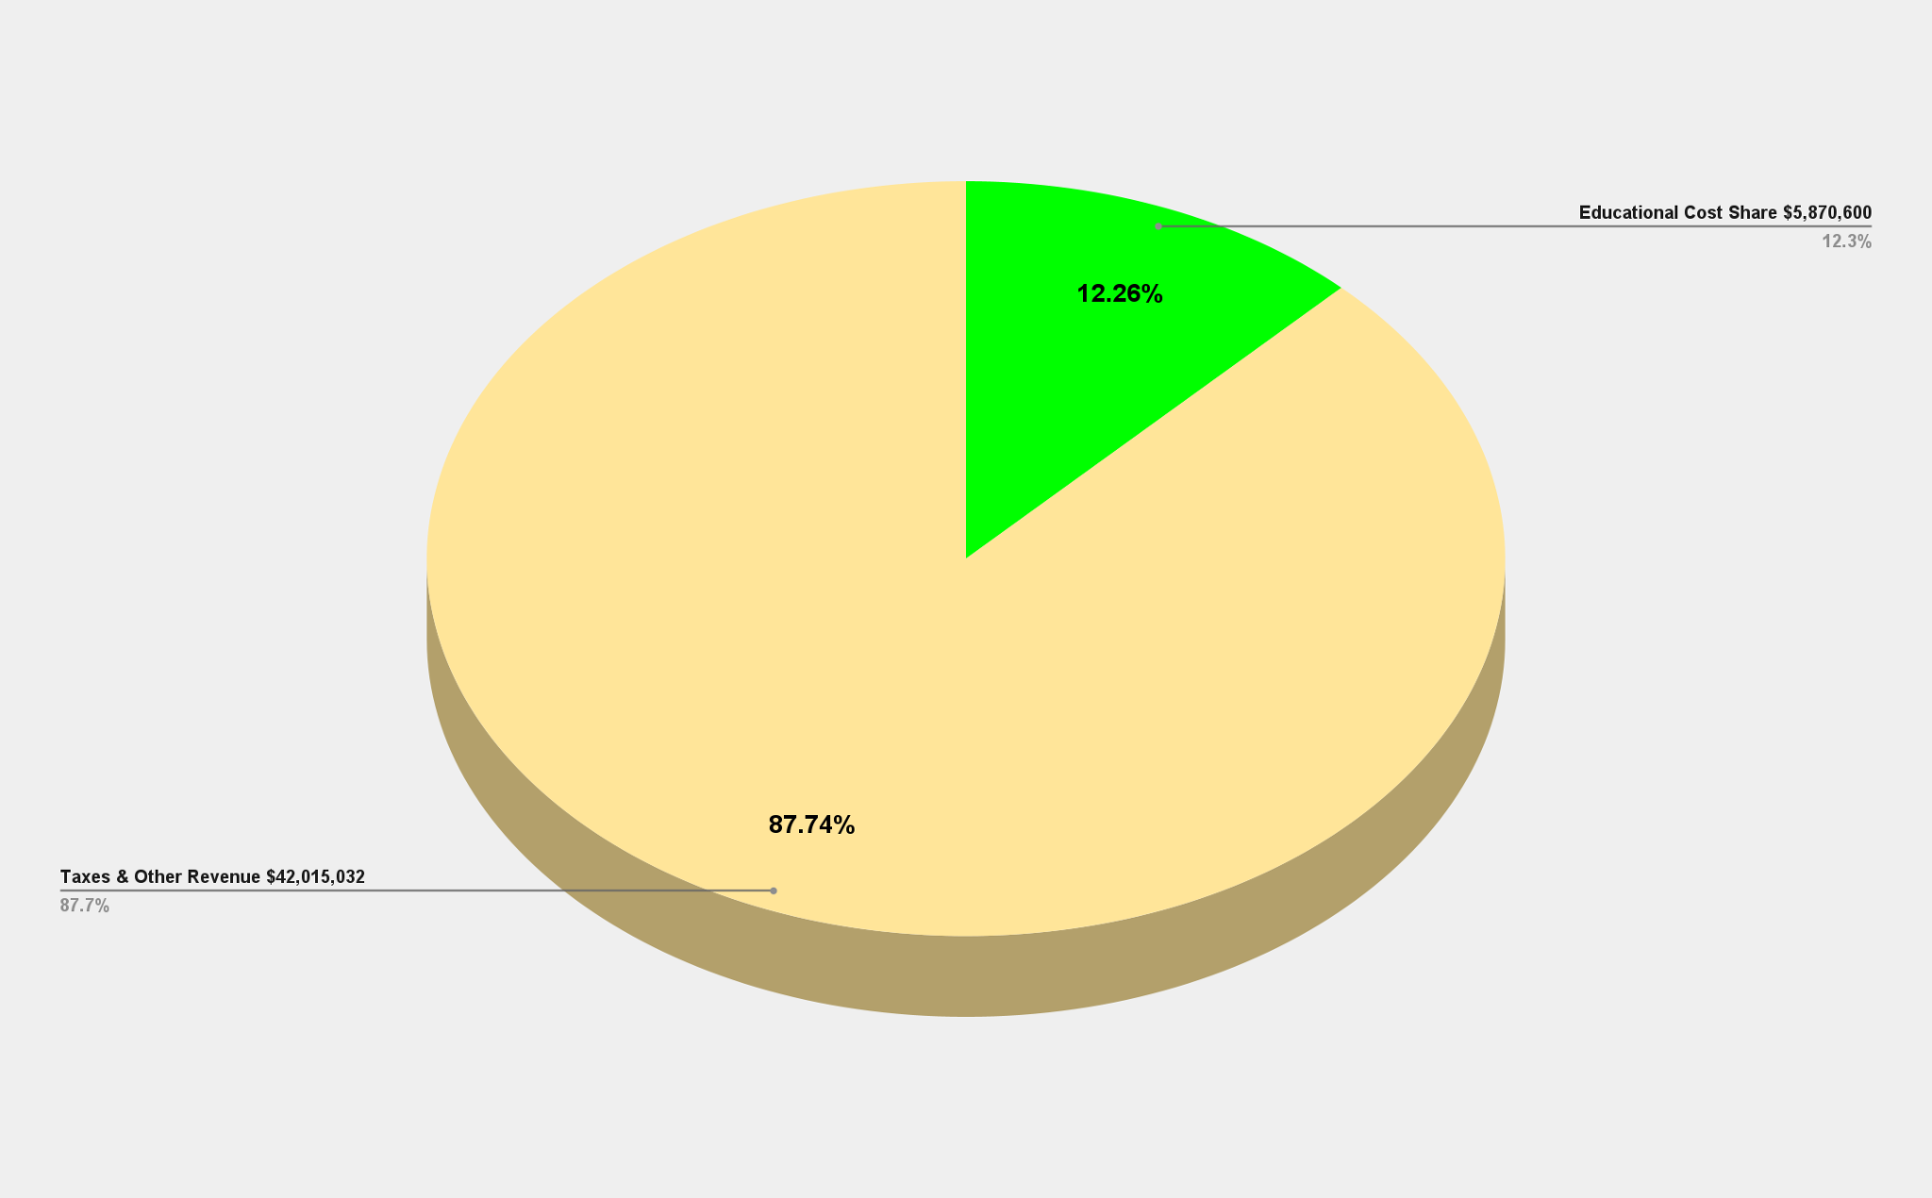
BOE Operational Funding Sources
Data from the FY 2021-22 Town General Fund Budget, Adopted at Referendum 4/27/2021

Slide 42
3-Year History of Non-Lapsing Deposits
Project Description | FY 2018-2019 | FY 2019-2020 | FY 2020-2021
Blast Classroom at McGee | $200,000.00
Refinish Gym Floors | $117,775.00
Paint McGee Gym | $37,225.00
Security Equipment | $25,000.00
 | $380,000.00
Hubbard Fire Alarms |  | $150,000.00
McGee Rooftop HVAC Unit |  | $225,000.00
 |  | $375,000.00
McGee LMC Lighting Upgrade |  |  | $150,000.00
Paving of Willard Playground |  |  | $150,000.00
Hubbard Classroom Storage |  |  | $50,000.00
McGee Removal of Retaining Wall and Paving |  |  | $25,000.00
Additional Funding for McGee Rooftop HVAC Unit |  |  | $25,000.00
 |  |  | $400,000.00
Total 3-Year History for Non-Lapsing Deposit for Unfunded Capital Projects |  |  | $1,155,000.00
In fiscal years 2020 and 2021 the District was significantly impacted by the COVID-19 pandemic and substantial savings were realized. In both fiscal years, the District returned $400,000 to the Town.

Slide 43
3-Year History of End of Year Purchases
Purchase Description | FY 2018-2019 | FY 2019-2020 | FY 2020-2021
McGee Camera & Video Management System | $127,730.00
Willard / Hubbard Camera & Video Management System | $198,680.00
Chromebooks | $107,250.00
 | $433,660.00
Staff Laptops |  | $289,100.00
iPads (200) |  | $81,590.00
MacBooks |  | $10,415.00
Adaptors |  | $15,000.00
Vans |  | $117,000.00
Facility Plan Updates |  | $31,500.00
Equipment for McGee Gym Painting Equipment |  | $26,675.00
 |  | $571,280.00
Boardroom Remodel & Furniture |  |  | $43,988.00
New Building Signs (Districtwide) |  |  | $38,000.00
Cafeteria Equipment (Districtwide) |  |  | $20,350.00
Bleacher Repairs & Gym Floor Resurfacing and Equipment (Districtwide) |  |  | $26,693.00
BHS Camera Storage |  |  | $12,589.00
SonicWall Security |  |  | $20,750.00
iMacs for Art Departments |  |  | $37,856.00
iPads & Apple TVs (Districtwide) |  |  | $49,037.00
Exterior Door Repairs (Hubbard & McGee) |  |  | $27,962.00
 |  |  | $277,225.00
Total 3-Year End of Year Purchase History |  |  | $1,282,165.00

Slide 44
A school district's budget reflects the commitment of the community to invest in the future of our children.
The erosion of funding for education challenges the sustainability of Berlin as a competitive school district with rich educational and extracurricular opportunities for our students.

Slide 45
Questions

