Slide 1


Town of Berlin
FY2023 Board of Finance Budget Review
March 2, 2022

Slide 2
Agenda
Overall Budget
Board of Education Operating Budget
Revenue
Long-term Liabilities
Capital
Transfers
General Government (incl BWC) Operating Budget
Notes:
Overall: 10 minutes
Revenue: 15 minutes
LT Liabilities/Capital: 30 minutes
Transfers: 5 minutes
BOE: 30 minutes
GG: 30 minutes

Slide 3
Overall Budget
Notes:
Overall: 10 minutes
Revenue: 15 minutes
LT Liabilities/Capital: 30 minutes
Transfers: 5 minutes
BOE: 30 minutes
GG: 30 minutes

Slide 4
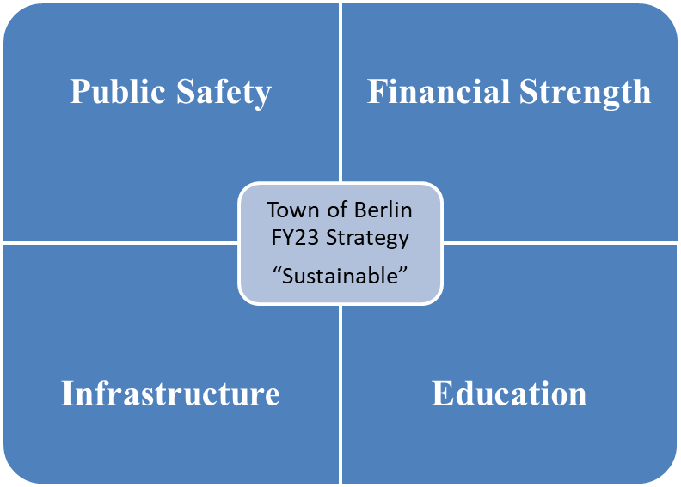
Budget Strategy
Exercise fiscal restraint to keep taxes down as much as possible
No new money borrowing to prepare for impending large projects
Structurally balanced budget while maintaining a high-quality educational system, public safety, infrastructure and honoring legal/contractual obligations
Focus limited capital requests on Schools, Public Safety & critical Infrastructure

Slide 5
Fiscal Year 2023 Overall Budget Proposal
Total Proposal: $99.4 million (+$5.5 million or +5.8%)
Mill Rate: 35.91 mills (+1.98 mills)
State Funds: based on Governor Lamont’s budget proposal
  ECS flat to FY22
  Budget does not include motor vehicle cap (Governor proposed motor vehicle cap at 29 mils)
    Uncertain if legislature will pass
    If the proposal passes, uncertain at what level the motor vehicle mil rate will be capped
Budgeted Grand List:
  1 mil is worth $2,438,139
  +2.9% YOY increase - generates $2,272,318 incremental tax revenue (@ 33.93 mill rate)
Notes:
Teacher’s Retirement charge is very likely coming in the next few years – strong balance sheet (including unassigned fund balance) will help mitigate the impact
Tried to offset proposed operating increases with revenue (for revenue generating departments) & fund balance for non-recurring items (pension & contingency)

Slide 6
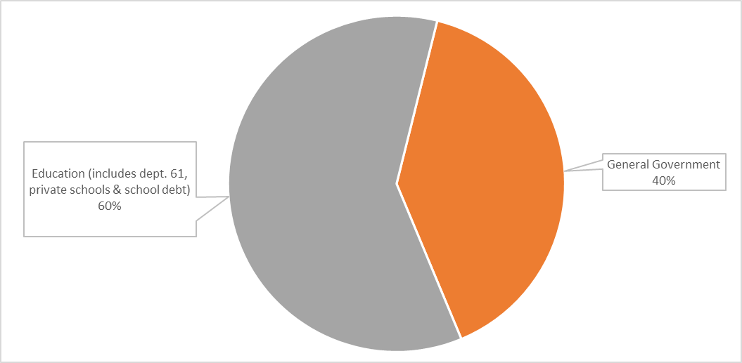
Breakdown of Total FY23 Budget
Notes:
KEEP????

Slide 7
QUESTIONS?

Slide 8

Board of Education Budget
2022-2023
March 2, 2022

Slide 9
BOE & Superintendent’s Goals for 2022-2023
Continue to provide quality education to all students at the standard that Berlin parents expect.
Provide all students with an education that prepares them for multiple options and opportunities upon graduation.
Maintain favorable class sizes and adequate course offerings.
Consistent support for technology use with adequate funding of hardware, software, infrastructure, and IT support.
An ongoing commitment to implementing safety measures, equipment and systems that provide all students and staff a safe learning environment.

Slide 10
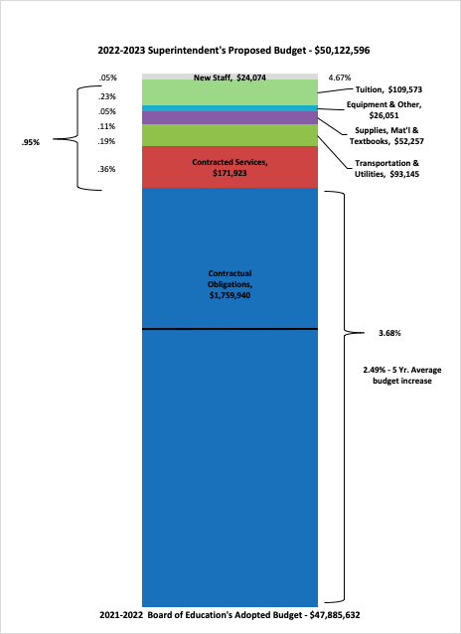
2022-2023 Superintendent’s Proposed Budget Overview
Administrative Salaries
Certified Salaries
Non-Certified Salaries
Employee Benefits

Slide 11
Budget Executive Summary |  |  |  |  |  | $50,122,596.00
Object Summary |  | FY 20-21 Budget | FY 20-21 Actual | FY 21-22 Budget as of 12/1/2021 | FY 22-23 Superintendent's Proposed | Dollar Difference | Percentage Difference
10 | Administrative Salaries | $2,737,080.00 | $2,772,037.00 | $2,855,887.00 | $2,974,826.00 | $118,939.00 | 4.16%
11 | Certified Salaries | $20,900,470.00 | $20,997,178.00 | $21,545,983.00 | $22,521,627.00 | $975,644.00 | 4.53%
12 | Non Certified Salaries | $7,472,905.00 | $7,085,852.00 | $7,646,170.00 | $7,960,043.00 | $313,873.00 | 4.10%
20 | Employee Benefits | $6,462,707.00 | $6,430,651.00 | $6,780,970.00 | $7,156,529.00 | $375,559.00 | 5.54%
30 | Contracted Services | $1,778,688.00 | $1,848,494.00 | $1,862,459.00 | $2,034,382.00 | $171,923.00 | 9.23%
40 | Utilities | $406,303.00 | $330,009.00 | $406,303.00 | $418,370.00 | $12,067.00 | 2.97%
51 | Transportation | $3,212,078.00 | $2,460,948.00 | $3,251,277.00 | $3,332,355.00 | $81,078.00 | 2.49%
56 | Tuition | $2,155,787.00 | $1,948,765.00 | $2,270,715.00 | $2,380,288.00 | $109,573.00 | 4.83%
60 | Supplies, Textbooks, & Materials | $1,074,100.00 | $1,112,560.00 | $973,450.00 | $1,025,707.00 | $52,257.00 | 5.37%
70 | Equipment | $154,200.00 | $535,863.00 | $176,979.00 | $226,205.00 | $49,226.00 | 27.81%
80 | All Other Expenditures | $62,186.00 | $485,535.00 | $115,439.00 | $92,264.00 | -$23,175.00 | -20.08%
Totals |  | $46,416,504.00 | $46,007,892.00 | $47,885,632.00 | $50,122,596.00 | $2,236,964.00 | 4.67%

Slide 12
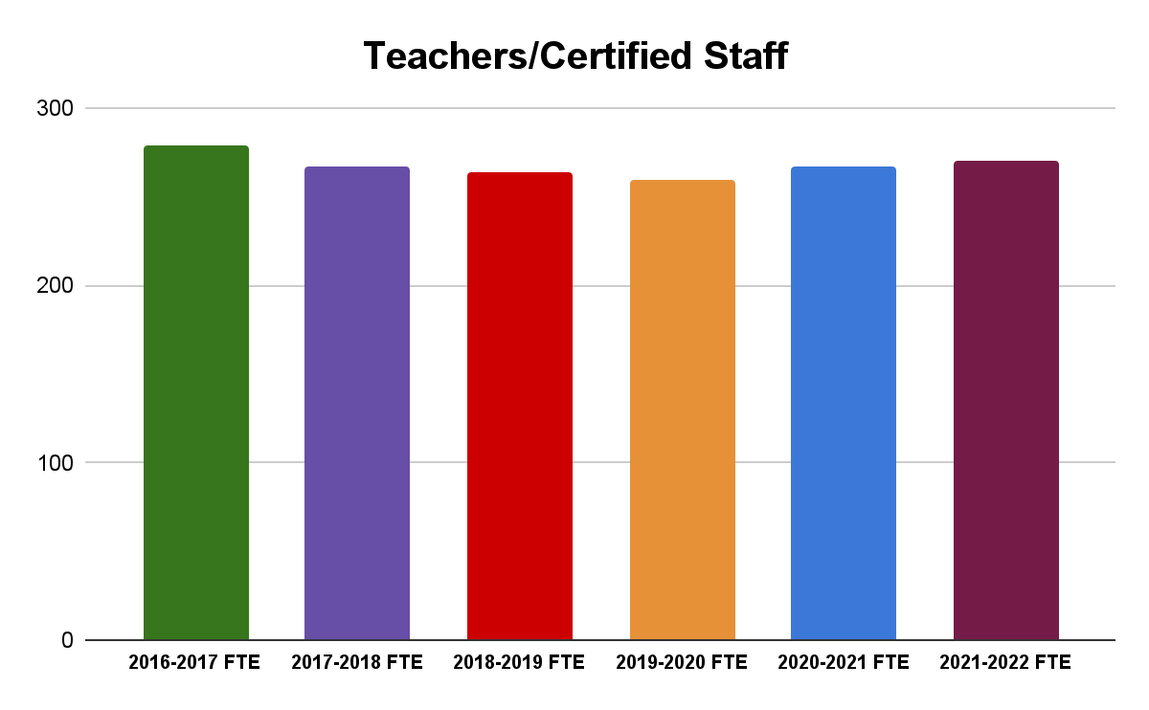
6 Year FTE Comparisons
Teachers/Certified Staff
Employee Type | 2016-2017 FTE | 2017-2018 FTE | 2018-2019 FTE | 2019-2020 FTE | 2020-2021 FTE | 2021-2022 FTE
Teachers/Certified Staff | 279.3 | 267.0 | 264.0 | 259.4 | 266.7 | 270.3

Slide 13
Initial Staffing Request for Operational Budget - $912,065
Total Initial Staffing Requests - $1,153,755
General Fund Requests | Position | FTE | Estimated Salary | Estimated Salary
Central Office | Office Assistant | 0.50 | $37,425.00 | $12,322.00
Central Office | Increase of Hours HR Director | 0.20 | $24,075.00 | $0.00
Districtwide | I.T. Technician | 1.00 | $65,000.00 | $23,890.00
Districtwide (PPS Department) | Paraprofessional | 6.00 | $157,764.00 | $65,991.00
Griswold Elementary School | Writing Interventionist | 1.00 | $64,189.00 | $19,365.00
Griswold Elementary School | Assistant Principal | 0.00 | $18,000.00 | $0.00
Hubbard Elementary School | Writing Interventionist | 1.00 | $64,189.00 | $19,365.00
Hubbard Elementary School | Social Worker | 0.50 | $31,000.00 | $9,666.00
Hubbard Elementary School | Art Teacher | 0.60 | $38,513.00 | $11,600.00
McGee Middle School | Assistant Principal | 0.00 | $18,000.00 | $0.00
Special Education | Elementary Teacher | 1.00 | $64,189.00 | $19,365.00
Special Education | Registered Behavior Technician | 1.00 | $35,604.00 | $10,999.00
Willard Elementary School | Writing Interventionist | 1.00 | $64,189.00 | $19,365.00
Willard Elementary School | Assistant Principal | 0.00 | $18,000.00 | $0.00
General Fund Subtotal |  | 13.80 | $700,137.00 | $211,928.00
Grant & Other Fund Requests
Districtwide | Armed Security Guard | 1.00 | $44,606.00 | $23,354.00
District Elementary | Resident Teacher | 1.00 | $67,500.00 | $19,365.00
BHS | Work Based Learning Coordinator | 1.00 | $67,500.00 | $19,365.00
Grant & Other Funds Subtotal |  | 3.00 | $179,606.00 | $62,084.00
Total |  |  | $879,743.00 | $274,012.00

Slide 14
2022-2023 New Staff Request Summary
16.80 Total Requests for New Staff
14.60 Requests Not Funded
2.20 Requested for Funding (Operational, Grant & Town)
  Operational General Fund
    .20 Increase to Director of Human Resources
  Town of Berlin
    1.0 Armed Security Guard (BHS Night Shift)
  Open Choice Grant
    1.0 Work Based Learning Coordinator

Slide 15
Budget Executive Summary |  |  |  |  |  | $50,122,596.00
Object Summary |  | FY 20-21 Budget | FY 20-21 Actual | FY 21-22 Budget as of 12/1/2021 | FY 22-23 Superintendent's Proposed | Dollar Difference | Percentage Difference
10 | Administrative Salaries | $2,737,080.00 | $2,772,037.00 | $2,855,887.00 | $2,974,826.00 | $118,939.00 | 4.16%
11 | Certified Salaries | $20,900,470.00 | $20,997,178.00 | $21,545,983.00 | $22,521,627.00 | $975,644.00 | 4.53%
12 | Non Certified Salaries | $7,472,905.00 | $7,085,852.00 | $7,646,170.00 | $7,960,043.00 | $313,873.00 | 4.10%
20 | Employee Benefits | $6,462,707.00 | $6,430,651.00 | $6,780,970.00 | $7,156,529.00 | $375,559.00 | 5.54%
30 | Contracted Services | $1,778,688.00 | $1,848,494.00 | $1,862,459.00 | $2,034,382.00 | $171,923.00 | 9.23%
40 | Utilities | $406,303.00 | $330,009.00 | $406,303.00 | $418,370.00 | $12,067.00 | 2.97%
51 | Transportation | $3,212,078.00 | $2,460,948.00 | $3,251,277.00 | $3,332,355.00 | $81,078.00 | 2.49%
56 | Tuition | $2,155,787.00 | $1,948,765.00 | $2,270,715.00 | $2,380,288.00 | $109,573.00 | 4.83%
60 | Supplies, Textbooks, & Materials | $1,074,100.00 | $1,112,560.00 | $973,450.00 | $1,025,707.00 | $52,257.00 | 5.37%
70 | Equipment | $154,200.00 | $535,863.00 | $176,979.00 | $226,205.00 | $49,226.00 | 27.81%
80 | All Other Expenditures | $62,186.00 | $485,535.00 | $115,439.00 | $92,264.00 | -$23,175.00 | -20.08%
Totals |  | $46,416,504.00 | $46,007,892.00 | $47,885,632.00 | $50,122,596.00 | $2,236,964.00 | 4.67%

Slide 16
Contracted Services - $171,923
Includes all operational and educational systems which increase 3% to 7% annually
Additional cybersecurity software required by insurance company
Increase in legal fees & anticipated copier contract

Slide 17
Transportation - $81,078
Contractual increase for 2022-2023 school year is 3.45% with New Britain Transportation
District intends to use a portion of Excess Cost funds to offset Special Education transportation

Slide 18
Tuition - $109,573
No funds have been budgeted for anticipated outplacements for 2022-2023.
The anticipated increase for CREC Magnet School is 12%
The budget assumes the current Pre-K (non-tuition students) will continue through the magnet school system as a tuition student in the next fiscal year
Tuition |  |  |  |  | $2,380,288.00
Description | FY 20-21 Budget | FY 20-21 Actual | FY 21-22 Budget as of 12/1/2021 | FY 22-23 Superintendent's Proposed | Dollar Difference | Percent Difference | Comments
Southington Vocational Agriculture Center | $34,115.00 | $27,292.00 | $40,801.00 | $36,250.00 | -$4,551.00 | -11.15%
Tuition Summer School | $0.00 | $118,737.26 | $0.00 | $0.00 | $0.00 | 0.00%
Out-Of-District Tuition- Public In State | $548,483.00 | $257,990.25 | $483,615.51 | $410,243.00 | -$73,372.51 | -15.17%
Out-Of-District Tuition- Private In State | $1,261,813.00 | $1,240,618.39 | $1,434,485.02 | $1,560,820.00 | $126,334.98 | 8.81%
Expulsion Program | $0.00 | $0.00 | $0.00 | $15,450.00 | $15,450.00 | 100.00%
Magnet School Tuition for Berlin Residents | $311,376.00 | $304,127.00 | $311,813.00 | $357,525.00 | $45,712.00 | 14.66%
Totals | $2,155,787.00 | $1,948,765.00 | $2,270,715.00 | $2,380,288.00 | $109,573.00 | 4.83%

Slide 19
All Other Expenditures - ($23,175)
The District is taking a 0% increase from the original July 1, 2021 budget for All Other Expenditures. The budget, as of 12/1/2021, includes the Board approved $20,000 transfers for the Griswold Band Room. The proposed budget redistributes funds to the original category or to other line items within the All Other Expenditures category.
Initial Requests to Superintendent included an additional $474,700 for equipment and facilities improvements which was cut by the Superintendent before the January 10th BOE Meeting.

Slide 20
Budget Executive Summary |  |  |  |  |  | $50,122,596.00
Object Summary |  | FY 20-21 Budget | FY 20-21 Actual | FY 21-22 Budget as of 12/1/2021 | FY 22-23 Superintendent's Proposed | Dollar Difference | Percentage Difference
10 | Administrative Salaries | $2,737,080.00 | $2,772,037.00 | $2,855,887.00 | $2,974,826.00 | $118,939.00 | 4.16%
11 | Certified Salaries | $20,900,470.00 | $20,997,178.00 | $21,545,983.00 | $22,521,627.00 | $975,644.00 | 4.53%
12 | Non Certified Salaries | $7,472,905.00 | $7,085,852.00 | $7,646,170.00 | $7,960,043.00 | $313,873.00 | 4.10%
20 | Employee Benefits | $6,462,707.00 | $6,430,651.00 | $6,780,970.00 | $7,156,529.00 | $375,559.00 | 5.54%
30 | Contracted Services | $1,778,688.00 | $1,848,494.00 | $1,862,459.00 | $2,034,382.00 | $171,923.00 | 9.23%
40 | Utilities | $406,303.00 | $330,009.00 | $406,303.00 | $418,370.00 | $12,067.00 | 2.97%
51 | Transportation | $3,212,078.00 | $2,460,948.00 | $3,251,277.00 | $3,332,355.00 | $81,078.00 | 2.49%
56 | Tuition | $2,155,787.00 | $1,948,765.00 | $2,270,715.00 | $2,380,288.00 | $109,573.00 | 4.83%
60 | Supplies, Textbooks, & Materials | $1,074,100.00 | $1,112,560.00 | $973,450.00 | $1,025,707.00 | $52,257.00 | 5.37%
70 | Equipment | $154,200.00 | $535,863.00 | $176,979.00 | $226,205.00 | $49,226.00 | 27.81%
80 | All Other Expenditures | $62,186.00 | $485,535.00 | $115,439.00 | $92,264.00 | -$23,175.00 | -20.08%
Totals |  | $46,416,504.00 | $46,007,892.00 | $47,885,632.00 | $50,122,596.00 | $2,236,964.00 | 4.67%

Slide 21
ESSER II FY 2023 - $308,946
Total ESSER II Funds - $641,868
Department | Description | Estimate | FY 22 Budget | FY 23 Budget
Curriculum | Extended Learning Opportunities | $142,922.00 | $70,000.00 | $72,922.00
Special Education | ESS in Middle School | $241,000.00 | $118,000.00 | $123,000.00
Districtwide | "Common Ground" Partnership w/ Social Services | $60,000.00 | $30,000.00 | $30,000.00
Districtwide | Partially Fund Zoom License | $105,946.00 | $45,946.00 | $60,000.00
Districtwide | Family Communication Specialist | $92,000.00 | $45,000.00 | $47,000.00
Totals |  | $641,868.00 | $308,946.00 | $332,922.00
ESSER II is a two year grant with the expectation that funds will be expended by September 30, 2023.

Slide 22
ESSER ARP FY 2023 - $521,000
Total ESSER ARP Funds - $800,942
Department | Description | Estimate | FY 22 Budget | FY 23 Budget | FY 24 Budget
Curriculum | Extended Learning Opportunities- expand summer programs, including offering some summer courses at BHS | $339,942.00 | $90,000.00 | $115,000.00 | $134,942.00
Curriculum | RULER training and curriculum work | $65,000.00 | $35,000.00 | $15,000.00 | $15,000.00
Facilities | Mental Health Suite- McGee | $124,000.00 | $124,000.00
Districtwide | WAN: Upgrade current fiber network between all buildings from 10gb to 40gb | $102,000.00 | $102,000.00
Districtwide | Install fiber from Town Hall data closet to Board of Education data center. | $10,000.00 | $10,000.00
Districtwide | BOE of Ed Data Center Switches should be upgraded to utilize 10-50gbps fiber runs | $40,000.00 | $40,000.00
Districtwide | Berlin High School MER (Main Equipment Room) Core Switches- end of life and need to be replaced with current models and have throughput increased | $120,000.00 | $120,000.00
Totals |  | $800,942.00 | $521,000.00 | $130,000.00 | $149,942.00
ESSER ARP is a three year grant with the expectation that funds will be expended by September 30, 2024.

Slide 23
Hartford Open Choice Enrollment
 | 2016-2017 | 2017-2018 | 2018-2019 | 2019-2020 | 2020-2021 | 2021-2022 | Projected 2022-2023
Choice Students | 96 | 92 | 131 | 116 | 121 | 109 | 110
Total Enrollment | 2792 | 2781 | 2787 | 2735 | 2688 | 2678 | 2639
% Choice Students | 3.44% | 3.31% | 4.70% | 4.24% | 4.50% | 4.07% | 4.17%
For the 2021-2022 school year, we offered 14 new seats for Choice students and 11 were filled.
8 kindergarten students
1 second grade, 1 third grade and 1 sixth grade – all siblings/relatives of students
Every effort is being made to accept students at the kindergarten level with a conscious awareness of maintaining at least 4% Choice Enrollment as these funds are tied to additional staff and programs.

Slide 24
Hartford Open Choice Anticipated Budget - $1,034,275
Expense Type | FY 2022 Budget | FY 2023 Budget | Dollar Difference | Percentage Difference
Certified Salaries
BHS | $176,734.00 | $247,304.00 | $70,570.00 | 39.93%
Griswold | 66,495.00 | 69,869.00 | 3,374.00 | 5.07%
Hubbard | 0.00 | 0.00 | 0.00 | 0.00%
McGee | 92,630.00 | 94,251.00 | 1,621.00 | 1.75%
Willard | 162,499.00 | 168,659.00 | 6,160.00 | 3.79%
 | 498,358.00 | 580,083.00 | $81,725.00 | 16.40%
Non Certified Salaries
BHS | $36,911.00 | $38,026.00 | $1,115.00 | 3.02%
Griswold | 55,958.00 | 57,201.00 | 1,243.00 | 2.22%
Hubbard | 38,592.00 | 39,457.00 | 865.00 | 2.24%
McGee | 47,760.00 | 51,883.00 | 4,123.00 | 8.63%
Willard | 105,082.00 | 108,390.00 | 3,308.00 | 3.15%
 | 284,303.00 | 294,957.00 | 10,654.00 | 3.75%
Salaries Totals: | 782,661.00 | $875,040.00 | $92,379.00 | 11.80%
Remaining Fund for Allocation |  |  |  | $159,235.00
Special Education Reserve | $150,000.00 | $134,235.00 | -$15,765.00 | -10.51%
Rent for CCTA | 25,000.00 | 25,000.00 | 0.00 | 0.00%
Other Expenses: | $175,000.00 | $159,235.00 | -$15,765.00 | -9.01%

Slide 25
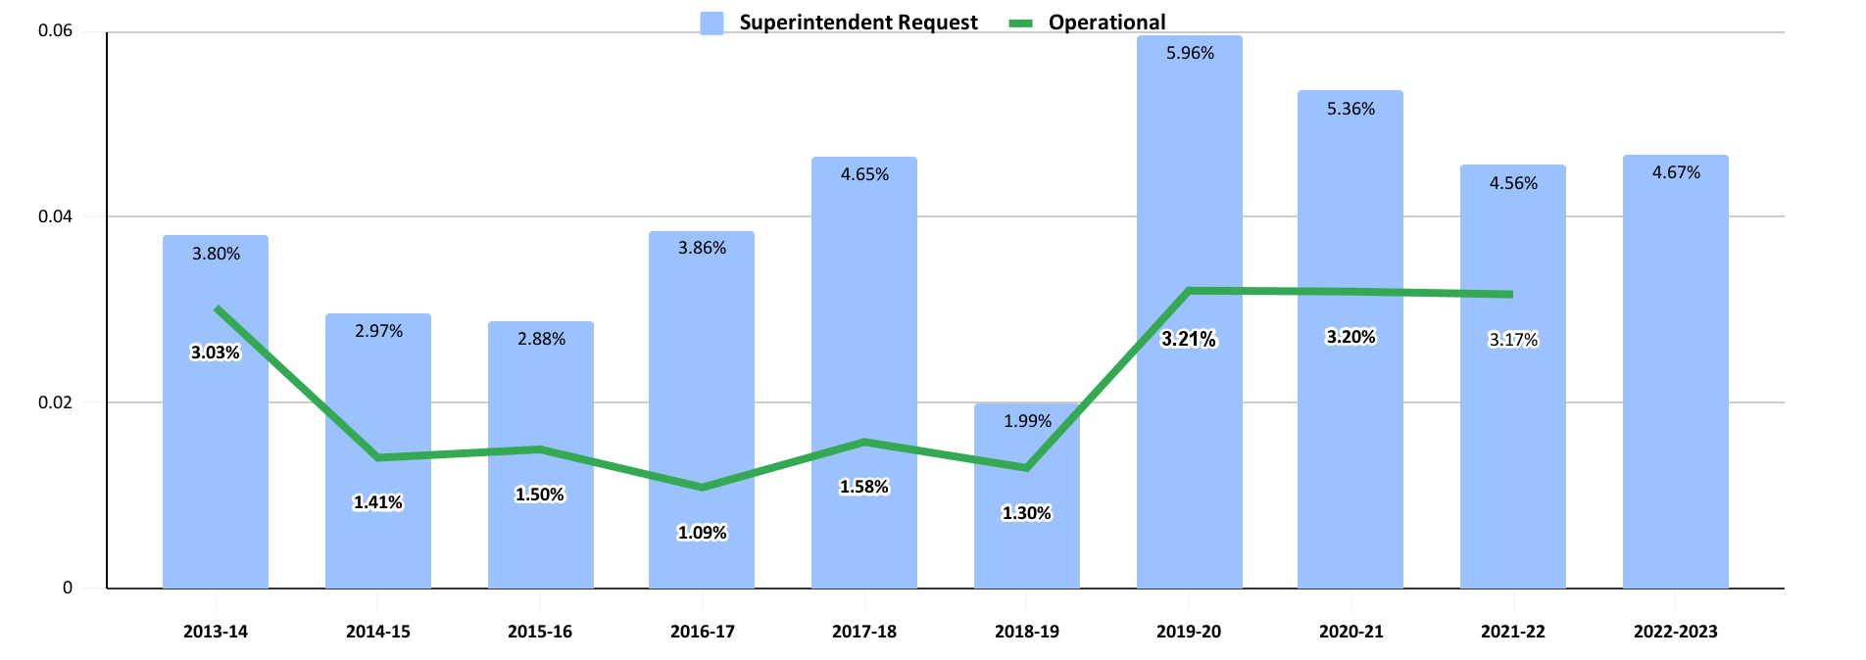
Budget Funding History

Slide 26
Berlin’s adopted budgets in the past three years have compared favorably
District | Adopted 2017-18 | Adopted 2018-19 | Adopted 2019-20 | Adopted 2020-21 | Adopted 2021-22 | 5 Yr. Average Increase
Rocky Hill | 2.93% | 4.54% | 2.50% | 3.84% | 3.75% | 3.51%
Farmington | 2.37% | 2.54% | 2.90% | 3.35% | 3.30% | 2.89%
Cromwell | 2.00% | 1.53% | 3.29% | 3.60% | 2.97% | 2.68%
Berlin | 1.58% | 1.30% | 3.21% | 3.20% | 3.17% | 2.49%
Wethersfield | 0.75% | 2.97% | 3.50% | 2.05% | 0.53% | 1.96%
Glastonbury | 0.00% | 2.20% | 3.16% | 2.81% | 1.60% | 1.95%
Newington | 0.29% | 3.40% | 2.70% | 2.67% | 0.00% | 1.81%

Slide 27
Superintendent’s Proposed Budget by Surrounding Districts
District | Adopted 2017-18 | Adopted 2018-19 | Adopted 2019-20 | Adopted 2020-21 | Adopted 2021-22 | Proposed 2022-23 Budget
Wethersfield | 0.75% | 2.97% | 3.50% | 2.05% | 0.53% | 4.98%
Berlin | 1.58% | 1.30% | 3.21% | 3.20% | 3.17% | 4.67%
Rocky Hill | 2.93% | 4.54% | 2.50% | 3.84% | 3.75% | 4.49%
Cromwell | 2.00% | 1.53% | 3.29% | 3.60% | 2.97% | 3.81%
Newington | 0.29% | 3.40% | 2.70% | 2.67% | 0.00% | 3.63%
Glastonbury | 0.00% | 2.20% | 3.16% | 2.81% | 1.60% | 3.25%
Farmington | 2.37% | 2.54% | 2.90% | 3.35% | 3.30% | 2.99%
Average | 1.42% | 2.64% | 3.04% | 3.07% | 2.19% | 3.97%

Slide 28
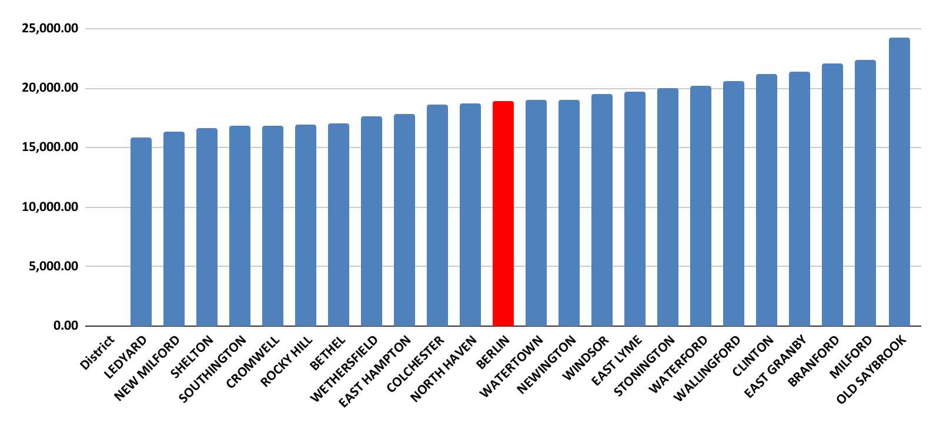
NCEP - Net Current Expenditure per Pupil
* Revised on 2/15/2022 to included the most recent information available from the CSDE.

Slide 29
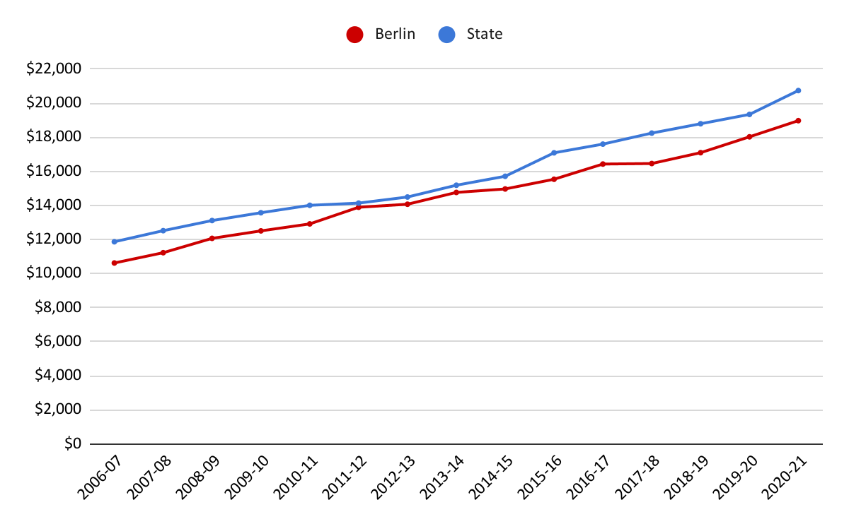
Berlin and State Per Pupil Expenditure
In the 20-21 school year, state per pupil spending was $20,740, Berlin per pupil spending was $18,973 or $1,767 less than the state.
* Revised on 2/15/2022 to included the most recent information available from the CSDE.

Slide 30
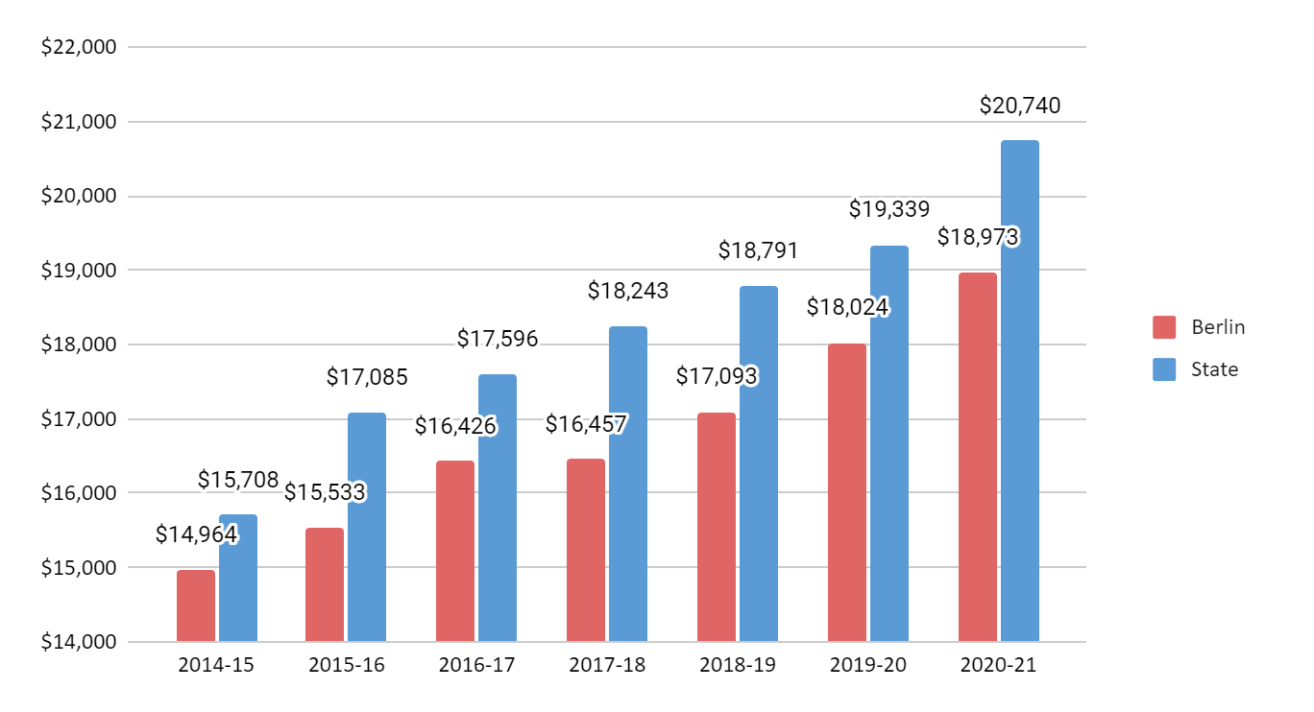
Berlin and State Per Pupil Expenditure
Wealth Ranking is 60th

Slide 31
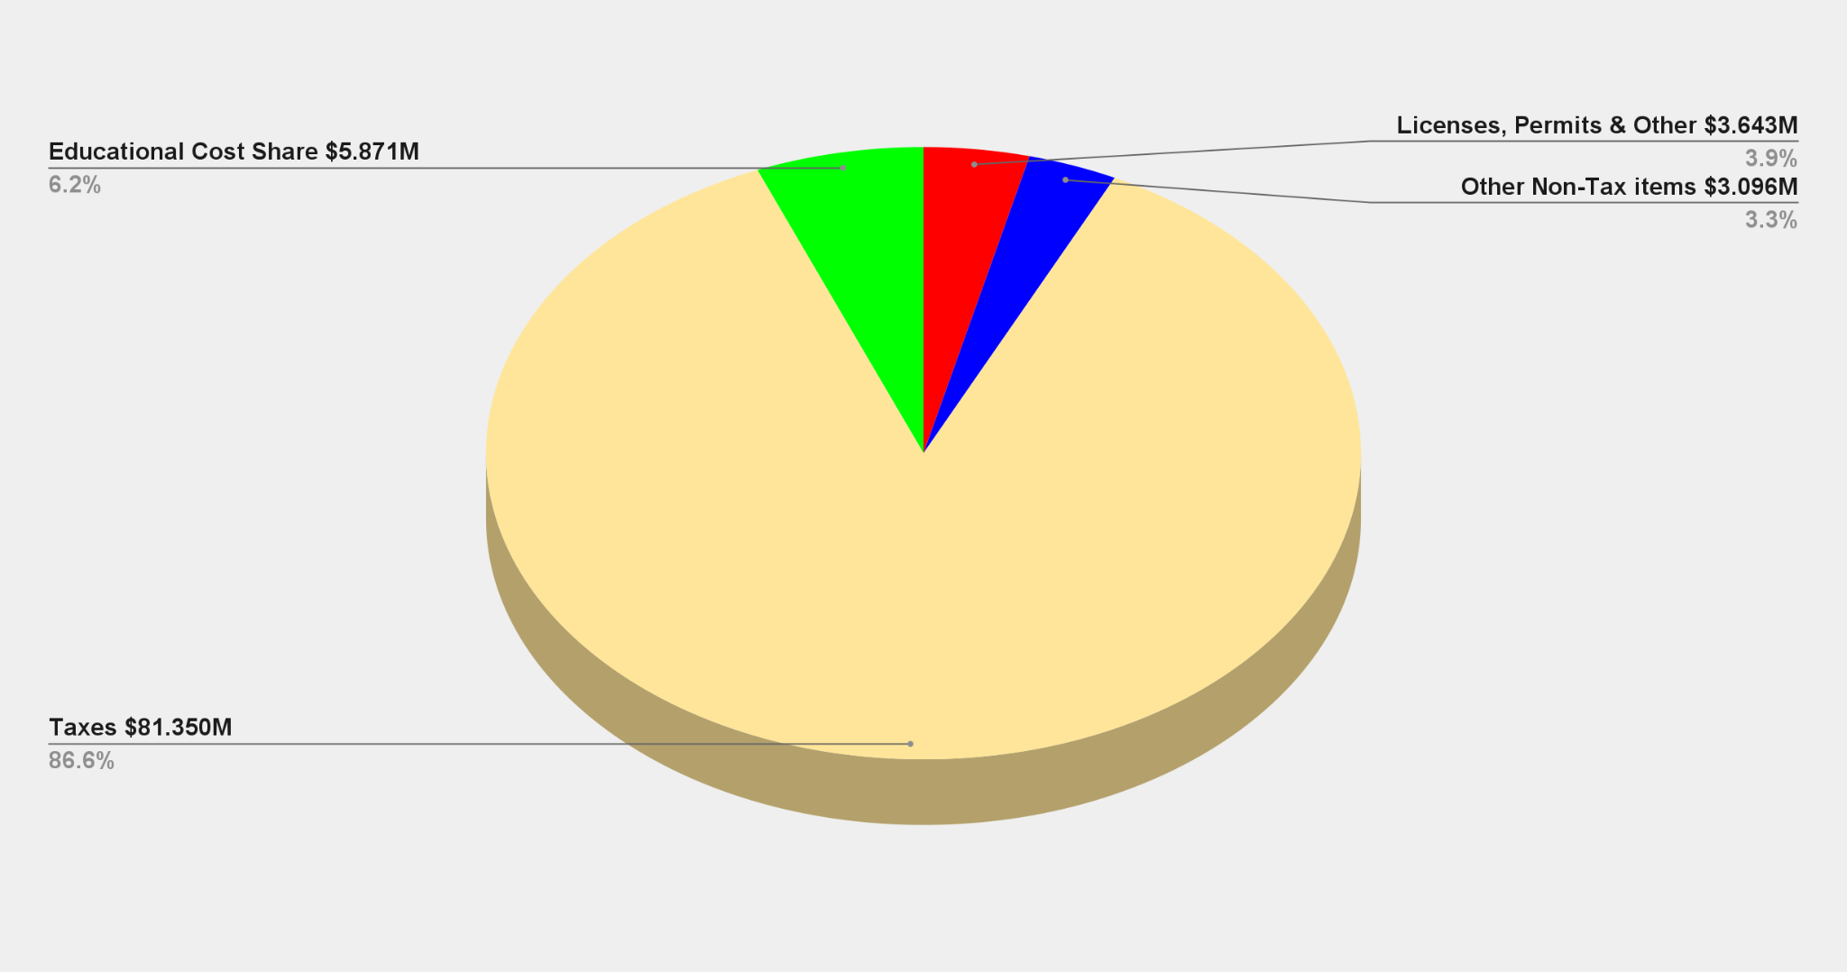
All Town Revenue Sources
Data from the FY 2021-22 Town General Fund Budget, Adopted at Referendum 4/27/2021

Slide 32
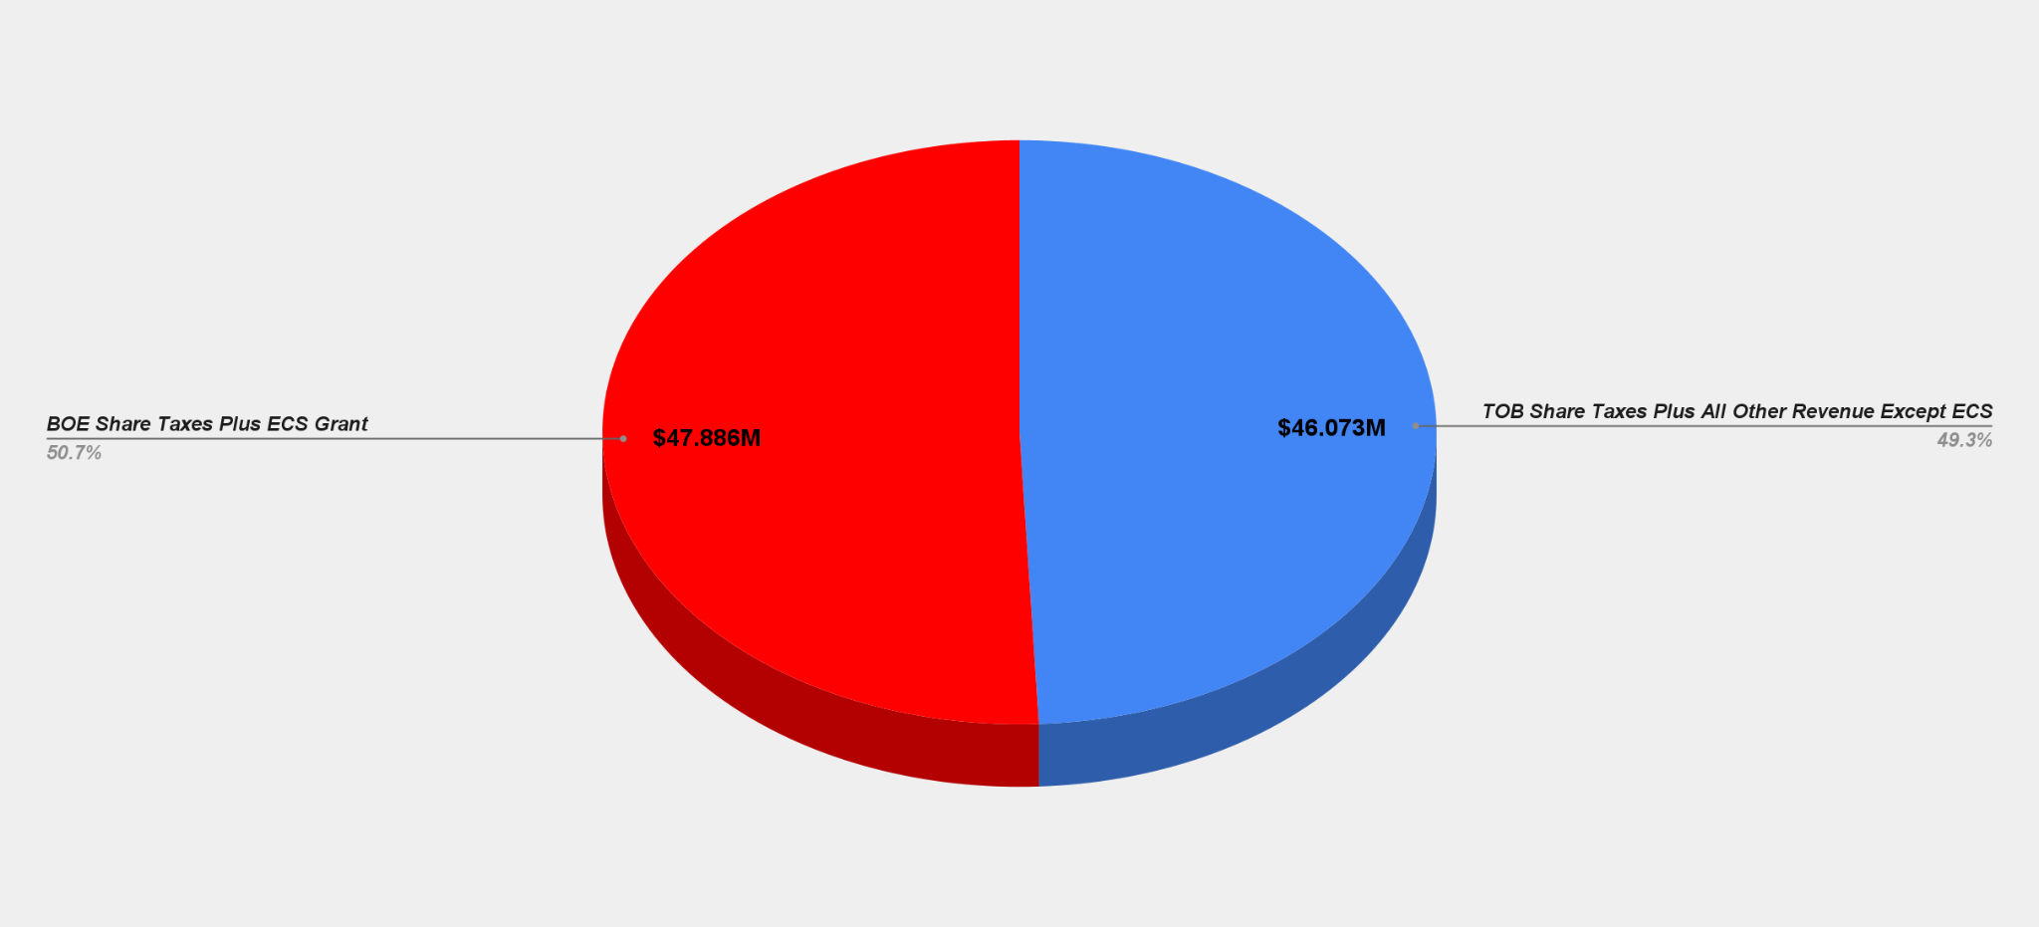
Share of Revenue Sources
Data from the FY 2021-22 Town General Fund Budget, Adopted at Referendum 4/27/2021

Slide 33
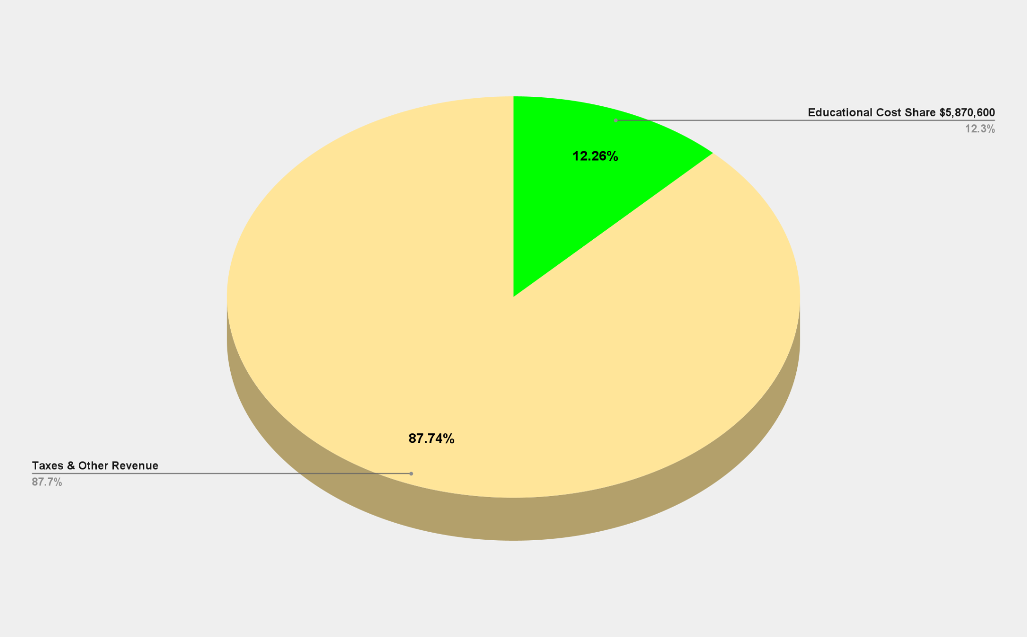
BOE Operational Funding Sources
Data from the FY 2021-22 Town General Fund Budget, Adopted at Referendum 4/27/2021

Slide 34
3-Year History of Non-Lapsing Deposits
Project Description | FY 2018-2019 | FY 2019-2020 | FY 2020-2021
Blast Classroom at McGee | $200,000.00
Refinish Gym Floors | $117,775.00
Paint McGee Gym | $37,225.00
Security Equipment | $25,000.00
 | $380,000.00
Hubbard Fire Alarms |  | $150,000.00
McGee Rooftop HVAC Unit |  | $225,000.00
 |  | $375,000.00
McGee LMC Lighting Upgrade |  |  | $150,000.00
Paving of Willard Playground |  |  | $150,000.00
Hubbard Classroom Storage |  |  | $50,000.00
McGee Removal of Retaining Wall and Paving |  |  | $25,000.00
Additional Funding for McGee Rooftop HVAC Unit |  |  | $25,000.00
 |  |  | $400,000.00
Total 3-Year History for Non-Lapsing Deposit for Unfunded Capital Projects |  |  | $1,155,000.00
In fiscal years 2020 and 2021 the District was significantly impacted by the COVID-19 pandemic and substantial savings were realized. In both fiscal years, the District returned $400,000 to the Town.

Slide 35
3-Year History of End of Year Purchases
Purchase Description | FY 2018-2019 | FY 2019-2020 | FY 2020-2021
McGee Camera & Video Management System | $127,730.00
Willard / Hubbard Camera & Video Management System | $198,680.00
Chromebooks | $107,250.00
 | $433,660.00
Staff Laptops |  | $289,100.00
iPads (200) |  | $81,590.00
MacBooks |  | $10,415.00
Adaptors |  | $15,000.00
Vans |  | $117,000.00
Facility Plan Updates |  | $31,500.00
Equipment for McGee Gym Painting Equipment |  | $26,675.00
 |  | $571,280.00
Boardroom Remodel & Furniture |  |  | $43,988.00
New Building Signs (Districtwide) |  |  | $38,000.00
Cafeteria Equipment (Districtwide) |  |  | $20,350.00
Bleacher Repairs & Gym Floor Resurfacing and Equipment (Districtwide) |  |  | $26,693.00
BHS Camera Storage |  |  | $12,589.00
SonicWall Security |  |  | $20,750.00
iMacs for Art Departments |  |  | $37,856.00
iPads & Apple TVs (Districtwide) |  |  | $49,037.00
Exterior Door Repairs (Hubbard & McGee) |  |  | $27,962.00
 |  |  | $277,225.00
Total 3-Year End of Year Purchase History |  |  | $1,282,165.00

Slide 36
Budget Executive Summary |  |  |  |  |  | $50,122,596.00
Object Summary |  | FY 20-21 Budget | FY 20-21 Actual | FY 21-22 Budget as of 12/1/2021 | FY 22-23 Superintendent's Proposed | Dollar Difference | Percentage Difference
10 | Administrative Salaries | $2,737,080.00 | $2,772,037.00 | $2,855,887.00 | $2,974,826.00 | $118,939.00 | 4.16%
11 | Certified Salaries | $20,900,470.00 | $20,997,178.00 | $21,545,983.00 | $22,521,627.00 | $975,644.00 | 4.53%
12 | Non Certified Salaries | $7,472,905.00 | $7,085,852.00 | $7,646,170.00 | $7,960,043.00 | $313,873.00 | 4.10%
20 | Employee Benefits | $6,462,707.00 | $6,430,651.00 | $6,780,970.00 | $7,156,529.00 | $375,559.00 | 5.54%
30 | Contracted Services | $1,778,688.00 | $1,848,494.00 | $1,862,459.00 | $2,034,382.00 | $171,923.00 | 9.23%
40 | Utilities | $406,303.00 | $330,009.00 | $406,303.00 | $418,370.00 | $12,067.00 | 2.97%
51 | Transportation | $3,212,078.00 | $2,460,948.00 | $3,251,277.00 | $3,332,355.00 | $81,078.00 | 2.49%
56 | Tuition | $2,155,787.00 | $1,948,765.00 | $2,270,715.00 | $2,380,288.00 | $109,573.00 | 4.83%
60 | Supplies, Textbooks, & Materials | $1,074,100.00 | $1,112,560.00 | $973,450.00 | $1,025,707.00 | $52,257.00 | 5.37%
70 | Equipment | $154,200.00 | $535,863.00 | $176,979.00 | $226,205.00 | $49,226.00 | 27.81%
80 | All Other Expenditures | $62,186.00 | $485,535.00 | $115,439.00 | $92,264.00 | -$23,175.00 | -20.08%
Totals |  | $46,416,504.00 | $46,007,892.00 | $47,885,632.00 | $50,122,596.00 | $2,236,964.00 | 4.67%

Slide 37
2022-2023 Superintendent’s Proposed Budget Overview
Administrative Salaries
Certified Salaries
Non-Certified Salaries
Employee Benefits

Slide 38
A school district's budget reflects the commitment of the community to invest in the future of our children.
The erosion of funding for education challenges the sustainability of Berlin as a competitive school district with rich educational and extracurricular opportunities for our students.

Slide 39
Questions

Slide 40
Revenue
Notes:
Overall: 10 minutes
Revenue: 15 minutes
LT Liabilities/Capital: 30 minutes
Transfers: 5 minutes
BOE: 30 minutes
GG: 30 minutes

Slide 41
Revenue
Local taxes largest funding source - collection rate remains at 99.3%
User fees increase:
  VNA +$100k
  Town Clerk +$95k
Funds FY22 one-time sources:
  BHS project tfr $1.2 million
  ARPA grant $700k
Fund balance only used to fund Pension admin. & contingency

Slide 42
Unassigned Fund Balance Projection
Potential future demands on fund balance: fire vehicles, school air quality, school vans, Griswold portables, Timberlin clubhouse and/or maintenance building, and backstop: Berlin Water Control, insurance funds and special education costs
Notes:
Assigning more fund balance than proposed will negatively impact:
Interest earnings
Pension liability coverage
Capital project funding (where the Town “fronts” the money)

Slide 43
$2.25 million projected surplus major drivers
Driver | Projected Surplus Amount | Notes
Tax revenue: tax sale pmts.: $450k suppl. MV: $350k prior yr. pmts.: $200k fav. court settlements: $200k | $1.2 million | One-time revenue COVID catch-up No court in FY23 budget
Town Clerk fees | $225k | Incr. in FY23 budget
Building inspection receipts | $150k
VNA receipts | ($130k) | FY22 staff challenges Incr. $230k in FY23 budget
Unanticipated position vacancies: Police: $100k VNA Director: $60k Physical Therapist: $55k | $300k | (net of vac payouts) WC process chg. in FY23 Removed from FY23 budget Tied to FY23 bud rev increase
Contractual services (schools & town) | $165k
Electricity (schools & town) | $140k
Fringes from unanticipated position vacancies: | $120k | $45k DC pension forfeit
Board of Education | $0 | Assumes budget expended or 2% request for deferred capital

Slide 44
QUESTIONS?

Slide 45
Long-term Liabilities
Notes:
Overall: 10 minutes
Revenue: 15 minutes
LT Liabilities/Capital: 30 minutes
Transfers: 5 minutes
BOE: 30 minutes
GG: 30 minutes

Slide 46
Long-Term Liabilities
Items in this category:
  Notes
  Bonds
  Capital Leases
  Unfunded Pension Costs
$217k year-over-year decline in debt service costs
$8.6 million or 8.7% of total budget:
  Down 0.7pp (from 9.4% in FY 22 adopted budget)
  Goal is 4% or less of total budget
  Significant pension payments ($5.3 million) in FY22 relieved pressure on FY23 budget, but reduced unassigned fund balance
Debt Service Costs

Slide 47
Long-Term Liabilities - Debt
Propose no bonding in June 2022 - prepare for future bonding…
Elementary schools HVAC project: $10+ million (3 schools but 1 funded with ARPA grant)
Fire vehicle: $900k
Swimming pools/pool buildings: $500k-$1 million+
New Police station/Renovate existing Police station: $5 million+
New senior/community center: $40 million?
New clubhouse at Timberlin: $2 million+
New portable classrooms at Griswold: TBD

Slide 48
After FY26, start retiring debt issues
First Drop
Second Drop
Third Drop
Fourth Drop

Slide 49
Long-term Liabilities – Closed DB Pension Plan
FY23 ADC was funded with July-Sep 2021 payouts…only administration and annuity payments are in this proposed budget
  6/30/2021 funding level 19%
  Census (1/1/2022):
    Active workers: 5
    Inactive, Retirees and Beneficiaries: 15
  Actuarially Determined Contribution (ADC): $2,664,914
    $100k normal cost
    $2,565k past service cost
  Fully funded ADC for both years in July/September 2022 to cover retirements
    2022 ADC: $2,395,640
    2023 ADC: $2,664,914
Notes:
Reference pension valuation from actuaries

Slide 50
QUESTIONS?

Slide 51
Capital
Notes:
Overall: 10 minutes
Revenue: 15 minutes
LT Liabilities/Capital: 30 minutes
Transfers: 5 minutes
BOE: 30 minutes
GG: 30 minutes

Slide 52
Capital Overview
Berlin has considerable assets that require maintenance and periodic replacement.
      37 bridges (5 replaced since 2012 & 8 more being rehabilitated or replaced)
      110 miles of roads (5 mile/year repair/replacement strategy)
      5 schools
      Town Hall
      Community Center/Library
      Senior Center
      Golf Course
      Animal Control
      Physical Services Complex (including recycling, salt building and garage)
      14 Police patrols
      13 Fire apparatus
      117,715 item library collection
      2,280 parks acreage
      2,559 streetlights
      2 swimming pools & 2 pool buildings
      11 playgrounds
      15 baseball/softball fields
      11 soccer/football fields
Notes:
Bridges are higher than most surrounding towns (Cheshire in the only neighboring town that is close)

Slide 53
Capital Overview
Capital Budget:
  Departments Requested = $4.4 million
  Proposing = $1,132,859 (0.3% of major capital assets)
Focus:
  Public Safety:
    Fire alarm upgrade – Willard
    School vans
  Technology – deferred upgrades & maintenance (Town & PD)
  Senior Center van (20% town-funded;80% federal-funded)
  Recreation/Safety:
    Demore, Dinda, Bittner Jr Memorial pool relining
    Year 1 of Timberlin cart bridge replacement (2 bridges)
  Infrastructure:
    Hubbard School Playground repaving
    New carpeting at Berlin-Peck Memorial Library – replace original
  Golf Course – replace old, critical maintenance equipment

Slide 54
Total Proposed FY23 Capital Plan

Slide 55
QUESTIONS?

Slide 56
Transfers
Notes:
Overall: 10 minutes
Revenue: 15 minutes
LT Liabilities/Capital: 30 minutes
Transfers: 5 minutes
BOE: 30 minutes
GG: 30 minutes

Slide 57
Transfers
No Change from FY22 Adopted Budget
  Pension, Health Insurance Administration: $65,000
  Business Continuity: $50,000
  Revaluation Fund: $72,500 – funds Oct 2022 revaluation
  Energy lease payments (debt service): $719,500
Increase from FY22 Adopted Budget
  Plan of Conservation & Development: $35,120
    +$10,120 to FY22 budget
    Necessary to fund contract for 2023 POCD

Slide 58
QUESTIONS?

Slide 59
General Government
(including Berlin Water Control)
Notes:
Overall: 10 minutes
Revenue: 15 minutes
LT Liabilities/Capital: 30 minutes
Transfers: 5 minutes
BOE: 30 minutes
GG: 30 minutes

Slide 60
Funding General Government Operations and
Shared Costs with BOE
Notes:
High percentage is people cost with two notable exceptions:
General government: liability insurance, postage, advertising, legal, probate court, auditing, pension, software (town clerk, financial, tax, assessment)
Physical Services: refuse disposal, vehicle fuel & parts, natural gas, streetlighting, snow & ice materials, catch basin cleaning, electricity, telephones

Slide 61
General Government operating cost drivers…
Employee-related costs: +$1,875k
  New position wages: +$706k
    7 new full-time:
      HR Director (partially offset by elimination of shared cost)
      Assistant Planner
      Facilities Superintendent (approved during FY22)
      2 Police Officers
      1 Dispatcher
      1 Floating School Nurse (needed for coverage)
    7 part-time:
      5 at Timberlin (fully funded by course fees & elimination of 1 FT position)
      2 Public Grounds (hire part-time to avoid benefits)
    1 custodian wage adjustment to remain market competitive
  Existing wages net increase: +$472k (2.7%)
  Health insurance: +$354k
    9.3% increase in budget
    Anthem renewal rates (received Feb 2022) = 13.5% increase
    Existing: +$139k
    New: +$215k
  Other fringes: +$343k
    New positions: +$126k
    Existing: +$217k

Slide 62
General Government operating cost drivers
Operations: +$814k
  Insurance (cyber & LAP): +$200k
  Vehicle fuel: +$158k
  Computer support: +$80k (+$50k for cyber insurance compliance)
  Refuse disposal: +$78k (inflation)
  Legal: +$75k (Atkins St. lawsuit, Affordable Housing Plan, Police DB Plan)
  Equipment: +$36k
    PD: +$13k to replace 8-yr old license plate reader w/ no hardware coverage
    PD: $16k crash / crime scene mapping equipment that will be paid one time by each municipality that participates in MSARS
  School Security Guards: +$30k
  Other individually small items: +$157k (copiers, playing field improvements, operating materials, irrigation, professional development, equipment testing, etc.)

Slide 63
VNA
FY22 Budget included in the elimination of 2.5 FTEs to offset the projected revenue decline (COVID) and better align FTEs with the census
FY22 Projected includes:
  Consolidating the Director and Nursing Supervisor positions
  Reduced revenue due to staff turnover
FY23 Proposed assumes:
  Start of revenue recovery
  Staffing stability
  Continued cost containment
Key Management Metrics:
50+ Medicare/Medicare advantage patients (in addition to CCCI patients)
Maintain Medicare scores to avoid penalties
Staffing stability:
  3 nurses required to take referrals
  3 health aides to support long-standing Berlin patients
  3 clerical for intake/outtake; billing/coding & administration

Slide 64
QUESTIONS?

Slide 65
Berlin Water Control – Enterprise Fund
Combined operating budget change: +$121k (+2.1%)
  Water: +$118k
  Sewer: +$3k
Capital needs:
  Deming Road Pump Station
    Complete replacement
    Est. $3.2 million (approx. 70% of cost borne by MDC)
  Berlin Turnpike (future development connection)
    Replace/enlarge pipe
    Est. $2.0 million
    Pursuing debt financing
  East Berlin water line updates

Slide 66
QUESTIONS?

