Slide 1


Board of Finance Proposed Budget
Fiscal Year 2022
March 30, 2021
This presentation is available under Finance/Budget on the Town website:
https://www.town.berlin.ct.us/topic/index.php?topicid=324&structureid=16
The Annual Report is under the Town Manager’s Dept. on the Town website:
https://www.town.berlin.ct.us/department/index.php?structureid=27

Slide 2
Agenda
Overall Budget
Revenue Budget
General Government Budget
Board of Education Budget
Citizen Feedback

Slide 3
$93,959,047 Total Budget
33.93 mill rate (flat to FY21)
Target = 3%
Ceiling = 6%
Board of Education
$47,885,632
+$1,469,128
+3.2%
General Government
$46,073,415
+$1,013,997
+2.3%
Total General Fund Budget
$93,959,047
+$2,483,125
+2.7%

Slide 4
Bifurcated Vote…
What Does Each Vote Include?
BOARD OF EDUCATION
Electricity
Liability Insurance
Worker’s Comp. Insurance
Facilities Maintenance
Grounds Maintenance
SHARED SERVICES
Nurses
Crossing Guards
School Security Guards
School Resource Officers
Debt Service
Capital
Financial Audit
GENERAL GOVERNMENT
$47.9MM
$9.3MM
$36.8MM
Total General Government

Slide 5
Board of Finance Budget Actions
Expenditure Changes
Receipt Changes
Assigned Savings for DB Pension ($2,210,640)
Increase State & Federal Grants $ 700,000
Transfer from BHS Project Fund $1,200,000
($ 310,640)
Notes:
- $648k reduction to BOE (including health insurance)
- $3.4M reduction to General Government – mostly through capital

Slide 6
Budget Drivers
Receipts:
  Grand list
  Property taxes
  Balance in BHS project
  State & Federal grants
Expenditures:
  Operating Costs – BOE & Gen Gov’t
  Capital Investments
  Servicing Liabilities (debt, leases, DB pension)

Slide 7
The Grand List
A Measure of the Local Economy
The Grand List for the proposed budget is
$2.37 billion (+1.4% vs FY21)
This growth generates $1.1 million in additional tax revenue.

Slide 8
Revenue Drivers
Local taxes drive over 86% of total revenue
99.3% tax collection rate
$1.2 million “transfers in” from BHS Project
$0.7 million from Federal grants
Same Education Cost Sharing grant funding as in FY21
Fees & Other Sources:
  Building Permits & Golf Course UP
  Interest & VNA DOWN

Slide 9
Where do your tax dollars go?
Notes:
Town Council priorities – Education, Public Safety, Economic Development, Social & Recreational Services
Recognition of economic challenges for individuals & businesses – 2nd year in a row with 0 mill rate increase – same mill rate in FY22 as in FY20

Slide 10
General Government

Slide 11
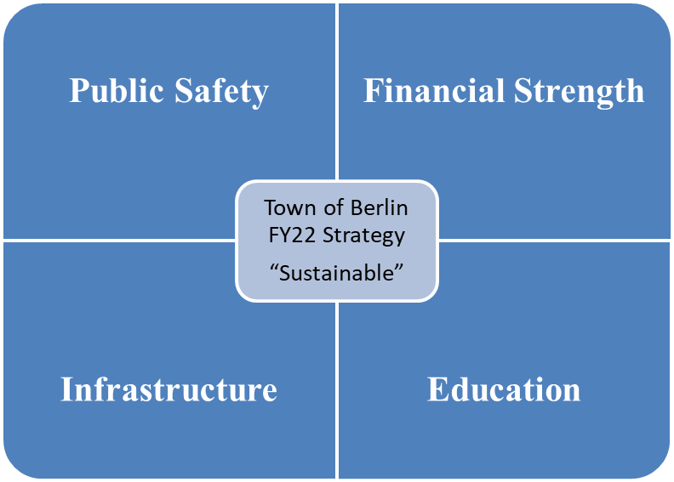
General Government Strategy
  Continue to provide services residents expect, grow the local economy and closely manage the Town’s liabilities.

Slide 12
General Gov’t Budget Priorities
AREAS OF “NEW” INVESTMENT IN FY 2022
Infrastructure
HVAC Updates
Athletic Fields
Roads
Bridges
Education
Fire Alarms
Vans
ADA Upgrades
Economic Dev.
Farm. Ave./
Main St./
Berlin Turnpike
Development
ON-GOING OPERATIONS
Legal, Contractual and Regulatory Compliance & Safe/Quality Community Features
LEGALLY REQUIRED LONG-TERM OBLIGATIONS
Bonds, Leases, Closed Defined Benefit Plan
Notes:
Roads: LOTCIP road project (Porters Pass, Christian Lane & Deming Rd); remaining local roads depend on final town contribution to LOTCIP project
Bridges: Kensington Rd, Glen Street, 4-Bridge (complete Heritage Drive and start last bridge), S-T work on Spruce (using reimbursement from 4-bridge to fund Spruce replacement)

Slide 13
Drivers of Gen Gov’t $1.3 million increase
(FY21 vs. FY22)
Contingency: +$200k (assigning fund balance – no tax impact)
Employee-related costs: +$447k (1.2%)
  Health insurance: +$194k (6.8% YOY increase)
  New position wages: +$139k
    1 full-time, temporary & 5 part-time
    Focus on Community Development & Social/Recreational efforts
    $71k of the increase completely offset by increased Building revenue
  Existing wages net increase: +$114k
    0.67% YOY increase
    Defunded 3 full-time & 1 part-time
Electricity (schools & town facilities): +$78k
Refuse Disposal: +$54k
Other costs increasing $10k - $50k each: +$387k
  Legal, Tax refunds, operating materials, irrigation at Timberlin, Economic Development promotion, computer equipment and school security guards

Slide 14
General Fund Capital Investments
$370K
(0.4% of proposed budget)
  $150k Fire Alarm @ Willard (Schools)
  $110k Vans (Schools)
  $ 60k Mobile Data Terminals (Public Safety)
  $ 50k ADA Improvements (Schools)

Slide 15
Projected 6/30/2021 Liability Balance
General Obligation Bonds (P&I) $70.6 million
Capital Leases (P&I) $11.0 million
Net Pension Liability (NPL) $ 8.0 million
TOTAL $89.6 million
(95% of Proposed Budget)
No 2021 bonding in budget – lowers debt $8.9 million
Notes:
Starting showing this slide in FY18 presentation – down $25.4 million in less than 5 years
6/30/2017 balance : $115 million ($106.1 debt + $8.9 million NPL)

Slide 16
Other Liabilities – DB Pension Plan
  At 6/30/2020, Berlin was 28.03% funded
  60% is minimum funding level of healthy plan(Moody’s)

Slide 17
In Summary
Education
+
Community Services
+
Public Safety
+
Infrastructure
+
Servicing Liabilities
=
33.93 Mill Rate

Slide 18
Berlin Water Control – Enterprise Fund
Combined operating budget change: -$12k (-0.2%)
  Water: -$23k
  Sewer: +$11k
Capital needs:
  Deming Road Pump Station
    Complete replacement
    Est. $2.5 million (60% is MDC cost)
  Berlin Turnpike (future development connection)
    Replace/enlarge pipe
    Est. $2.0 million
  East Berlin water line updates

Slide 19
Next Steps
Action to be taken… | Timing & Location…
Board of Finance votes to recommend Board of Education & General Government budgets to the Town Council. | Immediately following Annual Budget Hearing
Town Council acts on the recommended budget; either: - Approve the BOF recommended budget “as is” - Approve the BOF recommended budget “with reductions” - Reject the BOF recommended budget | April 6th Town Council Chambers Budget sent to referendum Budget sent to referendum Special joint meeting between Council & BOF immediately after the Council vote
Budget Referendum | April 27th

Slide 20

Board of Education Budget
2021-2022
March 30, 2021

Slide 21

Superintendent’s Goals for 2021-2022
Continue to provide quality education to all students at the standard that Berlin parents expect.
Maintain favorable class size and adequate course offerings
Provide all students with an education that prepares them for multiple options and opportunities upon graduation.
Ensure that appropriate courses, structures and staff are available for new graduation requirements.
Provide adequate safety measures (COVID requirements), equipment and systems that allow all students and staff a safe learning environment.
Expand the Berlin Transition Academy in partnership with Cromwell Public Schools.

Slide 22
Board of Education Goals
Effectively communicate the level of funding necessary to continue to provide a quality education that the students, parents, and community expect
Transparency
Fiscal Responsibility

Slide 23
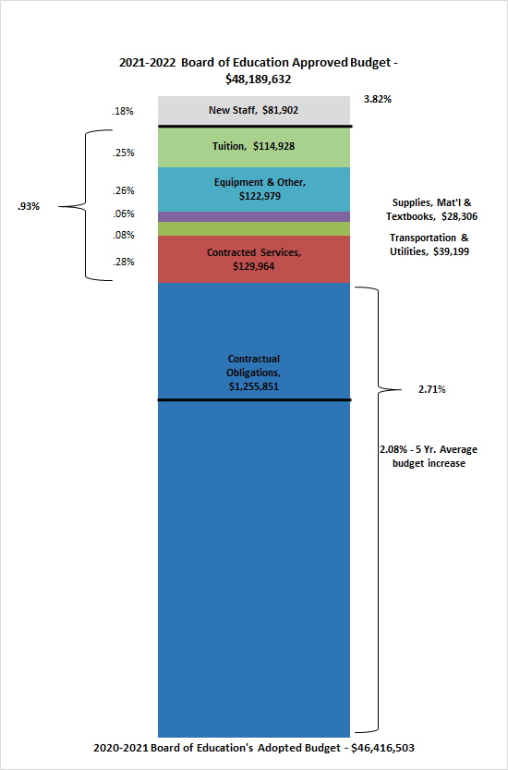
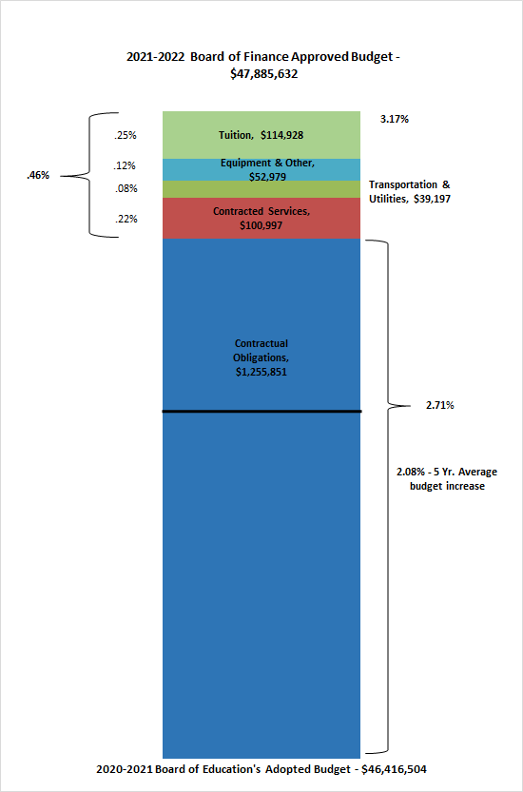
BOE Approved Budget
BOF Approved Budget
Administrative Salaries
Certified Salaries
Non-Certified Salaries
Employee Benefits
Administrative Salaries
Certified Salaries
Non-Certified Salaries
Employee Benefits

Slide 24
2021-2022
Board of Finance
Approved
Budget
Reductions to BOE approved budget of 3.82% to 3.17%
Category | Amount | Description
12 | $81,903.00 | Non-Certified Salaries- New Staff Request
30 | $28,967.00 | Contracted services- Zoom License
60 | $123,130.00 | Supplies
70 | $50,000.00 | Technology Equipment
80 | $20,000.00 | Capital Improvements
Administrative Salaries
Certified Salaries
Non-Certified Salaries
Employee Benefits

Slide 25
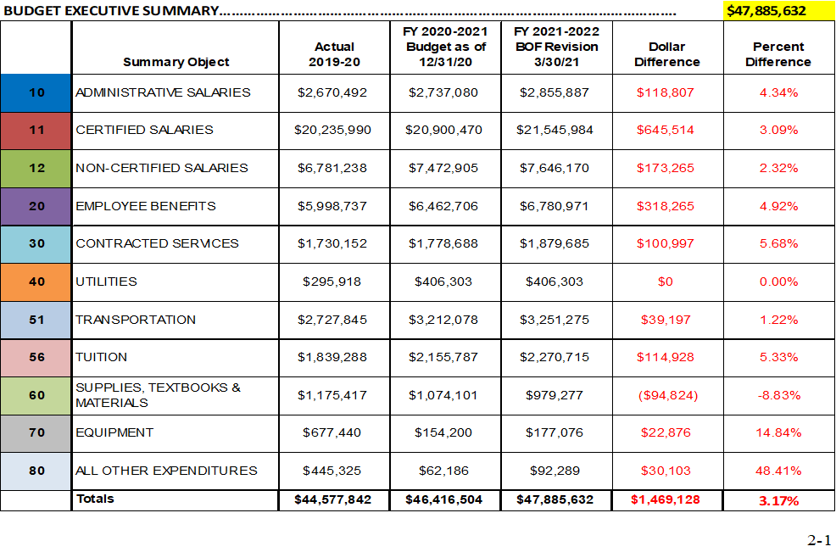

Slide 26
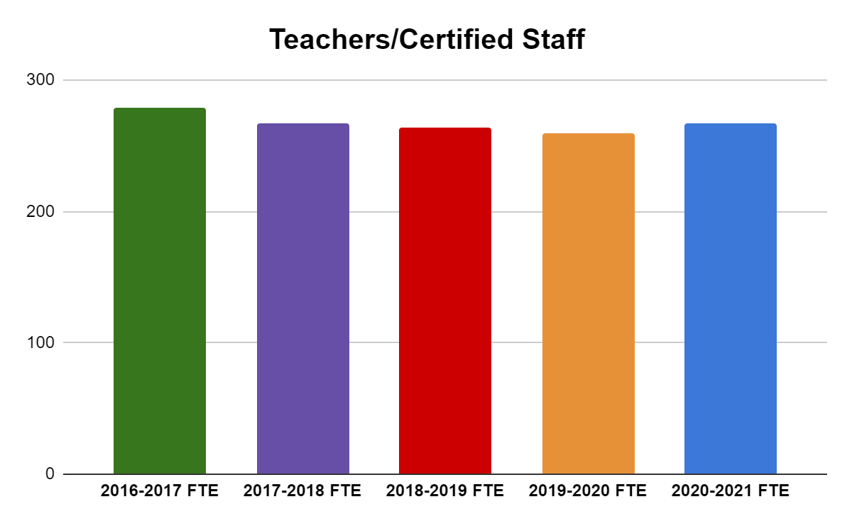
5 Year FTE Comparisons
Teachers/Certified Staff
Employee Type | 2016-2017 FTE | 2017-2018 FTE | 2018-2019 FTE | 2019-2020 FTE | 2020-2021 FTE
Teachers/Certified Staff | 279.32 | 267 | 264 | 259.4 | 266.7

Slide 27
2021-2022 New Staff Requests Summary
21.5 Total Requests for New Staff
16.6 Requests Not Funded
4.9 Funded through Open Choice Grant
    BTA: Program Coordinator (0.5)
    Griswold: Math Intervention Teacher (.7)
    Willard: Math Intervention Teacher (.7)
    Special Education: Paraprofessional (3.0)

Slide 28
Contracted Services - $100,997
Includes all operational and educational systems which increase annually.
  The annual increase can range from 3%-5%
Software and licensing
  Zoom Licenses $30,133
Nursing Services
  $60,000 for two students that require nursing services within their IEP.

Slide 29
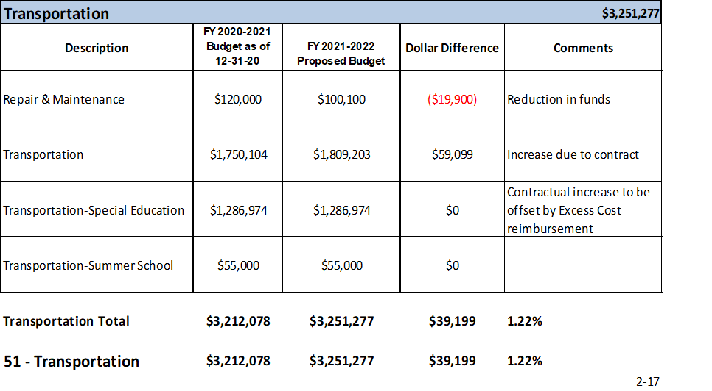
Transportation - $39,199
3% increase in based on Contract with New Britain Transportation
1.22% budgeted, $39,199
  Use of Special Education Excess Cost Grant funds
  Reduction in repairs and maintenance

Slide 30
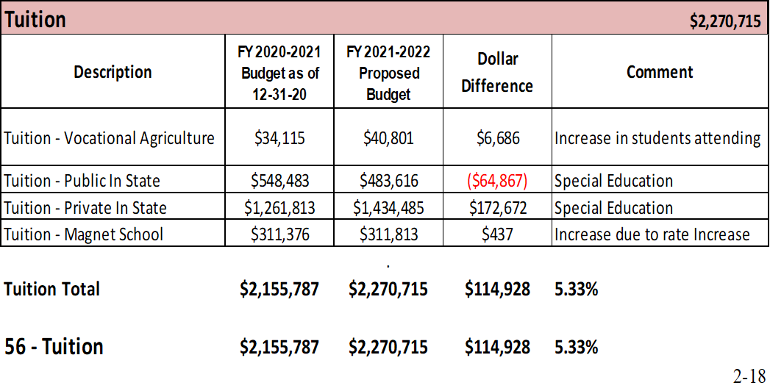
Tuition - $114,928
Magnet School rate increase - 4%
Private & public annual rate increases - 3%
Additional outplacement - $80,000

Slide 31
All Other Expenditures
2020-2021 Requested: $62,186.00
  We have exceeded this amount significantly this year
2021-2022 Requests: $122,289.00, 80.57% increase
Original requests over $1,000,000 reduced to $30,103 Capital Improvement not accepted in the Capital Plan
$949,897 in unfilled requests at all schools, all levels
  Routine Painting District wide
  Restoration of Recess Area
  Window Repairs

Slide 32
ESSER Grant/CRF Grant
ESSER I: $134,641
ESSER II: $641,868
CRF: $285,005
Next Steps:
Board of Education members review materials
Finance & Operations Committee for Discussion/Agenda Item
Board of Education Discussion/Agenda Item

Slide 33
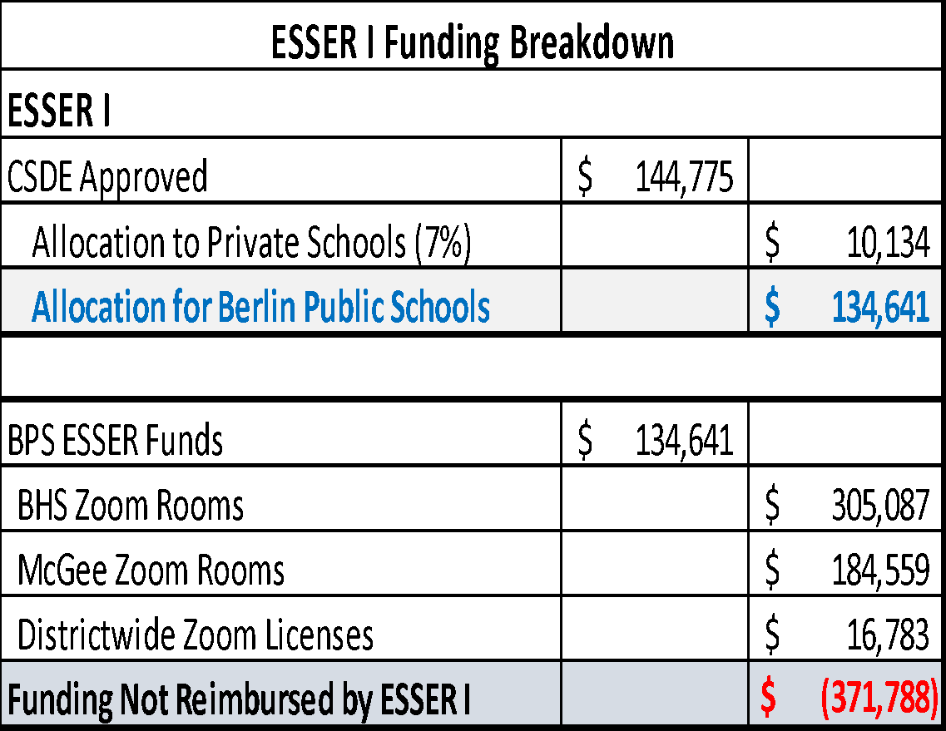
Elementary & Secondary School Emergency Relief Fund (ESSER I)
CSDE Approved $144,775
$10,134.00 reimbursed to Saint Paul School
$134,641 reimbursed to Berlin Public Schools for the initial purchase of Zoom Rooms & Licenses for secondary level
Actual Cost of initial Zoom purchases $506,429

Slide 34
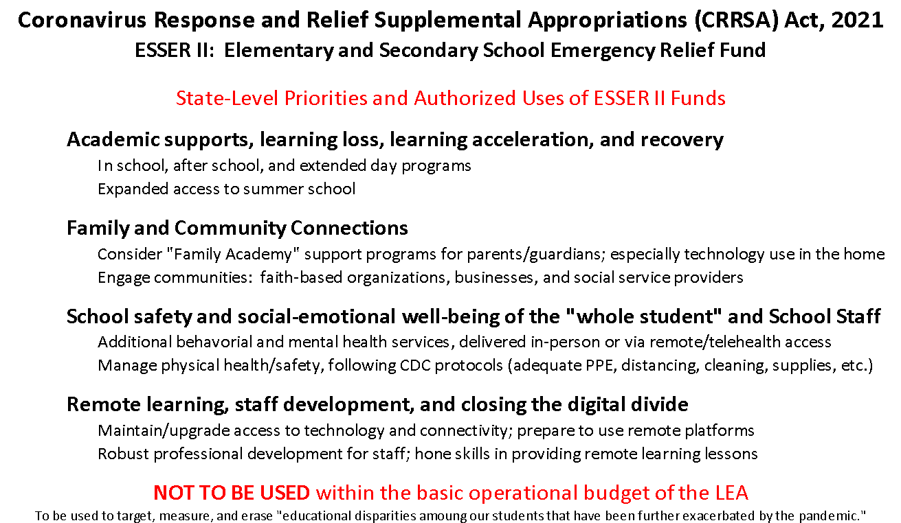

Slide 35
Elementary & Secondary School Emergency Relief Fund (ESSER II)
Authorized Uses for ESSER II Funding
Anticipated Funds$641,868
Address Learning Loss
Provide Mental Health Services
Purchase Educational Technology
Training & Professional Development
Summer Learning Programs
School Facilities Improvements & Repairs (HVAC)
Not intended to supplant local funding

Slide 36
Hartford Open Choice Enrollment
 | 2016-2017 | 2017-2018 | 2018-2019 | 2019-2020 | 2020-2021 | Projected 2021-2022
Choice Students | 96 | 92 | 131 | 116 | 121 | 120
Total Enrollment | 2792 | 2781 | 2787 | 2735 | 2688 | 2564
% Choice Students | 3.44% | 3.31% | 4.70% | 4.24% | 4.50% | 4.37%
2020-2021 school year we accepted 16 new seats for Choice students.
  9 Kindergarten Students
  4 First Grade Students
  2 Third Grade and 1 Eighth Grade – all siblings of students in district
Every effort is being made to accept students at the Kindergarten level with a conscious awareness of maintaining at least 4% Choice Enrollment
  Choice Funds are tied to additional staff and programs

Slide 37
Hartford Open Choice Budget Potential Alternatives
Option #1
BTA Coordinator | $34,400
Math Intervention (.7) - Griswold | $44,647
Math Intervention (.7) - Willard | $44,647
Paraprofessional | $81,903
New Staff Requests | $205,597
Option #2
COVID Equipment | $15,000
Covid Salaries (Teachers, Paras, Custodians) | $190,567
COVID Expenditures | $205,567
Option #3
Technology: School Hardware & Infrastructure | $205,597
Option #4
Special Education: Anticipated Outplacements | $205,597

Slide 38
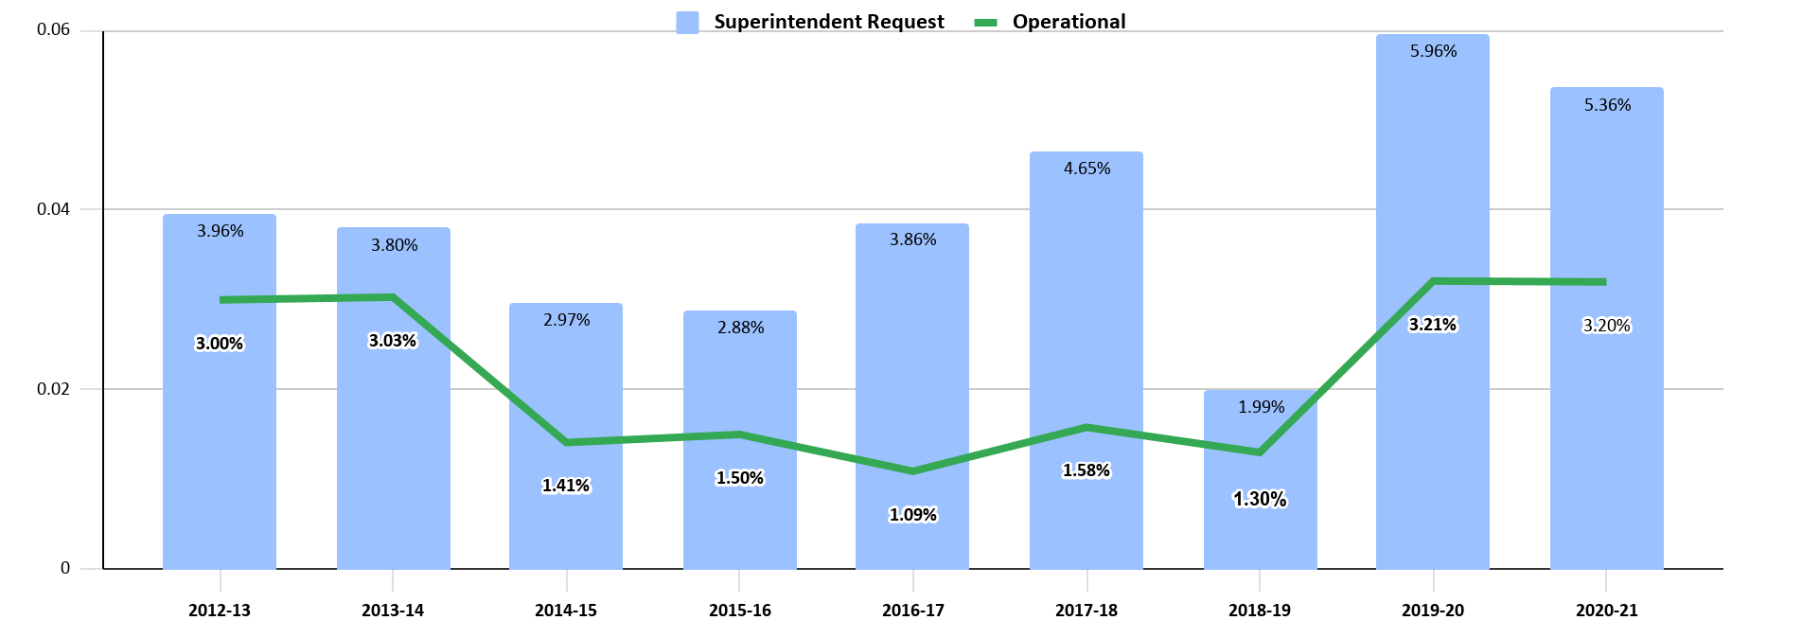
Budget Funding History

Slide 39
Berlin’s adopted budgets in the past two years have compared favorably
District | Adopted 2016-17 | Adopted 2017-18 | Adopted 2018-19 | Adopted 2019-20 | Adopted 2020-21 | 5 Yr. Average Increase
Rocky Hill | 5.76% | 2.93% | 4.54% | 2.50% | 3.84% | 3.91%
Farmington | 3.80% | 2.37% | 2.54% | 2.90% | 3.35% | 2.99%
Cromwell | 1.74% | 2.00% | 1.53% | 3.29% | 3.60% | 2.43%
Berlin | 1.09% | 1.58% | 1.30% | 3.21% | 3.20% | 2.08%
Glastonbury | 2.11% | 0.00% | 2.20% | 3.16% | 2.81% | 2.06%
Wethersfield | 0.42% | 0.75% | 2.97% | 3.50% | 2.05% | 1.94%
Newington | 0.49% | 0.29% | 3.40% | 2.70% | 2.67% | 1.91%

Slide 40
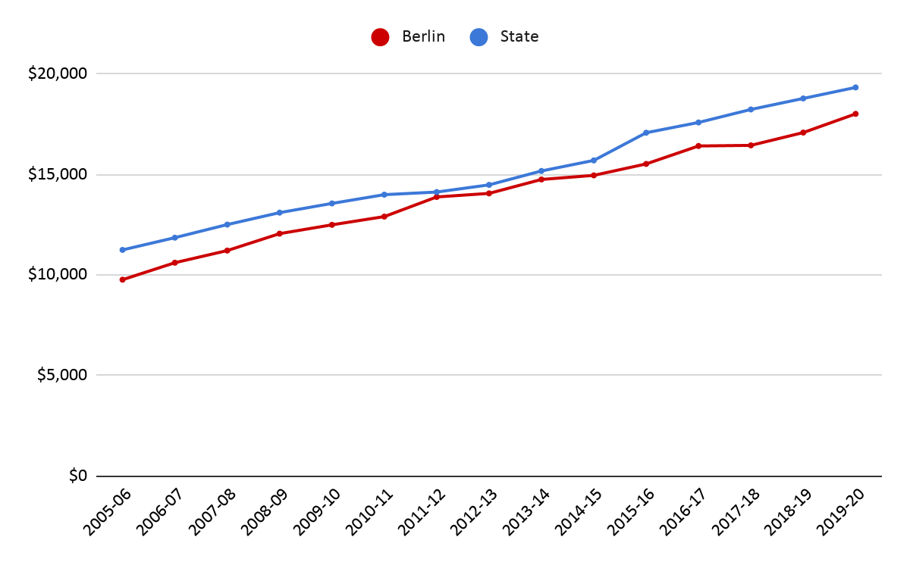
Berlin and State Per Pupil Expenditure
In 19-20 school year, state per pupil spending was $19,339, Berlin per pupil spending was $18,024 or $1,315
less than state.

Slide 41
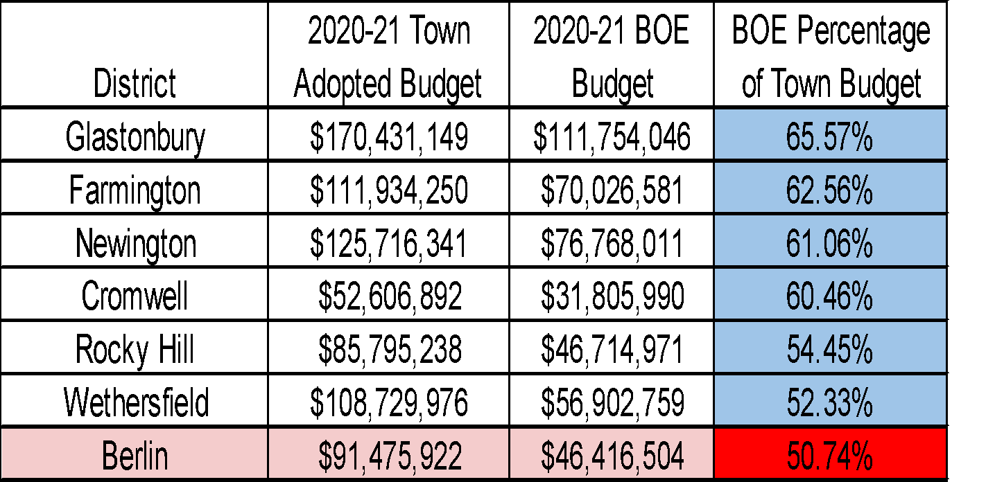
BOE % of Town Budget Compared to Surrounding Districts
Berlin has the lowest percentage: 50.74%

Slide 42
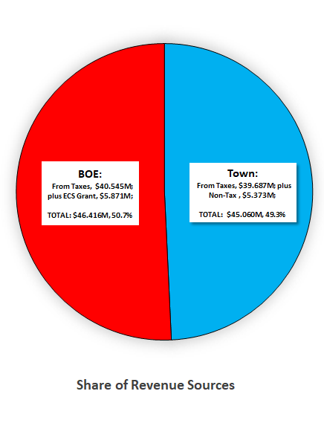
Share of Revenue Sources

Slide 43
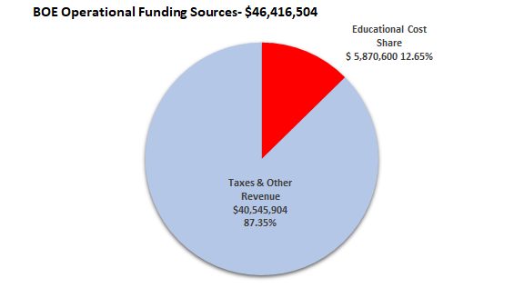
BOE Operational Funding Sources

Slide 45
Questions

