Slide 1


Town of Berlin
FY2022 Board of Finance Budget Review
March 3, 2021

Slide 2
Agenda
Overall Budget
Revenue
Long-term Liabilities
Capital
Transfers
Board of Education Operating Budget
General Government (incl BWC) Operating Budget
Notes:
Overall: 10 minutes
Revenue: 15 minutes
LT Liabilities/Capital: 30 minutes
Transfers: 5 minutes
BOE: 30 minutes
GG: 30 minutes

Slide 3
Overall Budget
Notes:
Overall: 10 minutes
Revenue: 15 minutes
LT Liabilities/Capital: 30 minutes
Transfers: 5 minutes
BOE: 30 minutes
GG: 30 minutes

Slide 4
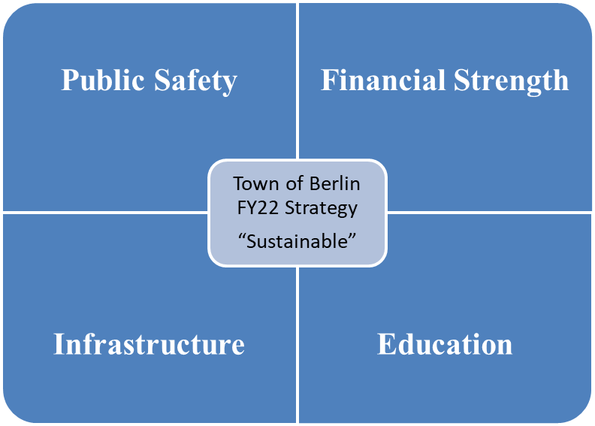
Budget Strategy
STRUCTURAL BALANCE:
Operating costs covered by recurring revenues.
Exercise fiscal restraint to keep taxes down during ongoing pandemic
Continue strengthening the balance sheet – fully fund ADC to deal with unfunded pension liability & no new money borrowing to prepare for impending large projects
Structurally balanced budget while maintaining a high-quality educational system & important town services/programs
Focus limited capital requests on Public Safety & ADA investments

Slide 5
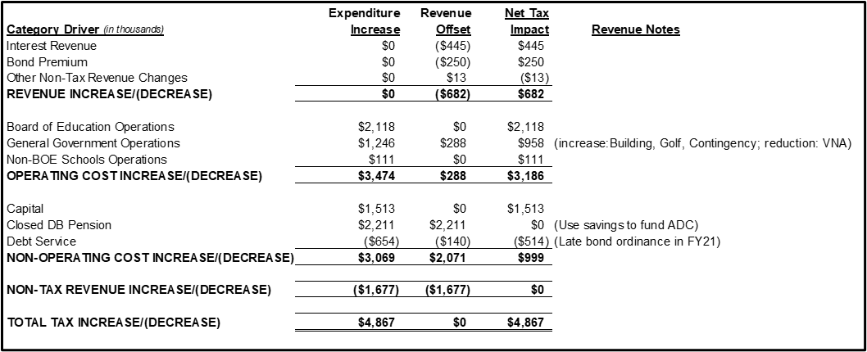
Fiscal Year 2022 Overall Budget Proposal
Total Proposal: $98.02 million (+$6.5 million or +7.2%)
Mill Rate: 35.53 mills (+1.60 mills)
State Funds: based on Governor Lamont’s budget proposal
  ECS grant flat to FY21
  Budget does not include local Teacher’s Retirement funding
Budgeted Grand List:
  +1.35% - worth $1,068,437 incremental tax revenue (@ 33.93 mill rate)
Notes:
Teacher’s Retirement charge is very likely coming in the next few years – strong balance sheet (including unassigned fund balance) will help mitigate the impact
Tried to offset proposed operating increases with revenue (for revenue generating departments) & fund balance for non-recurring items (pension & contingency)

Slide 6
Breakdown of total FY20 actual…
Notes:
SAGE PARK IS CONSIDERED GENERAL GOVERNMENT EVEN THOUGH BHS USES THE FACILITY HEAVILY FALL & SPRING…MOST OTHER TOWNS (EXCLUDING FARMINGTON) PLAY FALL & SPRING SPORTS ON CAMPUS

Slide 7
Breakdown of total FY22 budget…

Slide 8
Revenue
Notes:
Overall: 10 minutes
Revenue: 15 minutes
LT Liabilities/Capital: 30 minutes
Transfers: 5 minutes
BOE: 30 minutes
GG: 30 minutes

Slide 9
Revenue…
Local taxes largest funding source - collection rate remains at 99.3%
User fees increase:
  Golf course +$175k
  Building +$125k
  VNA -$212k
Service fees decrease:
  Investment earnings -$445k
  Bond premium -$250k
Fund balance used to fund ADC (pension) & contingency

Slide 10
Revenue…(cont.)
State funding assumptions – Governor’s proposal
  ECS: $5,870,600 (flat vs. FY21 Berlin budget) – SUBJECT TO CHANGE!
  Municipal Stabilization Grant: $258,989 (flat VS. FY21 Berlin budget) – SUBJECT TO CHANGE!
Two expenses have no mill rate impact:
  ADC pension funding is covered with assigned fund balance
  Personal property audit fee is covered with increased back tax revenue
Notes:
Meeting with the Speaker on Friday to confirm these amounts
As proposed, the revenue budget has been adjusted to eliminate taxpayer impact for the pension contribution and the tax audit fees

Slide 11
Unassigned Fund Balance Projection…
Potential future demands on fund balance: fire vehicles, school air quality short-term solutions, school vans, Timberlin clubhouse and/or maintenance building, and backstop for: Berlin Water Control, insurance funds and special education costs
Notes:
Assigning more fund balance than proposed will negatively impact:
Interest earnings
Pension liability coverage
Capital project funding (where the Town “fronts” the money)

Slide 12
QUESTIONS?

Slide 13
Long-term Liabilities
Notes:
Overall: 10 minutes
Revenue: 15 minutes
LT Liabilities/Capital: 30 minutes
Transfers: 5 minutes
BOE: 30 minutes
GG: 30 minutes

Slide 14
Long-Term Liabilities…
Items in this category:
  Notes
  Bonds
  Capital Leases
  Unfunded Pension Costs
$514k year-over-year decline in debt service costs
$11.2 million or 11.5% of total budget:
  Down 0.1pp (from 11.6%) vs. FY 21 proposed budget
  Goal is 4% or less of total budget
Debt Service Costs

Slide 15
Long-Term Liabilities - Debt
Propose no bonding in June 2021 - prepare for future bonding…
Elementary schools HVAC project: $6-$10 million (3 schools)
Fire vehicles: $2-$4 million
Swimming pools/pool buildings: $500k-$1 million+
New Police station/Renovate locker rooms at existing Police station: TBD
New senior/community center: TBD
New clubhouse at Timberlin: TBD

Slide 16
Recommend no June 2021 bond issue…finish $17.5 million of outstanding/funded projects
DEEP Athletic Improvements Grant is under development - $2.77 million in additional work that may take place in calendar 2021.

Slide 17
Long-term Liabilities – Closed DB Pension Plan
Proposed budget assigns fund balance for ADC.
As proposed, NO impact to taxpayers!!
  6/30/2020 funding level 28%
  Census (6/30/2020):
    Active workers: 10
    Inactive, Retirees and Beneficiaries: 19
    Since 6/30/2020 2 actives retired – current actives: 8
  Actuarially Determined Contribution (ADC): $2,395,640
    $145k normal cost
    $2,251k past service cost
Notes:
Reference pension valuation from actuaries

Slide 18
QUESTIONS?

Slide 19
Capital
Notes:
Overall: 10 minutes
Revenue: 15 minutes
LT Liabilities/Capital: 30 minutes
Transfers: 5 minutes
BOE: 30 minutes
GG: 30 minutes

Slide 20
Capital Overview…
Berlin has considerable assets that require maintenance and periodic replacement.
      37 bridges (5 replaced since 2012 & 8 more being rehabilitated or replaced)
      110 miles of roads (5 mile/year repair/replacement strategy)
      5 schools
      Town Hall
      Community Center/Library
      Senior Center
      Golf Course
      Animal Control
      Physical Services Complex (including recycling, salt building and garage)
      15 Police patrols
      13 Fire apparatus
      120,025 item library collection
      2,255 parks acreage
      2,559 streetlights
      2 swimming pools & 2 pool buildings
      11 playgrounds
      15 baseball/softball fields
      11 soccer/football fields
Notes:
Bridges are higher than most surrounding towns (Cheshire in the only neighboring town that is close)

Slide 21
Capital Overview…
Capital Budget:
  Departments Requested = $12.5 million
  Proposing = $1,513,000 (0.5% of major capital assets)
Focus:
  Public Safety:
    Fire vehicles (final payment on 1st; 50% deposit on 2nd)
    Fire rescue equipment (split cost over two years)
    MDTs for Police cruisers
    Fire alarm upgrade – Willard
    School vans
    Elevator at Town Hall
  ADA – BOE & Town
  Exterior repairs to Timberlin maintenance building
  Diagnostic analyzer

Slide 22
QUESTIONS?

Slide 23
Transfers
Notes:
Overall: 10 minutes
Revenue: 15 minutes
LT Liabilities/Capital: 30 minutes
Transfers: 5 minutes
BOE: 30 minutes
GG: 30 minutes

Slide 24
Transfers…
Pension, Health Insurance Administration: $65,000
  Actuary’s fees – payout calcs, audit support, liability calc
  Stirling Fees to administer retiree health insurance & FSA
Business Continuity: $50,000
Revaluation Fund: $72,500
  Current balance $81,755
  Est. cost of 2022 revaluation is $175,000
Plan of Conservation & Development: $25,000
  Est. cost of 2023 POCD is $150,000
  Current balance: $72,019
Energy lease payments (debt service): $719,500

Slide 25
QUESTIONS?

Slide 26

Board of Education Budget
2021-2022
March 3, 2021

Slide 27

Superintendent’s Goals for 2021-2022
Continue to provide quality education to all students at the standard that Berlin parents expect.
Maintain favorable class size and adequate course offerings
Provide all students with an education that prepares them for multiple options and opportunities upon graduation.
Ensure that appropriate courses, structures and staff are available for new graduation requirements.
Provide adequate safety measures (COVID requirements), equipment and systems that allow all students and staff a safe learning environment.
Expand the Berlin Transition Academy in partnership with Cromwell Public Schools.

Slide 28
Board of Education Goals
Effectively communicate the level of funding necessary to continue to provide a quality education that the students, parents, and community expect
Transparency
Fiscal Responsibility

Slide 29
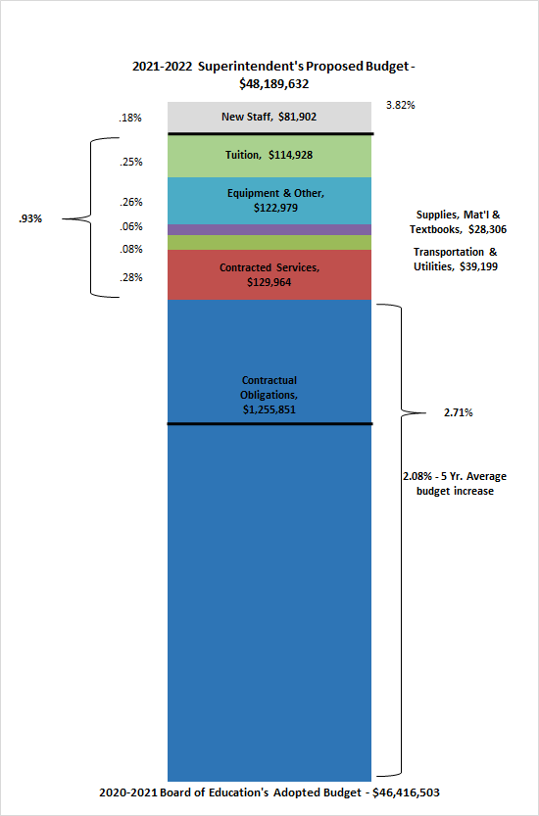
2021-2022 Superintendent’s Proposed Budget Overview
Administrative Salaries
Certified Salaries
Non-Certified Salaries
Employee Benefits

Slide 30
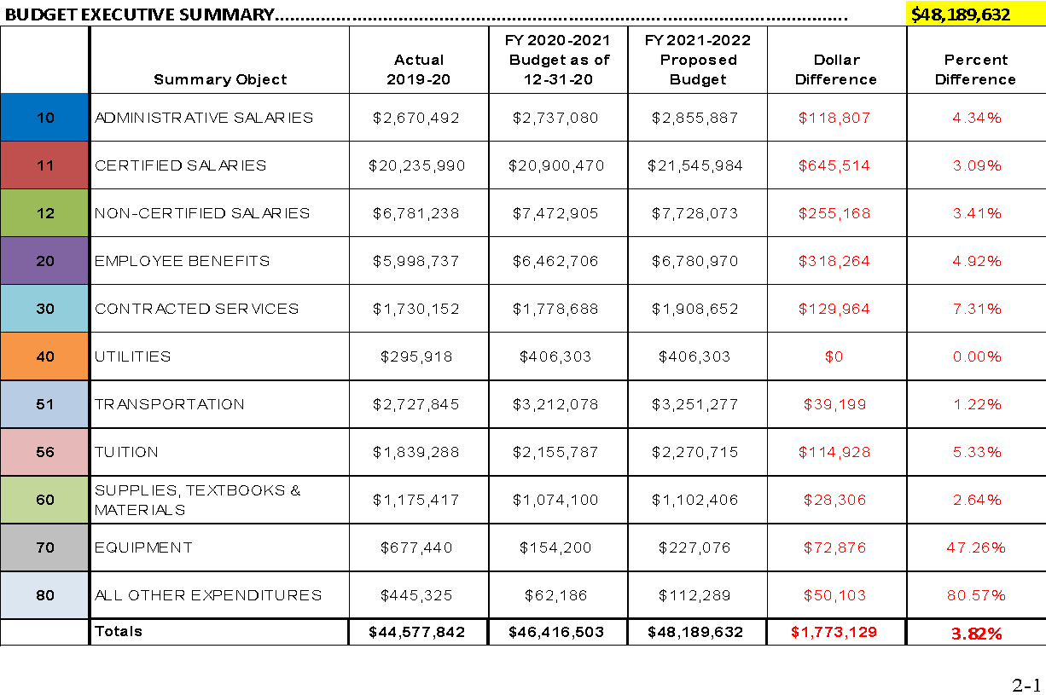

Slide 31
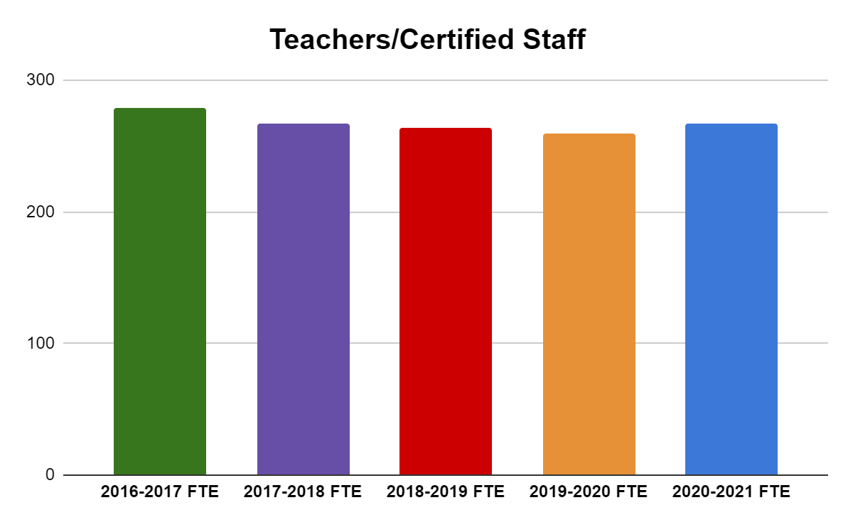
5 Year FTE Comparisons
Teachers/Certified Staff
Employee Type | 2016-2017 FTE | 2017-2018 FTE | 2018-2019 FTE | 2019-2020 FTE | 2020-2021 FTE
Teachers/Certified Staff | 279.32 | 267 | 264 | 259.4 | 266.7

Slide 32
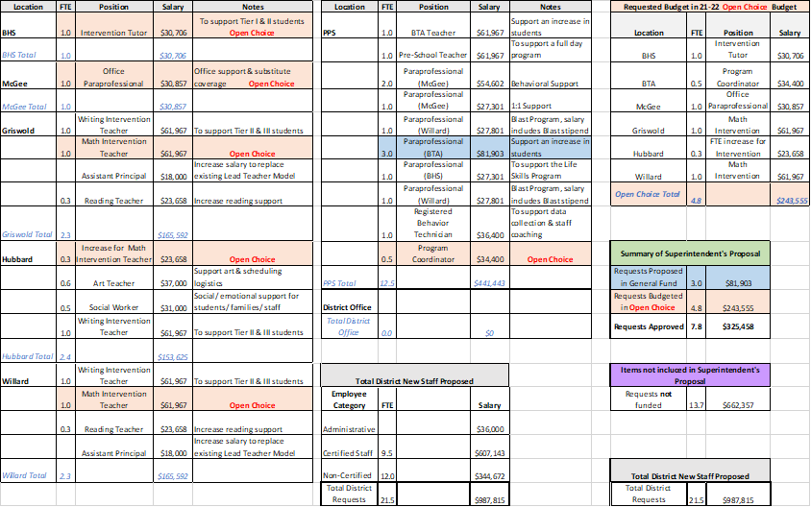
2021-2022 New Staff Requests

Slide 33
2021-2022 New Staff Requests Summary
21.5 Total Requests for New Staff
13.7 Requests Not Funded
7.8 Funded (Operational Budget/Open Choice)
3 Paraprofessionals in 2021-2022 Operational Budget
    Required to meet the needs of learners
4.8 Positions funded through Open Choice Grant
    BHS: Intervention Tutor (1.0)
    BTA: Program Coordinator (0.5)
    McGee: Office Paraprofessional (1.0)
    Griswold: Math Intervention Teacher (1.0)
    Hubbard: FTE Increase for Intervention Teacher (0.3)
    Willard: Math Intervention Teacher (1.0)

Slide 35
Contracted Services - $129,964
Includes all operational and educational systems which increase annually.
  The annual increase can range from 3%-5%
Software and licensing
  Zoom Licenses $60,00
Nursing Services
  $60,000 for two students that require nursing services within their IEP.

Slide 36
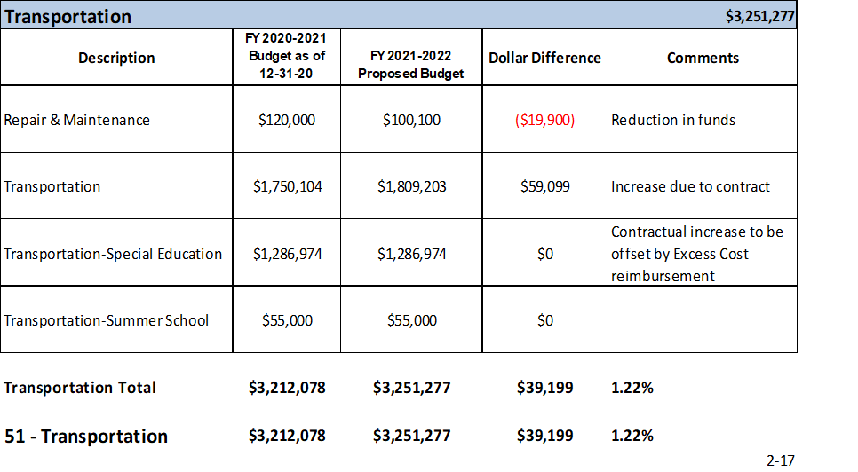
Transportation - $39,199
3% increase in based on Contract with New Britain Transportation
1.22% budgeted, $39,199
  Use of Special Education Excess Cost Grant funds
  Reduction in repairs and maintenance

Slide 37
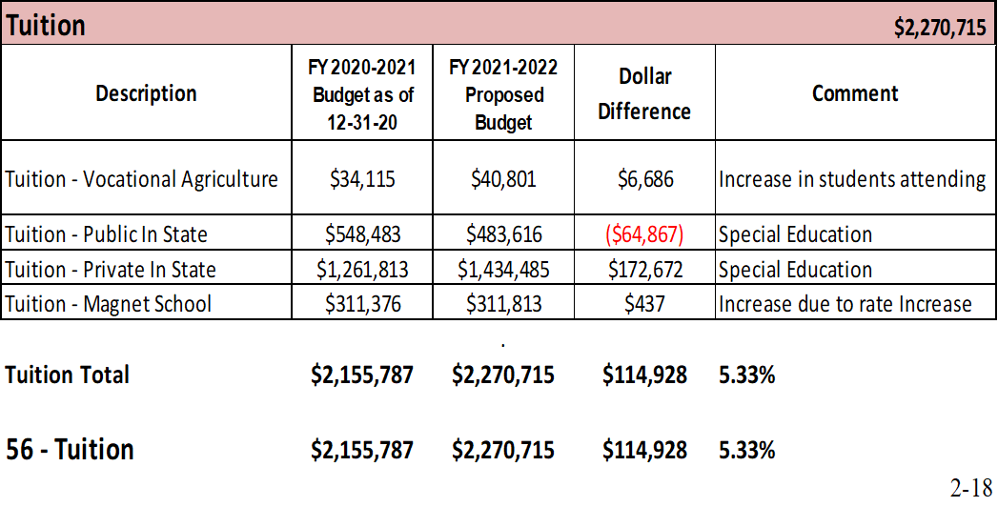
Tuition - $114,928
Magnet School rate increase - 4%
Private & public annual rate increases - 3%
Additional outplacement - $80,000

Slide 38
All Other Expenditures
2020-2021 Requested: $62,186.00
  We have exceeded this amount significantly this year
2021-2022 Requests: $122,289.00, 80.57% increase
Original requests over $1,000,000 reduced to $50,103 Capital Improvement not accepted in the Capital Plan
$949,897 in unfilled requests at all schools, all levels
  Routine Painting District wide
  Restoration of Recess Area
  Window Repairs

Slide 40
ESSER Grant/CRF Grant
ESSER I: $134,641
ESSER II: $596,937 (Anticipated)
CRF: $285,005
Next Steps:
Board of Education members review materials
Finance & Operations Committee for Discussion/Agenda Item
Board of Education Discussion/Agenda Item

Slide 41
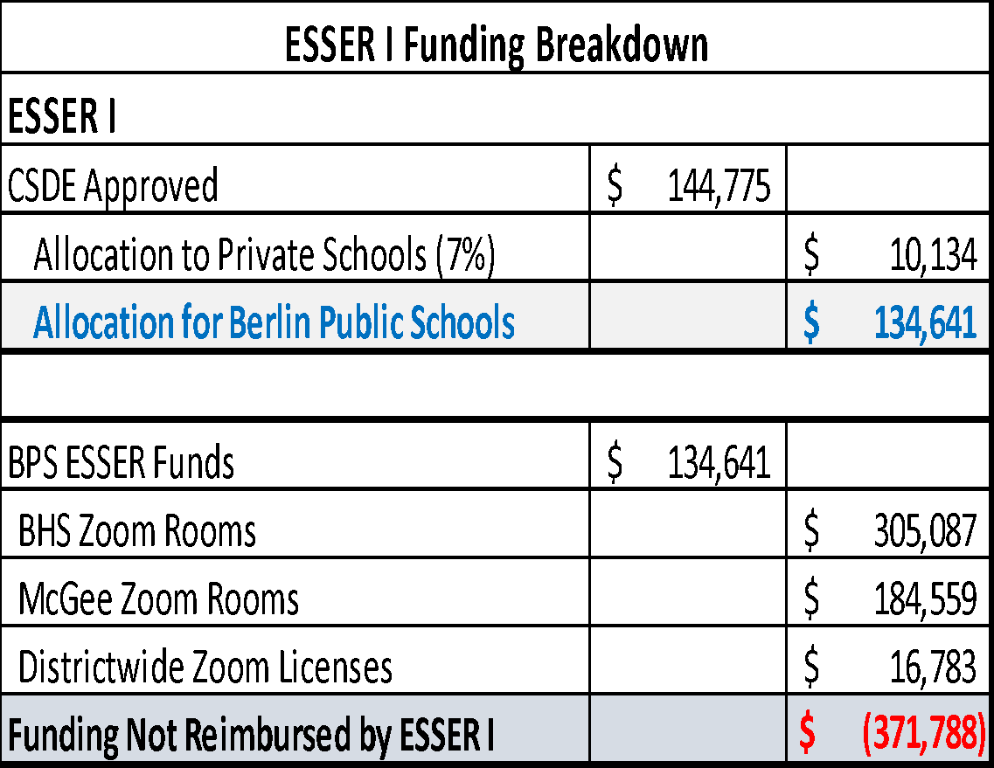
Elementary & Secondary School Emergency Relief Fund (ESSER I)
CSDE Approved $144,775
$10,134.00 reimbursed to Saint Paul School
$134,641 reimbursed to Berlin Public Schools for the initial purchase of Zoom Rooms & Licenses for secondary level
Actual Cost of initial Zoom purchases $506,429

Slide 42
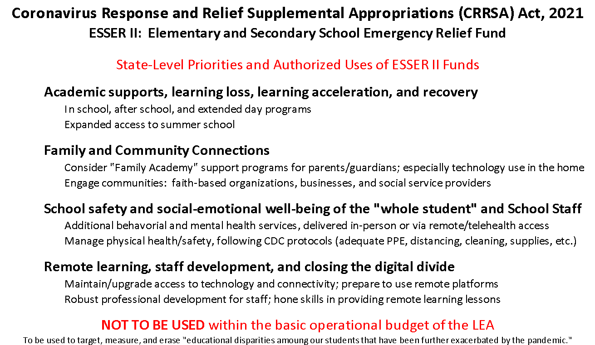

Slide 43
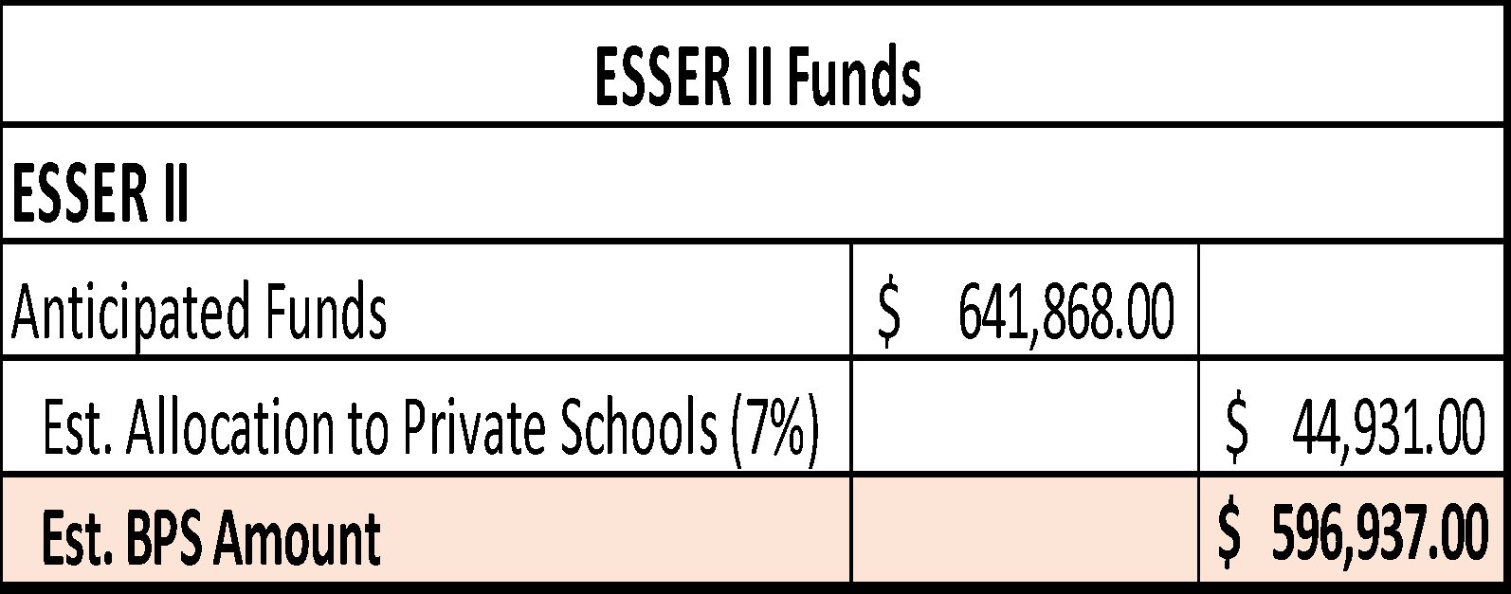
Elementary & Secondary School Emergency Relief Fund (ESSER II)
Anticipated Funds $641,868
Authorized Uses for ESSER II Funding
Not intended to supplant local funding
Assumed 7% allocation to Private Schools
Address Learning Loss
Provide Mental Health Services
Purchase Educational Technology
Training & Professional Development
Summer Learning Programs
School Facilities Improvements & Repairs (HVAC)

Slide 44
Hartford Open Choice Enrollment
 | 2016-2017 | 2017-2018 | 2018-2019 | 2019-2020 | 2020-2021 | Projected 2021-2022
Choice Students | 96 | 92 | 131 | 116 | 121 | 120
Total Enrollment | 2792 | 2781 | 2787 | 2735 | 2688 | 2564
% Choice Students | 3.44% | 3.31% | 4.70% | 4.24% | 4.50% | 4.37%
2020-2021 school year we accepted 16 new seats for Choice students.
  9 Kindergarten Students
  4 First Grade Students
  2 Third Grade and 1 Eighth Grade – all siblings of students in district
Every effort is being made to accept students at the Kindergarten level with a conscious awareness of maintaining at least 4% Choice Enrollment
  Choice Funds are tied to additional staff and programs

Slide 45
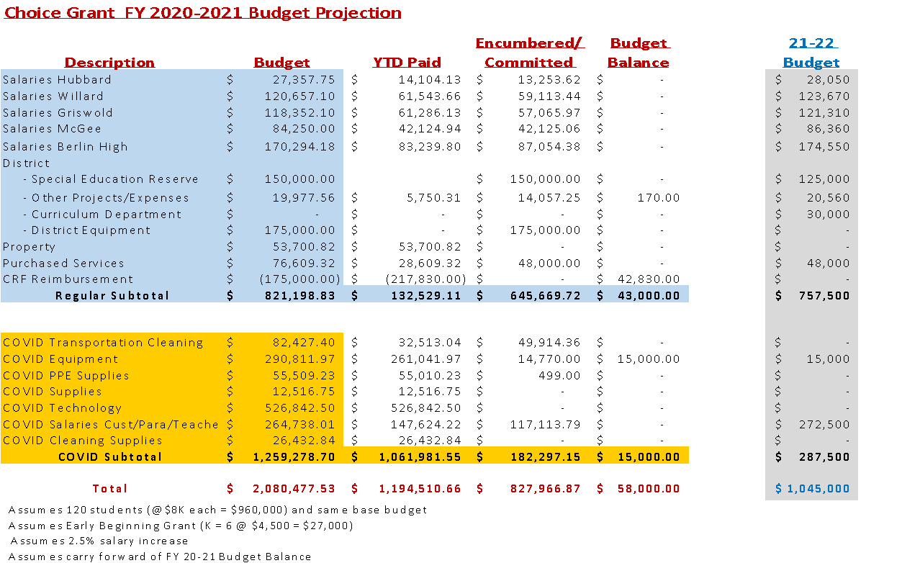
Hartford Open Choice Budget

Slide 46
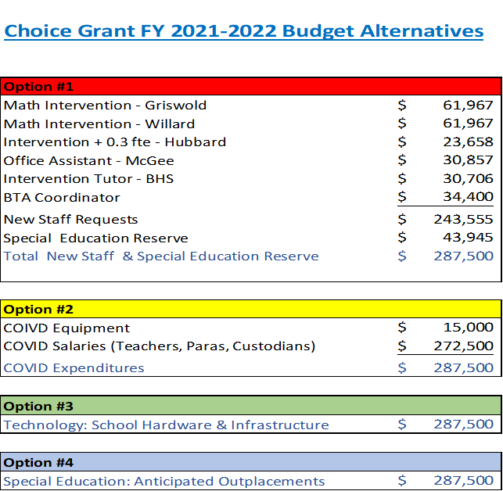
Hartford Open Choice Budget Potential Alternatives

Slide 47
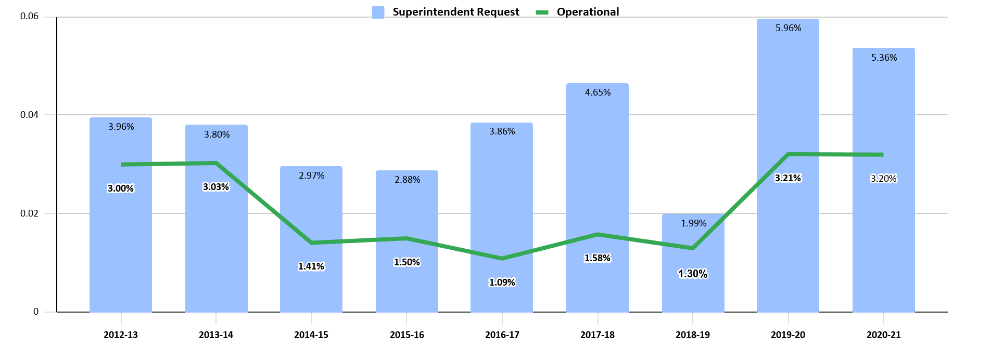
Budget Funding History

Slide 48
Berlin’s adopted budgets in the past two years have compared favorably
District | Adopted 2016-17 | Adopted 2017-18 | Adopted 2018-19 | Adopted 2019-20 | Adopted 2020-21 | 5 Yr. Average Increase
Rocky Hill | 5.76% | 2.93% | 4.54% | 2.50% | 3.84% | 3.91%
Farmington | 3.80% | 2.37% | 2.54% | 2.90% | 3.35% | 2.99%
Cromwell | 1.74% | 2.00% | 1.53% | 3.29% | 3.60% | 2.43%
Berlin | 1.09% | 1.58% | 1.30% | 3.21% | 3.20% | 2.08%
Glastonbury | 2.11% | 0.00% | 2.20% | 3.16% | 2.81% | 2.06%
Wethersfield | 0.42% | 0.75% | 2.97% | 3.50% | 2.05% | 1.94%
Newington | 0.49% | 0.29% | 3.40% | 2.70% | 2.67% | 1.91%

Slide 49
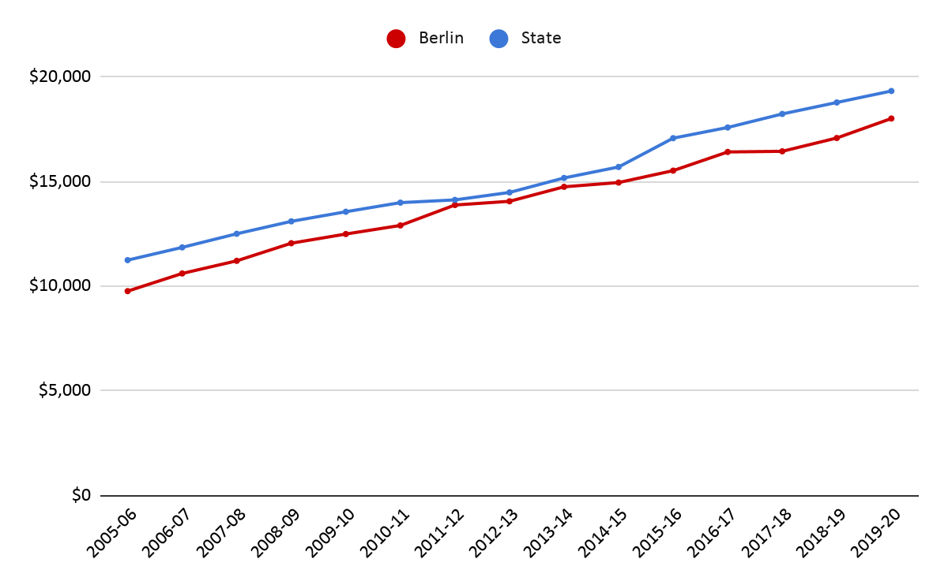
Berlin and State Per Pupil Expenditure
In 19-20 school year, state per pupil spending was $19,339, Berlin per pupil spending was $18,024 or $1,315
less than state.

Slide 50
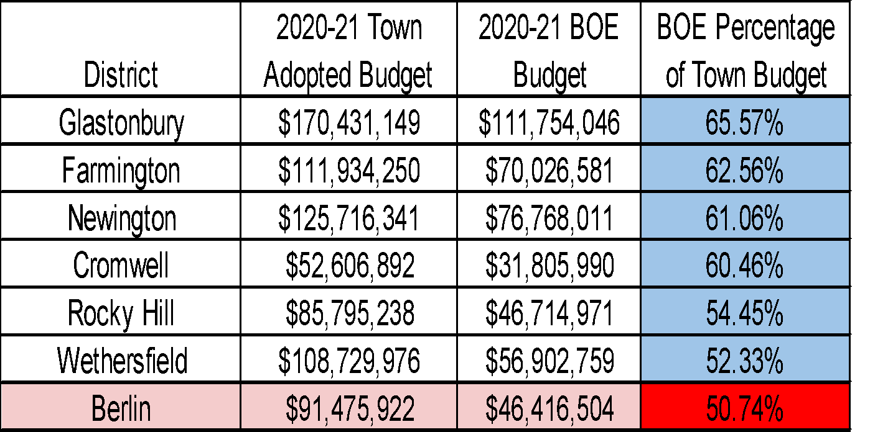
BOE % of Town Budget Compared to Surrounding Districts
Berlin has the lowest percentage: 50.74%

Slide 51
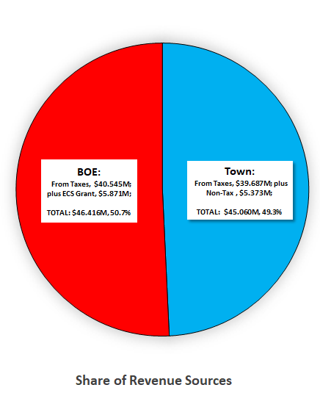
Share of Revenue Sources

Slide 52
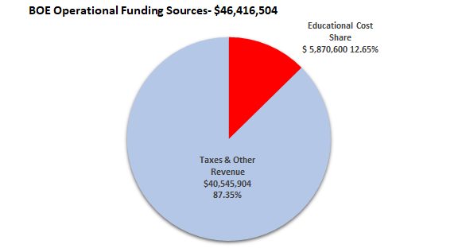
BOE Operational Funding Sources

Slide 54
2021-2022 Superintendent’s Proposed Budget Overview
Administrative Salaries
Certified Salaries
Non-Certified Salaries
Employee Benefits

Slide 55
Questions

Slide 56
General Government
(including Berlin Water Control)
Notes:
Overall: 10 minutes
Revenue: 15 minutes
LT Liabilities/Capital: 30 minutes
Transfers: 5 minutes
BOE: 30 minutes
GG: 30 minutes

Slide 57
Funding General Government Operations and
Shared Costs with BOE
Notes:
High percentage is people cost with two notable exceptions:
General government: liability insurance, postage, advertising, legal, probate court, auditing, pension, software (town clerk, financial, tax, assessment)
Physical Services: refuse disposal, vehicle fuel & parts, natural gas, streetlighting, snow & ice materials, catch basin cleaning, electricity, telephones

Slide 58
General Government operating cost drivers…
Contingency: +$200k (assigning fund balance)
Employee-related costs: +$447k (1.2%)
  Health insurance: +$194k
    6.8% increase w/ Anthem renewal rates (received after TM budget submitted)
    $81,696 reduction from TM budget submission – action required by BOF
  New position wages: +$139k
    1 full-time, temporary & 5 part-time
    Defunded 3 full-time & 1 part-time
    Focus on Community Development & Social/Recreational efforts
    $71k of the increase completely offset by increased Building revenue
  Existing wages net increase: +$114k (0.67%)
Electricity (schools & town): +$78k
Refuse Disposal: +$54k
Other costs increasing $25k - $50k each: +$230k
  Legal, Tax refunds, operating materials, irrigation at Timberlin, Economic Development promotion, computer equipment and school security guards

Slide 59
Berlin Water Control – Enterprise Fund
Combined operating budget change: -$12k (-0.2%)
  Water: -$23k
  Sewer: +$11k
Capital needs:
  Deming Road Pump Station
    Complete replacement
    Est. $2.5 million (60% is MDC cost)
  Berlin Turnpike (future development connection)
    Replace/enlarge pipe
    Est. $2.0 million
  East Berlin water line updates

Slide 60
QUESTIONS?

