Slide 1

Board of Finance Proposed Budget
Fiscal Year
2020-2021

Slide 2
Agenda
Overview of Total Proposal
Revenue
Board of Education
General Government
Capital
Debt

Slide 3
Proposed Budgets & Mill Rate
Board of Education General Government Total
$46.41 million $45.06 million $91.47 million
+$1.44 million -$0.15 million +$1.29 million
+3.2% -0.3% +1.4%
33.93 mills
(+0.00 mills or 0.00%)

Slide 4
Revenue: +$1.2 million
Taxes
  Grand List: +1.9% (+$1.4 million)
  Delinquent Tax Collections: +$217,000
  Tax Collection Rate: increased from 99.1% to 99.3% (+$160,000)
  Supplemental Motor Vehicle: +$50,000
Non-Tax Revenues
  State Grants: –$148,000
  User Fees: -$110,000
  Interest & Other Income: +$408,000
  Assigned Fund Balance: -$766,000

Slide 5
Board of Education
Please see the Board of Education presentation to the Board of Finance at:
https://www.town.berlin.ct.us/egov/apps/document/center.egov?view=item;id=6401

Slide 6
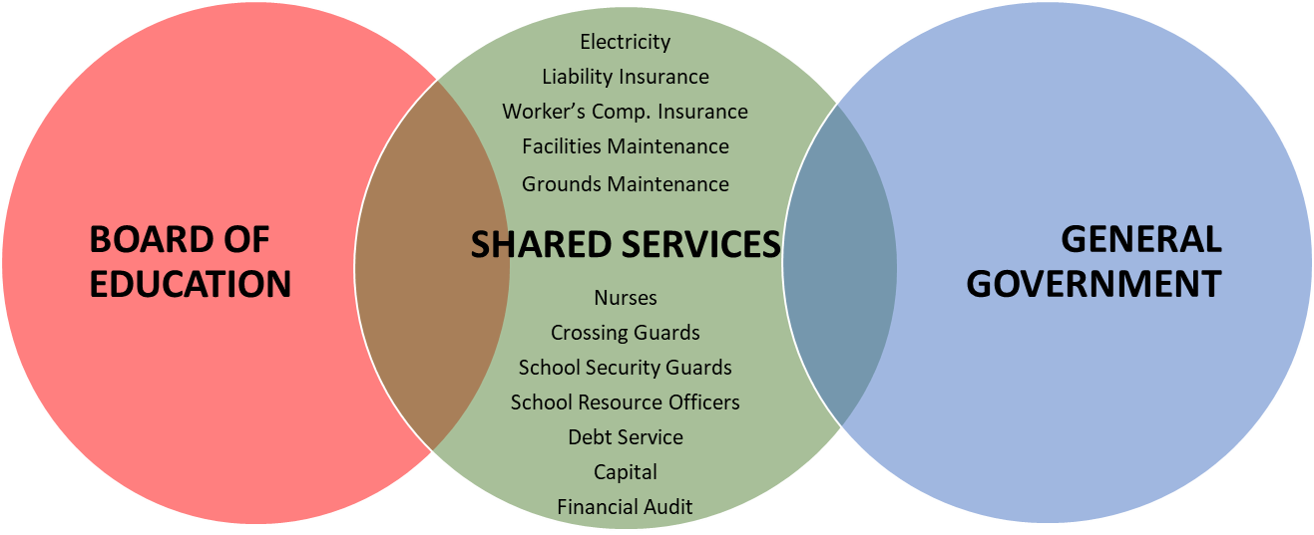
General Government Operating Budget
STATUS QUO
  Proposed spend is lower than FY20 budget
  No new headcount
  Maintains existing services
  Maintains public safety
$46.4MM
$9.9MM
$35.1MM
TOTAL GENERAL GOVERNMENT BUDGET

Slide 7
ALL CAPITAL ITEMS REMOVED FROM BUDGET
  Police cruisers
  Automated External Defibrillators (AEDs)
  Fire alarm upgrade at Hubbard
  School vans
  HVAC upgrades at McGee
  School security vehicle
  Office reconfigurations in support of new vestibules
  Timberlin maintenance building repairs
  Highway equipment

Slide 8
FY2021 Bond Plan
$4,950,000
Continue strategy: retire more than borrow
Bridges: $2,400,000
Roads: $1,150,000
Athletic Field Improvements: $1,000,000
Fire Vehicle (50% down payment): $400,000

Slide 9
Comments
Please email any comments to townbudget@town.berlin.ct.us.
Any comments received by noon on March 31st will be shared with the Board of Finance before the Board votes to send the budget to the Town Council.

