Slide 1
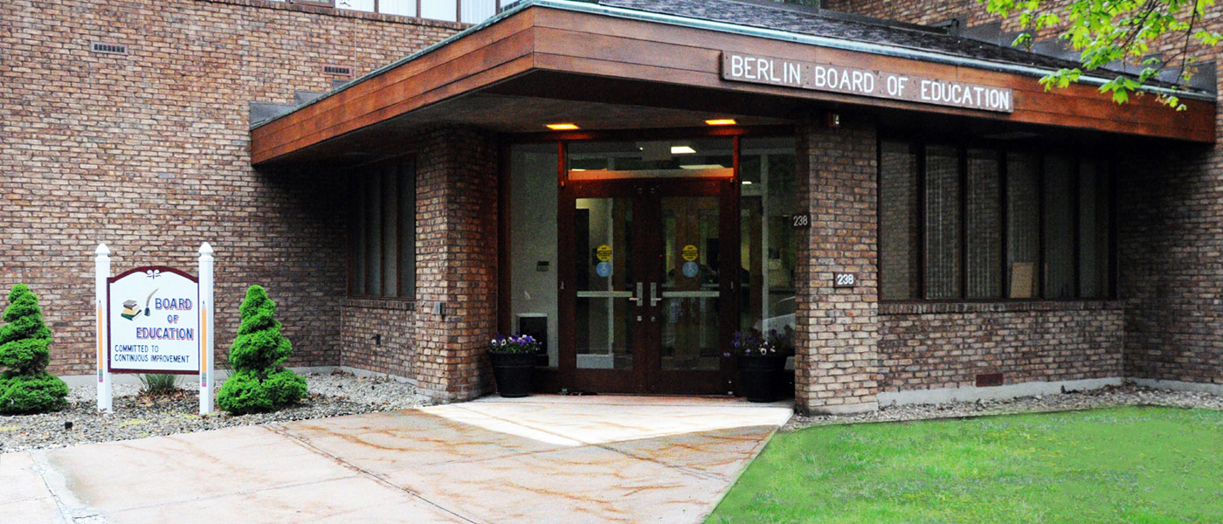
Berlin Board of Education Adopted Budget
2020-21
BERLIN BOARD OF EDUCATION
238 KENSINGTON ROAD
BERLIN, CT 06037
860-828-6581
Richard Aroian, President ∙ Julia Dennis, Secretary
Mary Ellen Maloney ∙ Jaymee Miller ∙ Timothy Oakes ∙ Adam Salina ∙ Dr. Kari Sassu ∙ Tracy Sisti ∙ Matthew Tencza

Slide 2

BOE Adopted Budget
“The school system is a good school system and when people move, they always look into the school system.” – Town Assessor Joseph Ferraro (Berlin Citizen)
Mayor Kaczynski is committed to the continued growth and vitality of our town and a responsible town government that is responsive to all the citizens of Berlin. (Berlin GOP website)
If the growth and vitality of our town is connected to the quality of the school system, how do we create a responsible budget that allows the town to grow and the schools to flourish?

Slide 3

BOE Adopted Budget

Slide 4
BOE Adopted Budget
Total Operational Budget Request
  $44,977,844 19/20 (revised 12/31/19)
  $47,387,504 20/21 (an increase of $2,409,660 or 5.36%)
5.36% increase from 2019-20
  4 Main drivers for that increase
    Mandates and Contractual Obligations
    Change in Capital Request Protocol
    The Addition of 4 Certified Positions
    Social/Emotional Support Services

Slide 5
BOE Adopted Budget
Mandates and Contractual Obligations include
  Utilities
  Certified and Non-Certified Contracts
  Transportation
  Tuition
  Special Education Costs

Slide 6
BOE Adopted Budget
            SPECIAL EDUCATION COSTS
Student qualifying for special education has increased 15% over the last 4 years.
  383 students in 2016-2017 as compared to 440 students in 2019-2020
Number of students receiving their education outside of the Berlin Public schools has increased

Slide 7
BOE Adopted Budget
Total Operational Budget Request
  $44,977,844 19/20 (revised 12/31/19)
  $47,387,504 20/21
5.36% increase from 2019-20
  4 Main drivers for that increase
    Mandates and Contractual Obligations
    Change in Capital Request Protocol
    The Addition of 4 Certified Positions
    Social/Emotional Support Services

Slide 8
Equipment - $128,207
BOE Adopted Budget
Town implemented a new budget process requiring that any item under $25,000 be included in the operating budget.
Majority of increase is allocated for instructional items and technology infrastructure (Chromebooks, SMART Boards, projectors, iPads for primary grades).

Slide 9
BOE Adopted Budget
Total Operational Budget Request
  $44,977,844 19/20 (revised 12/31/19)
  $47,387,504 20/21
5.36% increase from 2019-20
  4 Main drivers for that increase
    Mandates and Contractual Obligations
    Change in Capital Request Protocol
    The Addition of 4 Certified Positions
    Social/Emotional Support Services

Slide 10
Certified Staff - $812,386
Non – Certified Staff- $641,977
BOE Adopted Budget
Contractual obligation for certified staff – 3.04%
Proposed New staff:
  World Language teacher BHS – New Grad. Requirements
  Lead teacher/interventionist McGee
  Tech Integration Specialist Griswold/Willard
  Pre-school teacher – Willard – expand program to full day
Obligation for non-certified staff 2.0%
  Computer Technician – responsibility for all security equipment including the maintenance of over 300 cameras
  (2) Special Education Paraprofessionals
  (5) Kindergarten Paraprofessionals
  Increase budget for substitute teachers

Slide 11
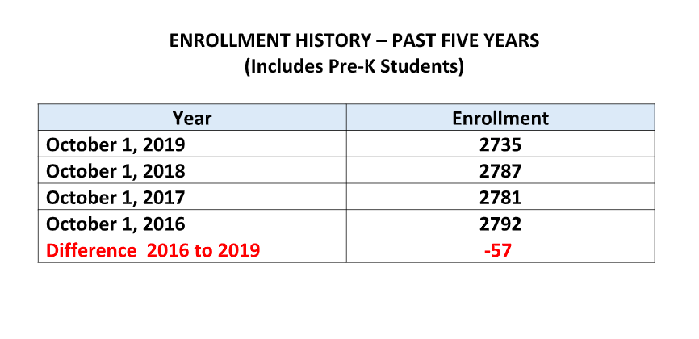
Over the last four years the Berlin Public School System has eliminated 19.92 FTE staff positions and 3.0 Administrative positions

Slide 12
BOE Adopted Budget
Total Operational Budget Request
  $44,977,844 19/20 (revised 12/31/19)
  $47,387,504 20/21
5.36% increase from 2019-20
  4 Main drivers for that increase
    Mandates and Contractual Obligations
    Change in Capital Request Protocol
    The Addition of 4 Certified Positions
    Social/Emotional Support Services

Slide 13
Contracted Services - $241,302
BOE Adopted Budget
Effective School Solutions- McGee - $100,000 – increase support for students
Software and licensing

Slide 14
Hartford Open Choice Enrollment
 | 2015-2016 | 2016-2017 | 2017-2018 | 2018-2019 | 2019-2020 | Projected 2020-2021
Choice Students | 105 | 96 | 92 | 131 | 116 | 126
Total Enrollment | 2863 | 2792 | 2781 | 2803 | 2735 | 2718
% Choice Students | 3.67% | 3.44% | 3.31% | 4.67% | 4.24% | 4.64%
For the 2020-2021 school year we have offered 17 new seats for Choice students.
  9 kindergarten students
  5 first grade
  1 third grade, 1 seventh grade and 1 eighth grade – all siblings of students
Every effort is being made to accept students at the Kindergarten level with a conscious awareness of maintaining at least 4% Choice enrollment as these funds are tied to additional staff and programs.
Notes:
Updated slide 20-21

Slide 15
Employee Benefits - $306,676
The Fiscal Responsibility of the BOE
New Wellness incentive program
Includes benefits for proposed positions
10% Increase – Rate is set by the town

Slide 16
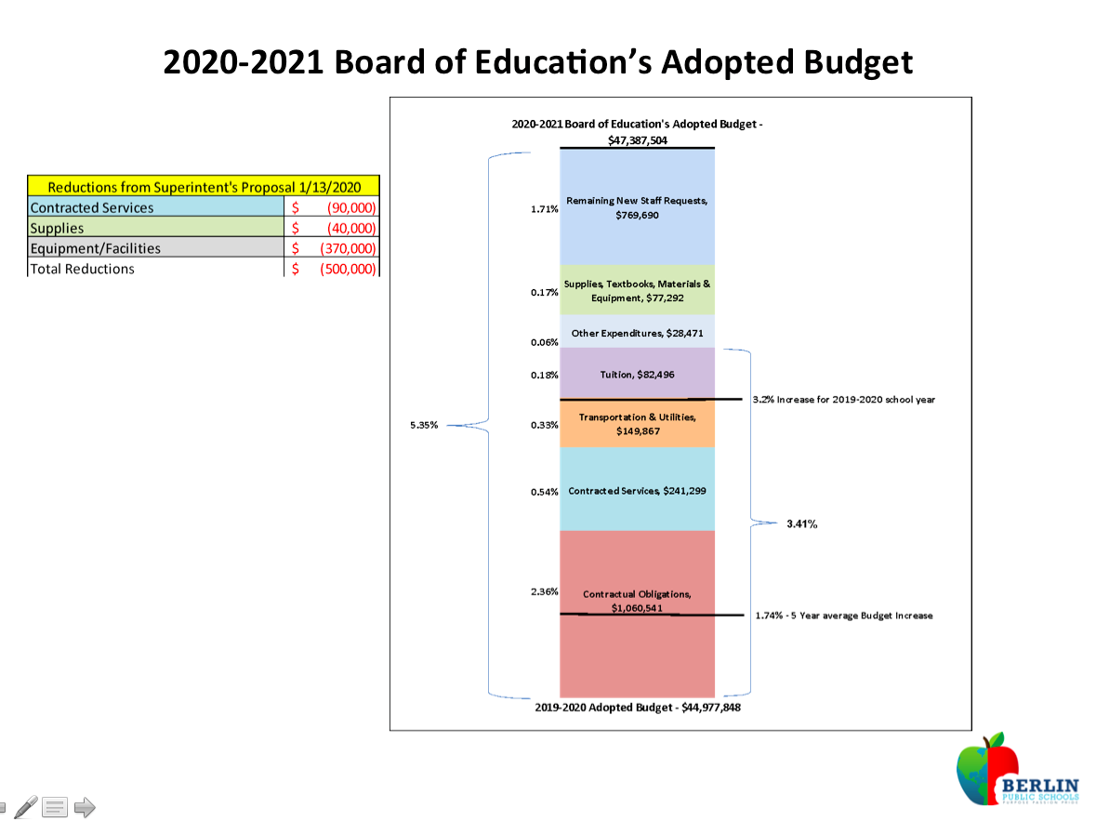
2020-2021 Board of Education Adopted Budget

Slide 17
Budget Funding History
Notes:
Updated slide 20-21

Slide 18
Are enough funds being allocated to education?
If the growth and vitality of our town is connected to the quality of the school system, how do we create a responsible budget that allows the town to grow and the schools to flourish?
“The school system is a good school system and when people move, they always look into the school system.” – Town Assessor Joseph Ferraro (Berlin Citizen)
Notes:
Updated slide 20-21

