Slide 1

Board of Finance Proposed Budget
Fiscal Year
2019-2020
March 26, 2019
This presentation is available under Finance/Budget on the Town website: https://www.town.berlin.ct.us/topic/index.php?topicid=324&structureid=16

Slide 2
Agenda
Overview of Total Proposal
Revenue Budget
General Government Budget
  Operating
  Capital
  Liabilities
Board of Education Budget

Slide 3
Proposed Budgets & Mill Rate
Board of Education General Government Total
$45.3 million $47.4 million $92.7 million
+$1.7 million +$3.0 million +$4.7 million
+3.9% +6.8% +5.4%
Mill Rate: 34.40 (+1.90 mills or 5.85%)

Slide 4
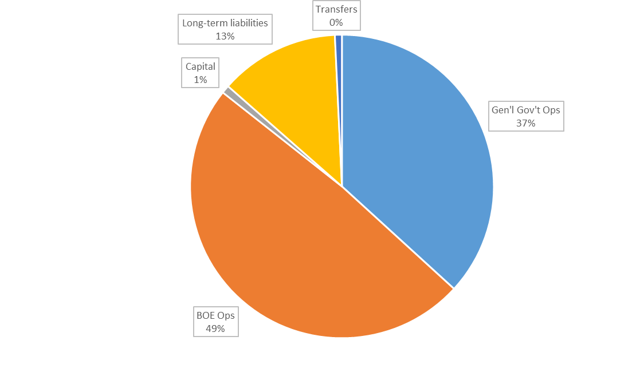
Breakdown of Total Budget
Target = 3%
Ceiling = 6%

Slide 5
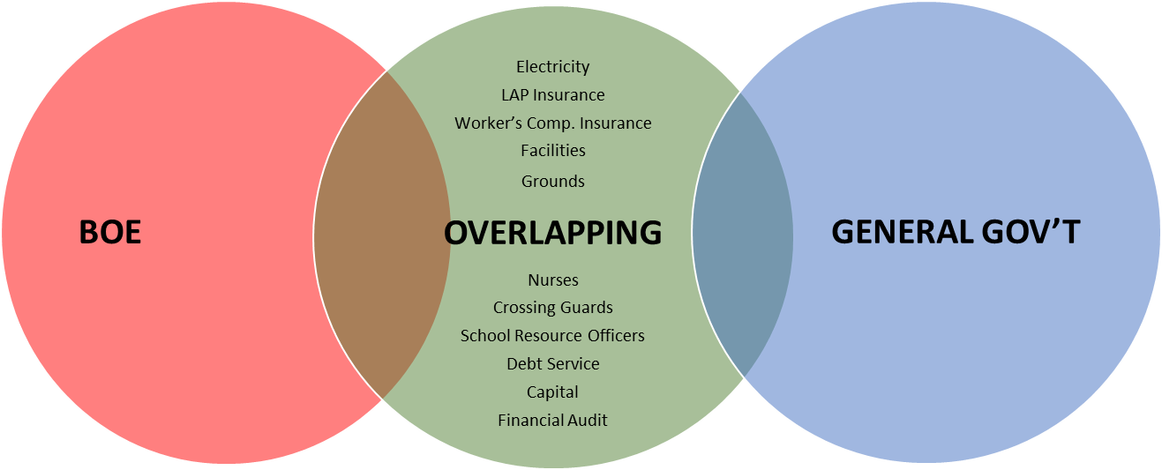
Bifurcated Vote…
What Does Each Vote Include?
$45.3MM
$9.5MM
$37.9MM
BOE Ops, General Gov’t Ops & Shared Services included in General Gov’t budget

Slide 6
Reductions Made to Original Requests
Town Mgr. changes include:
  Capital: -$3.48 million
  Transfers: -$370k
  Operating: -$127k
  TRS Contribution: +$134k (NEW)
BOF reductions include:
  Capital: $53k
  Operations: $584k
  BOE: $900k
BOF increased revenue for:
  $300k School Security Grant
  $20k Police Body Armor Grant
Notes:
- No change to BOE request
- $3.4M reduction to General Government – mostly through capital

Slide 7
Budget Drivers
Receipts:
  Grand List (times mill rate = tax revenue)
  Non-Tax Revenues:
    State Grants – Education & Non-Education
    User Fees
    Interest & Other Income
    Assigned Fund Balance
Expenditures:
  Operating Costs – BOE & Gen Gov’t
  Capital Investments
  Servicing Liabilities (debt, leases, DB pension)

Slide 8
The Grand List
A Measure of the Local Economy
The Grand List base for the proposed budget is $2.295 billion - flat to prior year. Although the Town experienced modest growth in the grand list submitted to the State, this growth was offset by ongoing legal challenges to the 2017 revaluation.
The Grand List is the basis for computing Berlin's current levy and resulting mill rate. The Assessor maintains, updates and continually reviews records for all real estate, personal property and motor vehicles for Berlin's Grand List.
State law requires every town to revalue real property every five years – 2017 was a revaluation year in Berlin. Revaluation aligns real property values with emerging sales information to ensure real estate taxes are applied appropriately

Slide 9
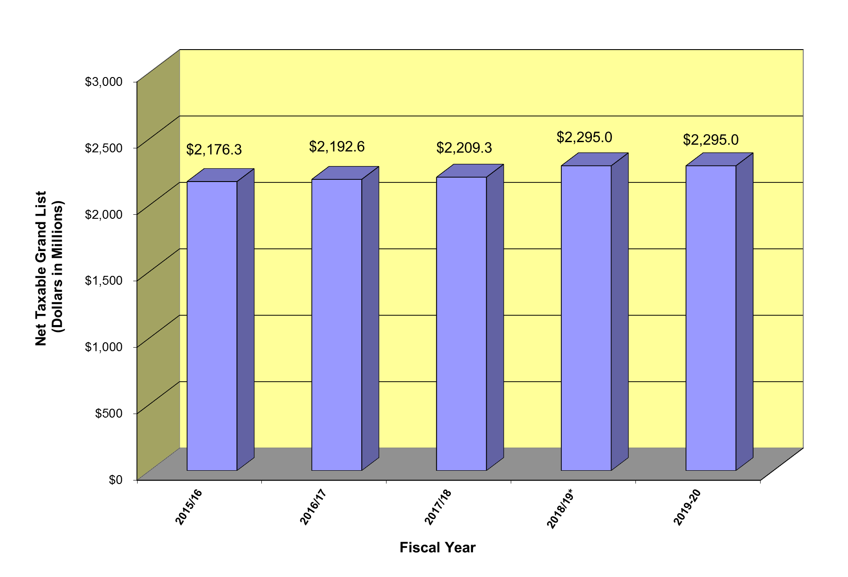
Grand List Over Last 5 Years
1% Compounded Annual Growth Rate
* Revaluation Year
Excluding revaluation lawsuits, GL CAGR would be 1.3% over last five years

Slide 10
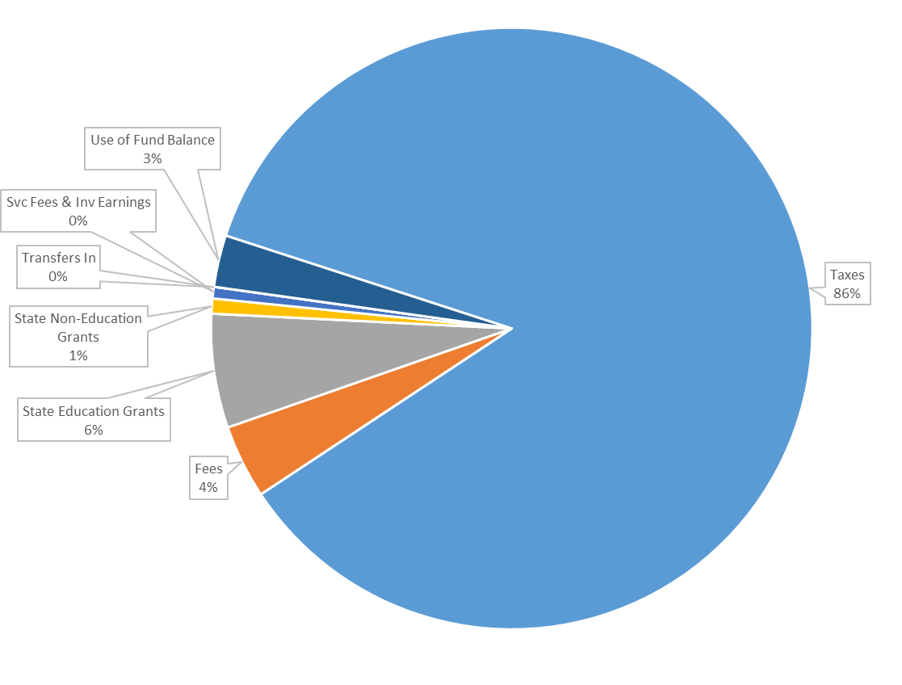
Revenues by Source
Local taxes drive 86% of revenue
Using fund balance to cover 100% of pension plan required contribution
Assigned additional $1 million of fund balance to offset mill rate increase
Continued volatility in State grants
User Fees & Investment Earnings budgeted higher

Slide 11
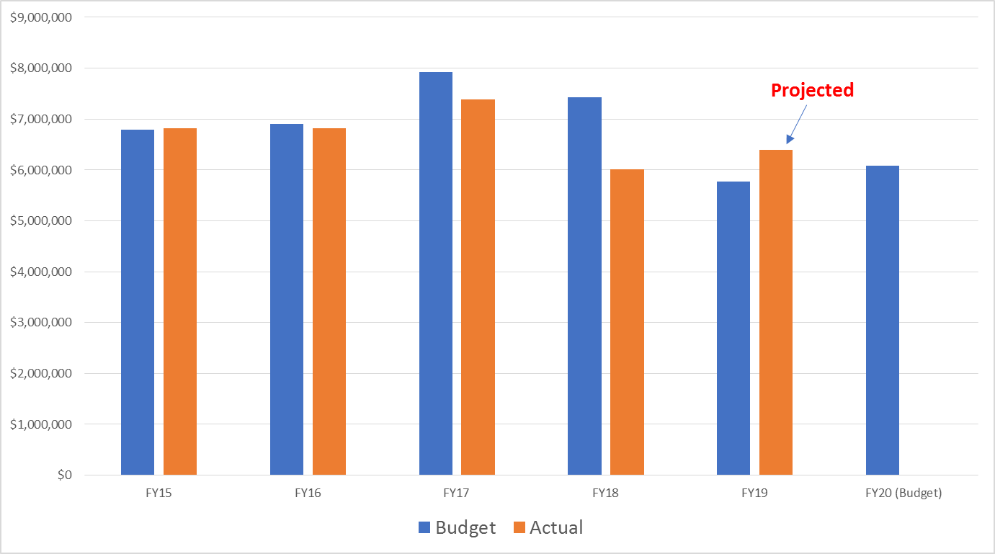
State Grant Uncertainty & Volatility
$300k decline vs. FY19 projection
$300k increase vs. FY19 adopted Berlin budget

Slide 12
Unassigned Fund Balance as a percent of Total Budgeted Expenditures
  “Use of reserves to address budgetary shortfalls is a challenge in Connecticut because the median fund balance in the state for towns and cities of 13% is already lower [than] the national median of 31 percent of revenues.” (Moody’s analyst Joseph Manoleas)
Solid balance has been built over many years of tight operational management
Balance is critical to stabilize town finances in the event of:
  A large number of DB pension retirements - $7 million unfunded liability
  Reimbursable grant activity – mitigates need for short-term borrowing
  A natural disaster – “fronting” cleanup costs reimbursed months later
  Higher level of Special Ed costs than BOE can absorb

Slide 13
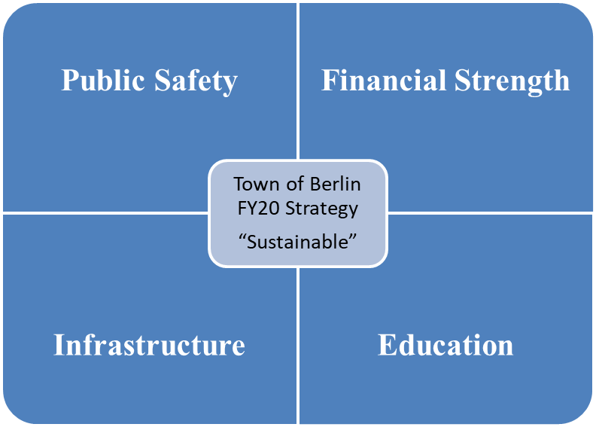
FY20 Strategic Spending Priorities
OVERALL GOALS
  Public safety
  Support educational needs
  Maintain infrastructure
  Manage down high fixed costs – debt, leases, DB pension
  Continue to provide services residents expect

Slide 14
General Gov’t Budget Development Process
AREAS OF “NEW” INVESTMENT IN FY 2020
Infrastructure
Buildings
Grounds
Roads
Bridges
Dams
School Security
Technology
Personnel
Vestibules
Economic Dev.
Farmington Ave.
Remediate Prop
Liability Mgmt.
ON-GOING OPERATIONS
Legal, Contractual and Regulatory Compliance & Safe/Quality Community Features
LEGALLY REQUIRED LONG-TERM OBLIGATIONS
Bonds, Notes, Leases, Closed Defined Benefit Plan
Notes:
Infrastructure: TH access controls (LoCIP grant from State), Garage roof (leaks – health & safety issue), Burnham Street Bridge (47% State funding), $2.9MM CRCOG grant for repairs of major roads; RR Pond Dam (State mandate – public safety issue); Scalise Field turf replacement
School Security: School Security Vestibules (Town funding in place + over $200k in State money), cameras, new school security personnel
Farmington Ave: clear bonding hurdles, remediate contaminated property, determine and, if necessary, clear the Town’s legal liability to other property owners, development existing Town-owned property & use as catalyst for further downtown development → INCREASED GRAND LIST!!
Legal: statutory requirements – MBR
Contractual: union contract compliance, existing vendor contract compliance
Regulatory: Spec Ed, VNA staffing/oversight, RR Pond Dam repairs, Bridge repairs

Slide 15
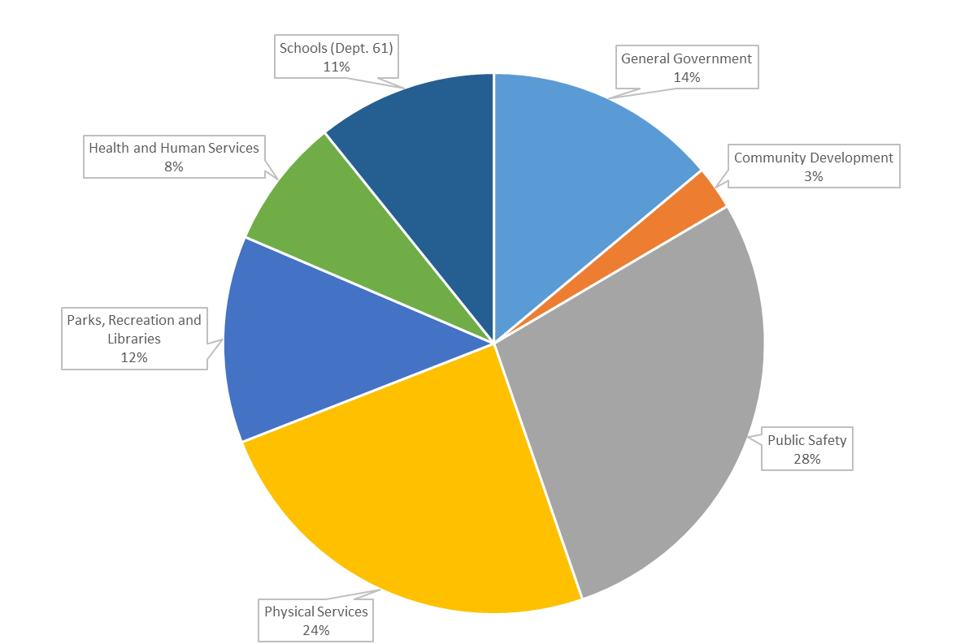
General Government Operating Expend. by Service

Slide 16
General Government Operating Expenditures Personnel vs. Operating

Slide 17
General Fund Capital Investments
$791K
(0.9% of proposed budget)
  Police Vehicles (safety)
  Handicap Door at Comm. Ctr. (Safety)
  Lightning Detection (Safety)
  Repairs at the Sr. Ctr. (Safety/Infrastructure)
  Garage Roof (Safety/Infrastructure)
  School Phones (Safety/Infrastructure)
  Highway Vehicles (Infrastructure)
  Golf Equipment (Infrastructure)
  Grounds Equipment (Infrastructure)

Slide 18
Projected Liability Balance as of 6/30/2019
General Obligation Bonds (P&I) $83.3 million
Bond Anticipation Notes (P&I) $ 0.9 million
Unfunded DB Pension $ 6.9 million
Capital Leases (P&I) $12.2 million
Farmington Ave. Clean Up Work $ 0.9 million
TOTAL $104.2 million
(113% of Proposed Budget)

Slide 19
FY2020 Annual Liability Plan
GENERAL OBLIGATION BONDS:
  Borrow $6.5 million
    $3.7 million new borrowing: Fire Radios, Burnham St. Bridge, Scalise Turf, Railroad Pond Dam
    $2.8 million rollover of short-term notes (Roads & RR Pond Dam)
    No GO bonds issued in FY2019
  Pay down $6.6 million (including $669k bond premium)
SHORT-TERM NOTES:
  Pay down $487K of principal
  No new short-term borrowing
  Use FY19 surplus, if available, to retire remaining $444k of principal in January 2020
DB PENSION: Fully fund Actuarially-Determined Contribution
ENERGY LEASE: $719.5k annual payment
FARMINGTON AVE CLEAN UP COSTS: $861k pay off with closed capital project funds (when available), FY19 surplus, if available, and General Fund balance, if necessary
MIGRATING TO “PAY AS WE GO”
FUNDING STRATEGY

Slide 20
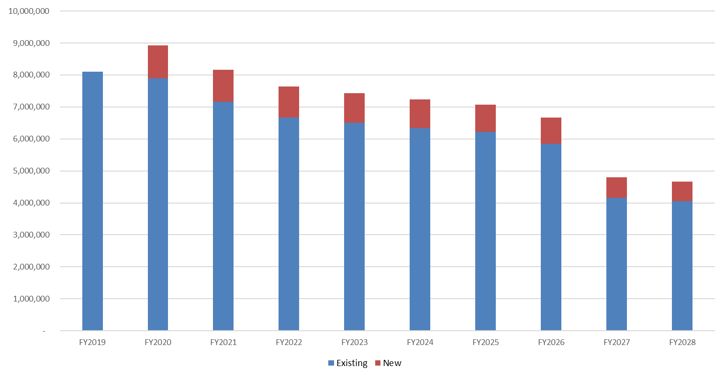
Projected Long-Term Bond Debt Service
Existing and FY2020 Proposed Issue (P&I)
FY20 Bonded Projects:
Fire Radio Upgrade: $1.2 million
Scalise Field Turf Replacement: $1.0 million
Burnham Street Bridge: $1.0 million
Railroad Pond Dam: $500k
Roll Existing Notes: $2.8 million

Slide 21
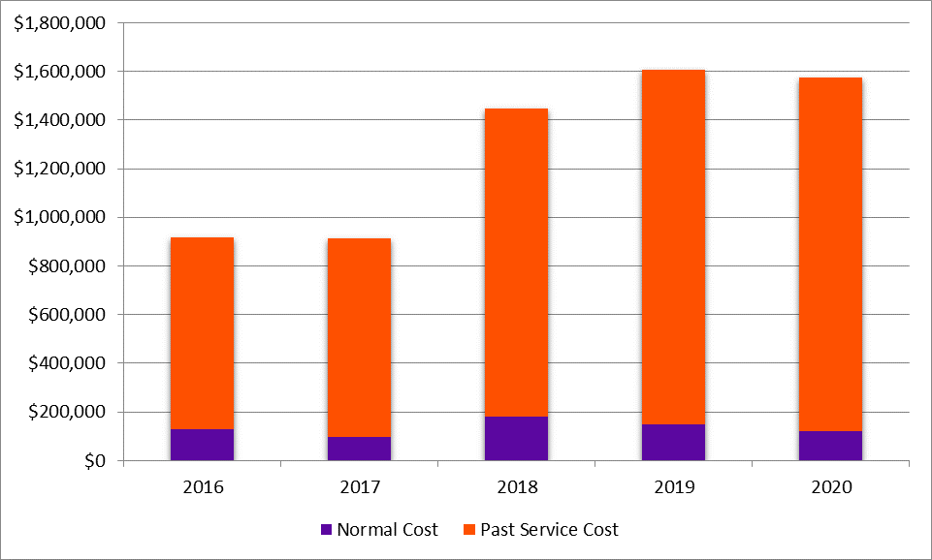
Other Liabilities – DB Pension Plan
  Use Fund Balance to cover 100% of the FY2020 contribution
  60% funded is considered minimum funding level
  At 6/30/2018, Berlin was 0.8% funded
  Funding Actuarially-Determine Contribution is essential

Slide 22
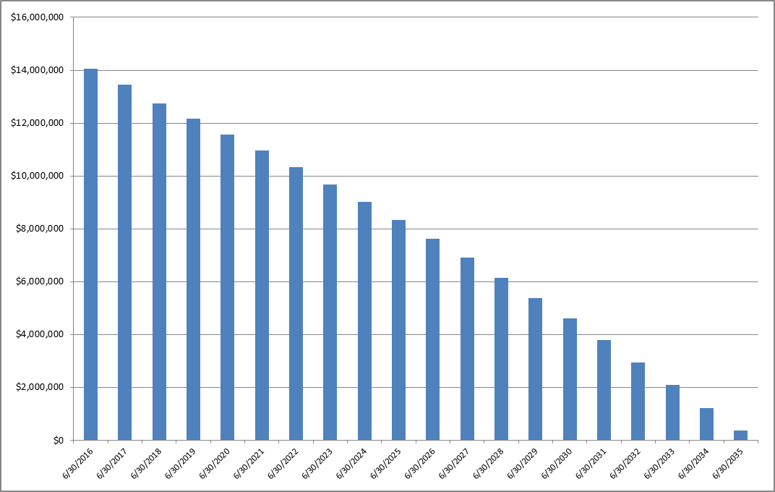
Other Liabilities – Energy Lease
Budget Yr.
  Town entered into a “$10 million Energy Lease” in February 2016
  Energy savings & credits intended to offset lease costs
  Total Principal & Interest = $14.05 million over 20-years

Slide 23
Expenditure Drivers
(FY19 vs. FY20)

Slide 24
How much will my taxes increase?
$250,000 House

Slide 25
In Summary
Proposed Budget…
  funds school security guards & equipment
  maintains existing services & programs
  makes limited but critical capital investments
  makes necessary contributions to closed pension fund
  addresses declining State grants, and
  maintains tight expenditure controls.
Safety + Infrastructure + Servicing Liabilities + Declining Grants =
34.40 Mill Rate

Slide 26
Water Control Commission
Decrease of $0.7 million or 12%
Major drivers:
  Lower capital in both water & sewer
  Lower salaries as 25% of Public Works Director cost shifted to General Fund
  Lower purchased water cost based on emerging experience
Rate study implementation generating higher revenues in both water & sewer

Slide 27
Next Steps
Action to be taken… | Timing & Location…
Board of Finance votes to recommend Board of Education & General Government budgets to the Town Council. | March 27th “Doc” McIntosh Conference Room
Town Council takes action on the recommended budget; either: - Approve the BOF recommended budget “as is” - Approve the BOF recommended budget “with reductions” - Reject the BOF recommended budget | April 2nd (3rd & 4th, if needed) Town Council Chambers Budget sent to referendum Budget sent to referendum Special joint meeting between Council & BOF immediately after the Council vote
Budget Referendum | April 30th

Slide 28

s
Board of Education Budget
2019-2020
March 26, 2019

Slide 29

Our budget reflects our district priorities:
  PURPOSE:
    Students and educators must feel that their work has purpose and meaning. Developing critical, lifelong skills is work that matters. As a district, we will build shared understanding of and commitment to student achievement of the Berlin Learner Outcomes.

Slide 30
Our budget reflects our district priorities:
  PASSION:
  Berlin students and educators care deeply about their work. As part of a learning community, they teach, inspire, motivate and learn from one another. As a district, we cultivate a strong learning culture for both educators and students.

Slide 31
Our budget reflects our district priorities:
  PRIDE:
  Education is a community responsibility. Students and educators benefit from the support of parents and community members. As a district, we strive to enhance community partnerships to support student learning.

Slide 32

We are proud of our students’ accomplishments, including:
SAT scores in Mathematics - #1 in DRG
SAT scores in Reading/Writing - #4 in DRG
386 AP exams taken; 84% with scores 3+
Willard Elementary School - CSDE School of Distinction

Slide 33
A school district’s budget reflects the commitment of the community to invest in the future of our children.
The erosion of funding for education challenges the sustainability of Berlin as a competitive school district with rich educational and extracurricular opportunities for our students.

Slide 34


2019-2020 Superintendent’s Proposed Budget Overview
1.38% - 5 Year Average Budget Increase

Slide 35
2019-2020 Superintendent’s Proposed Budget Overview
Board of Finance Reductions to Proposed 19-20 Budget
Certified Salaries/Employees Benefits (Elimination of 6 teachers) | ($500,000)
Tuition/Transportation (Optimistic about special education outplacements & required transportation) | ($400,000)
Contracted Services Effective School Solutions (ESS) at BHS | ($300,000)
Supplies/Textbooks/Materials (District-wide) | ($100,000)
Total Reductions - 2.98% | ($1,300,000)
1.38% - 5 Year Average Budget Increase

Slide 36
2019-2020 New Staff Requests
Notes:
Waiting for Jeff/Brian to provide total and percent increase for 2019-2020 New Requests. Jeff questioned whether or not the Business Office position should be eliminated since it is already filled.

Slide 37
Berlin’s adopted budgets are not keeping pace

Slide 38
Mill Rate Comparisons

Slide 39
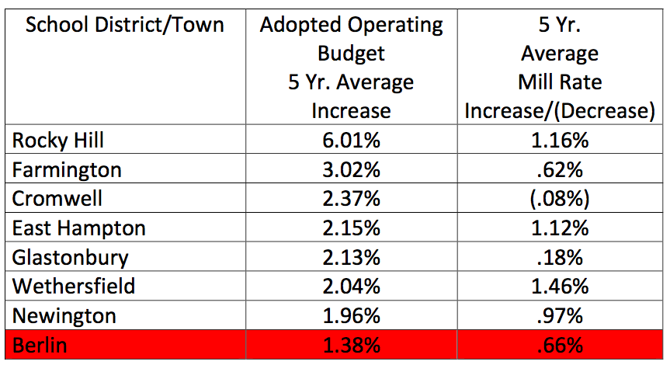
Are enough funds being allocated to education?

Slide 40
Budget Funding History
Notes:
Done

Slide 41
Net Current Expenditure per Pupil
NCEP – Net Current Expenditures per Pupil
Wealth Ranking is 65th & Per Pupil expenditure is 106th out of 169 towns
Notes:
Do you want both of these? This information on this slide is included on the previous one but does not stand out as much on the previous one.

Slide 42
Berlin and State Per Pupil Expenditure
In 17-18 school year, state per pupil spending was $18,243, Berlin per pupil spending was $16,457 or $1,786
less than state.

Slide 43
Federal Funding
Notes:
Need to remove highlighting

Slide 44
Hartford Open Choice
Why does Berlin accept Hartford students for $8,000 if the per pupil expenditure is $16,457?
The number of students that are accepted and their specific grade levels are determined by the superintendent and BOE.
These funds are used to offset inadequate funding of the budget.
Hartford reimburses all expenses over $8,000 for students with special needs.
This additional funding has allowed us to maintain staff that otherwise would have been eliminated based on an inadequate operational budget.

Slide 45
Hartford Open Choice Enrollment
 | 2014-2015 | 2015-2016 | 2016-2017 | 2017-2018 | 2018-2019 | Projected 2019-2020
Choice Students | 115 | 105 | 96 | 92 | 131 | 131
Total Enrollment | 2898 | 2863 | 2792 | 2781 | 2803 | 2816
% Choice Students | 3.97% | 3.67% | 3.44% | 3.31% | 4.67% | 4.65%
For the 2019-2020 school year we have offered 14 new seats for Choice students.
  13 kindergarten students and 1 seventh grade sibling.
Every effort is being made to accept students at the Kindergarten level with a conscious awareness of maintaining at least 4% Choice enrollment as these funds are tied to additional staff and programs.

Slide 46
State Funding
Notes:
Need to delete highlight and correct formatting

Slide 47
Student Enrollment
Notes:
Eliminated FTE chart since data wasn’t clean – if needed, need to know how to get data from past 5 or more years.

Slide 48
Elementary Projected Enrollment
Griswold
Hubbard
Willard
Notes:
Fix hyphen

Slide 49
Projected Enrollments
McGee
Berlin High School

Slide 50
5 Year FTE Comparisons

Slide 51
Impact of Further Reductions
If the Board of Education budget is reduced below 2.98%, the Board of Education will have no alternative but to make reductions that will negatively impact programs, learning experiences and opportunities for our students.

Slide 52
If the BOE Operational Budget is reduced below 2.98% the following areas will be considered…
Elimination of McGee sports
Elimination of freshmen sports
Reduction of JV sports
Elimination of all clubs and activities funded by stipends K-12
Reduction or elimination of co-curricular activities K-12
Institution of fees:
  Parking fee at BHS
  Pay to participate for all co-curricular
  Pre-school peer models
Reduction of teachers and administrators:
  Increase in class sizes
  Number of electives at BHS and exploratories at McGee
  Reduction/elimination of media specialists /tech integration teachers

Slide 53
Site and Building
2019-2020

Slide 54
Capital Equipment: 2019-2020

Slide 55
School Security Staff
The BOE has been working collaboratively with the mayor and town manager to secure funding and determine requirements for these positions.
It has always been the understanding that these funds would be in addition to the operational budget or reside in a town account that would be transferred to the BOE at a later date.
The Board of Education does not believe that a choice should have to be made between eliminating teachers or hiring security staff.

Slide 56
Without a substantive increase to the funding provided to the Board of Education, we cannot sustain Berlin as a competitive school district with rich educational and extracurricular opportunities for our students.
We must break the pattern of inadequate funding and invest in the future of our children.

Slide 57
5 Year FTE Comparisons
Administrators

Slide 58
5 Year FTE Comparisons
Teachers/Certified Staff

Slide 59
Budget Executive Summary

Slide 60
Certified Salaries
55.79%
54.54%
55.16%
44.21%
45.46%
44.84%

Slide 61
Non-Certified Salaries
84.69%
84.74%
84.74%
15.31%
15.26%
15.26%
Notes:
Done unless additional notes are needed

Slide 62
Employee Benefits
87.23%
85.04%
85.38%
12.77%
14.96%
14.62%
All unions are on the high deductible health plan with HSA
Included in this line item is:
  Health insurance coverage
  Unemployment
  Pension/Annuity
  Group term Life
  Disability
  Social Security
  Medicare
Notes:
See if notes need to be changed.

Slide 63
Transportation
93.56%
93.28%
93.49%
93.51%
6.49%
6.72%
6.51%

Slide 64
Transportation
Contractual obligations of 3%
Vo-Tech/special education/ 504 transportation due to state and federal mandates
34 vans – model years range from 2000-2017
2 cars – 2006 & 2013
Older fleet requires increased maintenance
Notes:
Brian said to delete photo.
Brian may edit data.

Slide 65
Special Education
77.95%
77.99%
77.06%
22.05%
22.01%
22.94%

Slide 66
Special Education Costs: Major Drivers
ADMINISTRATIVE SALARIES | 430,029
CERTIFIED SALARIES | 3,645,105
NON-CERTIFIED SALARIES | 1,992,374
EMPLOYEE BENEFITS | 732,750
CONTRACTED SERVICES | 579,607
TRANSPORTATION | 1,099,035
TUITION | 1,529,618
SUPPLIES, TEXTBOOKS & MATERIALS | 47,218
EQUIPMENT | 2,424
ALL OTHER EXPENDITURES | 7,100

