Slide 1


Town of Berlin
FY27 Board of Finance Budget Review
March 2, 2026

Slide 2
Agenda
Overall Budget
Revenue
Transfers/Long-term Liabilities/Capital
Board of Education Operating Budget
General Government Operating Budget
Water Control
Notes:
Overall: 10 minutes
Revenue: 15 minutes
Transfers: 5 minutes
LT Liabilities/Capital: 30 minutes
GG: 30 minutes

Slide 3
Fiscal Year 2027 Overall Budget Proposal
Total Proposal: $112.3 million (+$5.7 million or +5.4%)
Mill Rate: 31.94 mills (+1.29 mils)
Budgeted Grand List:
  1 mil is worth $3,046,841
  +$65 million (+2.18%) YOY increase
    +$14 million MV
    +$24 million RE
    +$27 million
  Growth generates $1,992,802 in tax revenue

Slide 4
Major Drivers of $5.7 million increase
Town Operations $2,918
BOE Operations $2,913
Capital $1,623
Transfers $ 225
Debt ($1,686)
Pension ($ 260)

Slide 6
Breakdown of Total FY27 Budget

Slide 7
Fund Balance
$5,495,640 used to fund pension payouts
  GFOA/Rating Agency level (16.6% or 2 months)
  State minimum (PA 22-35) is 5%
  Town policy “floor” is 11%

Slide 8
Revenue

Slide 9
Revenue
Local taxes
  Cover 88% of General Fund expenses
  Collection rate remains 99.3%
Grants: ECS flat (Gov budget)
User fees: +$278k
  Building Inspection increased $100k
  Golf Course increased $154k
Interest income decreased $250k
Fund balance:
  Fund contingency
  No ADEC required for closed DB plan

Slide 10
Municipal Spending Cap Calculation
Notes:
$2,325,000 reduction needed to bring the spending cap increase to 3.0%.

Slide 11
Transfers/Long-Term Liabilities/Capital
Notes:
Overall: 10 minutes
Revenue: 15 minutes
LT Liabilities/Capital: 30 minutes
Transfers: 5 minutes
BOE: 30 minutes
GG: 30 minutes

Slide 12
Transfers
NET Change: +$305k
PBC Architectural (capital): +$225k
Local match for future grants (capital): +$100k
Energy Lease (debt): -$20k

Slide 13
Long-Term Liabilities
DEBT:
  Retire $4,955,000 existing bond principal
  Issue $4,150,000 new bond principal
    $2,350,000 East Berlin Rec. Complex upgrade (ordinance needed)
    $1,500,000 Police Department upgrades
    $ 300,000 Timberlin on-course bridges
    All project costs are preliminary & subject to change
PENSION:
Plan | FY26 ADEC | FY27 ADEC | TOTAL
Town (closed) Plan | $295,618 | $0 | ($295,618)
Police Benefit Plan | $1,134,002 | $1,169,812 | $35,810
TOTAL | $1,402,620 | $1,169,812 | ($259,808)

Slide 14
Notes:
UPDATE

Slide 15
FY25 General Fund Capital Budget
Departments requested $6.2 million
Proposing $1.7 million
Primary Focus:
  Public safety
  Vehicles & machinery
  Building infrastructure
  Recreation infrastructure
Notes:
Update chart

Slide 16
General Fund Capital Requests
Notes:
UPDATE

Slide 17

Berlin Board of Education
Budget
Fiscal Year 2026-2027
March 2, 2026

Slide 18
Foundation of the Budget
Mission Statement
Goals
We empower our students to be enthusiastic, curious learners and kind, compassionate leaders in our community and the world.
Provide quality Education
Prepare students for multiple options & opportunities
Maintain favorable class sizes & course offerings
Consistent support for students, staff, & technology
Commitment to a safe learning environment
Core Values
Purpose
Passion
Pride
Notes:
ALD updated 1/8/26

Slide 19




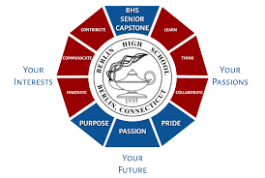
Student Achievement Highlights
4 Schools recognized by US News & World Report
AP Honor Roll
Lemelson-MIT InvenTeams Grant
2 National Merit Scholarship Semifinalists
1 National Merit Scholarship Commended Student
120 Presidential Award Recipients
73 NHS Members
51 Rho Kappa Members
53 Community Service Citations
27 Seal of Biliteracy Recipients
40 Capstone Exemplars
Notes:
Updated ALD 1/8/26
3- CA, 1- NY, 1-MA, 1-FL, 1-AZ

Slide 20
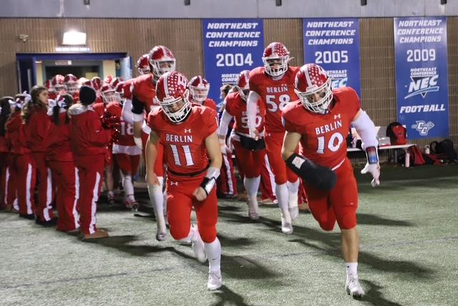
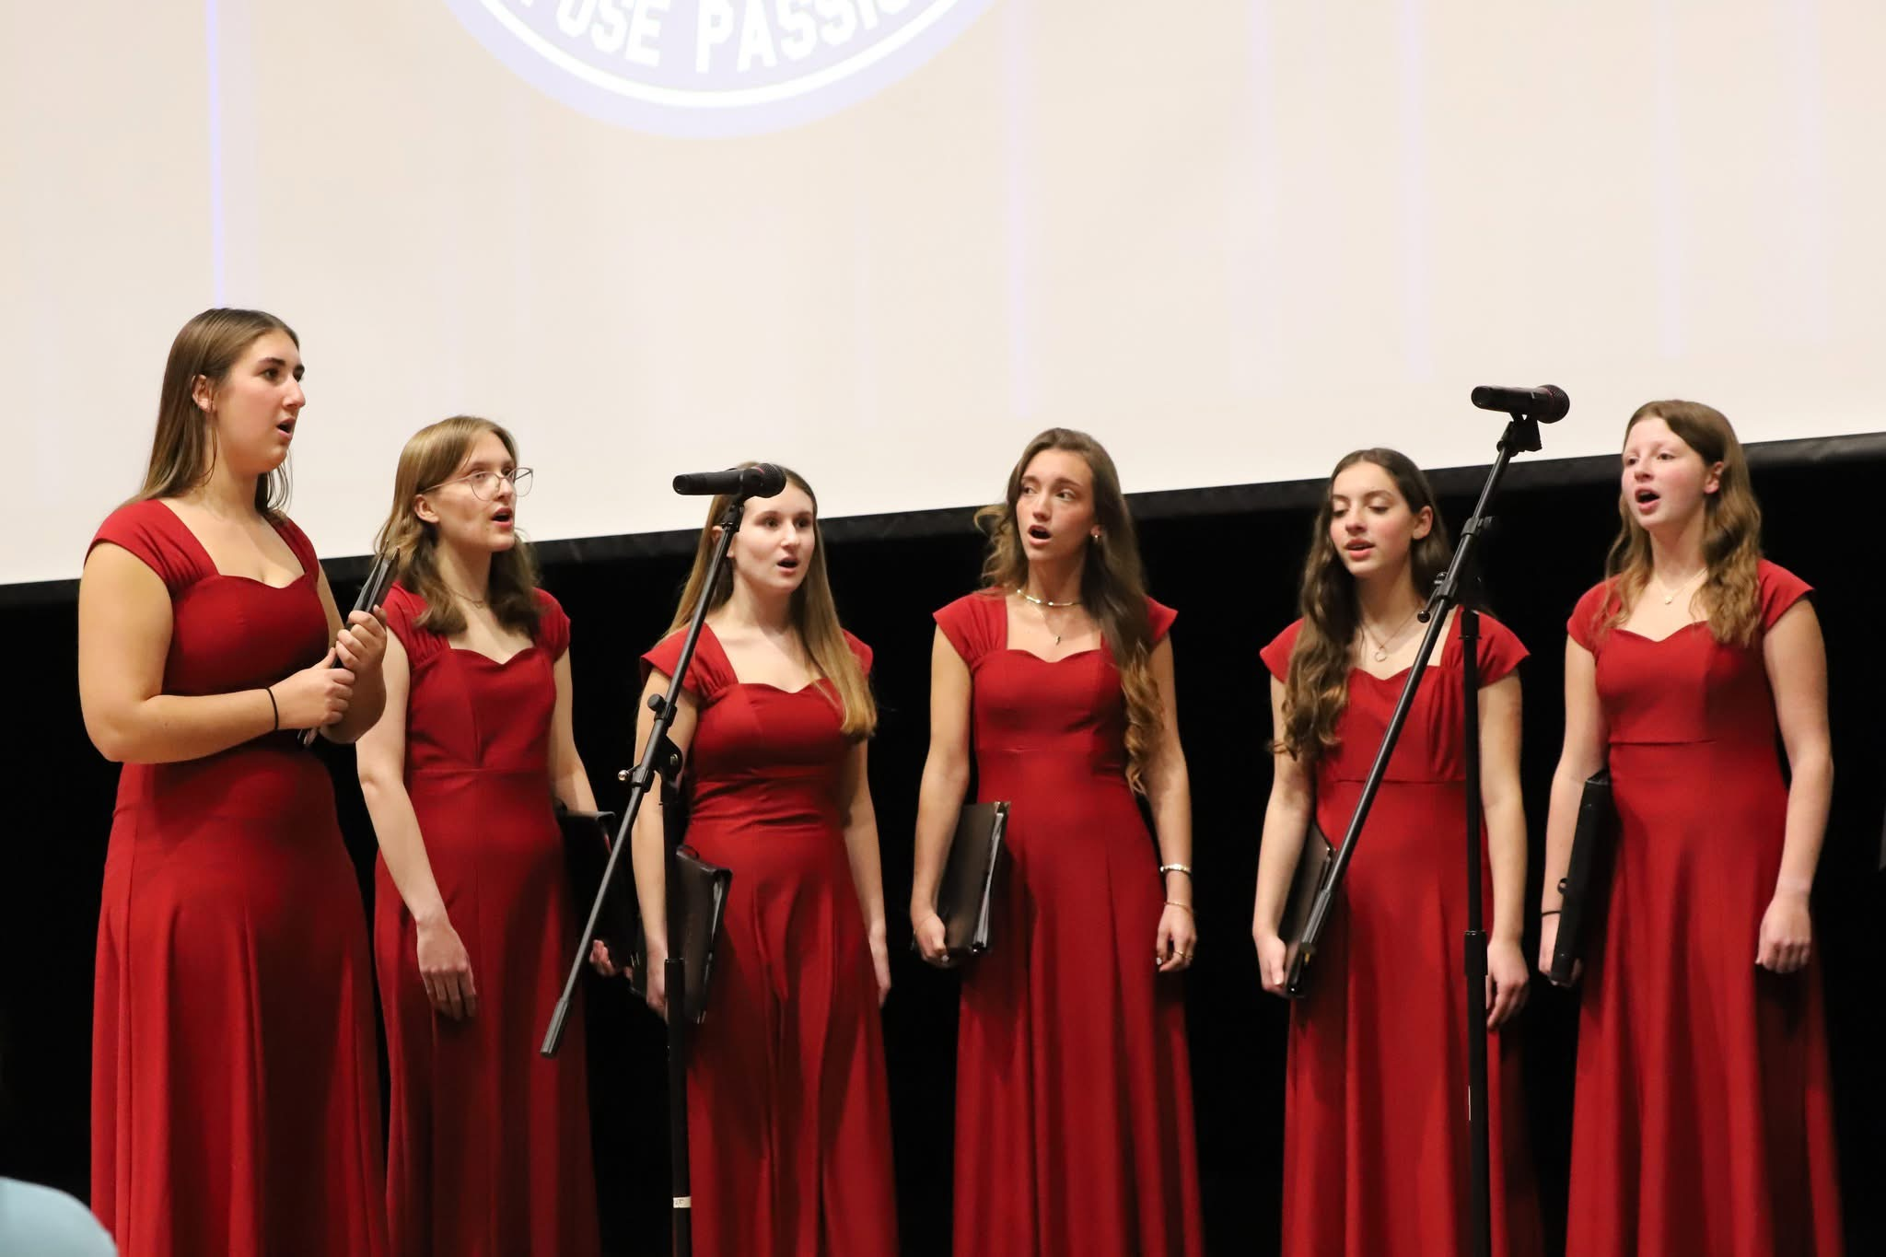
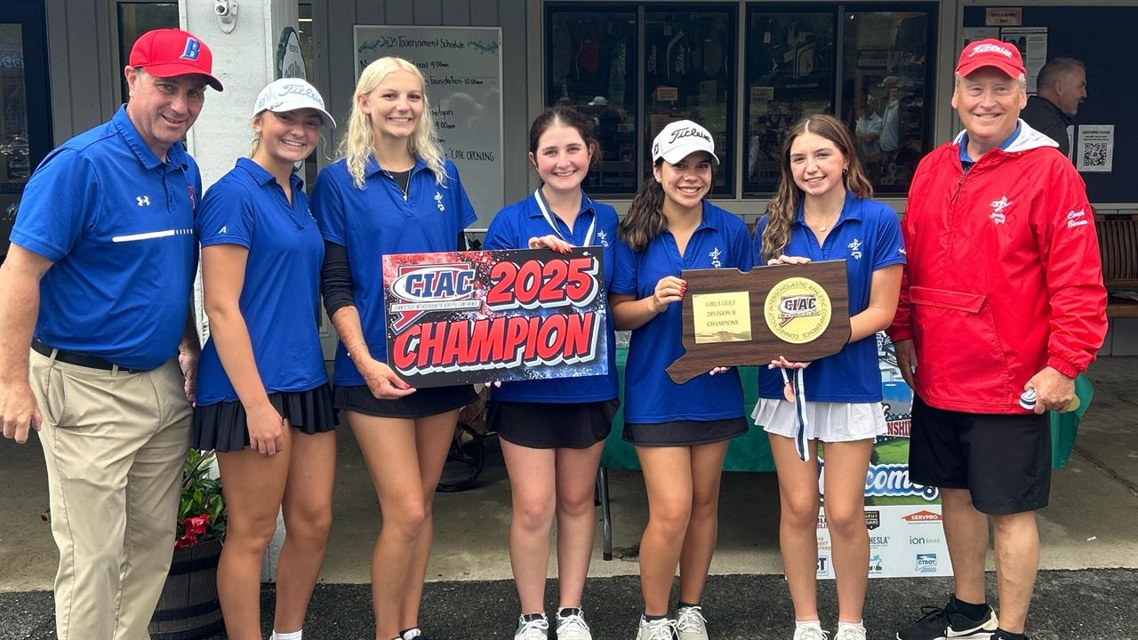
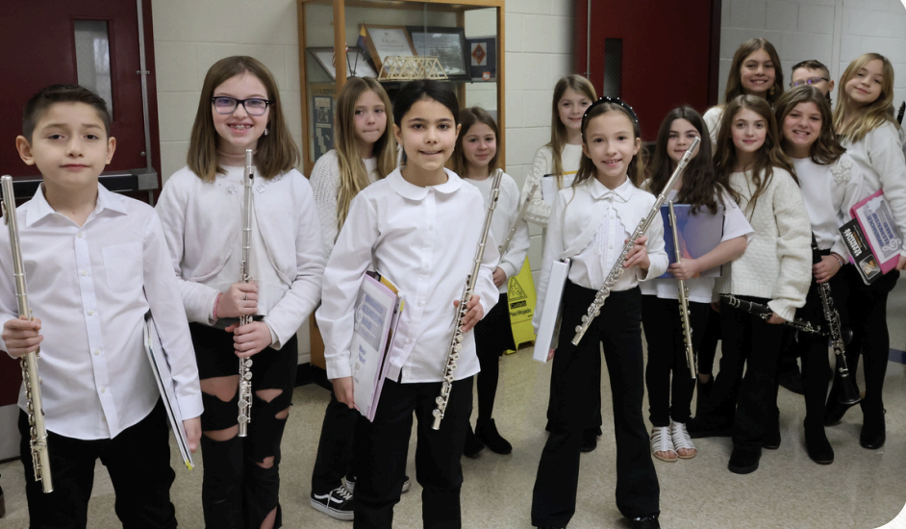
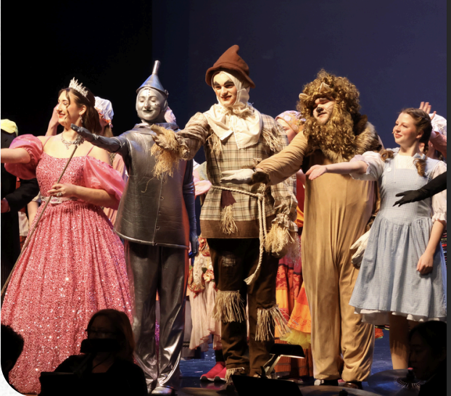
District Highlights
Co-Curricular Programming:
40 Interscholastic Sport Teams
Intramural Sports
Afternoon Sports & Adventures
Art League
Band & Chorus
Theater Program
Upbeat
Girls on the Run
Media Team
Tech Experts
Student Employment
Clubs:
70 plus viable clubs K-12

Slide 21
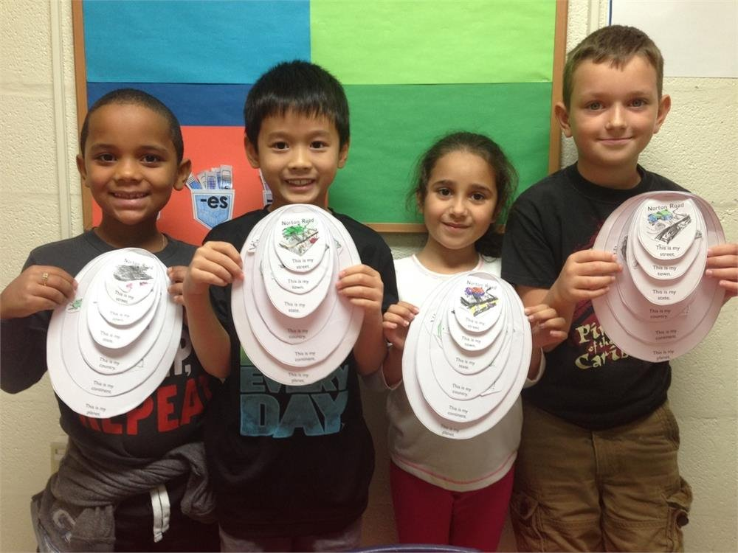
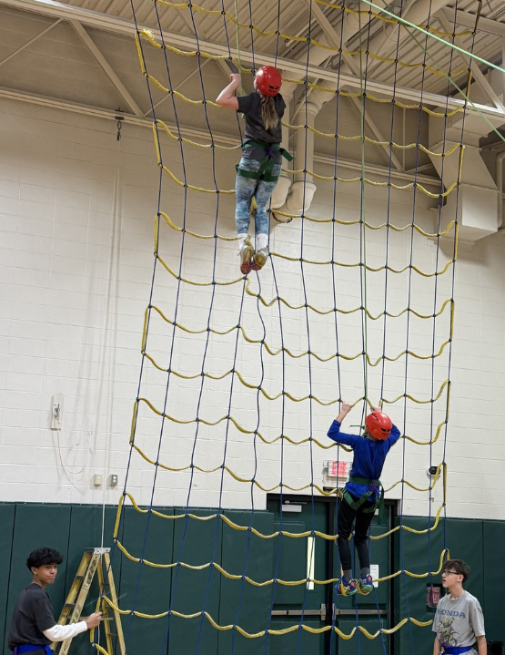
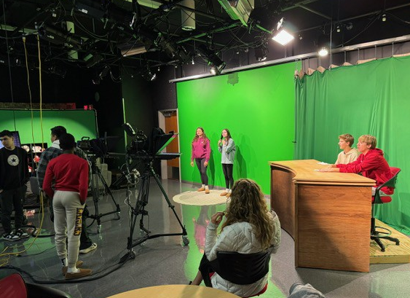
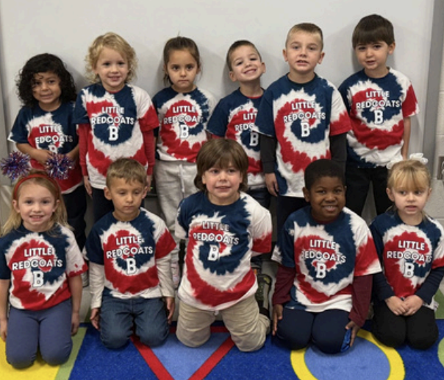
District Highlights
Average Elementary Class Size: 19
Average Secondary Class Size: 21
Programming:
STEAM
Pathways
Internships & Externships
PreSchool
ELL
Wellness
Quest Program
Capstone Project
Media & Digital Literacy
High Quality Instruction (HQI)
Vision of a Graduate
Project Adventure
AP, ECE, & College Partnerships
p

Slide 22
Board of Education
Budget for Fiscal Year 2026-2027

Slide 23
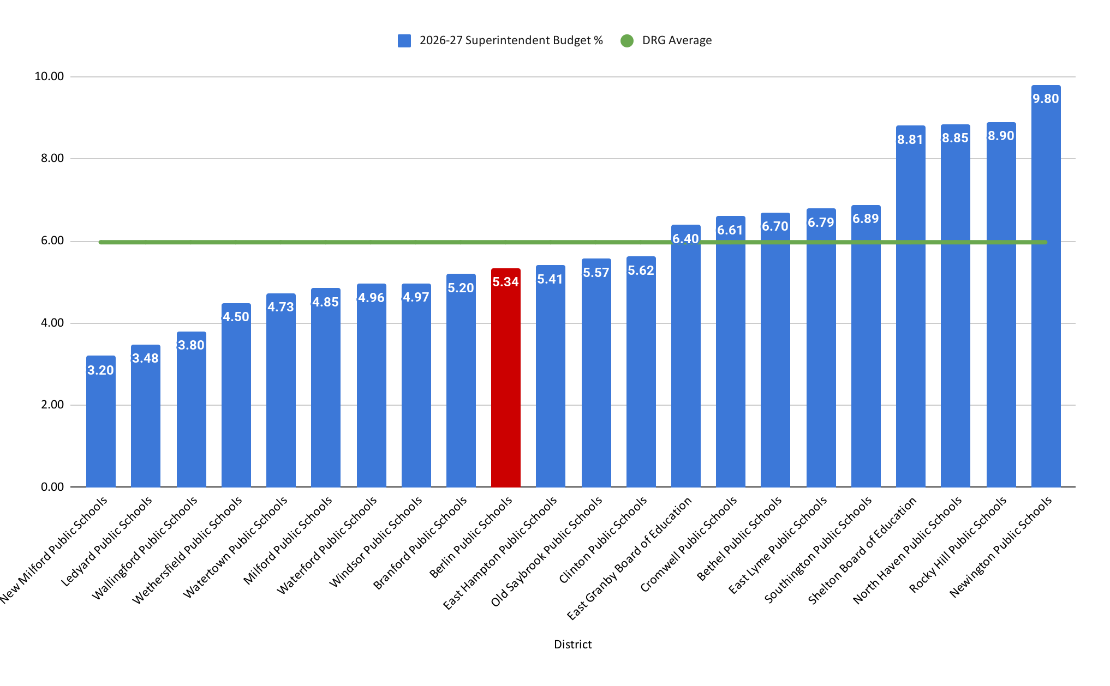
Superintendent’s Request by DRG D

Slide 24
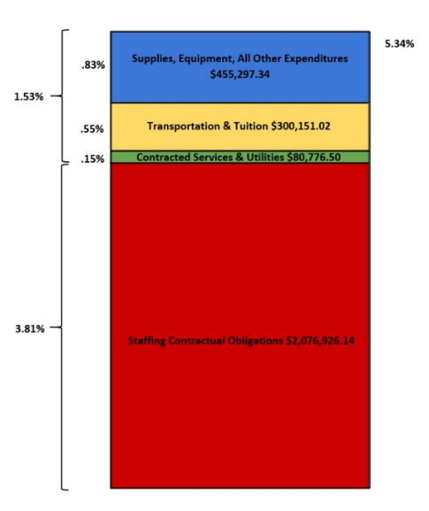
Board of Education’s Budget Request at a Glance
Total Request:
$57,481,059
Percentage Increase:
5.34%
Dollar Difference:
$2,913,151
Notes:
ALD Update 1/7/26
TL Updated 1/8/26
So the three million is the increase - when I read it, I thought it was the budget (but knew it wasn’t). This should be titled S’s Proposed Budget Increase or is should have the proposed budget amount.

Slide 25
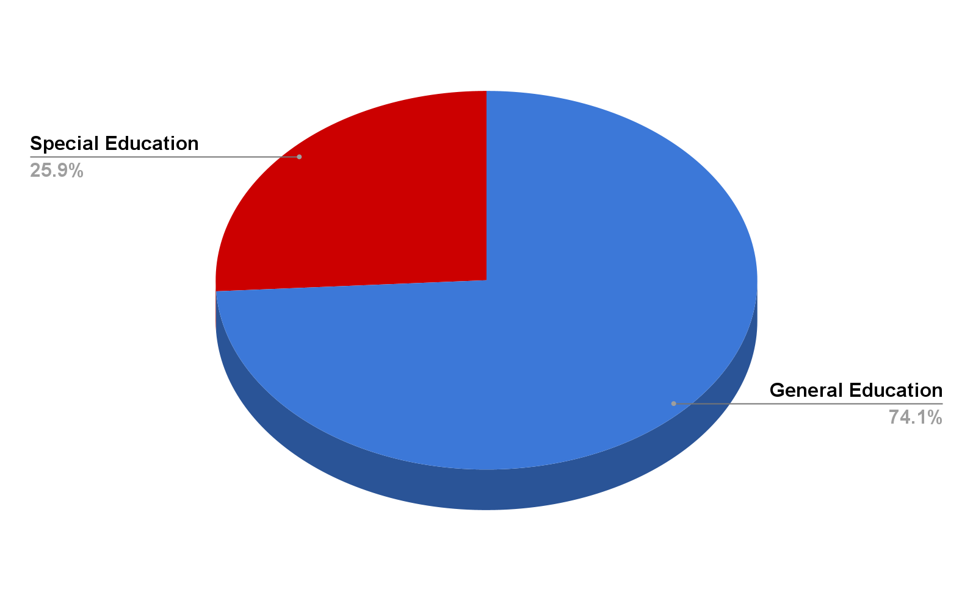
Percentage of Special Education Budget
Special Education Requests Budget:
$14,906,728
Percentage of General Fund Budget:
25.9%
Notes:
ALD Updated 1/9/26

Slide 26
Board of Education’s Requested Budget - $57,481,059
(Increase of 5.34%)
Description | FY 25-26 Budget as of 12/15/25 | FY 26-27 Superintendent Request | Dollar Difference | Percentage Difference
Administrative Salaries | $3,363,533.00 | $3,417,558.00 | $54,025.00 | 1.61%
Certified Salaries | $24,053,228.00 | $24,977,953.00 | $924,725.00 | 3.84%
Non-Certified Salaries | $8,433,998.13 | $9,006,179.00 | $572,180.87 | 6.78%
Employee Benefits | $8,626,432.73 | $9,152,428.00 | $525,995.27 | 6.10%
Contracted Services | $2,510,193.50 | $2,554,510.00 | $44,316.50 | 1.77%
Utilities | $500,830.00 | $537,290.00 | $36,460.00 | 7.28%
Transportation | $3,502,053.98 | $3,611,388.00 | $109,334.02 | 3.12%
Tuition | $2,250,912.00 | $2,441,729.00 | $190,817.00 | 8.48%
Supplies, Textbooks, & Materials | $1,019,125.92 | $1,022,854.00 | $3,728.08 | 0.37%
Equipment | $233,700.74 | $634,771.00 | $401,070.26 | 171.62%
All Other Expenditures | $73,900.00 | $124,399.00 | $50,499.00 | 68.33%
Total | $54,567,908.00 | $57,481,059.00 | $2,913,151.00 | 5.34%
Notes:
ALD Updated 1/8/26

Slide 27
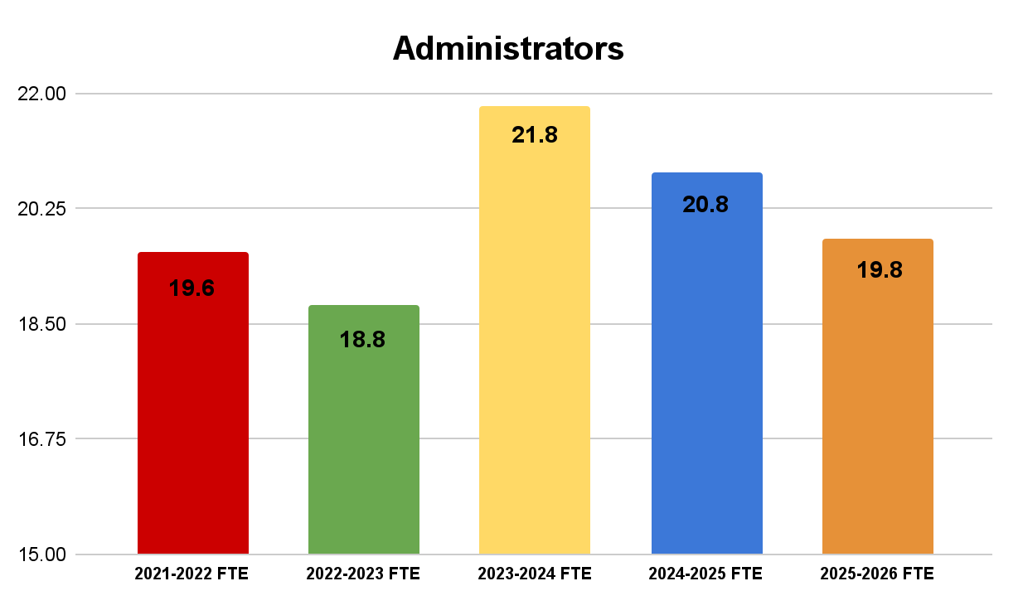
Administrative Salaries: $3,417,558
Increase of: $54,025 (1.61%)
WHAT CHANGED?
Reinstatement of Assistant Superintendent Position
Elimination of (1) Special Education Supervisor
Reclassification of Director of PPS & Athletic Director
3.00% Increase for all Unaffiliated & Step 5 Administrators (15.8)
5.40% Increase for Step 1-4 Administrators (4.0)
Reduction in FTE from prior year reflects the elimination of the Dean of Students at McGee Middle School. Anticipated FTE for 2026-27 is 19.8.
Notes:
Updated 11/25/25

Slide 28
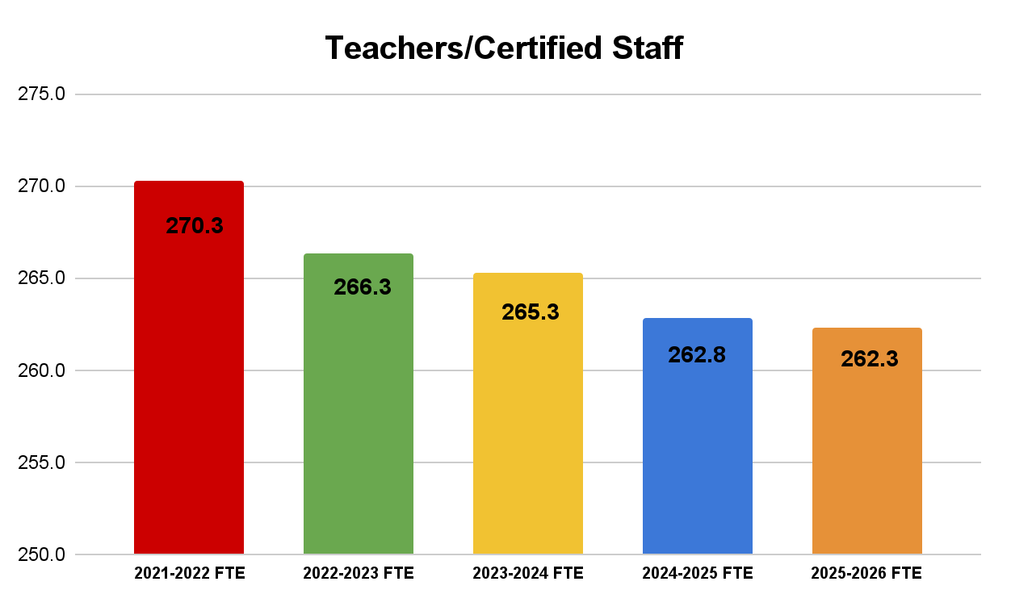
Certified Staff: $24,977,953
Increase of: $924,725 (3.84%)
WHAT CHANGED?
3% Contractual wage increase of Certified Staff
170 Certified Staff are Maxed on Column
92 Certified Staff advancing a Step in Column
Salaries adjust to MA7 for anticipated retirements
No new certified staff requested
2025-26 FTE pulled from official 10/1/25 census. FTE count includes all funding sources, i.e.General Fund (Local Tax), Grants (State & Federal), Special Revenue Accounts (Tuition).
Notes:
ALD updated 1/8/26

Slide 29
Non-Certified Salaries: $9,006,179
Increase of: $572,180.87 (6.78%)
WHAT CHANGED?
Non-Certified Staff Include:
Total Number of Non-Certified Staff:
Average 2.75% contractual wage increase of affiliated staff groups
Anticipated 3% wage increase for unaffiliated staff groups
Includes an additional (2) Special Education Paraeducators for the 2026-27 School Year
Para Educators
Clerical Staff
Custodians
OT/PT
Tutors
IT Departments
Per Diem Substitutes
Athletic Trainer
214.86
Increase in FTE from prior year are for 2.4 paraeducators in specialized elementary programs and .5 unaffiliated (clerical support) at BHS. Positions are funded by grants & other funding sources. Positions are not budgeted in the General Fund (local tax dollars).
Notes:
ALD Update 1/8/26
Non-affiliated staff increases (?) are budgeted at 3% (clarification)

Slide 30

Employee Benefits: $9,152,428
Increase of: $525,995.27 (6.10%)
Employee Benefits Include:
WHAT CHANGED?
Anticipated 10% increase in health insurance premiums
Benefit adjustments (Health & FICA) for the two new paraeducators calculated at EE+1
Includes increase for anticipated modifications to the paraeducator dental and dependent plans
Includes adjustments for pension eligible employees
Health Insurance
Social Security & Medicare
Pension
Life Insurance
Retirement Incentives
Unemployment
Annuity Benefits
Staff Course Reimbursement
Notes:
ALD Update 1/8/26

Slide 31



Contracted Services: $2,554,510
Increase of: $44,316.50 (1.77%)
WHAT CHANGED?
Contracted Services Include:
Anticipated 4% - 7% increase for software subscription services
Anticipated 3% increase for Special Education Professional Services
3% Contractual Obligation for Athletic Transportation
Reductions made for reallocation of funds
Operational & Educational Systems
Professional Services for PPS (including ESS at BHS)
Legal Services
Transportation for Athletics
Professional Development
Notes:
ALD Update 1/8/26
Non-affiliated staff increases (?) are budgeted at 3% (clarification)

Slide 32

Utilities: $537,290
Increase of: $36,460 (7.28%)
Utilities Include:
WHAT CHANGED?
Electrical rates at CCTA
Natural Gas
Water Usage
Phone Services
Electricity (CCTA only)
Natural Gas
Waste Management
Telephone Services
Water & Sewer Services
WERB Maintenance
Notes:
Non-affiliated staff increases (?) are budgeted at 3% (clarification)

Slide 33

Transportation: $3,611,388
Increase of: $109,334.02 (3.12%)
WHAT CHANGED?
Transportation Includes:
Contractual Increase of 3% for all transportation services
Special Education budgeted net of Excess Cost Reimbursement
Includes Fuel Contract
Increase for Repair & Maintenance Lines
Public School Transportation (In-Town Regular Education)
Special Education Transportation (In and Out-Of-Town)
Private School Transportation
Tech and Vocational School Transportation
Fuel
Repair & Maintenance
Notes:
ALD Updated 1/8/26
Non-affiliated staff increases (?) are budgeted at 3% (clarification)

Slide 34

Tuition: $2,441,729
Increase of: $190,817 (8.48%)
WHAT CHANGED?
Tuition Includes:
Anticipated 3% increase for all Outplacement Facilities
Special Education Tuition budgeted net of Excess Cost Reimbursement
Three unanticipated outplacements budgeted
Adjustment for Independent Study
Special Education Outplacements(Public & Private)
Independent Study
Magnet School Tuition
Vocational School Tuition
Notes:
ALD Updated 1/8/26

Slide 35

Supplies, Textbooks & Materials: $1,022,854
Increase of $3,728.08 (0.37%)
Supplies Includes:
WHAT CHANGED?
Building Budgets remain flat, no increase
Reduction in Textbooks
Increase for Custodial Supplies & Materials
All Educational & Non-Educational Supplies (Pencils to Toilet Paper)
Textbooks
Consumable Workbooks
Athletic Supplies
Graduation Supplies
Notes:
Non-affiliated staff increases (?) are budgeted at 3% (clarification)

Slide 36

Equipment: $634,771
Increase of $401,070.26 (171.62%)
Equipment includes:
WHAT CHANGED?
Technology (Projectors, Chromebooks, iPADs, Laptops, PCs, Servers, etc.)
Operations (Classroom furniture & equipment, Shelving, Custodial equipment, etc.)
Athletics (Baseballs, Soccer Balls, Track Equipment, etc.)
Increase for School Technology & Infrastructure
Increase for Operations & Maintenance
Building Budgets remain flat or minimal decrease
Notes:
UPDATED 1/5/2025
Non-affiliated staff increases (?) are budgeted at 3% (clarification)

Slide 37

All Other Expenditures: $124,399
Increase of $50,499 (68.33%)
All Other Expenditures Include:
WHAT CHANGED?
Professional Organizations (CABE, CASBO, SIIP, etc.)
Athletic Tournament Fees (Wrestling, Track, Swimming, etc.)
Minor Building Improvements (Safety, Department Reorganizations, etc.)
Increase for CABE
Increase for Operations & Maintenance
Building Budgets remain flat or minimal decrease
Notes:
Non-affiliated staff increases (?) are budgeted at 3% (clarification)

Slide 38
Armed Security Department: $439,404
Increase of $2,595 (0.59%)
WHAT CHANGED?
Security Department Budget |  |  |  | $439,404
Description | FY 24-25 Budget | FY 25-26 Budget | FY 26-27 Budget | Dollar Difference | Percentage Difference
Security/Safety/ Residency Director | $79,568 | $82,888 | $85,375 | $2,487 | 3.13%
Security Officers | $299,850 | $308,846 | $318,111 | $9,266 | 3.09%
Other Professional Services | $9,850 | $10,146 | $10,450 | $304 | 3.09%
Contracted Services | $8,330 | $8,580 | $8,837 | $257 | 3.09%
Uniforms | $9,070 | $9,350 | $9,631 | $281 | 3.09%
Equipment | $5,470 | $17,000 | $7,000 | -$10,000 | -182.82%
Totals | $412,138 | $436,809 | $439,404 | $2,595 | 0.59%
Includes 3% General Wage Increase
Includes anticipated overtime
Reduction of equipment
NOTE: The Security Department budget is funded by the Town of Berlin and is not included in the Superintendent’s Budget Request.
Notes:
Non-affiliated staff increases (?) are budgeted at 3% (clarification)

Slide 39
Additional Funding Sources

Slide 40
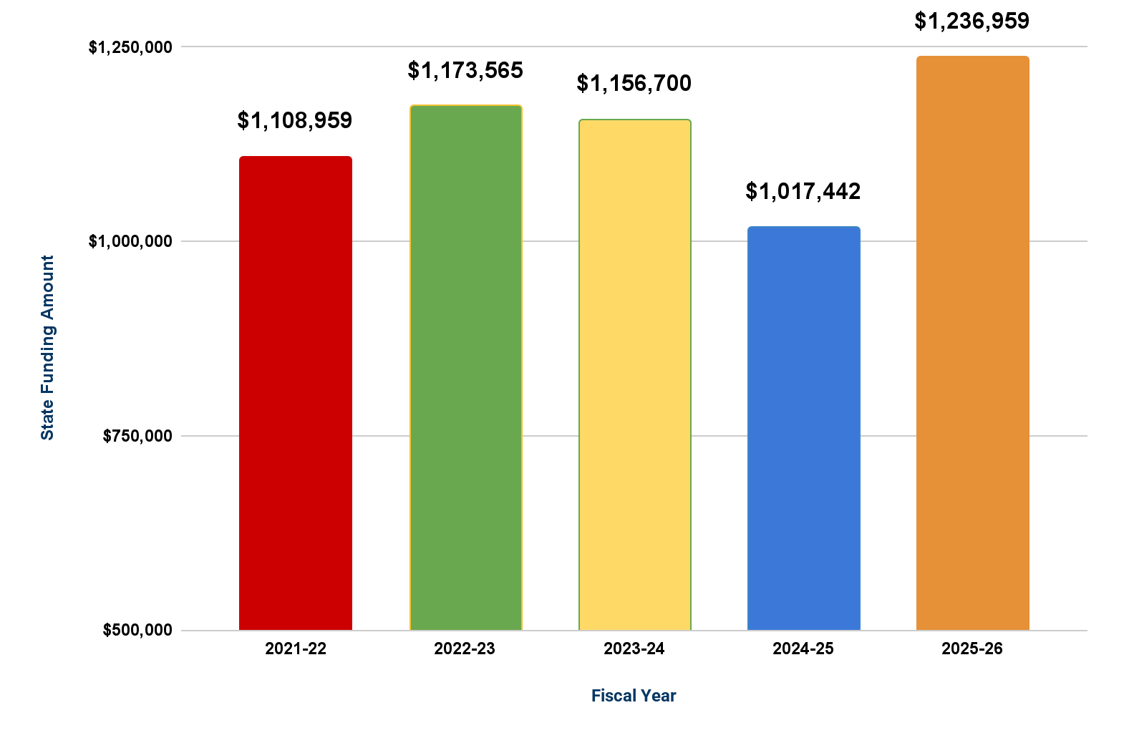
State Funding
WHAT CHANGED?
NEW GRANT: Special Education Expansion & Development (SEED)
Open Choice Funding Increased
Notes:
ALD updated 1/8/26

Slide 41
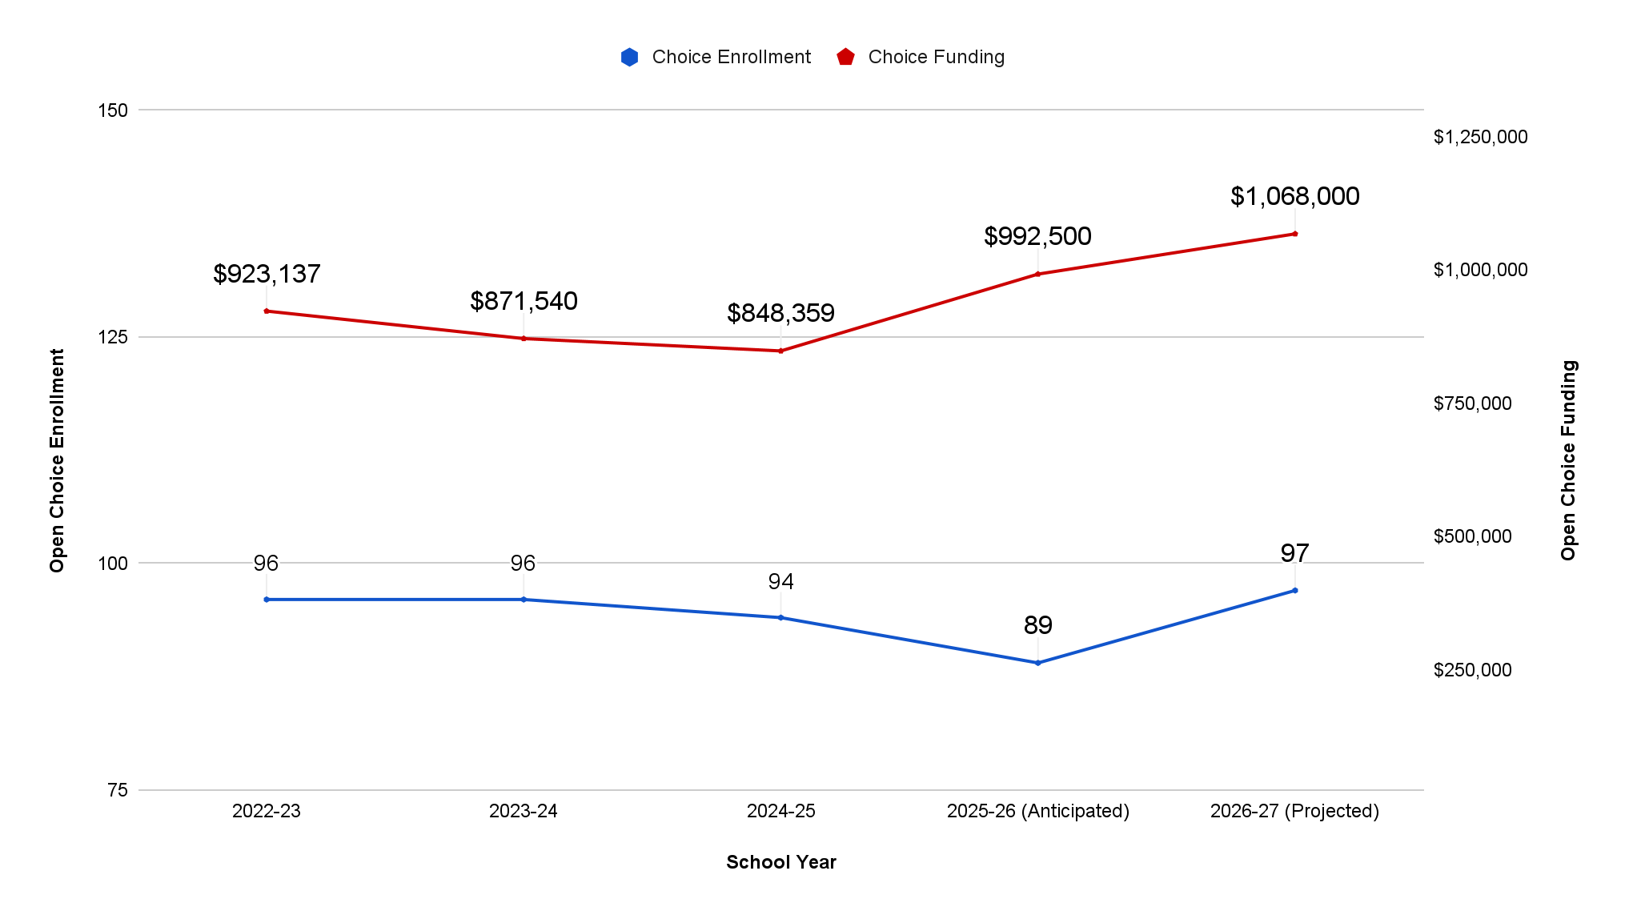
Open Choice Enrollment & Funding History
WHAT CHANGED?
Assumes 97 Open Choice Students for 2026-2027 district-wide
Anticipates 10 open seats in grade K
Assumes 3.78% Open Choice Population
Stipend increased $2,000 per student
Notes:
ALD Updated 1/8/26

Slide 42
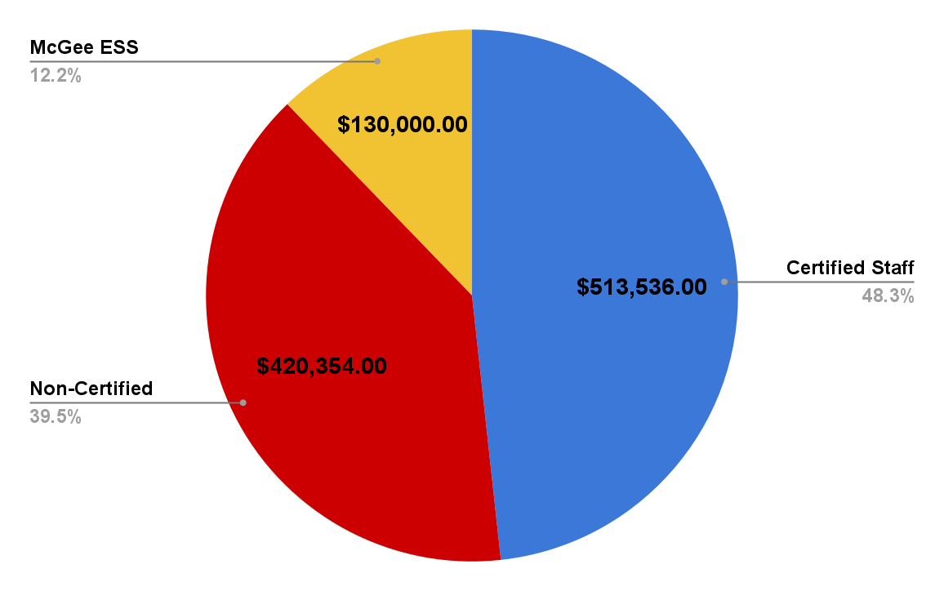
Anticipated Open Choice Budget:
$ 1,063,890
WHAT CHANGED?
Anticipates $400,000 carryover to fund Q1 and Q2 Payroll in FY27
14.5 Positions (5 Certified, 9.5 Non-Certified)
Stipend increased $2,000 per student
Assumes $400,000 Balance on 6/30/27 to fund Q1 & Q2 Payroll in FY28
Notes:
ALD updated 1/8/26

Slide 43
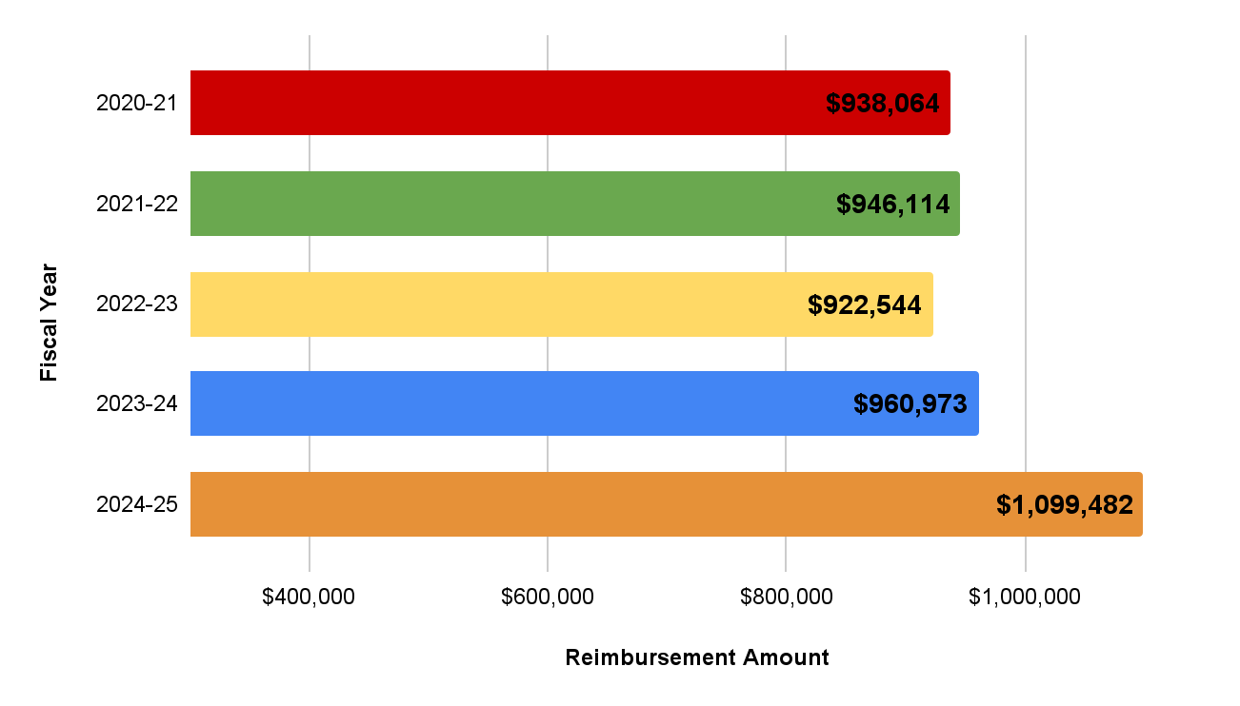
Historical Excess Cost Reimbursements
WHAT CHANGED?
Reimbursement is variable by the number of students who qualify for Excess Cost
Reimbursement threshold for FY26 is $105,520
Notes:
Updated 1/8/26

Slide 44
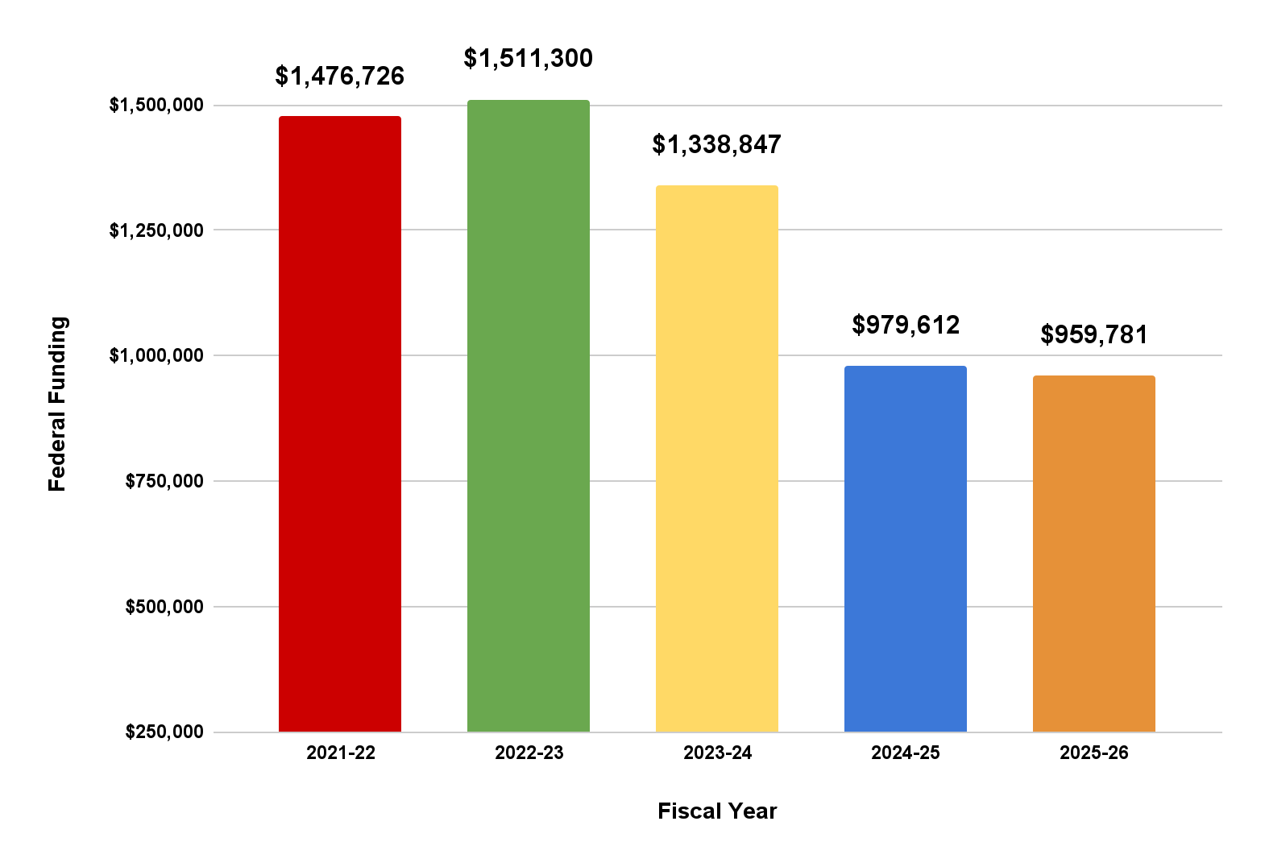
Federal Funding
WHAT CHANGED?
Increase in Title Funds
Slight decrease in IDEA Funds
Notes:
ALD Updated 1/8/26

Slide 45
Pre-K Tuition Revenue
Anticipated Revenue
Anticipated Full Tuition Students |  | 33
Anticipated FA Tuition Students |  | 4
Discounted (10%) Pay in Full |  | 3
Total Anticipated in Program |  | 40
Annual Tuition Rates:
Pay in Full |  | $8,250.00
Financial Assistance (Average) |  | $4,250.00
Discounted (10%) Pay in Full |  | $7,425.00
Anticipated Revenues:
Full Tuition Revenue |  | $272,250.00
Financial Assistance Revenue |  | $17,000.00
Discounted Revenue |  | $22,275.00
Total Anticipated Revenue for 2026-27 |  | $311,525.00
WHAT CHANGED?
In FY26 Berlin began a full-day, tuition-based program for Pre-K Students
Tuition rate for FY 27 is $8,250 annually, 3% increase from prior year
Revenue projections assume 40 peer leaders will enroll in the program
Revenue will offset previous expenses in the General Fund (5 positions)
The Pre-K tuition rate for the 2026-27 school year was approved by the Berlin Board of Education at the December meeting held on 12/8/25.
Notes:
Updated 1/10/26

Slide 46
Funding Comparisons

Slide 47
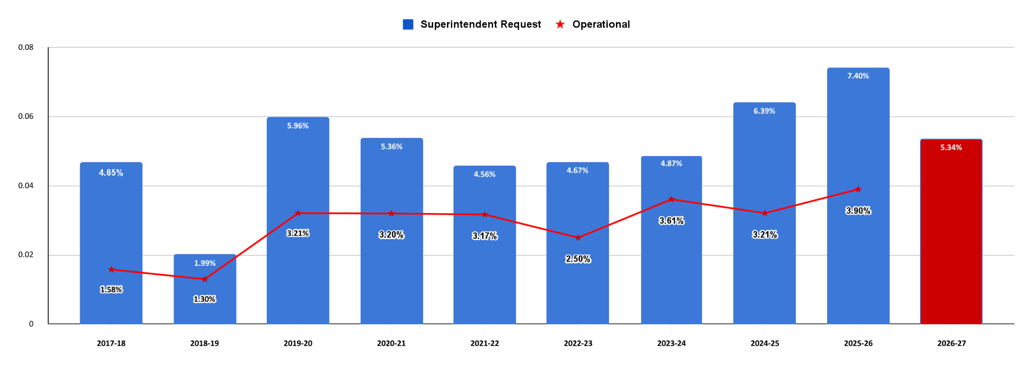
10 Year Budget Funding History
Notes:
ALD Updated 1/8/26

Slide 48
Neighboring Districts Adopted Budget Comparison
District | Adopted 2021-22 | Adopted 2022-23 | Adopted 2023-24 | Adopted 2024-25 | Adopted 2025-26 | 5 Yr. Average Increase
Cromwell | 2.97% | 3.81% | 6.37% | 5.88% | 6.03% | 5.01%
Newington | 0.00% | 2.46% | 4.50% | 5.95% | 5.19% | 3.62%
Farmington | 3.30% | 2.99% | 2.00% | 4.75% | 4.65% | 3.54%
Glastonbury | 1.60% | 2.98% | 2.85% | 3.50% | 3.93% | 2.97%
Wethersfield | 0.53% | 4.98% | 3.33% | 4.97% | 3.90% | 3.54%
Berlin | 3.17% | 2.50% | 3.61% | 3.21% | 3.90% | 3.28%
Rocky Hill | 3.75% | 3.26% | 3.78% | 3.62% | 3.60% | 3.60%
Berlin remains on the bottom of the table for both the 2025-26 budget increase, and the 5 year average, when compared to neighboring communities.
Notes:
ALD Update 1/8/26

Slide 49
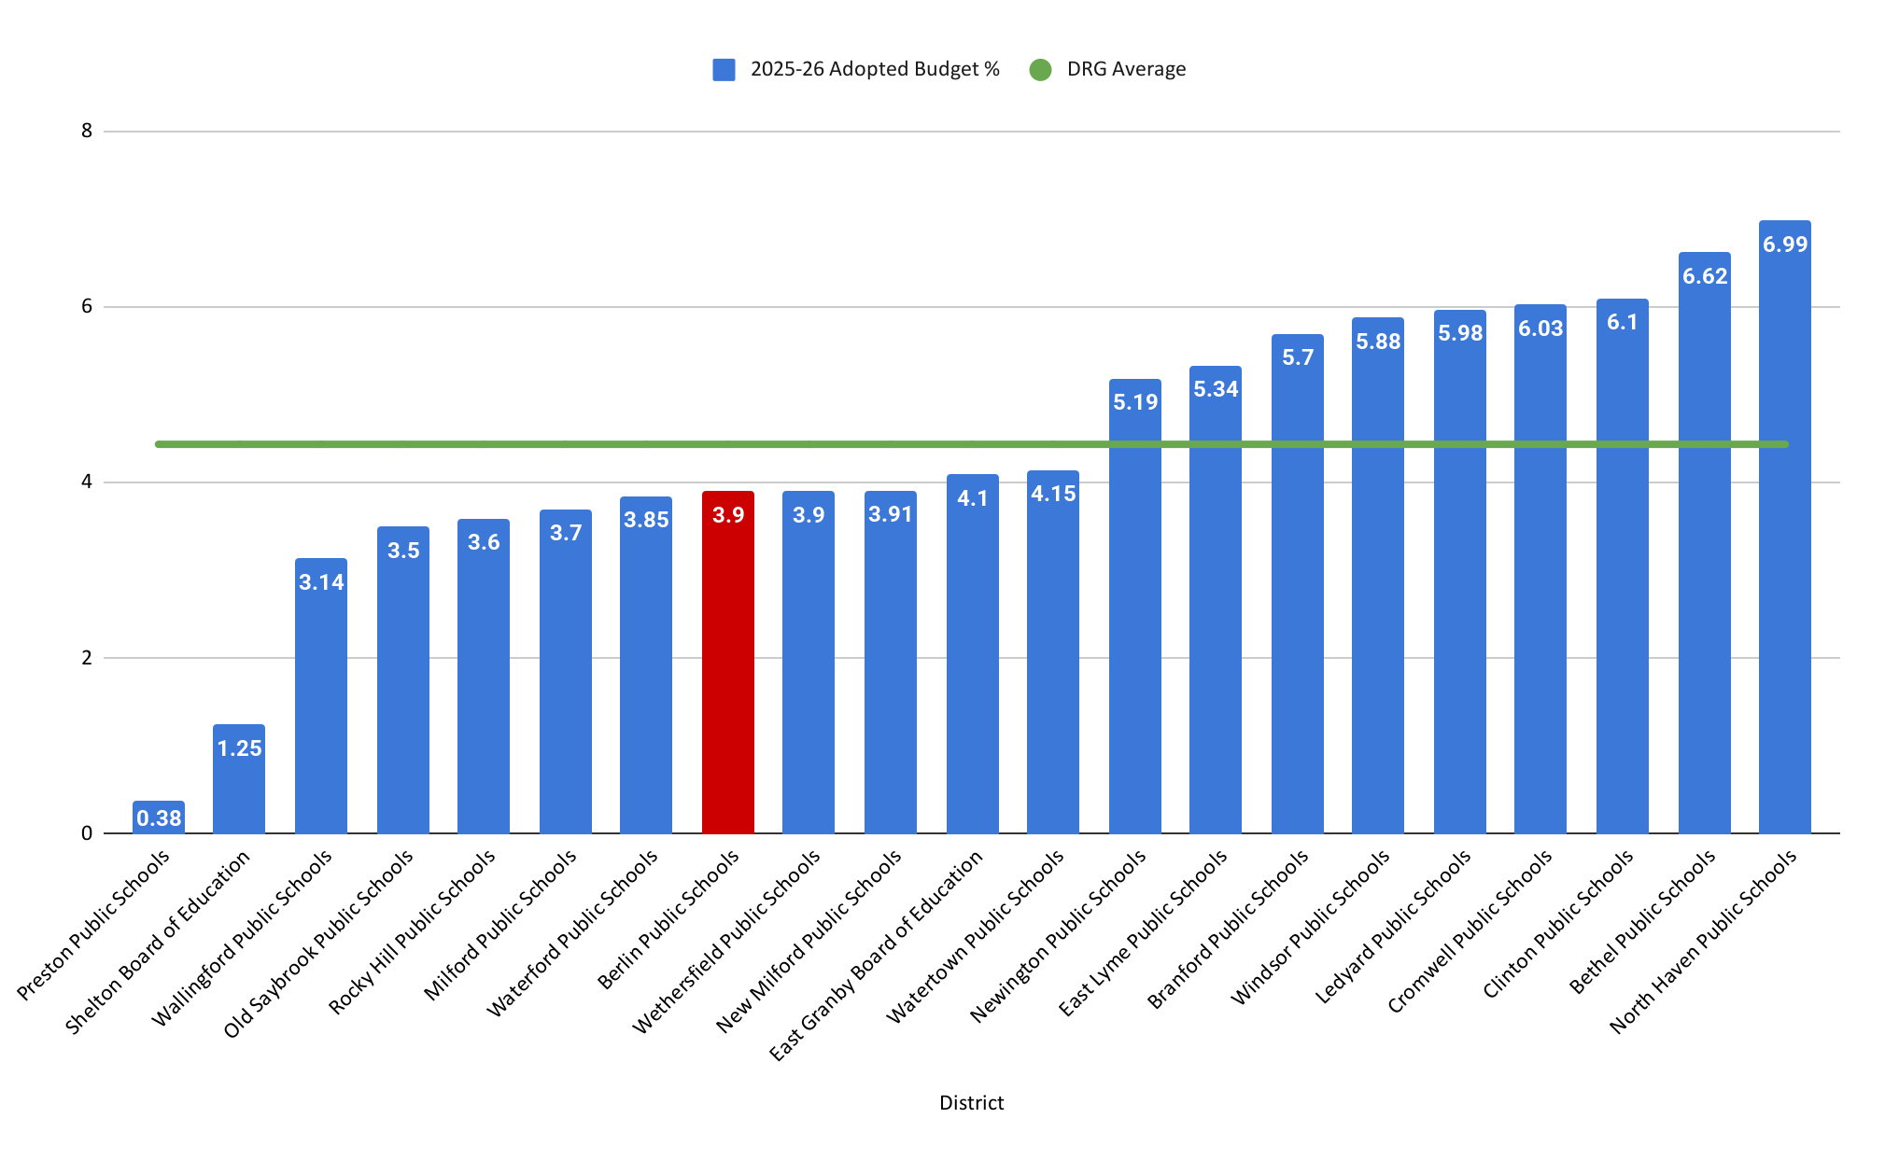
FY26 Budget Percentage Increase for DRG D
Berlin’s FY26 Budget increase was 3.90%
The average budget increase in FY25 or DRG D was 4.44%
Notes:
Partially Updated 1/9/26 waiting on 2 districts to respond to survey

Slide 50
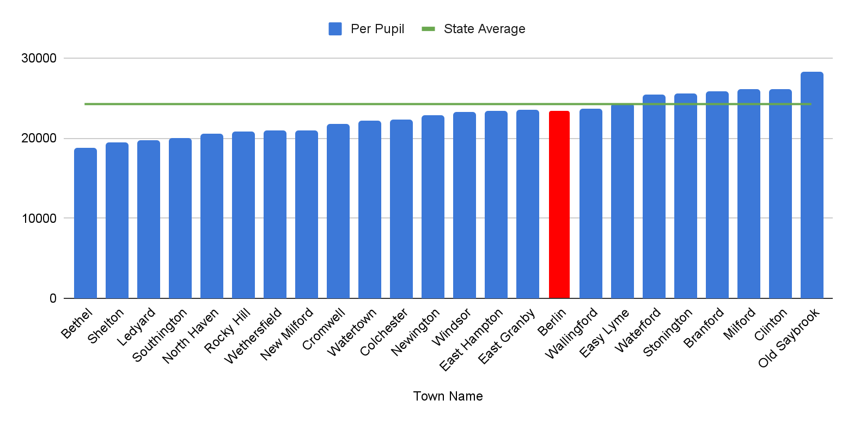
Net Current Expenditure per Pupil (NCEP)
DRG D & State Comparison
Berlin’s Net Current Expenditure is $23,449
The State’s average Net Current Expenditure is $24,270
Data is from the CSDE website posted in October of 2025
Notes:
ALD updated 1/9/26

Slide 51
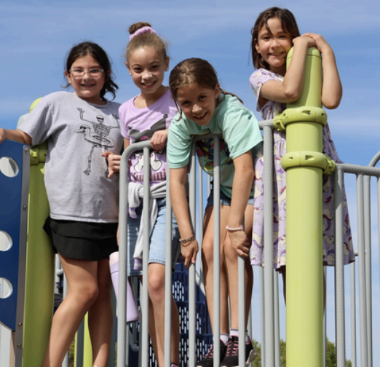
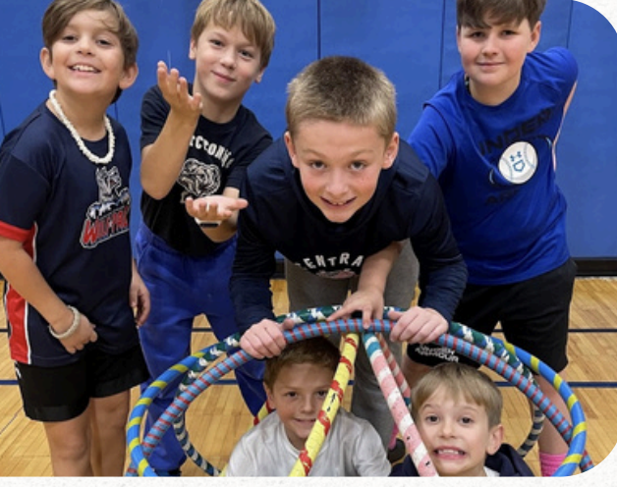
Board of Education’s Budget Request
Total Request:
$57,481,059
Percentage Increase:
5.34%
Dollar Difference:
$2,913,151
Notes:
ALD Update 1/7/26
TL Updated 1/8/26
So the three million is the increase - when I read it, I thought it was the budget (but knew it wasn’t). This should be titled S’s Proposed Budget Increase or is should have the proposed budget amount.

Slide 52
Questions & Comments

Slide 53
Additional Information

Slide 54
5 Year FTE Comparisons
Employee Type | 2021-22 FTE | 2022-23 FTE | 2023-24 FTE | 2024-25 FTE | 2025-26 FTE | 2026-27 Anticipated FTE | Change/Prior Year
Administrators | 19.6 | 18.8 | 21.8 | 20.8 | 19.8 | 19.8 | 0.0
Teachers/Certified Staff | 270.3 | 266.3 | 265.3 | 262.8 | 262.3 | 262.3 | 0.0
Paraprofessionals | 115.0 | 115.8 | 115.9 | 115.0 | 117.3 | 119.3 | 2.0
Clerical | 20.5 | 17.4 | 18.6 | 18.5 | 17.8 | 17.8 | 0.0
Custodians | 27.0 | 27.0 | 26.0 | 26.0 | 27.0 | 27.0 | 0.0
Cook Managers | 5.0 | 5.0 | 5.0 | 5.0 | 5.0 | 5.0 | 0.0
Food Service | 9.8 | 10.7 | 11.9 | 11.9 | 12.7 | 12.7 | 0.0
Unaffiliated | 25.1 | 29.8 | 29.4 | 29.5 | 29.0 | 29.0 | 0.0
Armed Security | 5.0 | 6.0 | 6.0 | 6.0 | 6.0 | 6.0 | 0.0
Total | 497.3 | 496.8 | 499.9 | 495.5 | 496.9 | 498.9 | 2.0
Note:
Includes all positions regardless of funding source.
Based of 10/1/25 census
Notes:
ALD Updated 1/9/26

Slide 55
5 Year Mill Rate Comparisons
District | FY 2021-2022 | FY 2022-2023 | FY 2023-2024 | FY 2024-2025 | FY 2025-2026 | 5 Year Change
Cromwell | 33.33 | 33.93 | 29.41 | 30.07 | 30.79 | -2.54
Glastonbury | 37.32 | 37.30 | 31.01 | 31.93 | 32.83 | -4.49
Wethersfield | 40.67 | 41.08 | 41.78 | 43.22 | 41.22 | 0.55
Farmington | 28.81 | 29.32 | 24.21 | 25.45 | 26.62 | -2.19
Rocky Hill | 34.10 | 34.52 | 35.92 | 39.67 | 30.24 | -3.86
Berlin | 33.93 | 34.31 | 29.56 | 30.21 | 30.65 | -3.28
Newington | 38.81 | 38.49 | 38.36 | 39.67 | 39.98 | 1.17
Notes:
Updated ALD 1/8/26

Slide 56
HISTORICAL BERLIN NET CURRENT EXPENDITURE PER PUPIL (NCEP)/WEALTH RANKINGS
The chart illustrates the per-pupil spending (NCEP) Ranking for Berlin along with its wealth ranking. In both columns, ranking #1 would be the "best" town and ranking #169 would be the "lowest".
Year | WEALTH RANK | NCEP RANK | Berlin | State Average | +/- | # of School Days
2015-16 | 69 | 108 | $15,533 | $17,085 | ($1,552) | 183
2016-17 | 72 | 101 | $16,426 | $17,596 | ($1,170) | 180
2017-18 | 65 | 106 | $16,457 | $18,243 | ($1,786) | 180
2018-19 | 72 | 108 | $17,093 | $18,791 | ($1,698) | 180
2019-20 | 60 | 96 | $18,024 | $19,339 | ($1,315) | 181
2020-21 | 60 | 106 | $18,973 | $20,740 | ($1,767) | 177
2021-22 | 60 | 86 | $20,322 | $21,355 | ($1,033) | 180
2022-23 | 59 | 84 | $20,671 | $21,657 | ($986) | 180
2023-24 | 62 | 82 | $21,719 | $22,836 | ($1,117) | 180
2024-25 | 64 | 89 | $23,449 | $24,270 | ($821) | 180
NCEP - Includes all educational expenses, less expenditures for (a) pupil transportation; (b) debt services; (c) adult education; (d) health and welfare services for non-public school children (e) tuition receipts; (f) food services; and (g) student activities supported by gate receipts. Sec 10-261
Per Connecticut State Department of Education Website
Wealth Rank is the AENGLC (Adjusted Equalized Net Grand List per Capita)
Notes:
ALD Updated 1/9/26

Slide 57
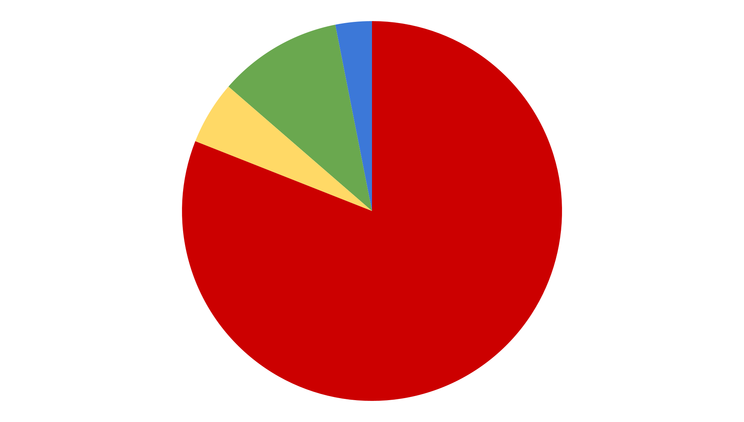
Superintendent’s Budget Request at a Glance
Transportation & Tuition
$6,053,117 (10.53%)
Supplies, Equipment & All Other
$1,782,024 (3.10%)
Contracted Services & Utilities
$3,091,800 (5.38%)
All Staffing & Benefits
$46,554,1184 (80.99%)
$57,481,059 (5.34%)
Notes:
ALD Updated 1/8/26

Slide 58
Elementary Projected Enrollment
Griswold | 10/1/2025 Enrollment | # Classes 2025/26 | AVG. 2025/26 | Proj. 2026/27 | Proj. # Classes 2026/27 | Proj. AVG. 2026/27 | FTE NET CHANGE
K | 82 | 5 | 16.4 | 79 | 5 | 15.8 | 0
1 | 75 | 4 | 18.75 | 83 | 4 | 20.75 | 0
2 | 69 | 4 | 17.25 | 75 | 4 | 18.75 | 0
3 | 96 | 5 | 19.2 | 69 | 4 | 17.25 | -1
4 | 90 | 4 | 22.5 | 96 | 5 | 19.2 | 1
5 | 82 | 4 | 20.5 | 90 | 4 | 22.5 | 0
TOTAL: | 494 | 26 |  | 492 | 26
# Teachers |  | 26 |  |  | 26 |  | 0
Hubbard | 10/1/2025 Enrollment | # Classes 2025/26 | AVG. 2025/26 | Proj. 2026/27 | Proj. # Classes 2026/27 | Proj. AVG. 2026/27 | FTE NET CHANGE
K | 31 | 2 | 15.5 | 34 | 2 | 17 | 0
1 | 30 | 2 | 15 | 31 | 2 | 15.5 | 0
2 | 40 | 2 | 20 | 30 | 2 | 15 | 0
3 | 30 | 2 | 15 | 40 | 2 | 20 | 0
4 | 46 | 2 | 23 | 30 | 2 | 15 | 0
5 | 30 | 2 | 15 | 46 | 2 | 23 | 0
TOTAL: | 207 | 12 |  | 211 | 12
# Teachers |  | 12 |  |  | 12 |  | 0
Willard | 10/1/2025 Enrollment | # Classes 2025/26 | AVG. 2025/26 | Proj. 2026/27 | Proj. # Classes 2026/27 | Proj. AVG. 2026/27 | FTE NET CHANGE
PK | 53 | 4 | 13.25 | 64 | 4 | 16 | 0
K | 57 | 3 | 19 | 63 | 4 | 15.75 | 1
1 | 58 | 3 | 19.33 | 57 | 3 | 19 | 0
2 | 61 | 3 | 20.33 | 58 | 3 | 19.33 | 0
3 | 64 | 3 | 21.33 | 61 | 3 | 20.33 | 0
4 | 69 | 3 | 23 | 64 | 3 | 21.33 | 0
5 | 80 | 4 | 20 | 69 | 3 | 23 | -1
TOTAL: | 442 | 23 |  | 436 | 23
# Teachers |  | 23 |  |  | 23 |  | 0
Notes:
TL updated 1/7/26
TL added PK 1/9/26

Slide 59
Secondary Projected Enrollment
McGee Middle School | 10/1/2025 Enrollment | 2026/27 Proj. Enrollment | NET CHANGE
6 | 197 | 192
7 | 200 | 197
8 | 206 | 200
TOTAL: | 603 | 589 | -14
Berlin High School | 10/1/2025 Enrollment | 2026/27 Proj. Enrollment | NET CHANGE
9 | 185 | 206
10 | 200 | 185
11 | 202 | 200
12 | 203 | 202
TOTAL: | 790 | 793 | 3
BHS PK | 10/1/2025 Enrollment | # Classes 2025/26 | AVG. 2025/26 | Proj. 2026/27 | Proj. # Classes 2026/27 | Proj. AVG. 2026/27 | FTE NET CHANGE
PK | 13 | 1 | 13 | 16 | 1 | 16 | 0
TOTAL: | 13 | 1 |  | 16 | 1
# Teachers |  | 1 |  |  | 1 |  | 0
Notes:
TL update 1/7/26

Slide 60
Student Achievement Report
SAT
SAT Reading & Writing DRG D
District | # of Students Tested | Participation Rate | # of Students at Level 3 & 4 | % of Students at Level 3 & 4 | Average Score
East Lyme | 234 | 96.7 | 192 | 82.1 | 563
East Hampton | 117 | 97.5 | 95 | 81.2 | 544
East Granby | 66 | 100 | 53 | 80.3 | 555
Stonington | 129 | 97.7 | 103 | 79.8 | 548
Ledyard | 174 | 98.9 | 136 | 78.2 | 543
Old Saybrook | 72 | 98.6 | 55 | 77.5 | 544
Waterford | 181 | 97.3 | 140 | 77.3 | 540
Rocky Hill | 182 | 97.8 | 139 | 76.4 | 548
Milford | 374 | 95.4 | 269 | 71.9 | 521
Bethel | 266 | 95.7 | 188 | 70.7 | 526
Southington | 489 | 98.6 | 340 | 69.7 | 511
Colchester | 142 | 96.6 | 97 | 68.3 | 522
Cromwell | 111 | 98.2 | 75 | 68.2 | 524
Berlin | 188 | 97.4 | 128 | 68.1 | 518
Clinton | 129 | 97.7 | 87 | 68 | 510
Branford | 177 | 94.1 | 119 | 67.2 | 517
North Haven | 211 | 99.5 | 140 | 66.7 | 520
Shelton | 296 | 98 | 194 | 65.5 | 518
Wethersfield | 292 | 99.7 | 188 | 64.4 | 507
Wallingford | 397 | 96.1 | 253 | 63.7 | 511
Newington | 292 | 97 | 183 | 62.7 | 508
New Milford | 268 | 95.7 | 159 | 59.6 | 497
Watertown | 168 | 94.4 | 98 | 58.7 | 492
Windsor | 256 | 92.8 | 112 | 44.1 | 470
Notes:
TL updated 1/7/26

Slide 61
Student Achievement Report
SAT
SAT MATH DRG D
District | # of Students Tested | Participation Rate | # of Students at Level 3 & 4 | % of Students at Level 3 & 4 | Average Score
Waterford | 181 | 97.3 | 104 | 57.5 | 536
Rocky Hill | 182 | 97.8 | 99 | 54.4 | 546
East Lyme | 234 | 96.7 | 114 | 48.7 | 534
East Granby | 66 | 100 | 31 | 47 | 529
North Haven | 211 | 99.5 | 89 | 42.4 | 498
Colchester | 142 | 96.6 | 60 | 42.3 | 501
Old Saybrook | 72 | 98.6 | 30 | 42.3 | 515
Bethel | 266 | 95.7 | 108 | 40.6 | 503
Stonington | 129 | 97.7 | 52 | 40.3 | 518
Milford | 374 | 95.4 | 148 | 39.6 | 499
Cromwell | 111 | 98.2 | 43 | 39.1 | 500
Shelton | 296 | 98 | 115 | 38.9 | 501
Ledyard | 174 | 98.9 | 66 | 37.9 | 498
Southington | 489 | 98.6 | 176 | 36.1 | 488
Branford | 177 | 94.1 | 62 | 35 | 494
East Hampton | 117 | 97.5 | 41 | 35 | 490
Berlin | 188 | 97.4 | 65 | 34.6 | 495
Newington | 292 | 97 | 101 | 34.6 | 484
Clinton | 129 | 97.7 | 39 | 30.5 | 485
Wethersfield | 292 | 99.7 | 87 | 29.8 | 480
Wallingford | 397 | 96.1 | 114 | 28.7 | 478
New Milford | 268 | 95.7 | 72 | 27 | 466
Watertown | 168 | 94.4 | 45 | 26.9 | 464
Windsor | 256 | 92.8 | 54 | 21.3 | 451
Notes:
TL updated 1/7/26

Slide 62
Student Achievement Report
ELA SBA grades 3 - 8
ELA DRG D
District | # of Students Tested | Participation Rate | # of Students at Level 3 & 4 | % of Students at Level 3 & 4
East Granby | 403 | 99.8 | 292 | 72.5
Stonington | 747 | 99.6 | 535 | 71.6
Rocky Hill | 1189 | 99.5 | 838 | 70.5
North Haven | 1442 | 97.3 | 1008 | 69.9
Old Saybrook | 410 | 99 | 283 | 69
East Lyme | 1016 | 95.6 | 697 | 68.6
Southington | 2738 | 99.1 | 1831 | 66.9
East Hampton | 743 | 98.5 | 465 | 62.6
Berlin | 1154 | 98.5 | 716 | 62.1
Cromwell | 875 | 98.4 | 534 | 61
Bethel | 1409 | 99.2 | 848 | 60.2
Wethersfield | 1544 | 99.5 | 916 | 59.4
Milford | 2199 | 98.2 | 1303 | 59.3
Colchester | 955 | 99.5 | 558 | 58.4
Branford | 1122 | 99.2 | 632 | 56.4
Waterford | 998 | 99 | 563 | 56.4
Newington | 1693 | 99.4 | 934 | 55.2
Shelton | 2063 | 99.8 | 1083 | 52.5
Wallingford | 2226 | 99.3 | 1166 | 52.4
Clinton | 604 | 99.5 | 304 | 50.3
Ledyard | 1052 | 99.2 | 523 | 49.7
Watertown | 1190 | 98.8 | 546 | 45.9
Windsor | 1354 | 98.4 | 621 | 45.9
New Milford | 1520 | 99.3 | 676 | 44.5
Notes:
TL updated 1/7/26

Slide 63
Student Achievement Report
MATH SBA grades 3 - 8
MATH DRG D
District | # of Students Tested | Participation Rate | # of Students at Level 3 & 4 | % of Students at Level 3 & 4
Stonington | 746 | 99.5 | 502 | 67.3
Rocky Hill | 1187 | 99.3 | 793 | 66.8
Southington | 2734 | 99 | 1822 | 66.7
East Lyme | 1012 | 95.2 | 642 | 63.4
North Haven | 1440 | 97.3 | 903 | 62.8
Colchester | 954 | 99.4 | 591 | 61.9
East Granby | 402 | 99.5 | 248 | 61.7
Bethel | 1404 | 98.8 | 849 | 60.5
Milford | 2200 | 98.3 | 1321 | 60.1
Berlin | 1148 | 98 | 681 | 59.4
Old Saybrook | 411 | 99.3 | 243 | 59.1
Waterford | 996 | 98.9 | 577 | 57.9
East Hampton | 741 | 98.3 | 428 | 57.8
Clinton | 604 | 99.5 | 339 | 56.1
Shelton | 2062 | 99.7 | 1139 | 55.2
Cromwell | 873 | 98.2 | 466 | 53.4
Branford | 1120 | 99 | 571 | 51.1
Wethersfield | 1543 | 99.4 | 774 | 50.2
Wallingford | 2223 | 99.2 | 1056 | 47.5
Newington | 1691 | 99.3 | 799 | 47.3
Ledyard | 1052 | 99.2 | 482 | 45.8
Watertown | 1184 | 98.7 | 509 | 43
Windsor | 1354 | 98.4 | 528 | 39
New Milford | 1512 | 98.8 | 555 | 36.7
Notes:
TL updated 1/7/26

Slide 64
Student Achievement Report
Next Generation Science Standards -11th grade
NGSS DRG D
District | # of Students Tested | Participation Rate | # of Students at Level 3 & 4 | % of Students at Level 3 & 4
East Hampton | 116 | 96.7 | 89 | 76.7
Stonington | 127 | 96.2 | 97 | 76.4
Ledyard | 173 | 98.3 | 124 | 71.7
Bethel | 270 | 96.4 | 193 | 71.5
East Lyme | 232 | 96.3 | 162 | 69.8
Berlin | 188 | 97.4 | 131 | 69.7
North Haven | 207 | 98.6 | 143 | 69.1
Southington | 487 | 98.4 | 327 | 67.1
Colchester | 135 | 91.8 | 88 | 65.2
Shelton | 297 | 99 | 191 | 64.3
Clinton | 129 | 99.2 | 77 | 59.7
Old Saybrook | 72 | 98.6 | 43 | 59.7
Newington | 290 | 96.3 | 172 | 59.3
Rocky Hill | 179 | 96.2 | 105 | 58.7
Waterford | 178 | 95.7 | 99 | 55.6
Wallingford | 398 | 96.6 | 221 | 55.5
East Granby | 66 | 100 | 36 | 54.5
Windsor | 258 | 94.2 | 137 | 53.1
Wethersfield | 289 | 99.3 | 146 | 50.5
Milford | 378 | 96.4 | 186 | 49.3
Branford | 178 | 95.2 | 86 | 48.3
Cromwell | 109 | 96.5 | 49 | 45
Watertown | 167 | 93.8 | 73 | 43.7
New Milford | 272 | 97.5 | 118 | 43.4
Notes:
TL updated 1/7/26

Slide 65
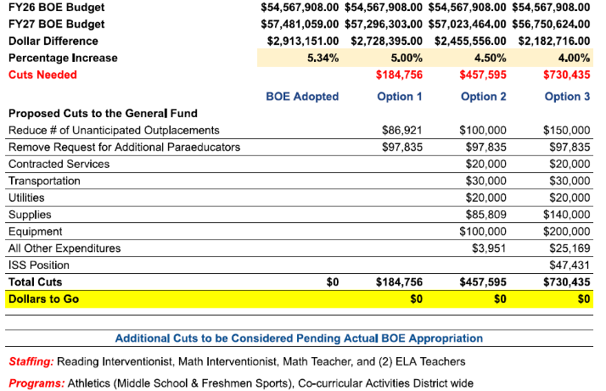
Tiered Reductions to Budget
(as of 2/20/26, Subject to Change)

Slide 66
General Government

Slide 67
General Government Operations

Slide 68
General Government Staffing

Slide 69
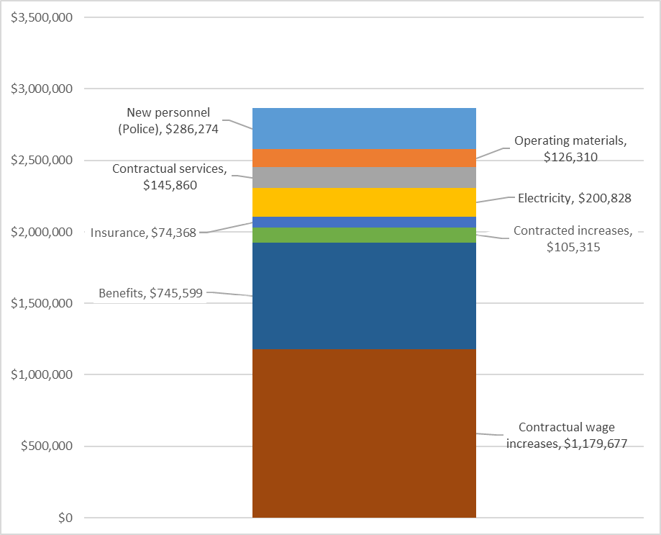
Drivers of $2.9 million General Government increase

Slide 70
Driver of new employees' cost…
New employees:
  Police Department (+$286k) - 2 additional sworn officers
Contractual Services:
  Facilities (inflation): $54k
  Public Works (55 Steele Blvd required testing):$36k
  Animal Control (required dog kennel upgrades):$20k
Operating Materials:
  Schools: $30k
  Timberlin (fertilizer): $22k
  Garage (tires): $22k
  Various departments: $27k

Slide 71
Berlin Water Control

Slide 72
Berlin Water Control – Enterprise Fund
Operating budget drivers:
  No staffing changes budgeted
  Budgeting Mattabassett cost increase
  Engineering/construction mgmt. for the Meriden Interconnection
Capital needs:
  Meriden water line connection accrued loan interest
  Lamentation tank corrosion rehabilitation
  Design for:
    East Berlin water system
    Division St upgrades
    Worthington Rd loop
Notes:
NEED TO UPDATE

