Slide 1


Board of Finance Proposed Budget
Fiscal Year 2026
March 25, 2025
This presentation is available under Finance/Budget on the Town website:
https://www.berlinct.gov/topic/index.php?topicid=324&structureid=16
The Annual Report is in the Town Manager’s Dept. on the Town website:
https://www.berlinct.gov/egov/apps/document/center.egov?view=item&id=11722

Slide 2
Agenda
Overall Budget
Revenue Budget
General Government Budget
Board of Education Budget

Slide 3
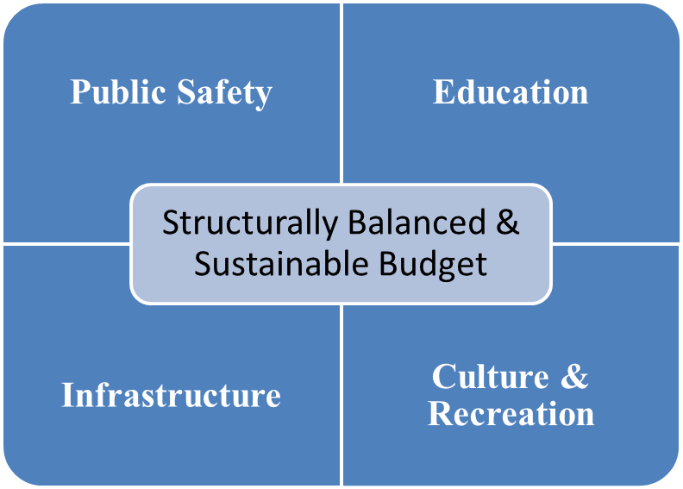
Overall Strategy
  Continue to provide services residents expect, grow the local economy and closely manage the Town’s liabilities.

Slide 4
Fiscal Year 2026 Budget Priorities
AREAS OF INVESTMENT IN FY 2026
Infrastructure
School HVAC
Town Hall & Library Roofs
Lighting Upgrades
Timberlin Sand Traps
Public Safety
Police Staffing
School Vans
Flock Cameras
Fire Vehicle
Police Servers
Economic Dev.
Steele Boulevard
Berlin Turnpike
Grant Match
Arts Grant
ON-GOING OPERATIONS
Public Safety, Education, Legal, Contractual and Regulatory Compliance & Recreation
REQUIRED LONG-TERM OBLIGATIONS
Bonds, Leases, Defined Benefit Plans
Notes:
UPDATE

Slide 5
$106,952,815 Total Budget
30.79 mil rate (+0.58 vs. FY25)
Board of Education
$54,617,908
+$2,100,689
+4.00%
General Government
$52,334,907
+$2,014,465
+4.00%
Total General Fund Budget
$106,952,815
+$4,115,154
+4.00%
Notes:
UPDATE if the MV chg is not adopted

Slide 6
5-Year Budget & Mill Rate Changes
Notes:
UPDATE if TC does not approve the MV change

Slide 7
The Grand List
State Legislature MV change
$2.982 billion (+1.78% vs FY25)
$1.5 million additional tax revenue.
Components:
Real Estate: +0.4%
Personal Property: +20.5%
Motor Vehicle: -8.3%
Notes:
w/ MV Chg

Slide 8
General Fund Revenue Drivers
Local taxes fund over 87% of the budget
Maintained 99.3% tax collection rate
$7,236,252 (+$1,128,492) Education Cost Sharing grant
$1,750,000 interest income
(-$200,000 from lower int rates & expended grants funds)
$358,634 non-education State grants
$595,618 appropriated unassigned fund balance

Slide 9
Board of Finance Budget Actions
Notes:
MV Chg is Adopted

Slide 10
Capital Funding
Funded with BHS Renovation reimbursement
  Vans (Schools)
  Emergency Comm Upgrades (Schools)
  Willard Plumbing (Schools)
  Boilers (Schools)
  Ballast Blocks (Schools)
  Bus (Senior Center)
  Flock Safety + CT (Police)
  Loader (Highway)
  Dump Tuck (Grounds)
  Centurelli Field Walkway (Grounds)
  Fire Command Vehicle (Fire Dept.)
  Repairs to Engine 10 (Fire Dept.)
  Leaf Collector (Timberlin)
  Van (Facilities)
  Scissor Lift (Facilities)
  Sage Park Lighting (Facilities) - Phase 1
  Server Replacements (IT/Police)
  Local Grant Match (Transfers)
  $2,038,732
Funded with General Obligation bonds
  HVAC upgrades at elementary schools
  New fire vehicle
  Library/Community Center roof
  Repair/renovations of Timberlin sand traps
  $3,585,000

Slide 11
General Government

Slide 12
Drivers of Gen Gov’t $2.0 million increase
(FY26 vs. FY25)

Slide 13
Berlin Water Control

Slide 14
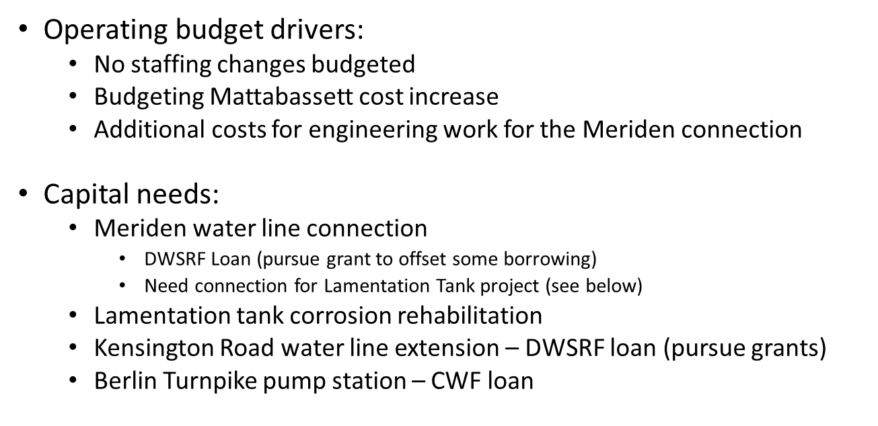
Berlin Water Control – Enterprise Fund
Notes:
INSERT FY26 SLIDE

Slide 15
Next Steps
Action to be taken… | Timing & Location…
Board of Finance votes to recommend Board of Education & General Government budgets to the Town Council. | Immediately following Annual Budget Hearing
Town Council acts on the recommended budget; either: - Approve the BOF recommended budget “as is” - Approve the BOF recommended budget “with reductions” - Reject the BOF recommended budget | April 1st Town Council Chambers Budget sent to referendum Budget sent to referendum Special joint meeting between Council & BOF
Budget Referendum | April 29th

Slide 16

Berlin Board of Education
Revised Budget Presentation for
Fiscal Year 2025-2026
March 25, 2025

Slide 17

Superintendent’s Goals for 2025-2026
Provide quality education
Goal 1
Prepare students for multiple options and opportunities
Goal 2
Goal 3
Maintain favorable class sizes and course offerings
Goal 4
Consistent support of student, staff, and classroom technology
Goal 5
Commitment to a safe learning environment
Notes:
Brian

Slide 18
Berlin’s Mission and Core Values
MISSION
We empower our students to be enthusiastic, curious learners and kind, compassionate leaders in our community and the world.
CORE VALUES
PURPOSE
PASSION
PRIDE
We understand our goals & why our efforts matter.
We inspire passion for learning & foster meaningful, caring relationships.
We act in a way that cultivates pride in ourselves, our school, and our community.
Notes:
Brian

Slide 19
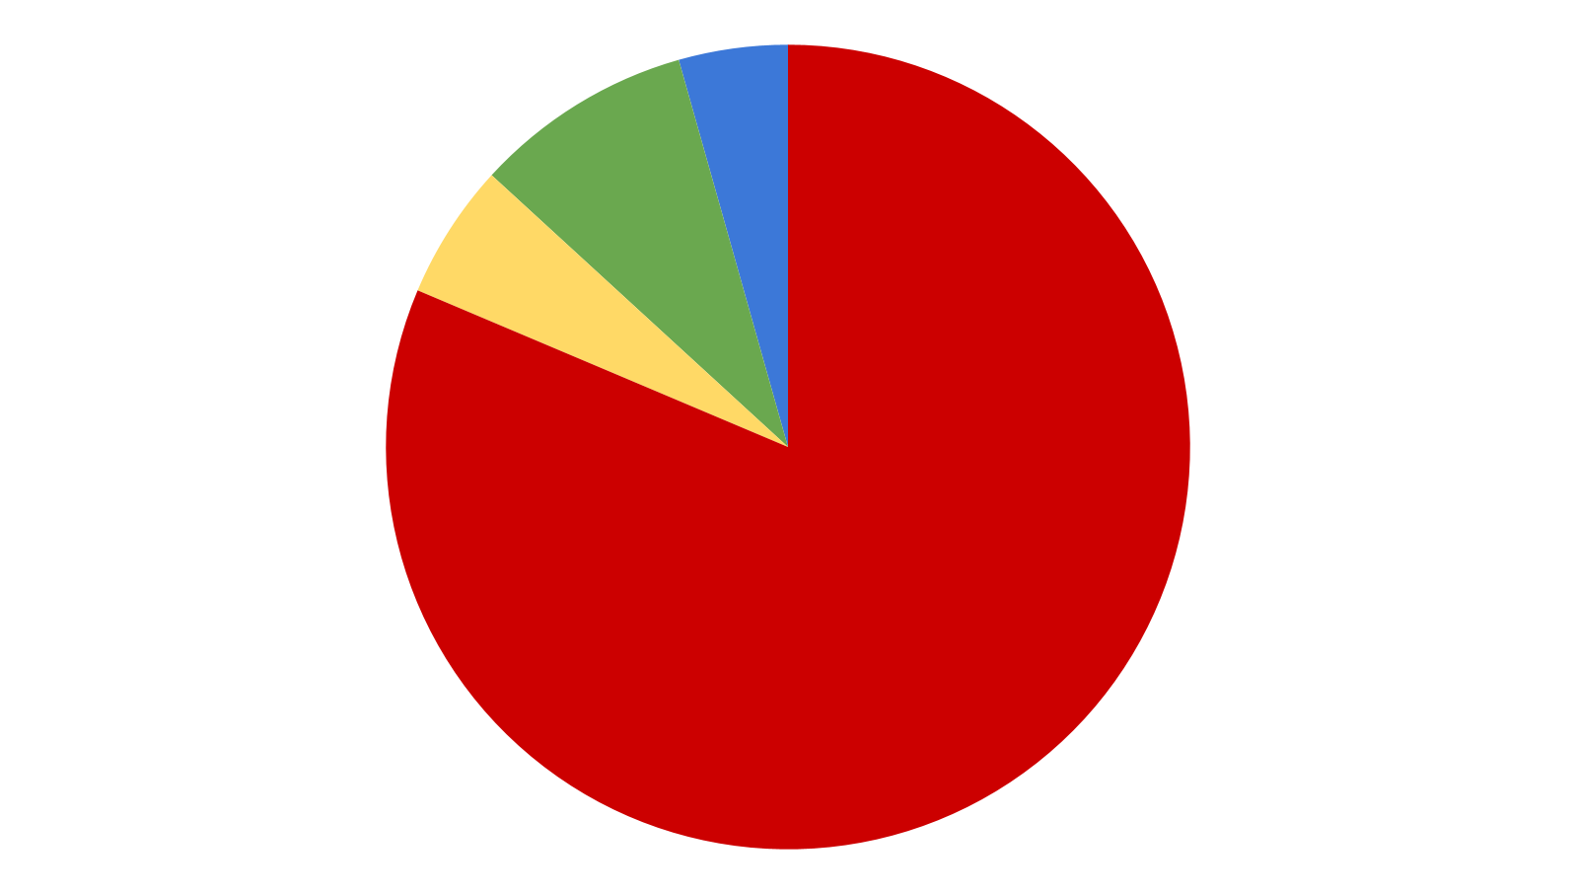
BOE’s Revised Budget at a Glance
Transportation & Tuition
$4,881,738 (8.86%)
Supplies, Equipment & All Other
$2,142,155 (3.89%)
Contracted Services & Utilities
$3,015,548 (5.47%)
All Staffing & Benefits
$45,078,924 (81.79%)
$56,118,365 (6.86%)
Notes:
Updated 1/5/2025

Slide 20
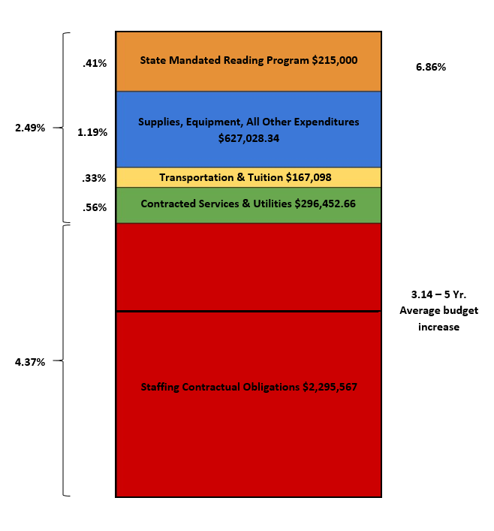
BOE’s Budget Request at a Glance
Total Request:
$56,118,365
Percentage Increase:
6.86%
Dollar Difference:
$3,601,146
Notes:
Updated 2/10/25
So the three million is the increase - when I read it, I thought it was the budget (but knew it wasn’t). This should be titled S’s Proposed Budget Increase or is should have the proposed budget amount.

Slide 21
Major Drivers in BOE Revised Budget
STATE MANDATED READING PROGRAM
TECHNOLOGY & EQUIPMENT
STAFFING ACCOUNTS
MATERIALS
&
REPAIR & MAINTENANCE COST
Notes:
Ashley

Slide 22
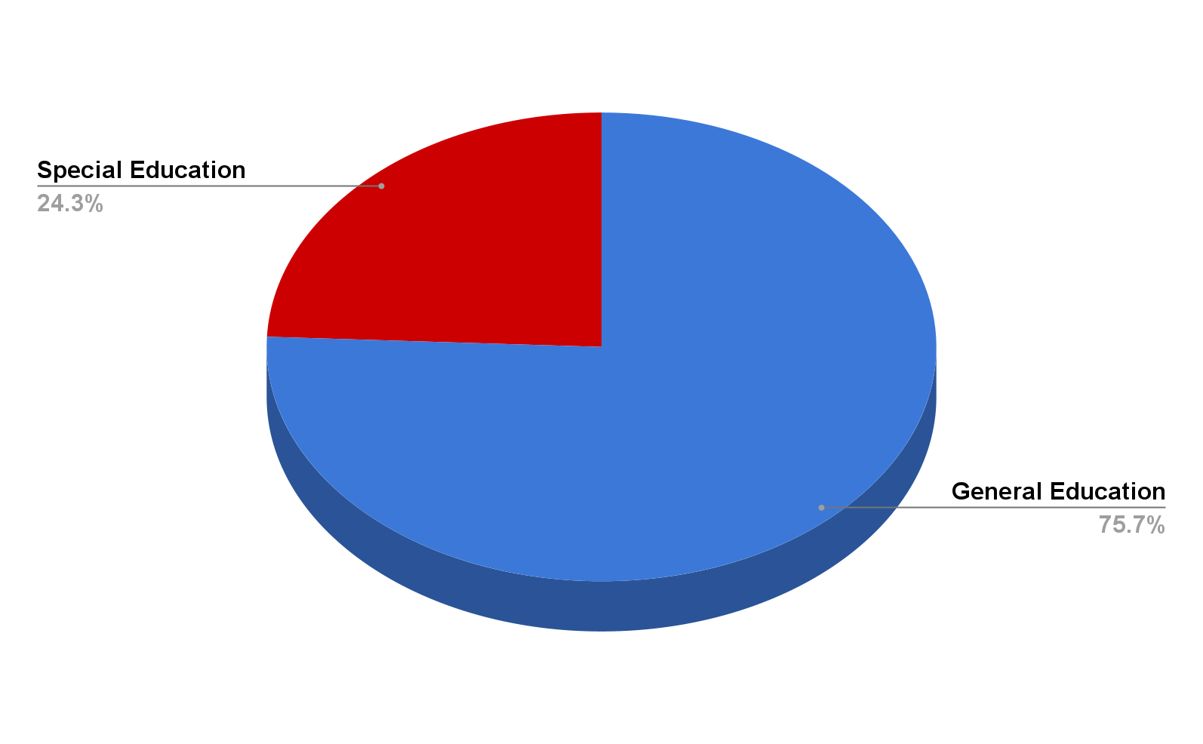
Percentage of Special Education Budget
Special Education Requests Budget:
$13,642,345
Percentage of General Fund Budget:
24.3%
Notes:
Updated 2/10/25

Slide 23
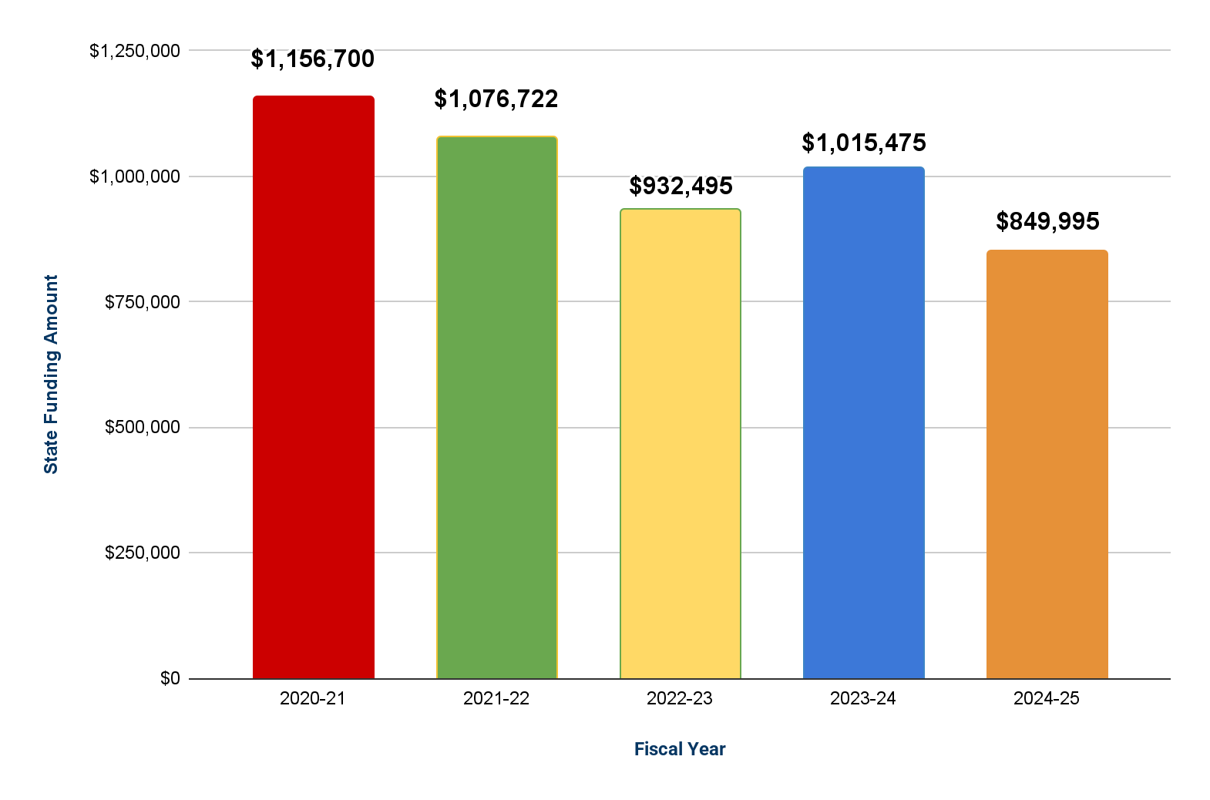
State Funding
Notes:
Updated 1/9/2025

Slide 24
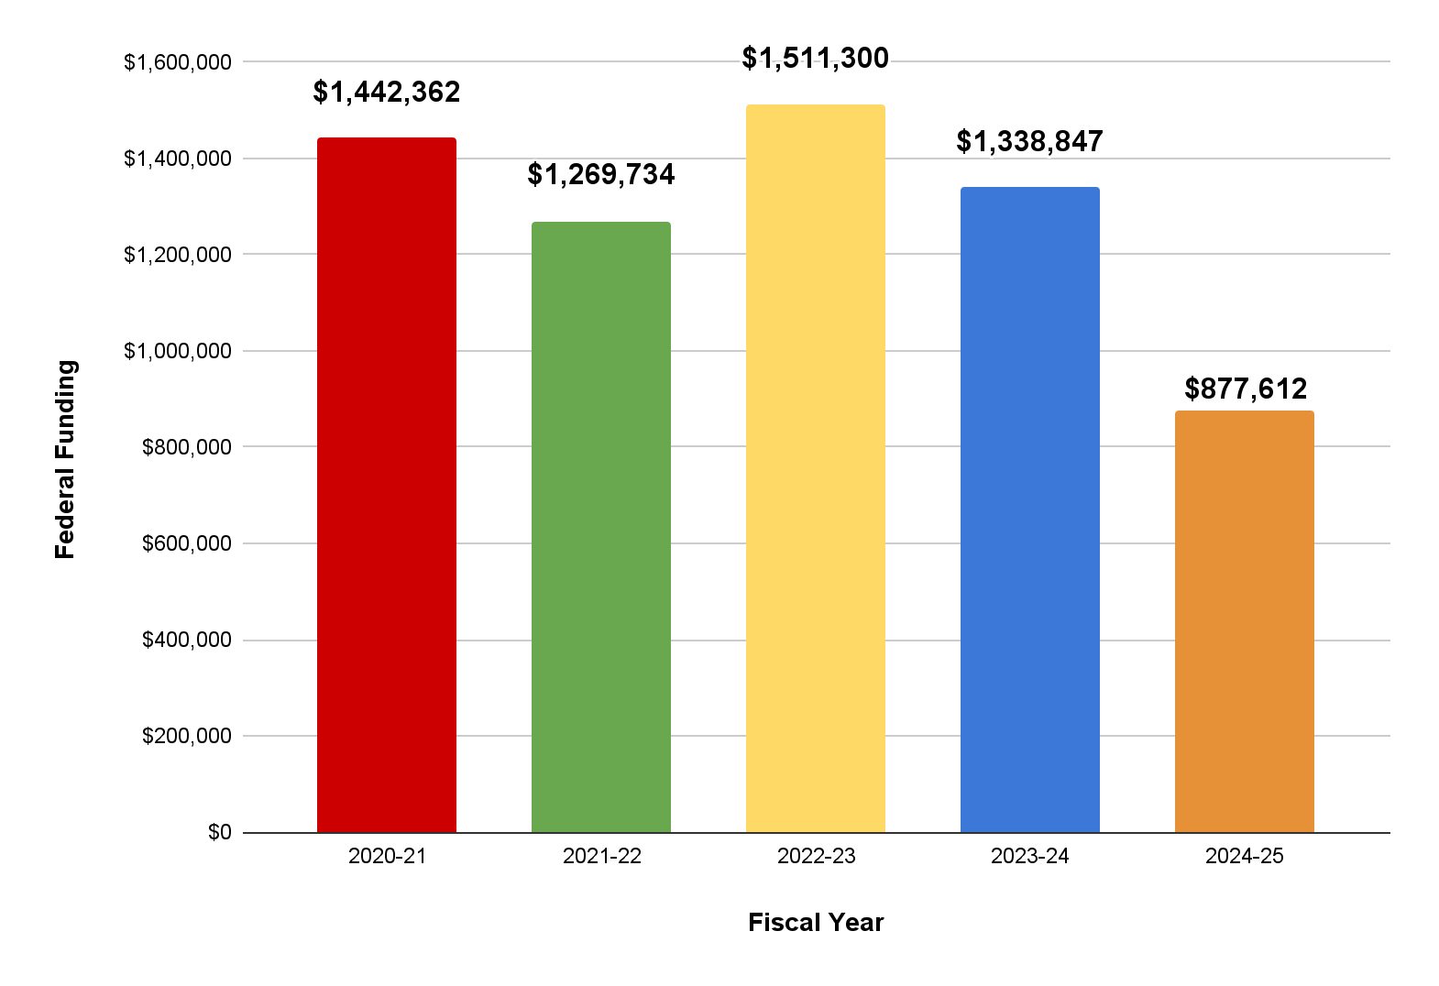
Federal Funding
Notes:
NEED TO UPDATE

Slide 25
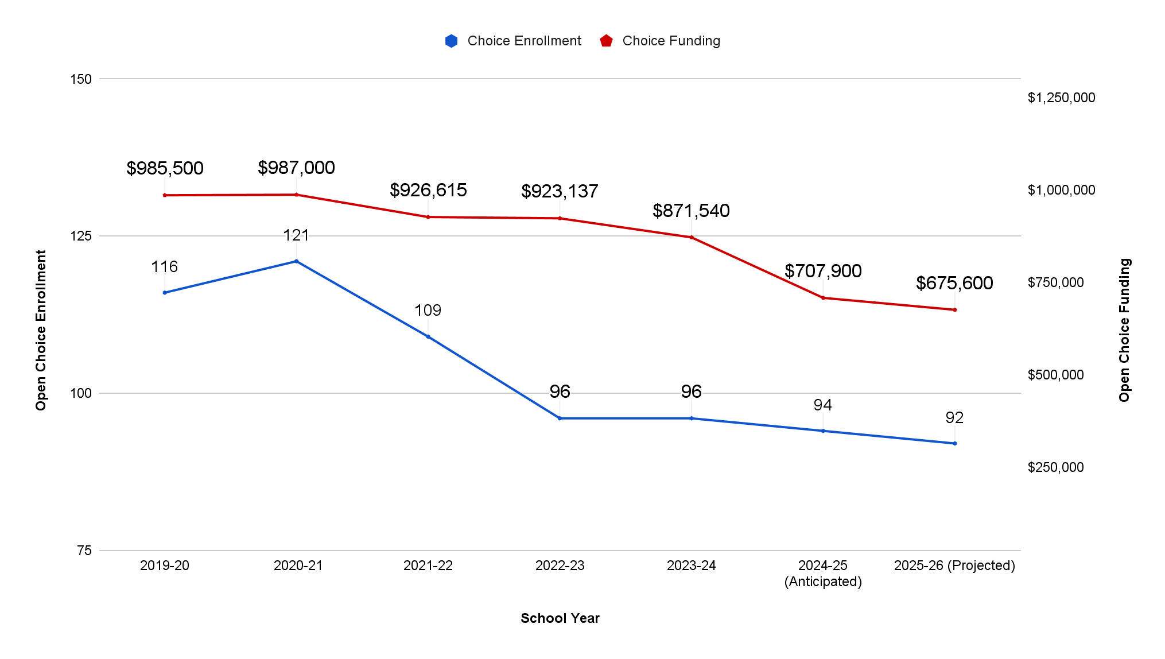
Open Choice Enrollment & Funding History
Assumes 92 Open Choice Students in the upcoming school year
Assumes 3.59% Open Choice population
Notes:
NEED TO UPDATE

Slide 26
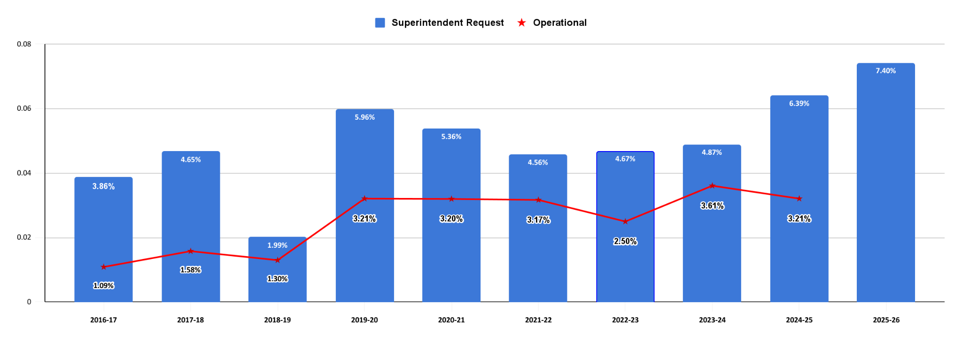
10 Year Budget Funding History
Notes:
UPDATED 1/6/25- A.Dorsey

Slide 27
Neighboring Districts Adopted Budget Comparison
District | Adopted 2020-21 | Adopted 2021-22 | Adopted 2022-23 | Adopted 2023-24 | Adopted 2024-25 | 5 Yr. Average Increase
Newington | 2.67% | 0.00% | 2.46% | 4.50% | 5.95% | 3.12%
Cromwell | 3.60% | 2.97% | 3.81% | 6.37% | 5.88% | 4.53%
Wethersfield | 2.05% | 0.53% | 4.98% | 3.33% | 4.97% | 3.17%
Farmington | 3.35% | 3.30% | 2.99% | 2.00% | 4.75% | 3.28%
Rocky Hill | 3.84% | 3.75% | 3.26% | 3.78% | 3.62% | 3.65%
Glastonbury | 2.81% | 1.60% | 2.98% | 2.85% | 3.50% | 2.75%
Berlin | 3.20% | 3.17% | 2.50% | 3.61% | 3.21% | 3.14%
Berlin received the lowest percentage increase for FY 25 when compared to neighboring communities.
Notes:
All updated but Wethersfield 24-25, Debbie calling
TL 1/6/25

Slide 28
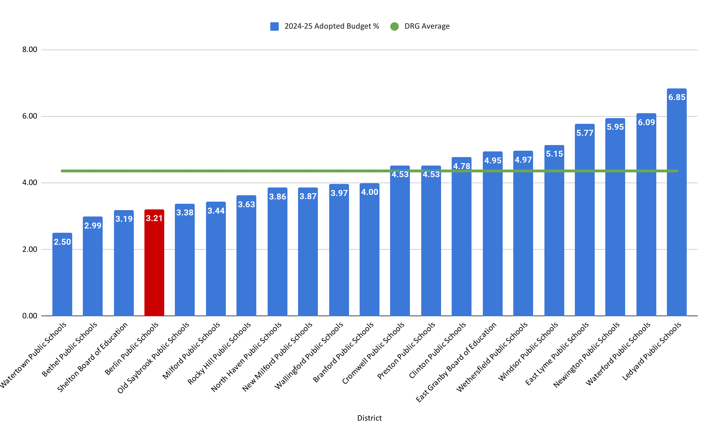
FY25 Budget Percentage Increase for DRG D
Berlin’s FY25 Budget increase was 3.21%
The average budget increase in FY25 or DRG D was 4.36%
Notes:
NEED TO UPDATE WITH CASBO INFORMATION

Slide 29
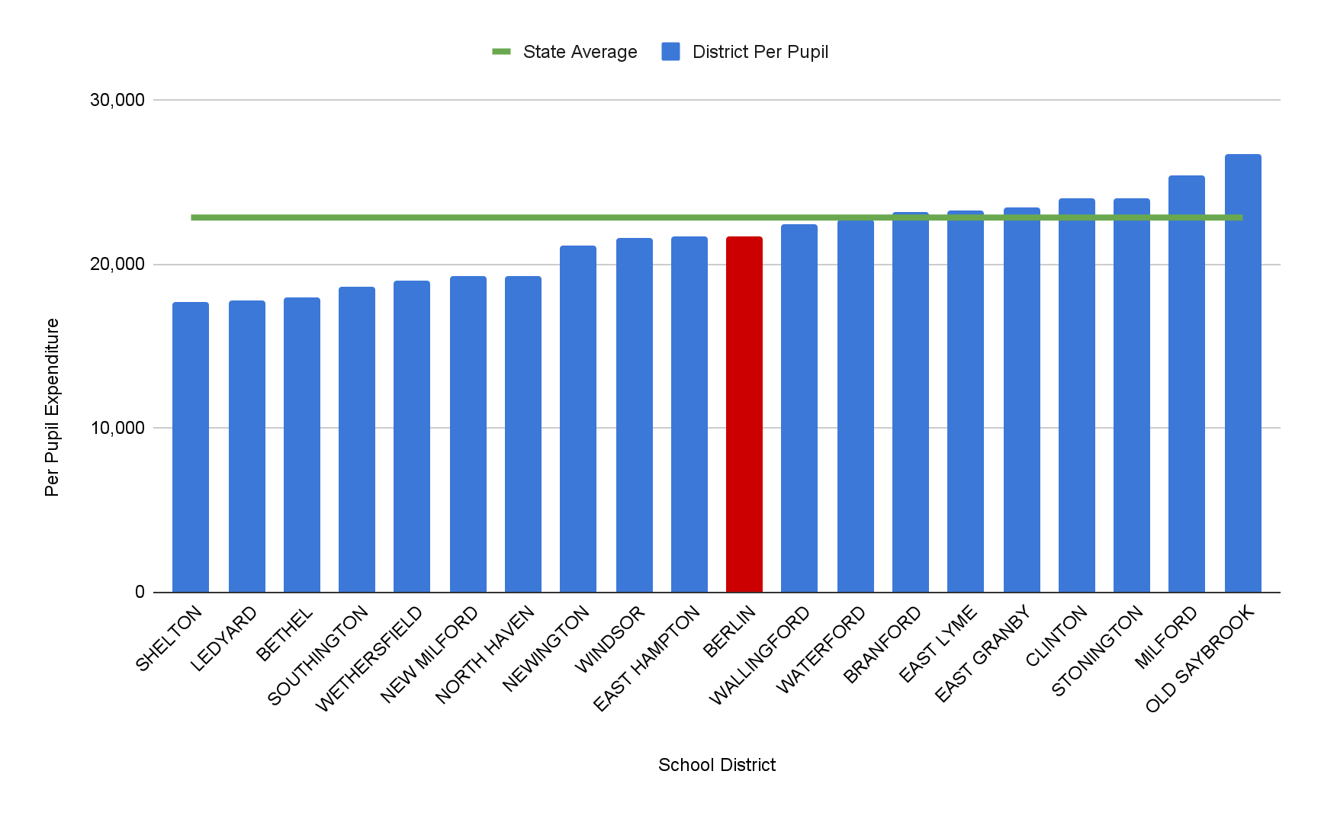
NCEP Net Current Expenditure per Pupil
DRG D & State Comparison
Berlin’s net Current Expenditure is $21,719
The State’s average Net Current Expenditure is $22,836
Data is from the CSDE website posted in October of 2024
Notes:
NEED TO UPDATE

Slide 30
HISTORICAL BERLIN NET CURRENT EXPENDITURE PER PUPIL (NCEP)/WEALTH RANKINGS
The chart illustrates the per-pupil spending (NCEP) Ranking for Berlin along with its wealth ranking. In both columns, ranking #1 would be the "best" town and ranking #169 would be the "lowest".
Year | WEALTH RANK | NCEP RANK | Berlin | State Average | +/- | # of School Days
2014-15 | 65 | 116 | $14,964 | $15,708 | ($744) | 183
2015-16 | 69 | 108 | $15,533 | $17,085 | ($1,552) | 183
2016-17 | 72 | 101 | $16,426 | $17,596 | ($1,170) | 180
2017-18 | 65 | 106 | $16,457 | $18,243 | ($1,786) | 180
2018-19 | 72 | 108 | $17,093 | $18,791 | ($1,698) | 180
2019-20 | 60 | 96 | $18,024 | $19,339 | ($1,315) | 181
2020-21 | 60 | 106 | $18,973 | $20,740 | ($1,767) | 177
2021-22 | 60 | 86 | $20,322 | $21,355 | ($1,033) | 180
2022-23 | 59 | 84 | $20,671 | $21,657 | ($986) | 180
2023-24 | 62 | 82 | $21,719 | $22,836 | ($1,117) | 180
NCEP - Includes all educational expenses, less expenditures for (a) pupil transportation; (b) debt services; (c) adult education; (d) health and welfare services for non-public school children (e) tuition receipts; (f) food services; and (g) student activities supported by gate receipts. Sec 10-261
Per Connecticut State Department of Education Website
Wealth Rank is the AENGLC (Adjusted Equalized Net Grand List per Capita)
Notes:
NEED TO UPDATE

Slide 31
5 Year FTE Comparisons
Employee Type | 2020-21 FTE | 2021-22 FTE | 2022-23 FTE | 2023-24 FTE | 2024-25 FTE | 2025-26 Anticipated FTE | Change/Prior Year
Administrators | 19.6 | 19.6 | 18.8 | 21.8 | 20.8 | 20.8 | 0.0
Teachers/Certified Staff | 266.7 | 270.3 | 266.3 | 265.3 | 262.8 | 262.8 | 0.0
Paraprofessionals | 109.1 | 115.0 | 115.8 | 115.9 | 115.0 | 115.0 | 0.0
Clerical | 22.1 | 20.5 | 17.4 | 18.6 | 18.5 | 18.5 | 0.0
Custodians | 29.5 | 27.0 | 27.0 | 26.0 | 26.0 | 26.0 | 0.0
Cook Managers | 5.0 | 5.0 | 5.0 | 5.0 | 5.0 | 5.0 | 0.0
Food Service | 9.3 | 9.8 | 10.7 | 11.9 | 11.9 | 11.9 | 0.0
Unaffiliated | 10.8 | 25.1 | 29.8 | 29.4 | 29.5 | 30.5 | 1.0
Armed Security | 5.0 | 5.0 | 6.0 | 6.0 | 6.0 | 6.0 | 0.0
Total | 477.1 | 497.3 | 496.8 | 499.9 | 495.5 | 496.5 | 1.0
Includes all positions regardless of funding source.
Notes:
NEED TO UPDATE

Slide 32






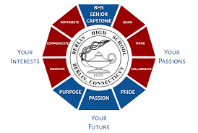


2023-24 Recognitions
Notes:
NEED TO UPDATE

